Slide 1


Slide 2
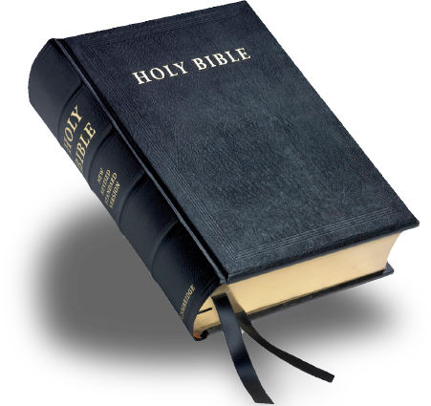

A Reading of the Text

Slide 3
Introductory Information
Author
Unknown
(Paul is often claimed. No way of knowing for sure.)
Author is very familiar with O.T.

Slide 4
Introductory Information
Date of Writing
Probably 66-69 AD
Latest possible (90-96 AD) Clement
Persecution present
Temple probably still in existence

Slide 5
Introductory Information
Thesis, Purpose, Form, Occasion
General Distribution and Reading
(13:22), “the word of exhortation”
Weakness and Apathy. Persecution?
Thesis (1:1-4)
Final, better, perfect faith.

Slide 6
Christ, Superior to Angels (1:1-14)
God’s Final Revelation in the Son (1-4)
Two subjects: Father 1-2a; Son 2b-4
Problem of Sin solved in Jesus (3)
Previous means of revelation, varied (1)
Finality of Jesus as spokesman (2)
Jesus becomes better than angels (4)

