Slide 1
Lesson 1
The Man, the Times, and the Book

Slide 2
The Messianic PRophet
Twice as many Messianic prophecies as any other book.
Very cultured language and style in book.
Prophet – Spokesman for God. More “forthteller” than “foreteller.” God’s spokesman to Judah and Jerusalem during time of sin. A Call to repent.
Foretold a brighter future of mercy.

Slide 3
Isaiah, The Man
Isaiah – “the Lord is salvation”
Isaiah received his visions in the days of “Uzziah, Jotham, Ahaz, and Hezekiah, kings of Judah” (Isaiah 1:1)
Jewish tradition - Isaiah executed by Manasseh a few years after he ascended the throne. One source – Isaiah was sawn asunder with a wooden saw (cf. Hebrews 11:37), “they were sawn in two”

Slide 4
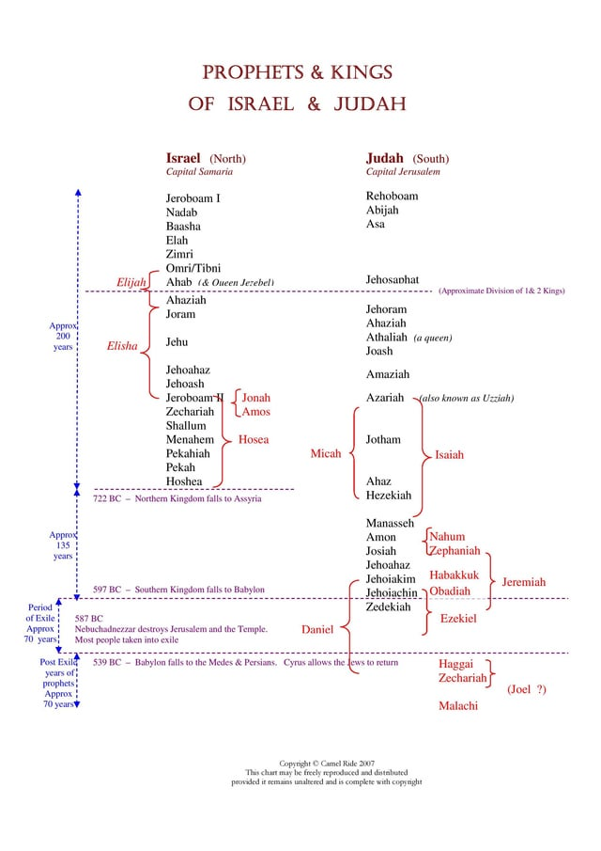
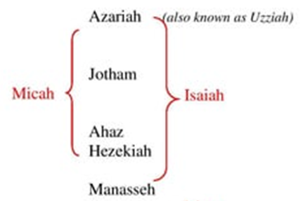
“This would mean Isaiah prophesied during a period of approximately fifty years (ca. 739-690 B.C.).”

Slide 5
Isaiah, The Times
World Empire: Assyria. Israel and Syria attack Judah for not helping them.
Assyria defeats Israel, looks to conquer Judah.
Hezekiah trusts in God, Assyria is repelled.
However, Babylon (who defeated Assyria) eventually took Judah away into captivity. Chapters 40-66 deal with the prophesied captivity, and eventual return to glory through the Messiah.

Slide 6
Isaiah, The book
Two Major Themes: 1) Trust in Jehovah; 2) The Messiah to come, and the glory of His age.
Phrase, “the Lord of hosts” used 62 times. Also, “the Holy One of Israel”, 25 times (only 6 other times in the entire Bible.
Two Divisions: 1) Assyrian Period (1-39); Babylonian Period (40-66)

Slide 7
Reasons to Study the Book
It increases faith in Jesus as the Messiah.
It strengthens hope in God as the One in control.
It inspires love for God and His Messiah.
It enlarges understanding of how God did and does rule in the nations of men.

Slide 8
Questions
Any comments or inquiries about the 13 questions at the end of the lesson?

Slide 9
Lesson 2
Introduction to the Entire Prophecy (1)

Slide 10
The Great Arraignment (1:2-15)
God Spoke but nation (ignorant and inconsiderate) rebelled.
Description: sinful, iniquitous, evildoers, corrupters, forsakers, provokers, apostates
Despite chastisement, remained rebellious
God demands obedience before worship and sacrifice

Slide 11
God offers restoration (1:16-20)
God Spoke but nation (ignorant and inconsiderate) rebelled.
Description: sinful, iniquitous, evildoers, corrupters, forsakers, provokers, apostates
Despite chastisement, remained rebellious
God demands obedience before worship and sacrifice

Slide 12
Lesson 3
Introduction to the Entire Prophecy / B (2)
Early Messages of Isaiah (2-5)

Slide 13
The Judgment of Jerusalem (1:21-31)
Unfaithfulness = Harlotry
A Rebellious and unrighteous people
Thus, God’s judgment on the wicked
Choice: Restoration to righteousness; or destruction to those who remain wicked.

Slide 14
Questions
Any comments or inquiries about the 16 questions at the end of lesson 2?

Slide 15
Lesson 4
Early Messages of Isaiah (2-5) / B

Slide 16
Zion’s Glorious Future (2:1-4)
Mountain of the Lord’s house established in the latter days
Word of the Lord go forth from Jerusalem
Many will learn of His ways, & walk in peace
Clearly Messianic: Coming of the Christ
Clearly Messianic: Establishment of His church
Prophetic foreshortening: cf. Joel 2:28-32

Slide 17
Zion’s inGlorious Present (2:5-4:6)
Worldliness, materialism and idolatry of the people in that day
Day of the Lord (of Jehovah) a day of punishment and chastisement for the people
[Arrogant humbled, loss of good leadership, wanton women humbled by God]
The purpose of the “day of the Lord” was to purify the remnant

Slide 18
Lesson 5
Early Messages of Isaiah (2-5) / C
Isaiah’s Vision of the Holy God of Israel / A

Slide 19
God’s Song to Israel (5)
God is the Beloved, the Vine is Israel. Good grapes is what God expects (obedience). Instead, God gets wild grapes (sin). Therefore, God would destroy the vineyard! (5:1-6)
Captivity would come, as God would use other people to chastise the Jews. (5:13,26)
Note the description given of the rebellious people, & how it relates to our nation (5:20-24)

Slide 20
IsAiah’s Vision (6:1-4)
The vision took place at the beginning of Isaiah’s ministry, or calling as a prophet. Uzziah was the first king under which he prophesied (1:1)
Note the similarities between the seraphim and the four living creatures of Revelation 4 & 5
seraphim - (Brown-Driver-Briggs) majestic beings with 6 wings, human hands or voices in attendance upon God.

Slide 21
IsAiah’s Reaction (6:5)
The reaction to what he saw was guilt, because of his recognition of sin and that of his people. This is an appropriate reaction as we consider ourselves before God! (cf. Job 40:3-4).
Isaiah fully recognized the sinfulness of God's people, as his "eyes have seen the King, the LORD of hosts."

Slide 22
Lesson 6 (4/21/24)
Isaiah’s Vision of the Holy God of Israel / B
Judah’s True Hope: The Messianic King / A

Slide 23
IsAiah’s ABSOLUTION (6:6-7)
Fire (the live coal) takes the dross out of metals, and is used in scripture to refer to purification (cf. Malachi 3:2-3).
Isaiah is readied and qualified to be a prophet of a rebellious people because,“Your iniquity is taken away, And your sin purged” (vs. 7).
He has been called by God, separated for a holy mission, (cf. 8)

Slide 24
IsAiah’s Commission (6:8-13)
The use of the word “US” seems to indicate the Trinity (8)
The willingness of Isaiah is remarkable (8)
The message of Isaiah would be rejected because of the rebellion of the nation (9-10)
How long would this rejection of Isaiah’s words last? Until desolation and captivity! (11-12)
Promise of the remnant (10%, or the stump) (13)

Slide 25
Lesson 7 (4/28/24)
Judah’s True Hope: The Messianic King / A

Slide 26
Overview of chapters(7-12)
Complete the first major section (1-12)
Discuss prophecies arising concerning Ahaz’s conflict with Israel and Syria, and his tendency to look to alliances with Assyria and Egypt, rather than to trust in God.
Isaiah’s thoughts travel from current conflict to the true hope of the Messianic Kingdom (a concept referred to as “prophetic suggestion”)

Slide 27
A Messianic Promise (7:14)
Threatening from Israel and Syria, and Ahaz’s attempt to curry the favor of Assyria
The sign (rebuffed by Ahaz) that is a prophecy fulfilled by the Lord in Matthew 1:18-23
Dual fulfillment – (Maher-Shalal-Hash-Baz). Israel and Syria would fail, but Assyria would afflict Jerusalem
Prophetic Suggestion

