Slide 1
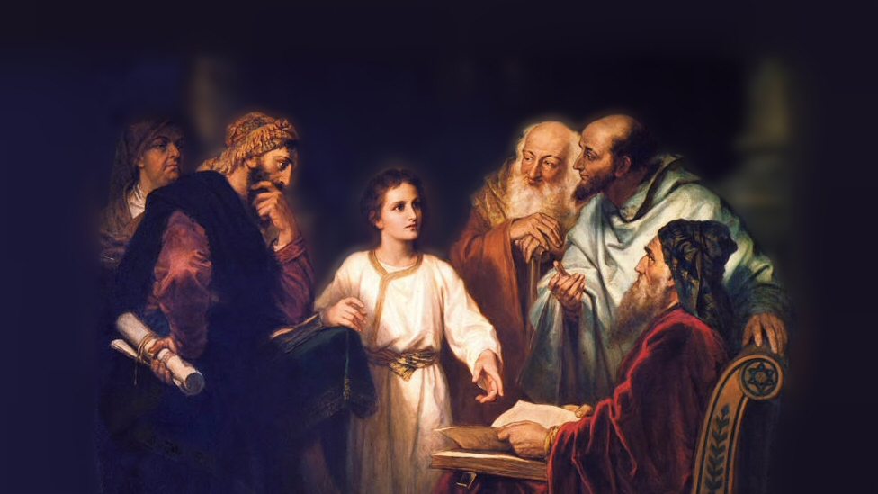
About My Father’s Business
The Birth of Jesus
(Matthew 1:18-25)
Notes:
(Galatians 4:4-5), “But when the fullness of time had come, God sent forth his Son, born of woman, born under the law, ⁵ to redeem those who were under the law, so that we might receive adoption as sons.”
This first advent (the arrival of a notable person) is recorded in Matthew 1 and Luke 2
(Matthew 1:18-25) READ
(18) Mary was a virgin, the conception of the child was miraculous (“of the Holy Spirit”)
(21) He was born to be the Savior of mankind
(23) He was God the Son “God with Us”
(John 1:1-3), “In the beginning was the Word, and the Word was with God, and the Word was God. ² He was in the beginning with God. ³ All things were made through Him, and without Him nothing was made that was made.”
(John 1:14), “And the Word became flesh and dwelt among us, and we beheld His glory, the glory as of the only begotten of the Father, full of grace and truth.”
What does the Birth of Jesus mean to us?
Picture attribution: More Good Foundation (cropped, with background blurred) Creative Commons License
https://www.flickr.com/photos/moregoodfoundation/5135438113

Slide 2
What does the birth of Jesus mean to us?
God keeps His promises!
Genesis 12:1-3 Ephesians 1:3-6
Notes:
(Genesis 12:1-3), “Now the Lord had said to Abram: ‘Get out of your country, from your family and from your father's house, to a land that I will show you. ² I will make you a great nation; I will bless you and make your name great; and you shall be a blessing. ³ I will bless those who bless you, and I will curse him who curses you; and in you all the families of the earth shall be blessed.’“
The establishment of Israel in the promised land was God’s means of establishing His Son as the true Messiah of mankind
(Ephesians 1:3-6), “Blessed be the God and Father of our Lord Jesus Christ, who has blessed us with every spiritual blessing in the heavenly places in Christ, ⁴ just as He chose us in Him before the foundation of the world, that we should be holy and without blame before Him in love, ⁵ having predestined us to adoption as sons by Jesus Christ to Himself, according to the good pleasure of His will, ⁶ to the praise of the glory of His grace, by which He made us accepted in the Beloved.”
God created man
Man sinned (as God knew He would)
God promised a Savior, and delivered Him “in the fulness of time” just as He said He would!

Slide 3
What does the birth of Jesus mean to us?
God keeps His promises!
Genesis 12:1-3 Ephesians 1:3-6
God loves mankind!
John 3:16-17 Romans 5:6-8 1 John 4:7-10
Notes:
(John 3:16-17), “For God so loved the world that He gave His only begotten Son, that whoever believes in Him should not perish but have everlasting life. ¹⁷ For God did not send His Son into the world to condemn the world, but that the world through Him might be saved.”
The extension of God’s grace was motivated by His love for mankind
There has never been a greater expression of any love, than that shown by our God who sent His only begotten Son to die as a sin sacrifice for rebellious mankind!
(Romans 5:6-8), “For when we were still without strength, in due time Christ died for the ungodly. ⁷ For scarcely for a righteous man will one die; yet perhaps for a good man someone would even dare to die. ⁸ But God demonstrates His own love toward us, in that while we were still sinners, Christ died for us.”
As such, we should love Him in return!
(1 John 4:7-10), “Beloved, let us love one another, for love is of God; and everyone who loves is born of God and knows God. ⁸ He who does not love does not know God, for God is love. ⁹ In this the love of God was manifested toward us, that God has sent His only begotten Son into the world, that we might live through Him. ¹⁰ In this is love, not that we loved God, but that He loved us and sent His Son to be the propitiation for our sins.”

Slide 4
What does the birth of Jesus mean to us?
God keeps His promises!
Genesis 12:1-3 Ephesians 1:3-6
God loves mankind!
John 3:16-17 Romans 5:6-8 1 John 4:7-10
Jesus came to redeem us from our sins!
Matthew 1:21; 20:27-28 Galatians 1:3-5
Notes:
(Matthew 1:21), [Angel of the Lord to Joseph], “And she will bring forth a Son, and you shall call His name Jesus, for He will save His people from their sins.“
Name Jesus – (Barnes) “The name Jesus is the same as Saviour. It is derived from the verb signifying to save, In Hebrew it is the same as Joshua.”
It was a very common name.
Note, in verse, literally: You shall call him “He who saves” for “He will save His people from their sins.”
(Matthew 20:27-28), “And whoever desires to be first among you, let him be your slave — ²⁸ just as the Son of Man did not come to be served, but to serve, and to give His life a ransom for many.“
(Galatians 1:3-5), “Grace to you and peace from God the Father and our Lord Jesus Christ, ⁴ who gave Himself for our sins, that He might deliver us from this present evil age, according to the will of our God and Father, ⁵ to whom be glory forever and ever. Amen.”

Slide 5
What does the birth of Jesus mean to us?
God keeps His promises!
Genesis 12:1-3 Ephesians 1:3-6
God loves mankind!
John 3:16-17 Romans 5:6-8 1 John 4:7-10
Jesus came to redeem us from our sins!
Matthew 1:21; 20:27-28 Galatians 1:3-5
Men can’t defeat God’s purpose!
Matthew 2:1-16 Acts 2:29-36
Notes:
Wise men of the East informed King Herod of the birth of Jesus
Herod sought to find the location of the Son of God, with the deceit of offering worship, but desiring instead to kill Him
When thwarted, Herod sought to kill Jesus by having all males in Bethlehem to be put to death
(Matthew 2:16), “Then Herod, when he saw that he was deceived by the wise men, was exceedingly angry; and he sent forth and put to death all the male children who were in Bethlehem and in all its districts, from two years old and under, according to the time which he had determined from the wise men.”
Herod was not able to thwart God’s purpose in redeeming man!
Nor the Jews, who brought about His crucifixion
(Acts 2:29-36), "Men and brethren, let me speak freely to you of the patriarch David, that he is both dead and buried, and his tomb is with us to this day. ³⁰ Therefore, being a prophet, and knowing that God had sworn with an oath to him that of the fruit of his body, according to the flesh, He would raise up the Christ to sit on his throne, ³¹ he, foreseeing this, spoke concerning the resurrection of the Christ, that His soul was not left in Hades, nor did His flesh see corruption. ³² This Jesus God has raised up, of which we are all witnesses. ³³ Therefore being exalted to the right hand of God, and having received from the Father the promise of the Holy Spirit, He poured out this which you now see and hear. ³⁴ "For David did not ascend into the heavens, but he says himself: 'The Lord said to my Lord, "Sit at My right hand, ³⁵ Till I make Your enemies Your footstool." '³⁶ "Therefore let all the house of Israel know assuredly that God has made this Jesus, whom you crucified, both Lord and Christ."

Slide 6
Conclusion
When the Son of God, who first came as a child, finished His ministry on earth, He ascended to Heaven with this promise:
“This same Jesus, who was taken up from you into heaven, will so come in like manner as you saw Him go into heaven.” (Acts 1:11)
Notes:
Because God kept His promise, and Jesus was born into the world to redeem man – we can rest in the knowledge He will keep His promise of a second advent or coming!
(1 Thessalonians 4:15-18), “For this we say to you by the word of the Lord, that we who are alive and remain until the coming of the Lord will by no means precede those who are asleep. ¹⁶ For the Lord Himself will descend from heaven with a shout, with the voice of an archangel, and with the trumpet of God. And the dead in Christ will rise first. ¹⁷ Then we who are alive and remain shall be caught up together with them in the clouds to meet the Lord in the air. And thus we shall always be with the Lord. ¹⁸ Therefore comfort one another with these words.”

