Slide 1
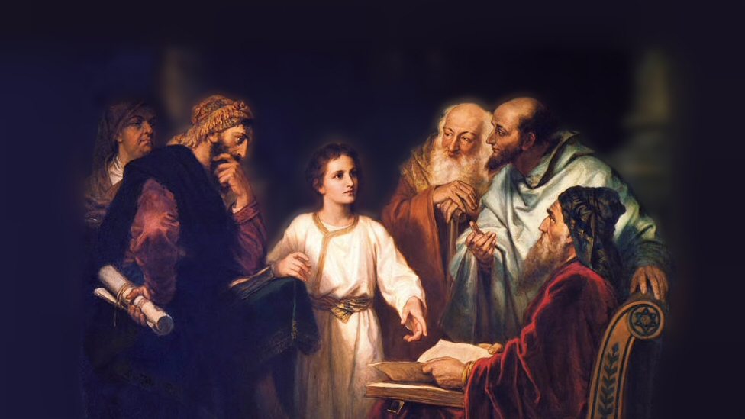
About My Father’s Business
The Widow’s Offering
(Mark 12:41-44)
Notes:
An observation of the Lord while sitting in the temple, teaching his disciples
A wonderful example of how day to day experiences can serve as object lessons, and offer teaching opportunities
Recorded in Luke 21:1-4, and with a bit more detail, here in Mark 12:41-44
(Mark 12:41-44), “Now Jesus sat opposite the treasury and saw how the people put money into the treasury. And many who were rich put in much. ⁴² Then one poor widow came and threw in two mites, which make a quadrans. ⁴³ So He called His disciples to Himself and said to them, “Assuredly, I say to you that this poor widow has put in more than all those who have given to the treasury; ⁴⁴ for they all put in out of their abundance, but she out of her poverty put in all that she had, her whole livelihood.”
Note: A mite (obviously a pittance) Reading from the material used in our classes:
“The mite was a small copper coin, the smallest Jewish coin, and valued at 1/128th part of the Roman Denarius. The Roman denarius was the amount of one day’s wage in N.T. times, or about 17 cents. Two mites would therefore be about ¼ of a penny.
What lessons can we learn from the widow’s example, and our Lord’s observations?
Picture attribution: More Good Foundation (cropped, with background blurred) Creative Commons Liscense
https://www.flickr.com/photos/moregoodfoundation/5135438113

Slide 2
Lessons learned from Jesus and the widow
Jesus is watching!
Psalm 11:4-7; Proverbs 5:21-23
Notes:
Jesus is watching!
It is doubtful that the poor widow was aware of the fact that our Lord’s eyes were upon her.
But, he was literally watching what she did!
It is possible that we too are unaware, or at least do not take time to think that Jesus is watching us as well.
He is as LITERALLY watching us as he was her.
(Psalm 11:4-7), “The Lord is in His holy temple, the Lord's throne is in heaven; His eyes behold, His eyelids test the sons of men. ⁵ The Lord tests the righteous, but the wicked and the one who loves violence His soul hates. ⁶ Upon the wicked He will rain coals; fire and brimstone and a burning wind shall be the portion of their cup. ⁷ For the Lord is righteous, He loves righteousness; His countenance beholds the upright.”
(Proverbs 5:21-23), “For the ways of man are before the eyes of the Lord, and He ponders all his paths. ²² His own iniquities entrap the wicked man, and he is caught in the cords of his sin. ²³ He shall die for lack of instruction, and in the greatness of his folly he shall go astray.

Slide 3
Lessons learned from Jesus and the widow
Jesus is watching!
Psalm 11:4-7; Proverbs 5:21-23
The measure of devotion (What can I do?)
Mark 14:6-9; Matthew 25:26-27, 30
Notes:
Devotion is measured, not by what you can't do, rather by how you do what you are capable of doing! (And we are certainly grateful for that fair way of God’s judgment!)
The widow’s sacrifice surpassed, not by amount but by degree. She “put in all that she had, he whole livelihood” (vs. 44)
Remember the ointment Mary anointed Jesus’ with in the house of Simon the Leper. Jesus said…
(Mark 14:6-9), “But Jesus said, “Let her alone. Why do you trouble her? She has done a good work for Me. ⁷ For you have the poor with you always, and whenever you wish you may do them good; but Me you do not have always. ⁸ She has done what she could. She has come beforehand to anoint My body for burial. ⁹ Assuredly, I say to you, wherever this gospel is preached in the whole world, what this woman has done will also be told as a memorial to her.”
Remember the parable of the talents, and the master’s words to the unprofitable servant, who did not do what he could do!
(Matthew 25:26-27), “But his lord answered and said to him, ‘You wicked and lazy servant… you ought to have deposited my money with the bankers, and at my coming I would have received back my own with interest.’”
The application of that parable:
(Matthew 25:30), “And cast the unprofitable servant into the outer darkness. There will be weeping and gnashing of teeth.”

Slide 4
Lessons learned from Jesus and the widow
Jesus is watching!
Psalm 11:4-7; Proverbs 5:21-23
The measure of devotion (What can I do?)
Mark 14:6-9; Matthew 25:26-27, 30
The least are the greatest!
Mark 16:9; Matthew 20:25-28
Notes:
Greatness in the kingdom is not measured by power, talent, standing, culture, prestige. It is only and always found in service!
We applaud the widow (and Mary, and others like them) because, “this poor widow has put in more than all those who have given to the treasury” (43). “she out of her poverty put in all that she had, her whole livelihood.” (44).
It is wonderful that she has been known the world over for generations, because she put ¼ of a penny into the treasury!
(Mark 16:9), [concerning Mary, as noted before], “Assuredly, I say to you, wherever this gospel is preached in the whole world, what this woman has done will also be told as a memorial to her.”
This is because we are His disciples. Jesus taught this principle by example!
(Matthew 20:25-28), “But Jesus called them to Himself and said, “You know that the rulers of the Gentiles lord it over them, and those who are great exercise authority over them. ²⁶ Yet it shall not be so among you; but whoever desires to become great among you, let him be your servant. ²⁷ And whoever desires to be first among you, let him be your slave— ²⁸ just as the Son of Man did not come to be served, but to serve, and to give His life a ransom for many.”
Generosity in Giving (Specifically money)
Question: Are you doing what you can do? Are you generous in the sacrifices you make (monetarily and otherwise) to the Lord?

Slide 5
Lessons learned from Jesus and the widow
Jesus is watching!
Psalm 11:4-7; Proverbs 5:21-23
The measure of devotion (What can I do?)
Mark 14:6-9; Matthew 25:26-27, 30
The least are the greatest!
Mark 16:9; Matthew 20:25-28
God expects sacrificial giving
2 Corinthians 8:3-5, 9-15
Notes:
The key to true greatness is Sacrifice! What you give up. God demands that we give sacrificially.
The applications are endless, here it was money.
The Macedonians personify this sacrificial giving
(2 Corinthians 8:3-5), “For I bear witness that according to their ability, yes, and beyond their ability, they were freely willing, ⁴ imploring us with much urgency that we would receive the gift and the fellowship of the ministering to the saints. ⁵ And not only as we had hoped, but they first gave themselves to the Lord, and then to us by the will of God.”
Christ is our example (Paul makes this point in the context of material giving)
(2 Corinthians 8:9-15), “For you know the grace of our Lord Jesus Christ, that though He was rich, yet for your sakes He became poor, that you through His poverty might become rich. ¹⁰ And in this I give advice: It is to your advantage not only to be doing what you began and were desiring to do a year ago; ¹¹ but now you also must complete the doing of it; that as there was a readiness to desire it, so there also may be a completion out of what you have. ¹² For if there is first a willing mind, it is accepted according to what one has, and not according to what he does not have. ¹³ For I do not mean that others should be eased and you burdened; ¹⁴ but by an equality, that now at this time your abundance may supply their lack, that their abundance also may supply your lack—that there may be equality. ¹⁵ As it is written, “He who gathered much had nothing left over, and he who gathered little had no lack.”

Slide 6
Conclusion
Are you doing what you can do?
Are you generous in the sacrifices you make (monetarily and otherwise) to the Lord?
Notes:
Question: Are you doing what you can do? Are you generous in the sacrifices you make (monetarily and otherwise) to the Lord?

