Slide 1
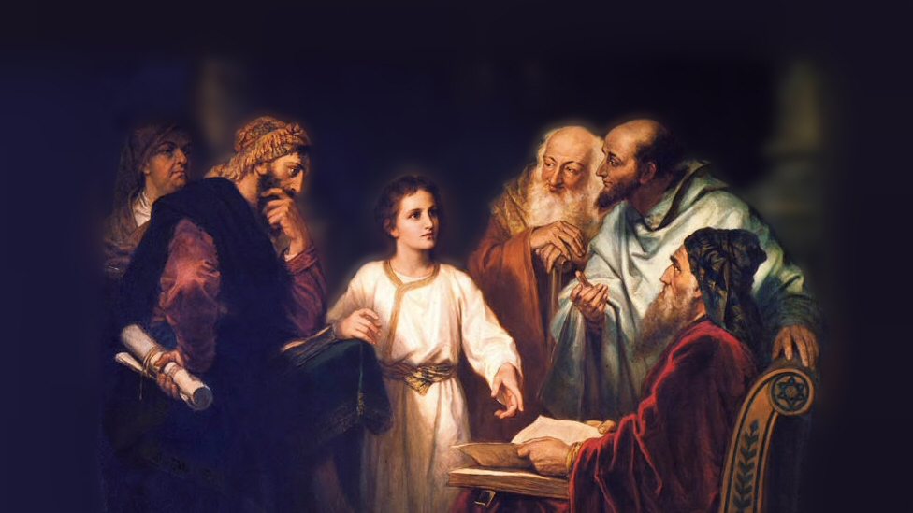
About My Father’s Business
Stilling the Storm
(Luke 8:22-25)
Notes:
This account of one of Jesus’ Miracles is found in Luke 8; Matthew 8:23-27; and Mark 4:35-41
The accounts a very similar (we have chosen to examine as the main text Luke 8)
(LUKE 8:22-25), “Now it happened, on a certain day, that He got into a boat with His disciples. And He said to them, “Let us cross over to the other side of the lake.” And they launched out. ²³ But as they sailed He fell asleep. And a windstorm came down on the lake, and they were filling with water, and were in jeopardy. ²⁴ And they came to Him and awoke Him, saying, “Master, Master, we are perishing!” Then He arose and rebuked the wind and the raging of the water. And they ceased, and there was a calm. ²⁵ But He said to them, “Where is your faith?” And they were afraid, and marveled, saying to one another, “Who can this be? For He commands even the winds and water, and they obey Him!”
Overview
The lake here is Lake Gennesaret, also referred to as the Sea of Galilee (relatively small body of water)
When we went on our trip, the morning trip from Tiberias (west shore) to Capernaum (North shore) VERY CALM
However, afternoon winds made for large waves for a lake that size (remember, the fishing boats were small).
If there was a storm, there was real danger “they were in jeopardy!”
Picture attribution: More Good Foundation (cropped, with background blurred) Creative Commons Liscense
https://www.flickr.com/photos/moregoodfoundation/5135438113

Slide 2
Where is your faith? (vs. 25)
Despite Jesus’ presence, the disciples were afraid!
23-24, 25 (Job 38:25-30; John 1:1-3; Matt. 10:28)
Notes:
Note that at first they were afraid of the elements, and their predicament.
Have you not felt the same? Powerless to the forces of nature? (Earthquakes, tornadoes, strong currents, raging thunderstorms, blizzards).
Note: Men often are unequipped to withstand such assaults of nature, and NEVER have the ability to CONTROL them, seldom even to PREDICT them.
(Job 38:25-30), [Regarding man’s impotence in the face of water], “Who has divided a channel for the overflowing water, or a path for the thunderbolt, ²⁶ To cause it to rain on a land where there is no one, A wilderness in which there is no man; ²⁷ to satisfy the desolate waste, and cause to spring forth the growth of tender grass? ²⁸ Has the rain a father? Or who has begotten the drops of dew? ²⁹ From whose womb comes the ice? And the frost of heaven, who gives it birth? ³⁰ The waters harden like stone, and the surface of the deep is frozen.”
Of course, they had the Creator of the universe in the boat with them!
(John 1:1-3), “In the beginning was the Word, and the Word was with God, and the Word was God. ² He was in the beginning with God. ³ All things were made through Him, and without Him nothing was made that was made. ⁴ In Him was life, and the life was the light of men. ⁵ And the light shines in the darkness, and the darkness did not comprehend it.”
The above, when demonstrated to them, caused them finally to FEAR JESUS! (We should as well)
(Matthew 10:28), “And do not fear those who kill the body but cannot kill the soul. But rather fear Him who is able to destroy both soul and body in hell.”

Slide 3
Where is your faith? (vs. 25)
Despite Jesus’ presence, the disciples were afraid!
23-24, 25 (Job 38:25-30; John 1:1-3; Matt. 10:28)
Their fear came from a lack of faith!
25, (Romans 10:17; Psalm 23:4)
Notes:
The question is, why did they lack faith?
One response is an unwillingness to believe!
Here the more probable answer is their ignorance!
(25), “Who can this be? For He commands even the winds and water, and they obey Him!”
(Romans 10:17), “So then faith comes by hearing, and hearing by the word of God.”
It was not until after Jesus’ resurrection that even His own disciples had a full understanding of His eternal power and Godhood.
Jesus was with them. A full understanding of Who their Master was would have filled them with calm despite the storm.
(Psalm 23:4), “Yea, though I walk through the valley of the shadow of death, I will fear no evil; for You are with me; Your rod and Your staff, they comfort me.”
Ex: Walking with Sawyer, down the street. Older children coming toward us. She wanted me to hold her. She trusted I would protect her.
We can trust in Jesus Christ!

Slide 4
Where is your faith? (vs. 25)
Despite Jesus’ presence, the disciples were afraid!
23-24, 25 (Job 38:25-30; John 1:1-3; Matt. 10:28)
Their fear came from a lack of faith!
25, (Romans 10:17; Psalm 23:4)
Jesus has power over the physical universe
24, (Mark 4:29; Psalm 95:4-5; Psalm 33:8-11)
Notes:
(Mark 4:39), [Mark’s version of the same event. Note the power of His words!], “Then He arose and rebuked the wind, and said to the sea, “Peace, be still!” And the wind ceased and there was a great calm.”
(Psalm 95:4-5), “In His hand are the deep places of the earth; the heights of the hills are His also. ⁵ The sea is His, for He made it; and His hands formed the dry land.”
In fact, the earth is in His thrall. He is preeminent, sovereign and omnipotent!
(Psalm 33:8-11), “Let all the earth fear the Lord; Let all the inhabitants of the world stand in awe of Him. ⁹ For He spoke, and it was done; He commanded, and it stood fast. ¹⁰ The Lord brings the counsel of the nations to nothing; He makes the plans of the peoples of no effect. ¹¹ The counsel of the Lord stands forever, The plans of His heart to all generations.”

Slide 5
Where is your faith? (vs. 25)
Despite Jesus’ presence, the disciples were afraid!
23-24, 25 (Job 38:25-30; John 1:1-3; Matt. 10:28)
Their fear came from a lack of faith!
25, (Romans 10:17; Psalm 23:4)
Jesus has power over the physical universe
24, (Mark 4:29; Psalm 95:4-5; Psalm 33:8-11)
“Who can this be?” (The Anointed of God!)
25, (John 3:1-2; John 10:24-30)
Notes:
(John 3:1-2), “There was a man of the Pharisees named Nicodemus, a ruler of the Jews. ² This man came to Jesus by night and said to Him, “Rabbi, we know that You are a teacher come from God; for no one can do these signs that You do unless God is with him.”
The Jews wanted a plain answer, but they did not accept that the works Jesus did clearly proclaimed Him to be the Anointed of God!
(John 10:24-30), “Then the Jews surrounded Him and said to Him, “How long do You keep us in doubt? If You are the Christ, tell us plainly.” ²⁵ Jesus answered them, “I told you, and you do not believe. The works that I do in My Father's name, they bear witness of Me. ²⁶ But you do not believe, because you are not of My sheep, as I said to you. ²⁷ My sheep hear My voice, and I know them, and they follow Me. ²⁸ And I give them eternal life, and they shall never perish; neither shall anyone snatch them out of My hand. ²⁹ My Father, who has given them to Me, is greater than all; and no one is able to snatch them out of My Father's hand. ³⁰ I and My Father are one.”

Slide 6
Conclusion
“And truly Jesus did many other signs in the presence of His disciples, which are not written in this book; ³¹ but these are written that you may believe that Jesus is the Christ, the Son of God, and that believing you may have life in His name.”
(John 20:30-31)

