Slide 1
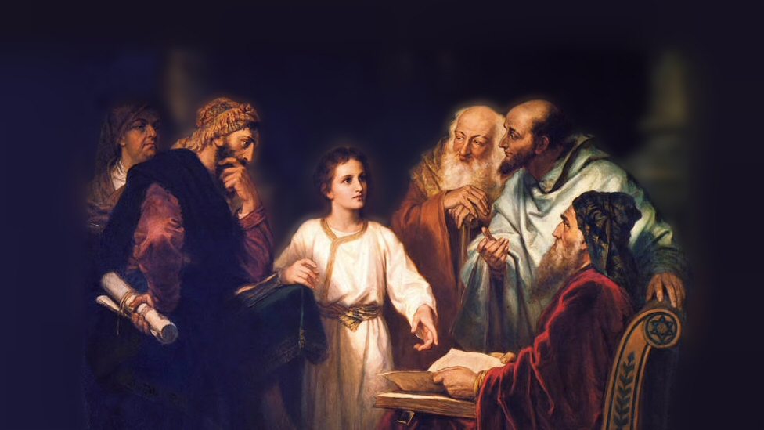
About My Father’s Business
The Temple Tax
(Matthew 17:24-27)
Notes:
(Matthew 17:24-27) READ
This text is near the end of Jesus’ ministry, in the village of Capernaum (where he was well known).
Soon after, he left Galilee, and traveled into Judah, where he ended up entering Jerusalem near Passover, leading to the events of his betrayal, arrest and death
It is important to note His efforts near the end to teach His disciples about His impending death, and its significance.
A short time earlier Peter had confessed Him as the Christ (Matthew 16:16), “You are the Christ, the Son of the living God.”
He had told His disciples of His impending death. (16:21), “From that time Jesus began to show to His disciples that He must go to Jerusalem, and suffer many things from the elders and chief priests and scribes, and to be killed, and be raised the third day.”
He had been transfigured before Peter, James and John (17:1-8)
Our text shows Jesus clearly affirming his status as the Son of God, in the lesson he taught Peter.
The Temple Tax
KJV (tribute). The word actually indicates a specific amount of money.
Greek word translated “tribute” is didrachma or double drachma.
The drachma was a days wages, and two of them equaled at that time a Jewish half-shekel, which was about 2 days wages.
(Exodus 30:13,16), [The origin of this tax] (13), “This is what everyone among those who are numbered shall give: half a shekel according to the shekel of the sanctuary (a shekel is twenty gerahs). The half-shekel shall be an offering to the Lord” … (16), “And you shall take the atonement money of the children of Israel, and shall appoint it for the service of the tabernacle of meeting, that it may be a memorial for the children of Israel before the Lord, to make atonement for yourselves.”
An additional tax to the call to tithe
Note: In no way related to taxes to Rome [Different principle in play later in Jerusalem, when He was tested by the Pharisees]
(Matthew 22:18, 21), (18), “But Jesus perceived their wickedness, and said, “Why do you test Me, you hypocrites?” … (21), “And He said to them, “Render therefore to Caesar the things that are Caesar's, and to God the things that are God’s.”
This was considered voluntary for most of the history of Israel. So, the question was not if Jesus was going to break the law. Rather, was He sufficiently zealous to fulfill what was considered a practice for the devout.
Perhaps this is why Peter responded so quickly in the affirmative.
Picture attribution: More Good Foundation (cropped, with background blurred) Creative Commons Liscense
https://www.flickr.com/photos/moregoodfoundation/5135438113

Slide 2
The Lesson & the Miracle
Jesus’ question of Peter, and Peter’s response
(25-26); Matt. 22:25; Jn. 1:49; 1 Kings 12:14
Notes:
Jesus’ question of Peter, and Peter’s response
(25-26), “And when he had come into the house, Jesus anticipated him, saying, ‘What do you think, Simon? From whom do the kings of the earth take customs or taxes, from their sons or from strangers?’ ²⁶ Peter said to Him, ‘From strangers.’”
Jesus anticipated. He could not have naturally known the conversation. But, He knew.
The Son of Man knows the thoughts, actions and motivations of men. He did then, He does now.
(Matthew 12:25) [Of the Pharisees, who accused Jesus of casting out Demon’s by the Devil’s authority], “But Jesus knew their thoughts…”
(John 1:48), [Nathaniel, when presented with the fact that Jesus knew him, when knowing him was not naturally possible, stated], “Rabbi, You are the Son of God! You are the King of Israel!”
Jesus’ analogy, to teach Peter, showed that Royalty does not pay taxes, Royalty imposes taxes.
(1 Kings 12:14) [Rehoboam’s answer to the people who desired a reduction in their taxes], ““My father made your yoke heavy, but I will add to your yoke.”
What was Jesus’ point here?

Slide 3
The Lesson & the Miracle
Jesus’ question of Peter, and Peter’s response
(25-26); Matt. 22:25; Jn. 1:49; 1 Kings 12:14
Jesus’ point (How would the tax apply?)
(26); Isaiah 9:6-7
Notes:
Jesus’ point (How would the tax apply?)
(26), “Jesus said to him, ‘Then the sons are free.’”
Jesus point to Peter, that he was Jewish royalty!
He was the Son of God, Ruler over the Temple, He had no lawful or ethical obligation to pay the Temple tax
The impulsive disciple showed his usual readiness by answering at once in the affirmative. He perhaps thought it was becoming his Master’s dignity to show not a moment’s hesitation in such a matter; but if so, he must have seen his mistake when he heard what his Lord had to say on the subject, reminding him as it did that, as Son of God, He was Lord of the Temple, and not tributary to it. (Expositors Bible Commentary).
(Isaiah 9:6-7), “For unto us a Child is born, unto us a Son is given; and the government will be upon His shoulder. And His name will be called Wonderful, Counselor, Mighty God, Everlasting Father, Prince of Peace. ⁷ Of the increase of His government and peace there will be no end, upon the throne of David and over His kingdom, to order it and establish it with judgment and justice from that time forward, even forever. The zeal of the Lord of hosts will perform this.”
Jesus was asserting to Peter His legitimate right, as the Son of God, not to pay tribute.

Slide 4
The Lesson & the Miracle
Jesus’ question of Peter, and Peter’s response
(25-26); Matt. 22:25; Jn. 1:49; 1 Kings 12:14
Jesus’ point (How would the tax apply?)
(26); Isaiah 9:6-7
The principle of giving offense
(27); 1 Corinthians 8:11-13
Notes:
The principle of giving offense
(27), “Nevertheless, lest we offend them.”
First, Peter had obligated Him. If the tribute was not paid, His refusal would not be understood
Second, by the means of the miracle, even in paying the tax His disciple would know the truth about His lofty claim to be the Messiah of God.
Regardless, there was not reason here to turn anyone away from the gospel unnecessarily. Nothing bad or inappropriate would happen by paying the tax.
A lesson for us: Sometimes, we do or refrain from doing, (not because it is right or wrong), but to remove a stumbling block to the faith of others.
(1 Corinthians 8:11-13), “And because of your knowledge shall the weak brother perish, for whom Christ died? ¹² But when you thus sin against the brethren, and wound their weak conscience, you sin against Christ. ¹³ Therefore, if food makes my brother stumble, I will never again eat meat, lest I make my brother stumble.”

Slide 5
The Lesson & the Miracle
Jesus’ question of Peter, and Peter’s response
(25-26); Matt. 22:25; Jn. 1:49; 1 Kings 12:14
Jesus’ point (How would the tax apply?)
(26); Isaiah 9:6-7
The principle of giving offense
(27); 1 Corinthians 8:11-13
The Miracle
(27); Prov. 30:4; Jeremiah 10:13; John 20:30-31
Notes:
The Miracle
(27), “Go to the sea, cast in a hook, and take the fish that comes up first. And when you have opened its mouth, you will find a piece of money; take that and give it to them for Me and you.”
This is another miracle that attests to Jesus’ power over nature!
(Proverbs 30:4), [the words of Agur], “Who has ascended into heaven, or descended? Who has gathered the wind in His fists? Who has bound the waters in a garment? Who has established all the ends of the earth? What is His name, and what is His Son's name, if you know?”
(Jeremiah 10:13), “When He utters His voice, there is a multitude of waters in the heavens: And He causes the vapors to ascend from the ends of the earth. He makes lightning for the rain, He brings the wind out of His treasuries.”
While Jesus’ miracle here was known only to Peter, it did confirm Him as the Son of God to Peter, and now to all of us as well!
(John 20:30-31), “And truly Jesus did many other signs in the presence of His disciples, which are not written in this book; ³¹ but these are written that you may believe that Jesus is the Christ, the Son of God, and that believing you may have life in His name.”

Slide 6
Conclusion
Philippians 2:8-11
Jesus of Nazareth is God’s Son. He is the King of Kings, and Lord of Lords. He has no obligation to pay tribute to men.
But, we have a responsibility to acknowledge Him. And all will one day, either sooner or later!
Notes:
Jesus of Nazareth is God’s Son. He is the King of Kings, and Lord of Lords. He has no obligation to pay tribute to men.
But, we have a responsibility to acknowledge Him. And all will one day, either sooner or later!
(Philippians 2:8-11), “And being found in appearance as a man, He humbled Himself and became obedient to the point of death, even the death of the cross. ⁹ Therefore God also has highly exalted Him and given Him the name which is above every name, ¹⁰ that at the name of Jesus every knee should bow, of those in heaven, and of those on earth, and of those under the earth, ¹¹ and that every tongue should confess that Jesus Christ is Lord, to the glory of God the Father.”

