Slide 1
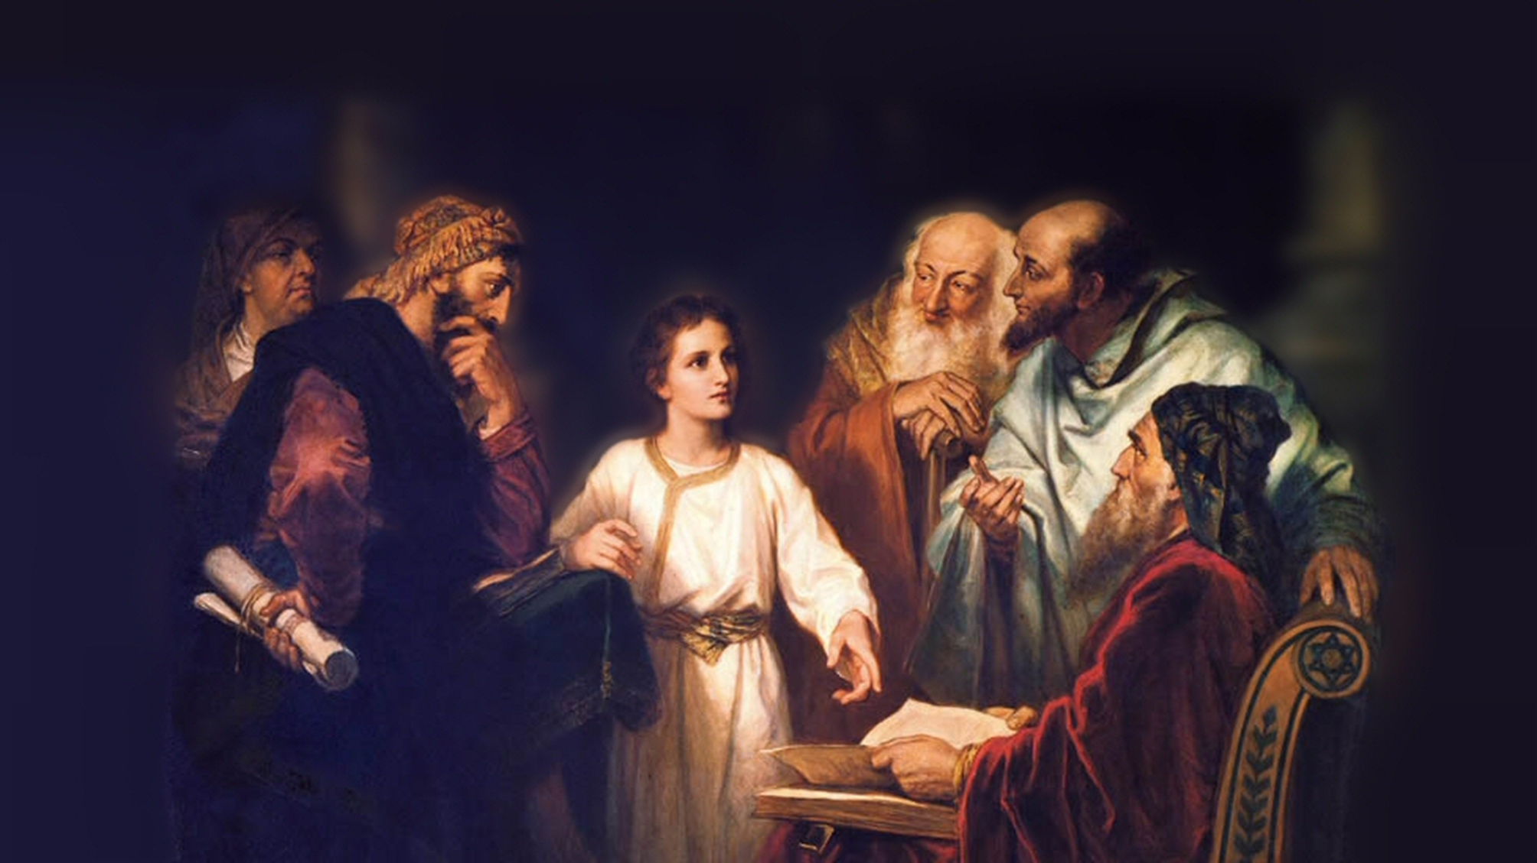
About My Father’s Business
Healing a Paralyzed Man
(Luke 5:17-26)
Notes:
(Luke 5:17-26) READ
also Matthew 9:2-8; Mark 2:1-12
Matthew’s account is cursory
Mark’s account is almost identical to Luke’s, but supplies the location (Capernaum)
Luke’s account supplies details regarding the large numbers of Pharisees and teachers of the law sitting by.
Presence of Pharisees and Scribes. (Typically critical, not true disciples)
This occasion was early in the Lord’s ministry
But, again and again the leaders of the people showed themselves less than sincere when they presented themselves to Jesus
Here they oppose the Lord, accusing Him of blasphemy, “Who can forgive sins but God alone.”
Jesus always proved His genuineness as God’s son, and was accepted by many, but never the leaders of the Jews.
But, let’s note a few lessons we can learn from our text…
Picture attribution: More Good Foundation (cropped, with background blurred) Creative Commons Liscense
https://www.flickr.com/photos/moregoodfoundation/5135438113

Slide 2
The Healing of the Paralyzed Man
The love of good friends (18-20)
  Acts 10:24,33; Ecclesiastes 4:9-12
Notes:
The love of friends (who brought the paralytic to Jesus)
(18-20), “Then behold, men brought on a bed a man who was paralyzed, whom they sought to bring in and lay before Him. ¹⁹ And when they could not find how they might bring him in, because of the crowd, they went up on the housetop and let him down with his bed through the tiling into the midst before Jesus. ²⁰ When He saw their faith, He said to him, “Man, your sins are forgiven you.”
Their love led them to great effort in the hope of a cure
Their love led Jesus to give the paralyzed man a greater blessing than even they could have imagined.
Consider, the greatest love we can show to our friends is to share Jesus with them [Cornelius as example]
(Acts 10:24), [Peter traveled to Cornelius house], “And the following day they entered Caesarea. Now Cornelius was waiting for them, and had called together his relatives and close friends” … (33) [Cornelius words to Peter upon his arrival], “So I sent to you immediately, and you have done well to come. Now therefore, we are all present before God, to hear all the things commanded you by God.”
Any man who gains a true friend is blessed
(Ecclesiastes 4:9-12), “Two are better than one, because they have a good reward for their labor. ¹⁰ For if they fall, one will lift up his companion. But woe to him who is alone when he falls, for he has no one to help him up. ¹¹ Again, if two lie down together, they will keep warm; but how can one be warm alone? ¹² Though one may be overpowered by another, two can withstand him. And a threefold cord is not quickly broken.”

Slide 3
The Healing of the Paralyzed Man
The love of good friends (18-20)
  Acts 10:24,33; Ecclesiastes 4:9-12
The graciousness of the Son of Man (20,24)
  Ephesians 5:25-27; Luke 23:42-43; James 5:14-15
Notes:
The graciousness of the Son of Man
Consider that first of all Jesus blessed him with the greater blessing
(Luke 5:20), “When He saw their faith, He said to him, “Man, your sins are forgiven you.”
Jesus purpose in coming to earth was to bring salvation to men!
(Ephesians 5:25-27), “Husbands, love your wives, just as Christ also loved the church and gave Himself for her, ²⁶ that He might sanctify and cleanse her with the washing of water by the word, ²⁷ that He might present her to Himself a glorious church, not having spot or wrinkle or any such thing, but that she should be holy and without blemish.”
Note: Jesus has power on earth to forgive sins (thief on the cross)
(Luke 23:42-43), “Then he said to Jesus, ‘Lord, remember me when You come into Your kingdom.’
⁴³ And Jesus said to him, ‘Assuredly, I say to you, today you will be with Me in Paradise.’”
The lesser blessing was nevertheless significant
(Luke 5:24), “But that you may know that the Son of Man has power on earth to forgive sins”—He said to the man who was paralyzed, “I say to you, arise, take up your bed, and go to your house.”
We too can pray for healing and help from God
(James 5:14-15), “Is anyone among you sick? Let him call for the elders of the church, and let them pray over him, anointing him with oil in the name of the Lord. ¹⁵ And the prayer of faith will save the sick…”

Slide 4
The Healing of the Paralyzed Man
The love of good friends (18-20)
  Acts 10:24,33; Ecclesiastes 4:9-12
The graciousness of the Son of Man (20,24)
  Ephesians 5:25-27; Luke 23:42-43; James 5:14-15
The Miracle (24-25)
  John 1:1,14; Daniel 7:13-14
Notes:
The miracle
(Luke 5:24-25), “But that you may know that the Son of Man has power on earth to forgive sins”—He said to the man who was paralyzed, “I say to you, arise, take up your bed, and go to your house.” ²⁵ Immediately he rose up before them, took up what he had been lying on, and departed to his own house, glorifying God.”
The effect of the miracle was a paralyzed man, now able to walk.
The purpose of the miracle (as all miracles) was to confirm by God’s power the claim of Jesus!
[Pharisee claim of blasphemy], “Who can forgive sins but God alone?”
“But that you may know that the Son of Man has power on earth to forgive sins”
Jesus is God!
(John 1:1), “In the beginning was the Word, and the Word was with God, and the Word was God.” (14), “And the Word became flesh and dwelt among us, and we beheld His glory, the glory as of the only begotten of the Father, full of grace and truth.”
Jesus is the Son of Man!
(Daniel 7:13-14), ““I was watching in the night visions, and behold, One like the Son of Man, coming with the clouds of heaven! He came to the Ancient of Days, and they brought Him near before Him. ¹⁴ Then to Him was given dominion and glory and a kingdom, that all peoples, nations, and languages should serve Him. His dominion is an everlasting dominion, which shall not pass away, and His kingdom the one which shall not be destroyed.”
The phrase refers to the Messiah (the chosen of God)
It emphasizes the humanity of Jesus, come as a sacrifice for sin
In Daniel’s vision there is one “like the Son of Man” – i.e. Like a human being, but coming from the clouds of heaven. This is an indication of Deity, come down from heaven. It is a perfect explanation of the Christ’s first advent!
And, one day He will come in the clouds again!
(Revelation 1:7), “Behold, He is coming with clouds, and every eye will see Him, even they who pierced Him. And all the tribes of the earth will mourn because of Him. Even so, Amen.”
The miracle validated Jesus’ self-identification as the promised Messiah
Jesus power: Other miracles had been performed (this is the reason for such great efforts)
Jesus power: Son of Man (identify the phrase)
Jesus power: Convinced the Pharisees and Scribes of His genuine claim to be “the Son of Man”

Slide 5
Conclusion
As we acknowledge Jesus’ power on earth to forgive sins, we too should be moved to Glorify God, and be filled with fear!
We never saw anything like this!
Notes:
(Mark 2:12), “Immediately he arose, took up the bed, and went out in the presence of them all, so that all were amazed and glorified God, saying, “We never saw anything like this!”
(Luke 5:25-26), “Immediately he rose up before them, took up what he had been lying on, and departed to his own house, glorifying God. And they were all amazed, and they glorified God and were filled with fear, saying, ‘We have seen strange things today!’”
The result (one that should be present in us as well!)
Glorified God – praising God for the blessings (physical and spiritual) in our lives
Filled with Fear – The awesome power of one who can heal the paralyzed, AND FORGIVE SINS!
“We never saw anything like this!”

