Slide 2
Angels
What does the Bible actually say about angels?

Slide 3
Do angels exist?
What are angels?
Will people become angels in heaven?
Do angels fly?
Do angels have wings?
Are all angels good?
What is the job of an angel?
Notes:
These are just some of the questions that people have about angels. People are always talking about angels; about having guardian angels. Many movies have been made about angels and how angels get their wings. The one thing that we can learn about angels from man is that he doesn’t really know what he is talking about. Man has a thought process that leaves out the bible and the things that God has told us so if we want to find out about angels we must go to God’s word.

Slide 4
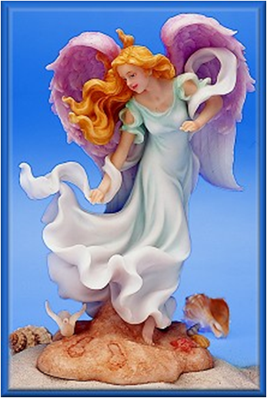
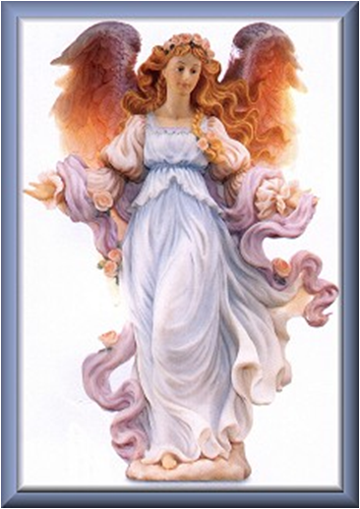
Angels
Deut. 29:29 – the secret things belong to God

Slide 5
What are angels?
Angels are a class of spiritual beings created by God.
Psalm 148:1-5 – God created them.
Col. 1:16 – All things visible and invisible were created by God.
Luke 20:36 – Angels are immortal.
Heb. 12:22 – They are innumerable.

Slide 6
Luke 1:19 – They seem to have names; Gabriel is an angel.
Jude 9 – There is an order in their ranks; Michael is an archangel.
Other created beings:
Cherubim – Ezek. 1, 10:1-5
Seraphim – Isaiah 6:2-6

Slide 7
Angels are messengers of God.
Luke 1:26, Matt. 1:20, Matt. 28:5, Gen. 16:7-10, 1 Kings 19:5, Dan. 9:21-23
Angels are ministering spirits.
Heb. 1:14, Psalm 103:20-22

Slide 8
We do not know what angels look like apart from the word of God.
Gen. 18:2 – Angels appeared as men.
Gen. 19:1 – Angels appeared as men.
Matt. 28:2-3 – Appearance like lightening and as white as snow.
Rev. 8:13, Rev. 14:6 – Angels can fly, but there is no mention of wings.

Slide 9
What are some ways that angels worked in the Old Testament?
Gen. 19:1-13 – two angels at Sodom
Gen. 24:1-7 – angel would guide Abraham’s servant as he went to find a wife for Isaac
Exodus 23:20-24 – angel would go before Israelites as they went into the promised land – Joshua 5:13-14

Slide 10
1 Kings 19:1-8 – an angel appears to Elijah
Gen. 32:24 – Jacob wrestled with a man – Hosea 12:4 – it was an angel

Slide 11
What are some ways that angels worked in the New Testament?
Matt. 4:11 – angels ministered to Jesus
Acts 5:18-19 – angel released the apostles from prison
Acts 8:26 – angel spoke to Philip
Acts 10:3 – angel appears to Cornelius
Acts 27:23 – angel appears to Paul
Rev. 1:1 – angel appears to John

Slide 12
What is the role of angels when people die?
Luke 16:19-23 – the righteous will be carried to Abraham’s bosom, Paradise side of Hades

Slide 13
What is the role of angels for children?
Matt. 18:10 – their angels always see the face of the Father
Does this mean that these are guardian angels?
If so, are angels at fault in their jobs when children fall into various persecutions?
Notes:
Where do we read of an angel failing in his mission? Might there be an application of the innocence of children being reflected here? If the angels are really guardians then when does this guardianship stop? If it carries on into adulthood then are the guardian angels watching over us influencing us in our daily lives? Do they give us suggestions and thus influence our lives. Matt. 13:24-30 – this parable teaches that there will be no miraculous interference in our lives before judgment.

Slide 14
What will be the role of angels at the judgment?
2 Thess. 1:7 – mighty angels will come with Jesus
Matt. 13:41-42, 49 – gather out of the kingdom all things that offend
1 Peter 4:17 – judgment begins in the house of God

Slide 15
Are all angels good?
1 Tim. 5:21 – There are elect or chosen angels.
Mark 8:38 – Jesus calls some angels holy.
Luke 13:32 – Angels are in heaven.
Matt. 18:10 – Angels are in the presence of the Father.

Slide 16
Matt. 25:41 – Everlasting fire is prepared for the devil and his angels.
2 Peter 2:4 – God cast out of heaven the angels who sinned.
Jude 6 – Angels who did not keep themselves are reserved in chains waiting for judgment.
Rev. 12:7-17 – The devil and his angels wage war with the saints.
2 Cor. 11:14-15 – The devil transforms himself into and angel of light.
Notes:
The angels were given a habitation from God when He created them. Some decided to leave this place thus they sinned. This habitation must be separate from eternal heaven if not then it would be possible to sin in heaven.

Slide 17
Do angels work today?
Heb. 1:14 – ministering spirits; if they do this today it is probably best described as the providence of God
Heb. 13:2 – entertaining strangers may be entertaining angels – most probably refers to the hospitality that we should demonstrate
Notes:
If the miraculous gifts ceased that would necessarily included any miraculous work or intervention. 1 Cor. 13:8-10, Acts 8:14-16
This letter was written to Christians of the first century and the miraculous gifts had not ceased at this point so angels as ministering spirits would still have significance for them as would the direct possibility of angels visiting them as strangers.

Slide 18
Will people become angels?
Luke 20:34-36 – In the resurrection to life man will be equal to angels but not angels. This equality is eternal life.

Slide 19
Are angels to be worshipped?
Col. 2:18 – the worship of angels is cheating you of your reward.
Rev. 19:10, Rev. 22:9 –
“See that you do not do that”
“Worship God.”

Slide 20
Do angels exist? What are angels? Will people become angels in heaven? Do angels fly? Do angels have wings? Are all angels good? What is the job of an angel? Are there guardian angels? Can we worship angels? What will angels do at judgment?
Notes:
These are just some of the questions that people have about Aangels. People are always talking about angels; about having guardian angels. Many movies have been made about angels and how angels get their wings. The one thing that we can learn about angels from man is that he doesn’t really know what he is talking about. Man has a thought process that leaves out the bible and the things that God has told us so if we want to find out about angels we must go to God’s word.

Slide 21
As we try to answer these and other questions about angels we must simply look at God’s word and accept what He has said and remain silent about what He has not said.
Deut. 29:29
Notes:
These are just some of the questions that people have about Aangels. People are always talking about angels; about having guardian angels. Many movies have been made about angels and how angels get their wings. The one thing that we can learn about angels from man is that he doesn’t really know what he is talking about. Man has a thought process that leaves out the bible and the things that God has told us so if we want to find out about angels we must go to God’s word.

