Slide 1
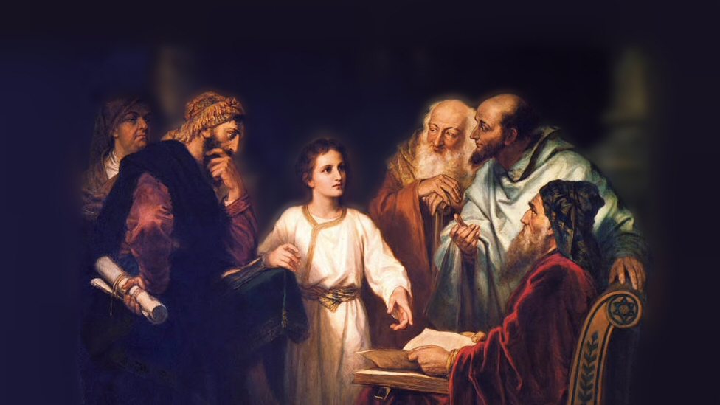
About My Father’s Business
The Beatitudes
(Matthew 5:1-8)
Notes:
Jesus’ Sermon on the mount (Matthew 5:1 – 7:29)
The longest single sermon recorded from Jesus’ earthly ministry
Paul Earnhart, “Jesus’ discource upon a Galilean mountainside is in reality no mere sermon. It more approximates a manifesto of the kingdom of God. There is more to Jesus’ teaching than this, but here we feel the very heartbeat of kingdom truth, and we will neglect it at our peril.” (Invitation to a Spiritual Revolution, 3).
Note how it was received by the hearers
(Matthew 7:28-29), “And so it was, when Jesus had ended these sayings, that the people were astonished at His teaching, ²⁹ for He taught them as one having authority, and not as the scribes.”
Challenging – A radical call to a higher ethics and aspirations
Principles established here do not allow for a half-hearted profession
The Beatitudes – (1-12) READ (from Latin – beatus, meaning blessed).
“Blessed are…” (“Happy” is a word that does not sufficiently explain this idea).
(Rejoicing, however, is a part of the idea, cf. 5:12)
It is an abiding state of the soul that comes when the human spirit is atuned to the Spirit of God!
(1 Peter 1:8) [Gives the idea, as it contemplates our final salvation due to the redeeming work of Christ], “Though now you do not see Him, yet believing, you rejoice with joy inexpressible and full of glory, ⁹ receiving the end of your faith—the salvation of your souls.”
Let’s examine these reasons to rejoice!
Picture attribution: More Good Foundation (cropped, with background blurred) Creative Commons Liscense
https://www.flickr.com/photos/moregoodfoundation/5135438113

Slide 2
Blessed are the poor in spirit, For theirs is the kingdom of heaven
Not cowardly, but humble
Matthew 18:2-4
Notes:
Not referring to despondent or cowardly.
Rather refers to those who are humble.
Not like the cowardly spies in Israel.
(Numbers 13:31), “We are not able to go up against the people.”
Not like the one talent man.
(Matthew 25:25), “And I was afraid, and went and hid your talent in the ground.”
Rather, Humble (they feel their need for God’s help)
(Matthew 18:2-4), “Then Jesus called a little child to Him, set him in the midst of them, ³ and said, “Assuredly, I say to you, unless you are converted and become as little children, you will by no means enter the kingdom of heaven. ⁴ Therefore whoever humbles himself as this little child is the greatest in the kingdom of heaven.”
Why blessed? “For theirs is the kingdom of heaven.”
“It is only the soul who recognizes his need for God that may be counted a citizen of the kingdom of heaven” (Kyle Pope, Commentary on Matthew)

Slide 3
Blessed are those who mourn, For they shall be comforted
The sorrow we feel must be godly!
2 Corinthians 7:9-10
Notes:
Mourning not virtuous in itself. So, not all mourning leads to comfort.
Not like King Ahab who wept because Naboth would not sell to him his family heritage. (cf. 1 Kings 21:4)
Not like Judas who wept after selling his Lord for 30 pieces of silver (cf. Matt. 27:3-5)
It is the one who exhibits Godly sorrow
“Why should Christians mourn? They mourn for the world which lies in the darkness of sin. They mourn for the sins that mar their own lives. They mourn for loved ones and members of their families out of Christ. They mourn for the slain who have fallen in the encounter with the evil one. They mourn from those sorrows and bereavements which are the common lot of all men.” (James Coffman)
(2 Corinthians 7:9-10), “Now I rejoice, not that you were made sorry, but that your sorrow led to repentance. For you were made sorry in a godly manner, that you might suffer loss from us in nothing. ¹⁰ For godly sorrow produces repentance leading to salvation, not to be regretted; but the sorrow of the world produces death.”

Slide 4
Blessed are the meek, For they shall inherit the earth
Meekness – not occupied with self
1 Peter 2:19-20; 1 Corinthians 4:21
Notes:
Does not refer to cowardice or weakness.
Definition: Meekness is the opposite of self-awareness… it is not occupied with self.)
Meekness is behind a willingness to take wrong patiently
(1 Peter 2:19-20), “For this is commendable, if because of conscience toward God one endures grief, suffering wrongfully. ²⁰ For what credit is it if, when you are beaten for your faults, you take it patiently? But when you do good and suffer, if you take it patiently, this is commendable before God.”
Meekness is behind a gentleness in dealing with others
(1 Corinthians 4:2), [It was how Paul preferred to deal with the Corinthians], “What do you want? Shall I come to you with a rod, or in love and a spirit of gentleness?”
“They shall inherit the earth”
A Parallel with the first promise – “theirs is the kingdom of heaven”
Consider the promise of God in Psalms
(Psalm 37:29), “The righteous shall inherit the land, And dwell in it forever.”
A reference to an eternal reward
(Revelation 21:1), “Now I saw a new heaven and a new earth, for the first heaven and the first earth had passed away.”

Slide 5
Blessed are those who hunger and thirst for righteousness, For they shall be filled.
Desire leads to growth!
1 Peter 2:2-3; Hebrews 5:14
Notes:
As babes in Christ, we are to “desire the pure milk of the word, that you may grow thereby, if indeed you have tasted that the Lord is gracious” (1 Peter 2:2-3)
Milk is not enough:
(Hebrews 5:14), “But solid food belongs to those who are of full age, that is, those who by reason of use have their senses exercised to discern both good and evil.”
The promise of being filled is seen in the Christ!
(John 6:32-35), “Then Jesus said to them, “Most assuredly, I say to you, Moses did not give you the bread from heaven, but My Father gives you the true bread from heaven. ³³ For the bread of God is He who comes down from heaven and gives life to the world.” ³⁴ Then they said to Him, “Lord, give us this bread always.” ³⁵ And Jesus said to them, “I am the bread of life. He who comes to Me shall never hunger, and he who believes in Me shall never thirst.”

Slide 6
Blessed are the merciful, For they shall obtain mercy
You have to give it to get it!
Matthew 6:14-15
Notes:
Definition: “An outward manifestation of pity, sympathy and compassion.”
Imitate God:
(Hebrews 8:12), “I will be merciful to their unrighteousness, and their sins and their lawless deeds I will remember no more”
If we are merciful to others, we too will obtain mercy from God
(Matthew 6:14-15), “For if you forgive men their trespasses, your heavenly Father will also forgive you. ¹⁵ But if you do not forgive men their trespasses, neither will your Father forgive your trespasses.”

Slide 7
Blessed are the pure in heart, For they shall see God
Control the heart – Control the man
Acts 15:8-9; James 4:8; 2 Corinthians 7:1
Notes:
Control the heart, and you control the man.
(Acts 15:8-9), [Peter, mentioning Cornelius, and the Gentiles inclusion in the kingdom], “So God, who knows the heart, acknowledged them by giving them the Holy Spirit, just as He did to us, ⁹ and made no distinction between us and them, purifying their hearts by faith.”
Indicates a heart singularly devoted to God! (such devotion will lead to moral purity)
(James 4:8), “Draw near to God and He will draw near to you. Cleanse your hands, you sinners; and purify your hearts, you double-minded.”
(2 Corinthians 7:1), “Therefore, having these promises, beloved, let us cleanse ourselves from all filthiness of the flesh and spirit, perfecting holiness in the fear of God.”
“For they shall see God”
The pure in heart see God in his revelation, and one day shall see the fullness of His glory (Kyle Pope)
(1 John 3:2-3), “Beloved, now we are children of God; and it has not yet been revealed what we shall be, but we know that when He is revealed, we shall be like Him, for we shall see Him as He is. ³ And everyone who has this hope in Him purifies himself, just as He is pure.”

Slide 8
Blessed are the peacemakers, For they shall be called sons of God.
As far as we can control the matter
Romans 12:17-21; 14:19
Notes:
Disciples should emulate their Lord who was called “Prince of Peace” (Isaiah 9:6)
Of course, we do not speak of a compromising peace.
(Jeremiah 6:14), [The false priests and prophets], “Saying, ‘Peace, peace!’, When there is no peace.”
Whenever possible, as the sons of God, we must be at peace with all men
(Romans 12:17-21), “Repay no one evil for evil. Have regard for good things in the sight of all men. ¹⁸ If it is possible, as much as depends on you, live peaceably with all men. ¹⁹ Beloved, do not avenge yourselves, but rather give place to wrath; for it is written, “Vengeance is Mine, I will repay,” says the Lord. ²⁰ Therefore “If your enemy is hungry, feed him; If he is thirsty, give him a drink; For in so doing you will heap coals of fire on his head.” ²¹ Do not be overcome by evil, but overcome evil with good.”
(Romans 14:19), [Regarding Christian relationships, especially], “Therefore let us pursue the things which make for peace and the things by which one may edify another.”

Slide 9
Blessed are those who are persecuted for righteousness’ sake, For theirs is the kingdom of heaven
Persecution for Christ is laudable and inevitable
1 Peter 4:15-16; Acts 14:21-22; 2 Timothy 3:12
Notes:
No blessing on those who suffer because they have done wrong,
(1 Peter 4:15), “But let none of you suffer as a murderer, a thief, an evildoer, or as a busybody in other people's matters.”
Persecution for Christ is laudable,
(1 Peter 4:16), “Yet if anyone suffers as a Christian, let him not be ashamed, but let him glorify God in this matter”
Persecution will happen!
(Acts 14:21-22), [Paul’s message, after being stoned and left for dead in Lystra] “And when they had preached the gospel to that city and made many disciples, they returned to Lystra, Iconium, and Antioch, ²² strengthening the souls of the disciples, exhorting them to continue in the faith, and saying, “We must through many tribulations enter the kingdom of God.”
(2 Timothy 3:12), “Yes, and all who desire to live godly in Christ Jesus will suffer persecution.”

Slide 10
Conclusion
Man’s idea of happiness, and that of God’s do not often coincide.
“Blessed” (happy, fortunate) is the man who serves God.
Notes:
(Matthew 5:11-12), “Blessed are you when they revile and persecute you, and say all kinds of evil against you falsely for My sake. ¹² Rejoice and be exceedingly glad, for great is your reward in heaven, for so they persecuted the prophets who were before you.”

