Slide 1
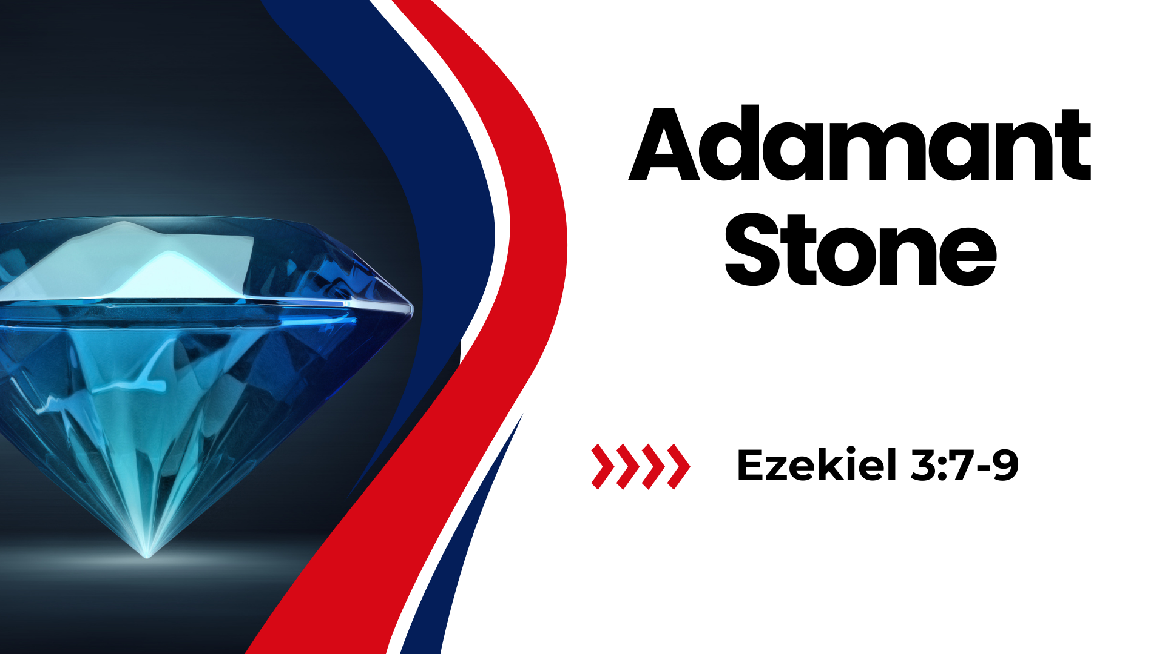
Notes:
Adamant Stone
Ezekiel 3:7-9
Ezekiel 3:7-9 But the house of Israel will not listen to you, because they will not listen to Me; for all the house of Israel are impudent and hard-hearted. (8) Behold, I have made your face strong against their faces, and your forehead strong against their foreheads. (9) Like adamant stone, harder than flint, I have made your forehead; do not be afraid of them, nor be dismayed at their looks, though they are a rebellious house."
INTRODUCTION:
Ezekiel was called by God to prophecy for him to a disobedient nation of Judah near the time of Jerusalem's destruction and Babylonian captivity.
Ezekiel was taken captive during the second stage of Judah's fall to Babylon, which took place in three stages between 605 B.C. and 586 B.C. when Jerusalem fell and the temple was destroyed.
Chapter 1 recounts a vision given to Ezekiel as he was called by God to prophesy
The calling of God is stated clearly in 2:3-4
Ezekiel 2:3-4 And He said to me: "Son of man, I am sending you to the children of Israel, to a rebellious nation that has rebelled against Me; they and their fathers have transgressed against Me to this very day. (4) For they are impudent and stubborn children. I am sending you to them, and you shall say to them, 'Thus says the Lord GOD.'
Define - Impudent (hard hearted, obstinate)
Define - Stubborn (hard, bold, violent, stiff hearted)
Whether they accepted what Ezekiel had to say or not, he was to proclaim God's word to them.
Ezekiel 2:5-7 As for them, whether they hear or whether they refuse—for they are a rebellious house—yet they will know that a prophet has been among them. (6) "And you, son of man, do not be afraid of them nor be afraid of their words, though briers and thorns are with you and you dwell among scorpions; do not be afraid of their words or dismayed by their looks, though they are a rebellious house. (7) You shall speak My words to them, whether they hear or whether they refuse, for they are rebellious.
This gets us to our text. God's word sent to Ezekiel made him more unyielding than even a people who were characterized by being hard hearted and rebellious.
His illustration in verses 8 and 9 is interesting, and helps to make some important points.
The Lord made his face strong against their faces.
The Lord made his forehead throng against their foreheads.
(This indicates that the Lord steeled and prepared him for the difficult task ahead).
Next phrase: "Like adamant stone, harder than flint, I have made your forehead"
Definition: English (adamant) - refusing to be persuaded or to change one's mind. (English etymology) - a legendary rock or mineral to which many, often contradictory, properties were attributed, formerly associated with diamond.
In fact, for any nerds here, this was why Marvel comics added the suffix -ium to the word adamant in creating the claws of the superhero Wolverine.
Hebrew Definition: (adamant) (shaw-meer'), a sharp stone, flint, perhaps a diamond. In other contexts, it is used in the sense of pricking, like a thorn.

Slide 2
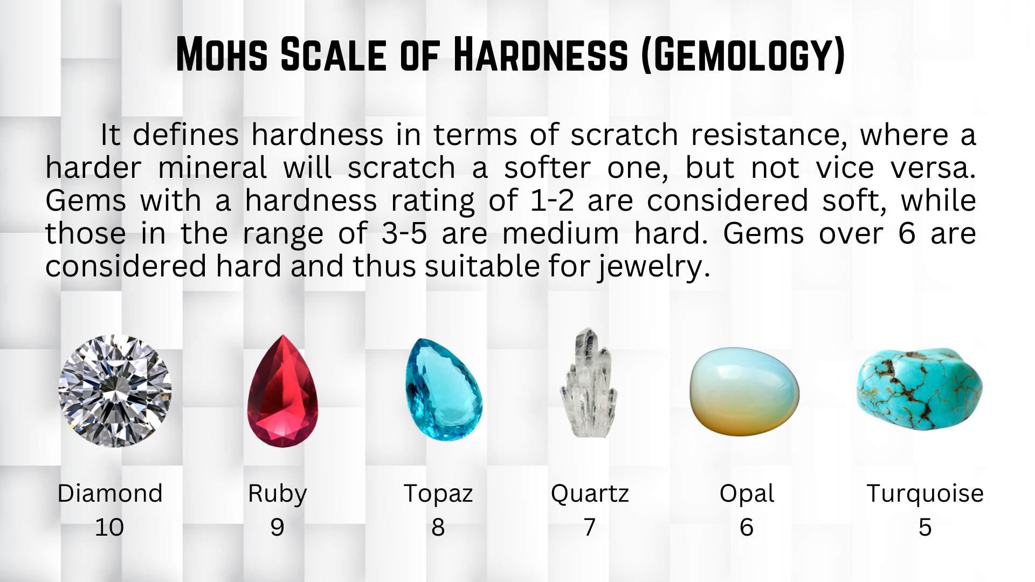
Notes:
ILLUSTRATION: The Mohs Scale
It defines hardness in terms of scratch resistance, where a harder mineral will scratch a softer one, but not vice versa. Gems with a hardness rating of 1-2 are considered soft, while those in the range of 3-5 are medium hard. Gems over 6 are considered hard and thus suitable for jewelry.
Diamonds are the hardest! And used to scratch other , Less hard gems
Flint is hard as well, has been used for knives and arrowheads. Effective in scratching, cutting and pricking. Would have been familiar to Ezekiel and the Jews.

Slide 3
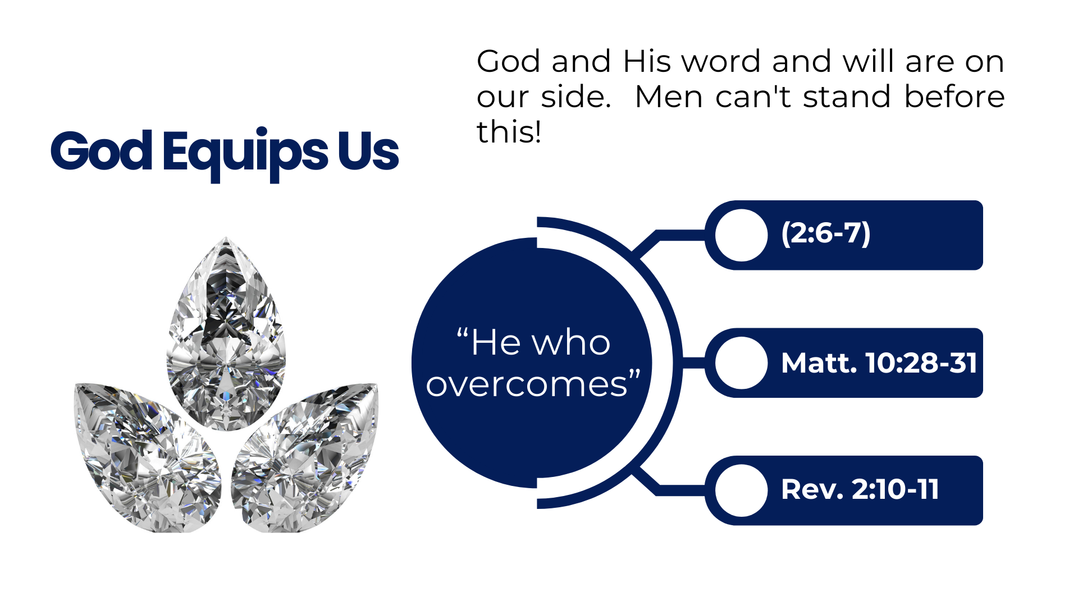
Notes:
DISCUSSION:
First, our primary context indicates God's protection and equipping of His servant in the work he would have him to do. (Applies to us as well).
The king and the people would resist Ezekiel, but he had God on his side!
Ezekiel 2:6-7 "And you, son of man, do not be afraid of them nor be afraid of their words, though briers and thorns are with you and you dwell among scorpions; do not be afraid of their words or dismayed by their looks, though they are a rebellious house. (7) You shall speak My words to them, whether they hear or whether they refuse, for they are rebellious.
The application fits us today as well. God and His word and will are on our side. Men can't stand before this!
Matthew 10:28-31 And do not fear those who kill the body but cannot kill the soul. But rather fear Him who is able to destroy both soul and body in hell. (29) Are not two sparrows sold for a copper coin? And not one of them falls to the ground apart from your Father's will. (30) But the very hairs of your head are all numbered. (31) Do not fear therefore; you are of more value than many sparrows.
Revelation 2:10-11 Do not fear any of those things which you are about to suffer. Indeed, the devil is about to throw some of you into prison, that you may be tested, and you will have tribulation ten days. Be faithful until death, and I will give you the crown of life. (11) "He who has an ear, let him hear what the Spirit says to the churches. He who overcomes shall not be hurt by the second death." '

Slide 4
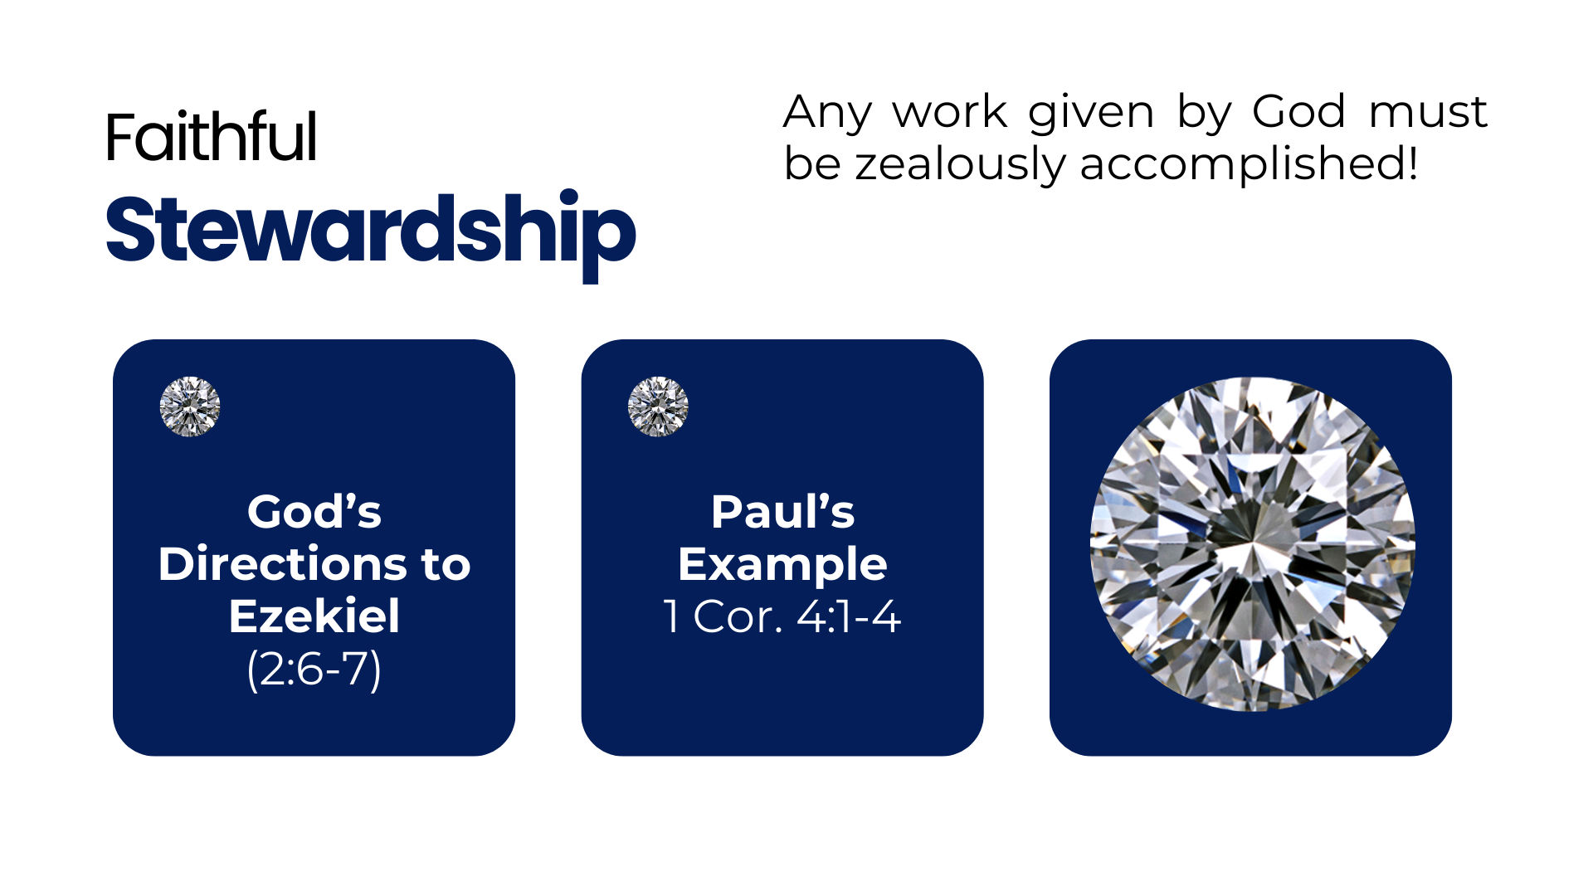
Notes:
Second, if God has given us the work, it is required of us to do it faithfully and zealously (stewardship)
Note God's emphatic directions to Ezekiel.
Ezekiel 2:8-10 But you, son of man, hear what I say to you. Do not be rebellious like that rebellious house; open your mouth and eat what I give you." (9) Now when I looked, there was a hand stretched out to me; and behold, a scroll of a book was in it. (10) Then He spread it before me; and there was writing on the inside and on the outside, and written on it were lamentations and mourning and woe.
Likewise, God expects faithfulness on our part (Example: Paul)
1 Corinthians 4:1-4 Let a man so consider us, as servants of Christ and stewards of the mysteries of God. (2) Moreover it is required in stewards that one be found faithful. (3) But with me it is a very small thing that I should be judged by you or by a human court. In fact, I do not even judge myself. (4) For I know of nothing against myself, yet I am not justified by this; but He who judges me is the Lord.

Slide 5
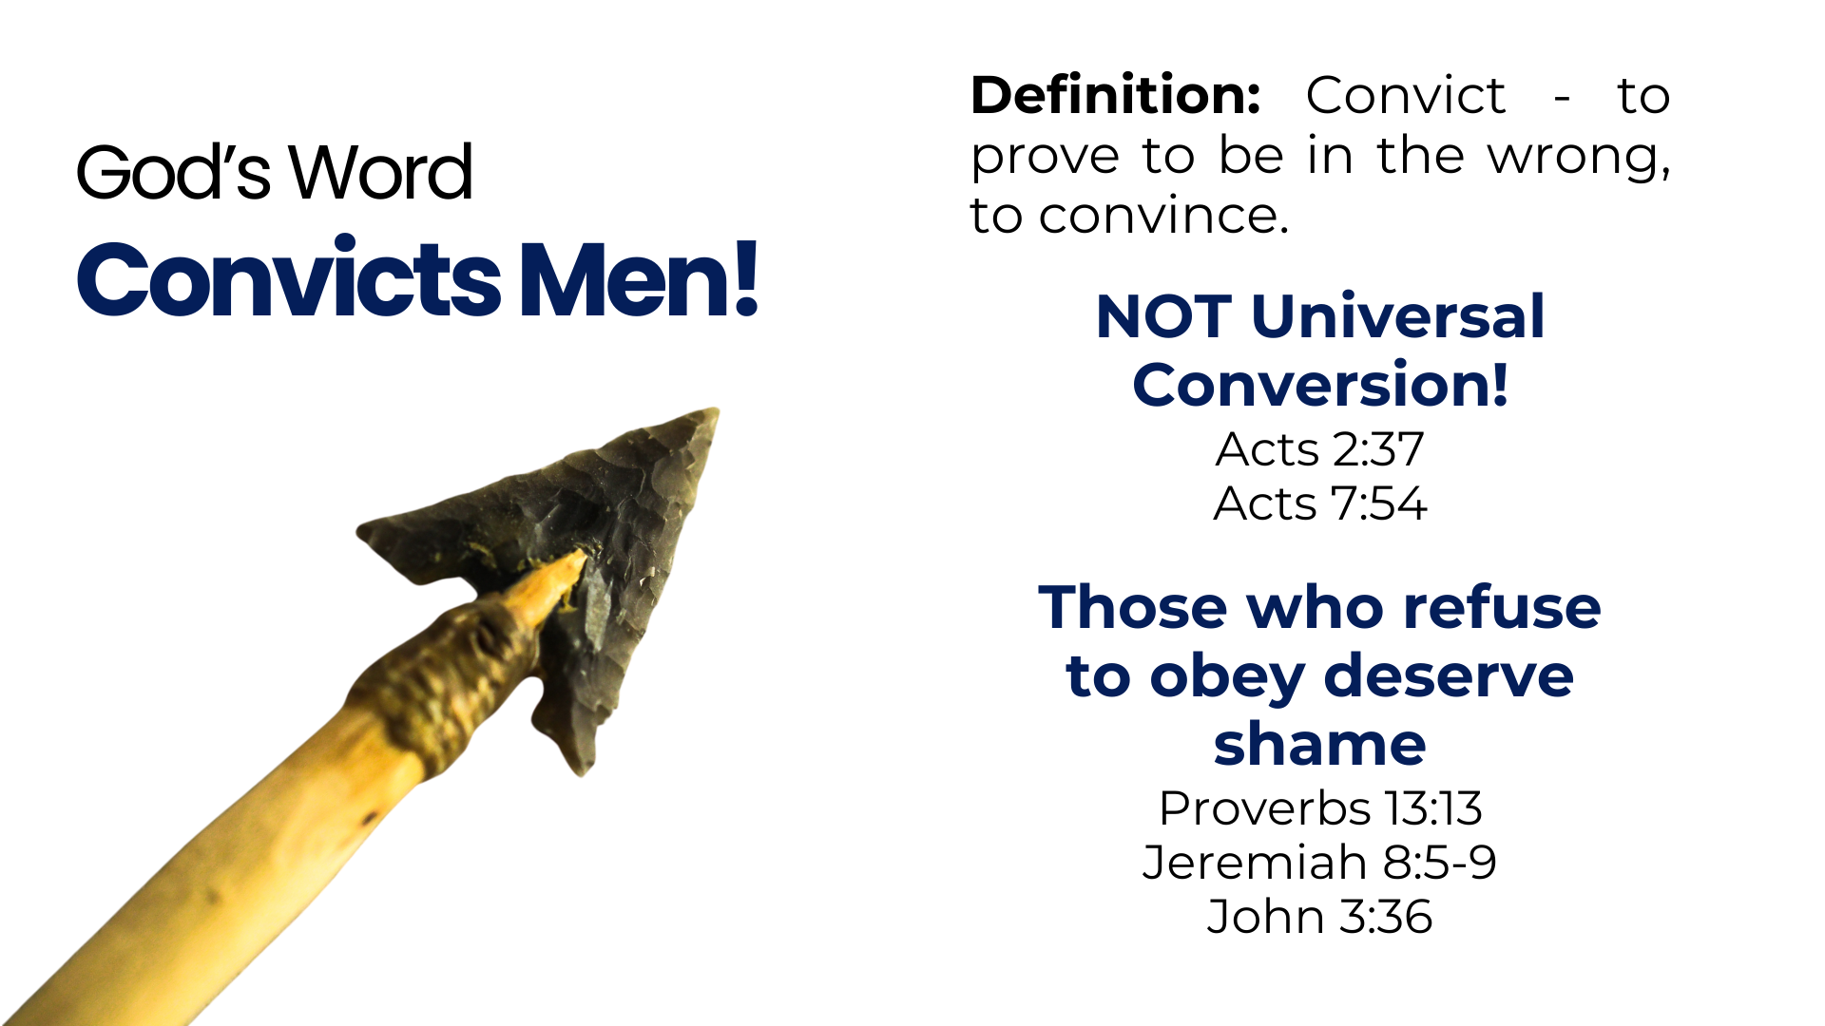
Notes:
Third, God's word has the ability to scratch, prick, convict the sinner
Definition: Convict - (ex-el-eng'-kho) - to prove to be in the wrong, to convince.
Note, this does not mean that it will convert everyone!
Acts 2:37 Now when they heard this, they were cut to the heart, and said to Peter and the rest of the apostles, "Men and brethren, what shall we do?"
Acts 7:54 When they heard these things they were cut to the heart, and they gnashed at him with their teeth.
This is free will.
But, it is truth, and those who refuse must suffer consequences, as the Jews in Ezekiel's time. They are shown to be in the wrong, and are worthy of shame!
Proverbs 13:13 He who despises the word will be destroyed, But he who fears the commandment will be rewarded.
Jeremiah 8:5-9 Why has this people slidden back, Jerusalem, in a perpetual backsliding? They hold fast to deceit, They refuse to return. (6) I listened and heard, But they do not speak aright. No man repented of his wickedness, Saying, 'What have I done?' Everyone turned to his own course, As the horse rushes into the battle. (7) "Even the stork in the heavens Knows her appointed times; And the turtledove, the swift, and the swallow Observe the time of their coming. But My people do not know the judgment of the LORD. (8) "How can you say, 'We are wise, And the law of the LORD is with us'? Look, the false pen of the scribe certainly works falsehood. (9) The wise men are ashamed, They are dismayed and taken. Behold, they have rejected the word of the LORD; So what wisdom do they have?
John 3:36 He who believes in the Son has everlasting life; and he who does not believe the Son shall not see life, but the wrath of God abides on him."

Slide 6
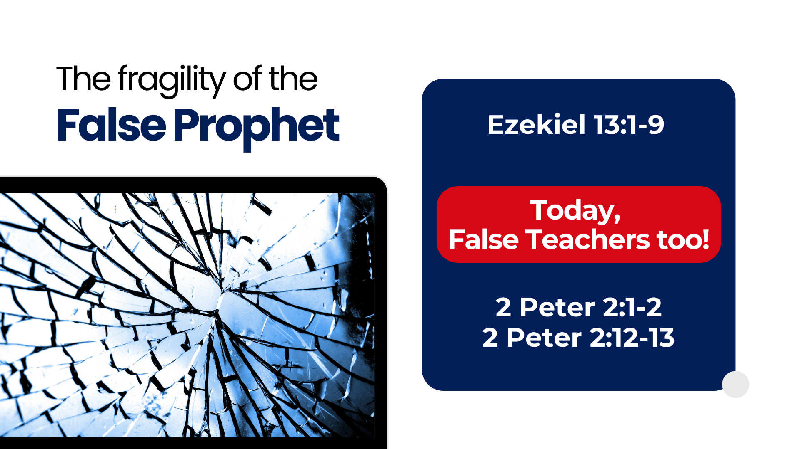
Notes:
Fourth, In contrast, the false prophet is fragile and weak.
Ezekiel 13:1-9 And the word of the LORD came to me, saying, (2) "Son of man, prophesy against the prophets of Israel who prophesy, and say to those who prophesy out of their own heart, 'Hear the word of the LORD!' " (3) Thus says the Lord GOD: "Woe to the foolish prophets, who follow their own spirit and have seen nothing! (4) O Israel, your prophets are like foxes in the deserts. (5) You have not gone up into the gaps to build a wall for the house of Israel to stand in battle on the day of the LORD. (6) They have envisioned futility and false divination, saying, 'Thus says the LORD!' But the LORD has not sent them; yet they hope that the word may be confirmed. (7) Have you not seen a futile vision, and have you not spoken false divination? You say, 'The LORD says,' but I have not spoken." (8) Therefore thus says the Lord GOD: "Because you have spoken nonsense and envisioned lies, therefore I am indeed against you," says the Lord GOD. (9) "My hand will be against the prophets who envision futility and who divine lies; they shall not be in the assembly of My people, nor be written in the record of the house of Israel, nor shall they enter into the land of Israel. Then you shall know that I am the Lord GOD.
Today, the false teacher is described in the same way, with the same condemnation from God
2 Peter 2:1-2 But there were also false prophets among the people, even as there will be false teachers among you, who will secretly bring in destructive heresies, even denying the Lord who bought them, and bring on themselves swift destruction. (2) And many will follow their destructive ways, because of whom the way of truth will be blasphemed.
2 Peter 2:12-13 But these, like natural brute beasts made to be caught and destroyed, speak evil of the things they do not understand, and will utterly perish in their own corruption, (13) and will receive the wages of unrighteousness, as those who count it pleasure to carouse in the daytime...

Slide 7
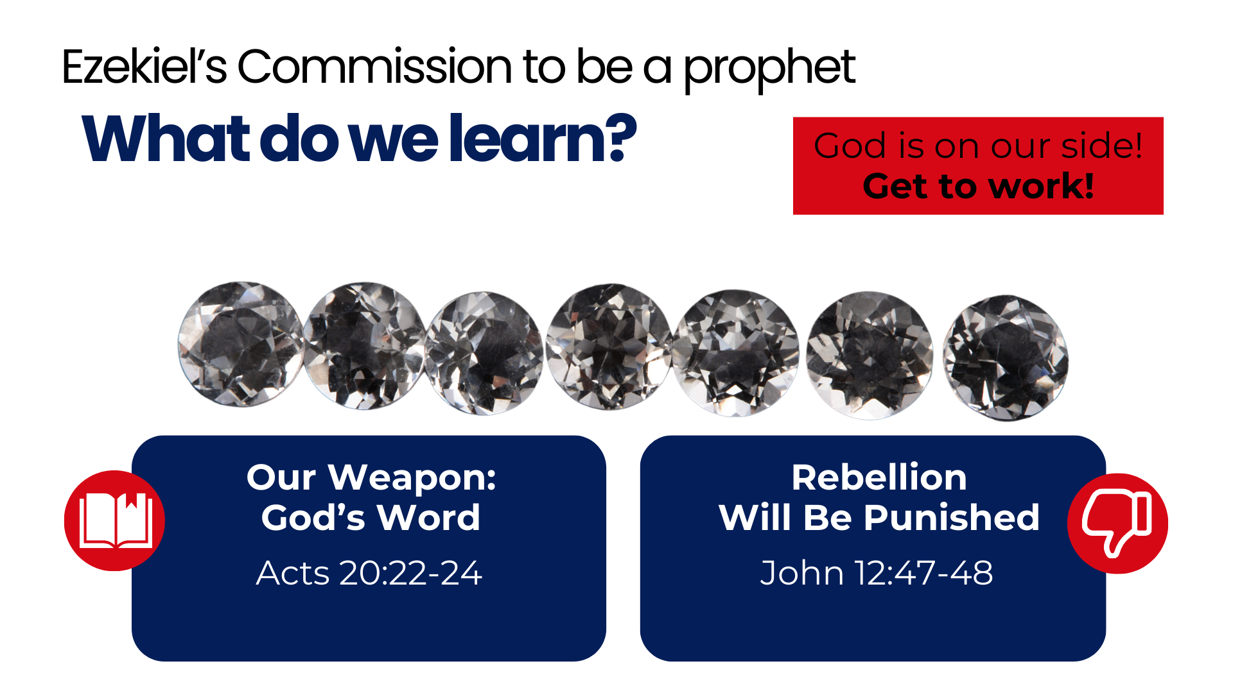
Notes:
CONCLUSION:
What Ezekiel's commission as a prophet teaches us!
God is on our side!
He expects us to get to work!
Our weapon is the word of God!
Acts 20:22-24 And see, now I go bound in the spirit to Jerusalem, not knowing the things that will happen to me there, (23) except that the Holy Spirit testifies in every city, saying that chains and tribulations await me. (24) But none of these things move me; nor do I count my life dear to myself, so that I may finish my race with joy, and the ministry which I received from the Lord Jesus, to testify to the gospel of the grace of God.
Rebelliousness to God will be punished!
John 12:47-48 And if anyone hears My words and does not believe, I do not judge him; for I did not come to judge the world but to save the world. (48) He who rejects Me, and does not receive My words, has that which judges him—the word that I have spoken will judge him in the last day.

