Slide 1
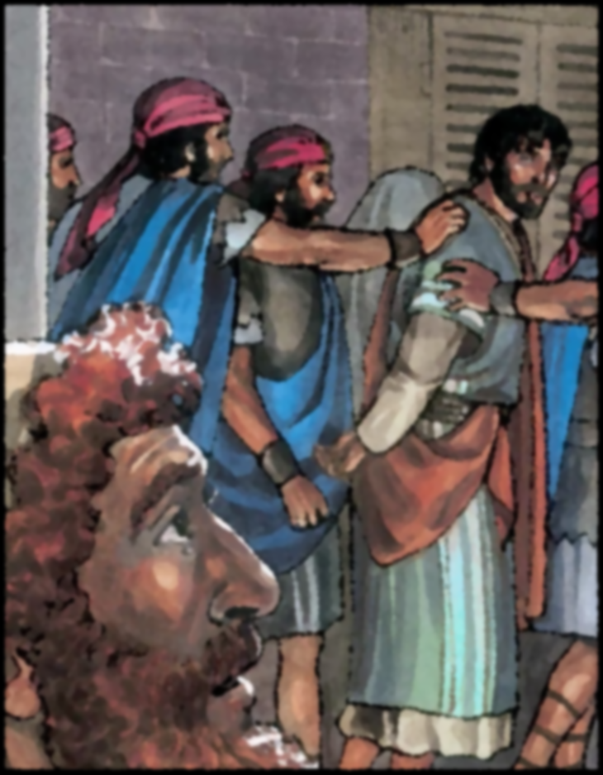
“And the Lord turned and looked at Peter” ( Luke 22 : 61)
Notes:
(Luke 22:31-34), “And the Lord said, “Simon, Simon! Indeed, Satan has asked for you, that he may sift you as wheat. ³² But I have prayed for you, that your faith should not fail; and when you have returned to Me, strengthen your brethren.” ³³ But he said to Him, “Lord, I am ready to go with You, both to prison and to death.” ³⁴ Then He said, “I tell you, Peter, the rooster shall not crow this day before you will deny three times that you know Me.”
(Luke 22:54-62), “Having arrested Him, they led Him and brought Him into the high priest's house. But Peter followed at a distance. ⁵⁵ Now when they had kindled a fire in the midst of the courtyard and sat down together, Peter sat among them. ⁵⁶ And a certain servant girl, seeing him as he sat by the fire, looked intently at him and said, “This man was also with Him.” ⁵⁷ But he denied Him, saying, “Woman, I do not know Him.” ⁵⁸ And after a little while another saw him and said, “You also are of them.” But Peter said, “Man, I am not!” ⁵⁹ Then after about an hour had passed, another confidently affirmed, saying, “Surely this fellow also was with Him, for he is a Galilean.” ⁶⁰ But Peter said, “Man, I do not know what you are saying!” Immediately, while he was still speaking, the rooster crowed. ⁶¹ And the Lord turned and looked at Peter. Then Peter remembered the word of the Lord, how He had said to him, “Before the rooster crows, you will deny Me three times.” ⁶² So Peter went out and wept bitterly.”
Jesus prophesied Peter’s thrice denial
Rooster Crowed
“And the Lord turned and looked at Peter”
Jesus knew, and when he looked at Peter, Peter knew that Jesus knew!
“So Peter went out and wept bitterly” (62)
Do we not realize?
When we sin, Jesus turns and looks at us!
He sees our sin!
Preached at West Side on May 15, 2011 PM
Preached again at West Side on June 5, 2022 at 11am
Prepared from Scratch

Slide 2
Do we seek to avoid Jesus’ Gaze ?
We rationalize our sin (King Saul)
1 Samuel 15
We cover up our sin (King David)
2 Samuel 11 & 12
We lie about our sin (Ananias & Sapphira)
Acts 5
We hide our sin (Achan)
Joshua 7
Notes:
Do we seek to avoid the gaze of our Lord?
How might we seek to do so? Consider these examples from scripture
King Saul sought to rationalize his sin. (Thus justifying himself).
The sin
(1 Samuel 15:7-9), “And Saul attacked the Amalekites, from Havilah all the way to Shur, which is east of Egypt. ⁸ He also took Agag king of the Amalekites alive, and utterly destroyed all the people with the edge of the sword. ⁹ But Saul and the people spared Agag and the best of the sheep, the oxen, the fatlings, the lambs, and all that was good, and were unwilling to utterly destroy them. But everything despised and worthless, that they utterly destroyed.”
The admonition (from Samuel)
(1 Samuel 15:18-19), “Now the Lord sent you on a mission, and said, ‘Go, and utterly destroy the sinners, the Amalekites, and fight against them until they are consumed.’ ¹⁹ Why then did you not obey the voice of the Lord? Why did you swoop down on the spoil, and do evil in the sight of the Lord?”
The rationalization
(1 Samuel 15:20-21), “And Saul said to Samuel, “But I have obeyed the voice of the Lord, and gone on the mission on which the Lord sent me, and brought back Agag king of Amalek; I have utterly destroyed the Amalekites. ²¹ But the people took of the plunder, sheep and oxen, the best of the things which should have been utterly destroyed, to sacrifice to the Lord your God in Gilgal.”
The condemnation (stated by Samuel) It didn’t work!
(1 Samuel 15:22-23), “So Samuel said: “Has the Lord as great delight in burnt offerings and sacrifices, as in obeying the voice of the Lord? Behold, to obey is better than sacrifice, and to heed than the fat of rams. ²³ For rebellion is as the sin of witchcraft, and stubbornness is as iniquity and idolatry. Because you have rejected the word of the Lord, He also has rejected you from being king.”
[CLICK] King David sought to cover up his sin!
The sin
(2 Samuel 11:3-5), “So David sent and inquired about the woman. And someone said, “Is this not Bathsheba, the daughter of Eliam, the wife of Uriah the Hittite?” ⁴ Then David sent messengers, and took her; and she came to him, and he lay with her, for she was cleansed from her impurity; and she returned to her house. ⁵ And the woman conceived; so she sent and told David, and said, “I am with child.”
The attempted cover up
(2 Samuel 11:12-13), “Then David said to Uriah, “Wait here today also, and tomorrow I will let you depart.” So Uriah remained in Jerusalem that day and the next. ¹³ Now when David called him, he ate and drank before him; and he made him drunk. And at evening he went out to lie on his bed with the servants of his lord, but he did not go down to his house.”
Since he could not get Uriah to have relations with Bathsheba, David compounded his sin by having him killed in battle.
The uncovering of David’s sin by Nathan
(2 Samuel 12:7-9), “Then Nathan said to David, “You are the man! Thus says the Lord God of Israel: ‘I anointed you king over Israel, and I delivered you from the hand of Saul. ⁸ I gave you your master's house and your master's wives into your keeping, and gave you the house of Israel and Judah. And if that had been too little, I also would have given you much more! ⁹ Why have you despised the commandment of the Lord, to do evil in His sight? You have killed Uriah the Hittite with the sword; you have taken his wife to be your wife, and have killed him with the sword of the people of Ammon.”
The consequences of the sin
(2 Samuel 12:10), “Now therefore, the sword shall never depart from your house, because you have despised Me, and have taken the wife of Uriah the Hittite to be your wife.”
Also, the child conceived by their adultery became ill and died (12:18)
[CLICK] Ananias and Sapphira outright lied about their sin!
First, Ananias was caught in his lie by the Holy Spirit
(Acts 5:1-5), “But a certain man named Ananias, with Sapphira his wife, sold a possession. ² And he kept back part of the proceeds, his wife also being aware of it, and brought a certain part and laid it at the apostles’ feet. ³ But Peter said, “Ananias, why has Satan filled your heart to lie to the Holy Spirit and keep back part of the price of the land for yourself? ⁴ While it remained, was it not your own? And after it was sold, was it not in your own control? Why have you conceived this thing in your heart? You have not lied to men but to God.” ⁵ Then Ananias, hearing these words, fell down and breathed his last. So great fear came upon all those who heard these things.”
Then, His wife Sapphira was likewise caught and punished.
(Acts 5:7-11), “Now it was about three hours later when his wife came in, not knowing what had happened. ⁸ And Peter answered her, “Tell me whether you sold the land for so much?” She said, “Yes, for so much.” ⁹ Then Peter said to her, “How is it that you have agreed together to test the Spirit of the Lord? Look, the feet of those who have buried your husband are at the door, and they will carry you out.” ¹⁰ Then immediately she fell down at his feet and breathed her last. And the young men came in and found her dead, and carrying her out, buried her by her husband. ¹¹ So great fear came upon all the church and upon all who heard these things.”
[CLICK] Achan, literally, tried to hide his sin!
The sin
(Joshua 7:1), “But the children of Israel committed a trespass regarding the accursed things, for Achan the son of Carmi, the son of Zabdi, the son of Zerah, of the tribe of Judah, took of the accursed things; so the anger of the Lord burned against the children of Israel.
The sin uncovered and confessed
(Joshua 7:20-22), “And Achan answered Joshua and said, “Indeed I have sinned against the Lord God of Israel, and this is what I have done: ²¹ When I saw among the spoils a beautiful Babylonian garment, two hundred shekels of silver, and a wedge of gold weighing fifty shekels, I coveted them and took them. And there they are, hidden in the earth in the midst of my tent, with the silver under it.” ²² So Joshua sent messengers, and they ran to the tent; and there it was, hidden in his tent, with the silver under it.”
The consequences of the sin!
(Joshua 7:25-26), “And Joshua said, “Why have you troubled us? The Lord will trouble you this day.” So all Israel stoned him with stones; and they burned them with fire after they had stoned them with stones. ²⁶ Then they raised over him a great heap of stones, still there to this day. So the Lord turned from the fierceness of His anger. Therefore the name of that place has been called the Valley of Achor to this day.”

Slide 3
Conclusion
No matter how you try to hide it, “Your sin will find you out” (Numbers 32:23)
At least figuratively, when you sin, like Peter, the Lord turns and looks at you.
Consider that, the next time temptation besets you.
Notes:
Conclusion
No matter how you try to hide it, “Your sin will find you out” (Numbers 32:23)
At least figuratively, when you sin, like Peter, the Lord turns and looks at you.
Consider that, the next time temptation besets you.

