Slide 1
Anger Wrath
and
Bible teaching on the importance of controlling your anger!
Notes:
Perhaps you have some similar examples to these actual situations among Christians:
Two brethren had a fist fight in the church building as a result of their differences.
An elder and his wife both lose control to the point of shouting and shaking fingers in the face of others.
A former preacher made a threat of violence on a faithful brother in a business meeting.
Sadder still is the fact that in each case, those supposed “Christians” not only justified their ungodly actions, but were joined by others who justified them as well. The sinful anger and wrath has been given the benign label of “intensity” or “frustration” or some other term rather than what it really is – SIN.
The Bible has much to say upon the subject of controlling our temper. God repeatedly condemns the one who is quick to anger, but He praises those who let reason predominate over wrath. Let us notice a few examples:
(Note: Based on an article by Harry Osborne, found in “The Spirit’s Sword”, 11/28/2010)

Slide 2
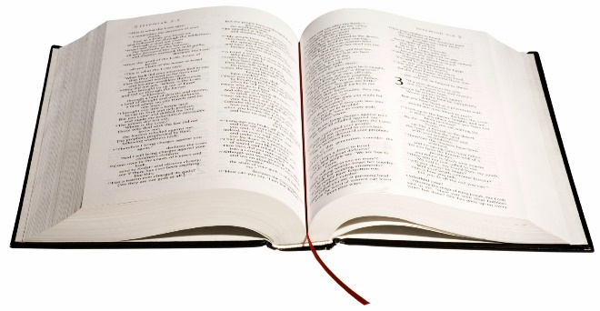
Proverbs 14:29
He who is slow to wrath has great understanding, but he who is impulsive exalts folly.
Notes:
The person who continually flies off the handle does not learn from situations and become wiser, but lingers in ignorance.
The person who controls anger learns something from every occasion that will make him a better person.

Slide 3
Proverbs 29:22
An angry man stirs up strife, and a furious man abounds in transgression.
Notes:
An anger which is not controlled always brings other sins along with it.
The fury of one so driven by anger leads him to do many things that more rational thought would have prevented.

Slide 4
Matthew 5:22
But I say to you that whoever is angry with his brother without a cause shall be in danger of the judgment. And whoever says to his brother, 'Raca! ' shall be in danger of the council. But whoever says, 'You fool! ' shall be in danger of hell fire.
Notes:
Unreasonable anger is not only foolish, but will cause one to lose his soul.
The rash words vented in anger are not a harmless release of steam, but an evidence of sin which will cause one to spend eternity with the devil in hell.

Slide 5
Ephesians 4:26, 31
“‘Be angry, and do not sin’: do not let the sun go down on your wrath” …
“Let all bitterness, wrath, anger, clamor, and evil speaking be put away from you, with all malice.”
Notes:
Anger should not be allowed to dwell in one’s heart and fester into raging wrath.
It must be pushed out of the heart immediately “with all malice” never to return again. That means today and not tomorrow!
Giving more time to a wrathful person in hopes of peace being achieved will only guarantee future outbursts, less peace and the loss of souls.

Slide 6
Proverbs 22:24-25
Make no friendship with an angry man, and with a furious man do not go, ²⁵ lest you learn his ways and set a snare for your soul.
Notes:
Not only does the unbridled wrath of an angry man bring trouble to himself, it also brings great turmoil for those who would associate with such a person.
Thus, God instructs us to keep our distance from a wrathful person lest we suffer from the fallout of his fiery temper.

Slide 7
Proverbs 17:27
He who has knowledge spares his words, and a man of understanding is of a calm spirit.
Notes:
Usually, a rash temper and constant talker occupy the same body.
The traits prevent one from gaining understanding.
The wrathful man is often the same one who engages in filibuster to justify self instead of opening the Scripture and calmly discussing differences.

Slide 8
Proverbs 16:32
He who is slow to anger is better than the mighty, and he who rules his spirit than he who takes a city.
Notes:
Patience and an even temper will aid us far more than strength in this life.
More importantly, such a demeanor is necessary to please God and share an eternal home in heaven with Him!
(2 Peter 1:10-11), (Adding Christian graces/correct demeanor) “Therefore, brethren, be even more diligent to make your call and election sure, for if you do these things you will never stumble; 11 for so an entrance will be supplied to you abundantly into the everlasting kingdom of our Lord and Savior Jesus Christ.”

Slide 9
Proverbs 19:11
The discretion of a man makes him slow to anger, and his glory is to overlook a transgression.
Notes:
A patient man of wisdom recognizes that it is often best to suffer a wrong in silence.
He does not try to retaliate for perceived wrongs done to him.
Vengeance only works to make a bad situation worse by increasing hostility.

Slide 10
Ecclesiastes 7:9
Do not hasten in your spirit to be angry, for anger rests in the bosom of fools.
Notes:
Plain enough, isn’t it?

Slide 11
Conclusion
Instead of being rash, the Bible instructs us to follow a different path.
James 1:19-21
Notes:
(James 1:19-21), “So then, my beloved brethren, let every man be swift to hear, slow to speak, slow to wrath; ²⁰ for the wrath of man does not produce the righteousness of God. ²¹ Therefore lay aside all filthiness and overflow of wickedness, and receive with meekness the implanted word, which is able to save your souls.
Both men and women are challenged by this command. (Churches have been destroyed by both genders). May we be slow to wrath!

