Slide 1
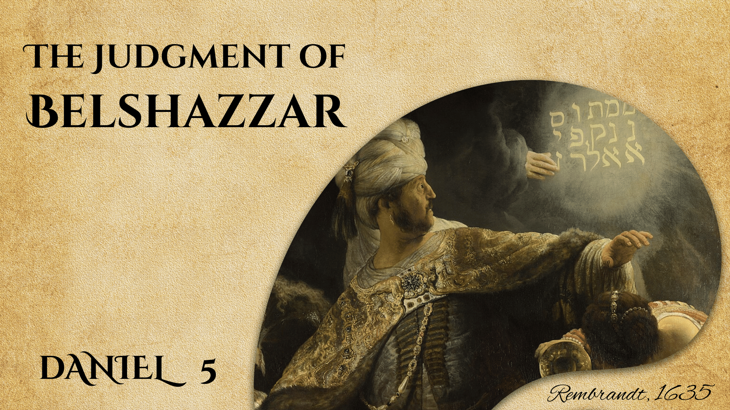

Slide 2

THE HANDWRITING
ON THE WALL
The Feast (5:1-4)
The Writing on the Wall (5:5-9)
The Consultation of Daniel (5:13-17)
The Interpretation of the Vision (5:22-28)
The Result (5:30-31)

Slide 3

The Judgment of BELSHAZZAR
The Circumstances of the Judgment
2 Kings 19:5-7; Isaiah 37:38; Luke 12:16-21
1 Thessalonians 5:2-3; Daniel 5:4; Matthew 24:37-39
The Form of the Judgment
1 Corinthians 4:5; 1 Kings 19:11-13; Daniel 5:26-28
Mark 16:15-16; 2 Thessalonians 1:7-9
The Effect of the Judgment
Daniel 5:6; Isaiah 6:1-7
Hebrews 10:28-31

Slide 4
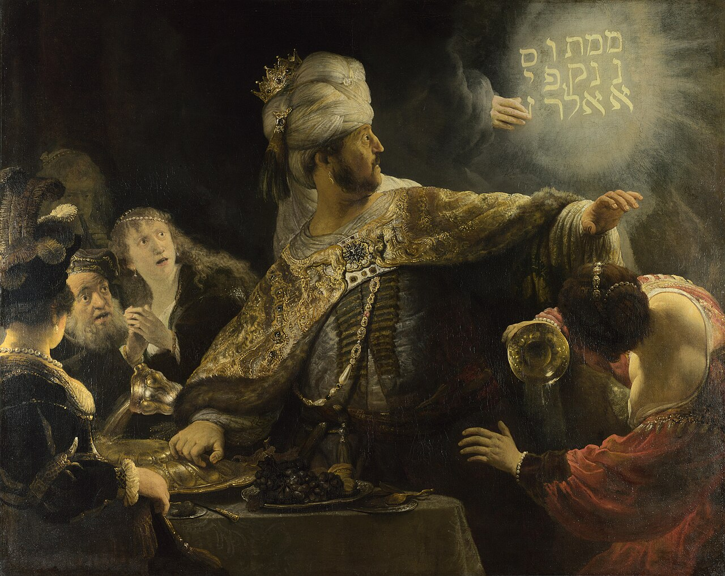
CONCLUSION
As of today, it is not too late to respond to good counsel regarding the coming judgment!
2 Corinthians 6:1-2

