Slide 1
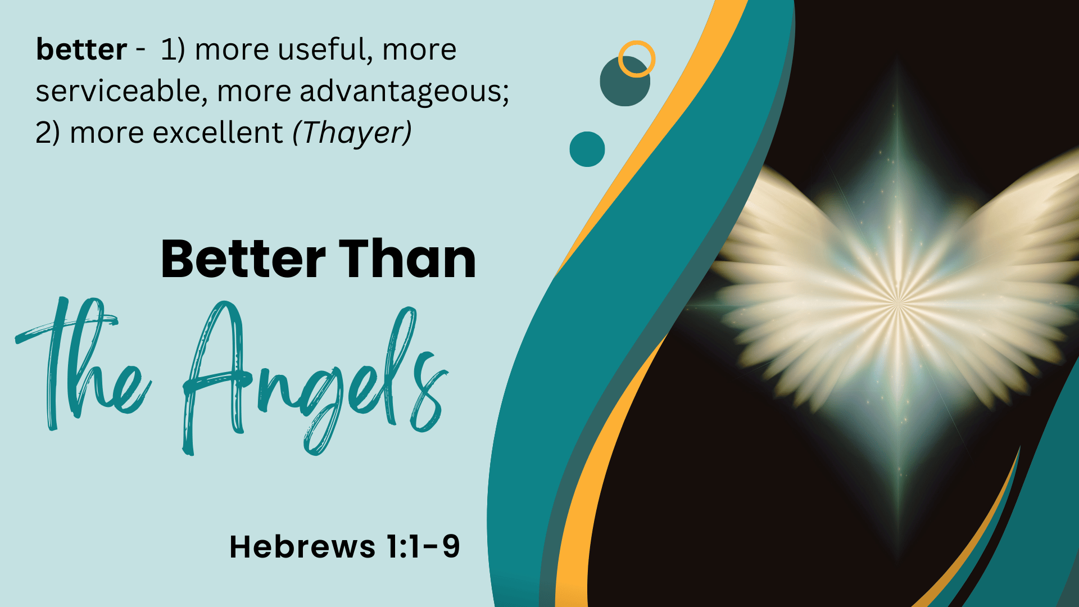
Notes:
Better Than the Angels
(Hebrews 1:1-9)
Introduction:
Note: Our reading, which is actually today's reading on our schedule, has a bit of an arbitrary stopping point because of the nature of the schedule. The complete context goes through tomorrow and covers the entire chapter. However, we will spend our time only in examining the first 9 verses.
A number of years ago we had a very beneficial ladies Bible class on the book of Hebrews
We used the classbook by Ferrell Jenkins "Better Things" (A Workbook on Hebrews)
Using this idea of constructing a study of the book of Hebrews is a helpful approach to studying it.
Consider a portion of the NKJV intro to the book (written by a man)
"Many Jewish believers, having stepped out of Judaism into Christianity, want to reverse their course in order to escape persecution by their countrymen. The writer of Hebrews exhorts them to “go on unto perfection” (6:1). His appeal is based on the superiority of Christ over the Judaic system. Christ is better than the angels, for they worship Him. He is better than Moses, for He created him. He is better than the Aaronic priesthood, for His sacrifice was once for all time. He is better than the law, for He mediates a better covenant. In short, there is more to be gained in Christ than to be lost in Judaism."
The word "better" is explicitly used 12 times in the book
1:4 better than the angels (Christ VS Angels)
6:9 "better things concerning you" (Things that accompany salvation VS Apostasy)
7:7 the lesser is blessed by the better (Priesthood of Melchizedek VS Priesthood of Aaron)
7:19 better hope (God's favor in Israel VS God's eternal hope of heaven)
7:22 better covenant (New Covenant VS Old Covenant)
8:6 better covenant; better promises (New Covenant VS Old Covenant; Physical VS Spiritual promises)
9:23 better sacrifices (Christ as the Lamb of God VS Animal Sacrifices)
10:34 better and an enduring possession for yourselves in heaven. (Heaven VS Physical possessions)
11:16 better, that is, a heavenly country (Heaven VS Canaan)
11:35 better resurrection (Eternal resurrection to life VS Temporary physical resurrection)
11:40 better for us (something provided by God. An eternal reward faithful Jews waited on)
12:24 better things that that of Abel (Christ's blood [mercy] VS Abel's blood [vengeance, cf Genesis 4:10)
Definition: better (kreittōn, krite'-tohn) - stronger, nobler, best, better. (Strong)
1) more useful, more serviceable, more advantageous; 2) more excellent
(Thayer)

Slide 2
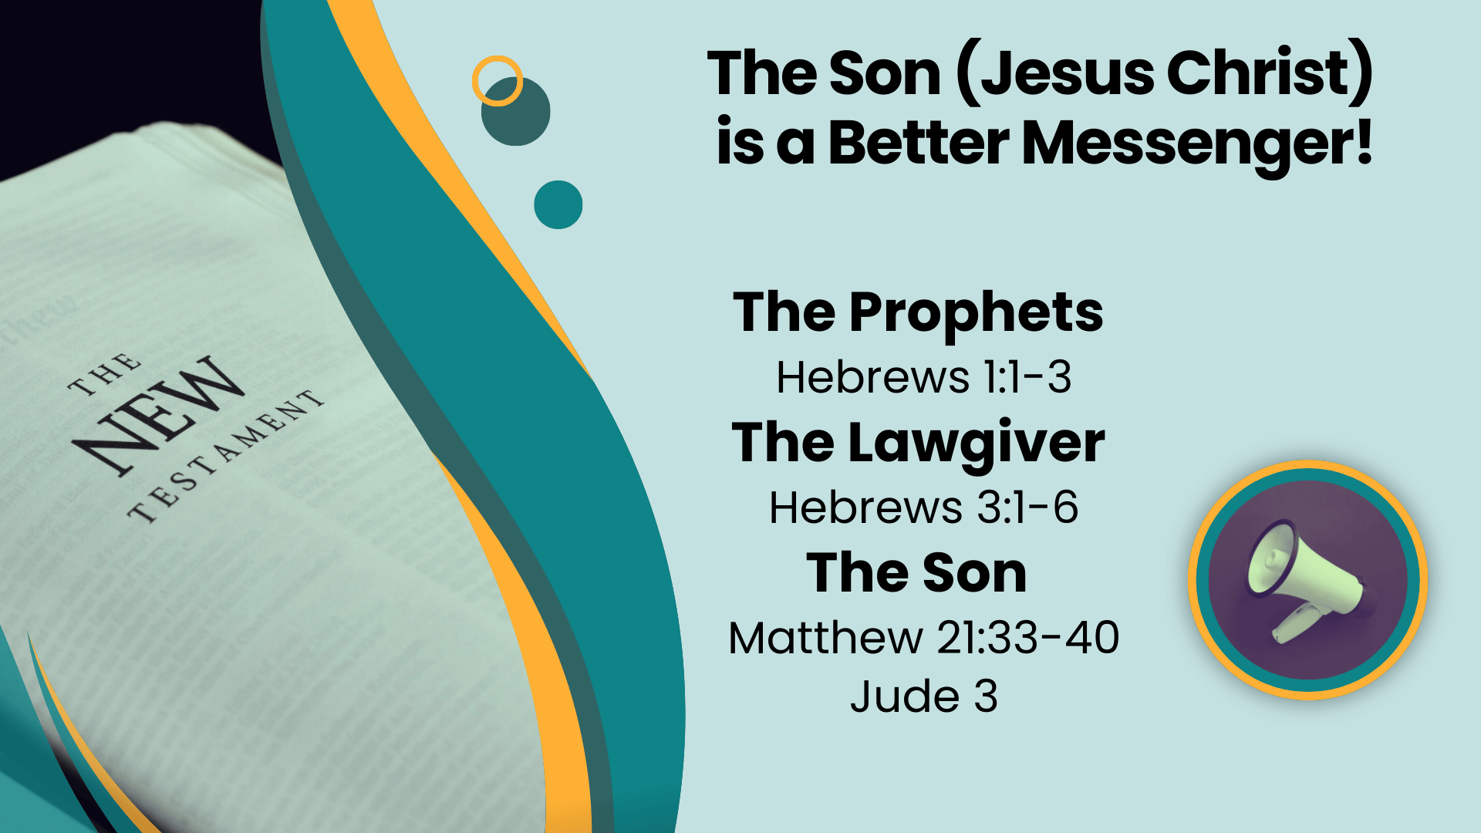
Notes:
The Son (Jesus Christ) is a better messenger than those who came before. (1-3)
Hebrews 1:1-3 God, who at various times and in various ways spoke in time past to the fathers by the prophets, (2) has in these last days spoken to us by His Son, whom He has appointed heir of all things, through whom also He made the worlds; (3) who being the brightness of His glory and the express image of His person, and upholding all things by the word of His power, when He had by Himself purged our sins, sat down at the right hand of the Majesty on high,
The Prophets - Those who by inspiration of the Spirit gave the people the law of God
There are over 80 specific instances of Biblical references to those who received messages from God, including 70 elders in Israel (Numbers 11:25); and Philip the Evangelist's four daughters (Acts 21:8-9).
God also promised the Spirit's message to all the apostles
We have the most well known prophesies found in Isaiah, Jeremiah, Ezekiel & Daniel. As well as the writings of the 12 minor prophets.
However, there was something different about Jesus
Hebrews 3:1-6 Therefore, holy brethren, partakers of the heavenly calling, consider the Apostle and High Priest of our confession, Christ Jesus, (2) who was faithful to Him who appointed Him, as Moses also was faithful in all His house. (3) For this One has been counted worthy of more glory than Moses, inasmuch as He who built the house has more honor than the house. (4) For every house is built by someone, but He who built all things is God. (5) And Moses indeed was faithful in all His house as a servant, for a testimony of those things which would be spoken afterward, (6) but Christ as a Son over His own house, whose house we are if we hold fast the confidence and the rejoicing of the hope firm to the end.
As the only begotten of the Father, He is both God's preeminent messenger, and also the last one sent by God!
"In these last days spoken to us by His Son" (2)
Matthew 21:33-40 "Hear another parable: There was a certain landowner who planted a vineyard and set a hedge around it, dug a winepress in it and built a tower. And he leased it to vinedressers and went into a far country. (34) Now when vintage-time drew near, he sent his servants to the vinedressers, that they might receive its fruit. (35) And the vinedressers took his servants, beat one, killed one, and stoned another. (36) Again he sent other servants, more than the first, and they did likewise to them. (37) Then last of all he sent his son to them, saying, 'They will respect my son.' (38) But when the vinedressers saw the son, they said among themselves, 'This is the heir. Come, let us kill him and seize his inheritance.' (39) So they took him and cast him out of the vineyard and killed him. (40) "Therefore, when the owner of the vineyard comes, what will he do to those vinedressers?"
The Pharisees knew Jesus spoke of them, in rejecting His words. They rejected Jesus, who was the chief cornerstone chosen by God!
Note: Any who claim a new prophet will come bringing a new message are wrong! (Mohammed, Joseph Smith, Mary Baker Eddy, etc.) Jesus came last! Once His word was confirmed and spread (the perfect law of liberty), it is silly for us to look for another!
Jude 3 Beloved, while I was very diligent to write to you concerning our common salvation, I found it necessary to write to you exhorting you to contend earnestly for the faith which was once for all delivered to the saints.

Slide 3
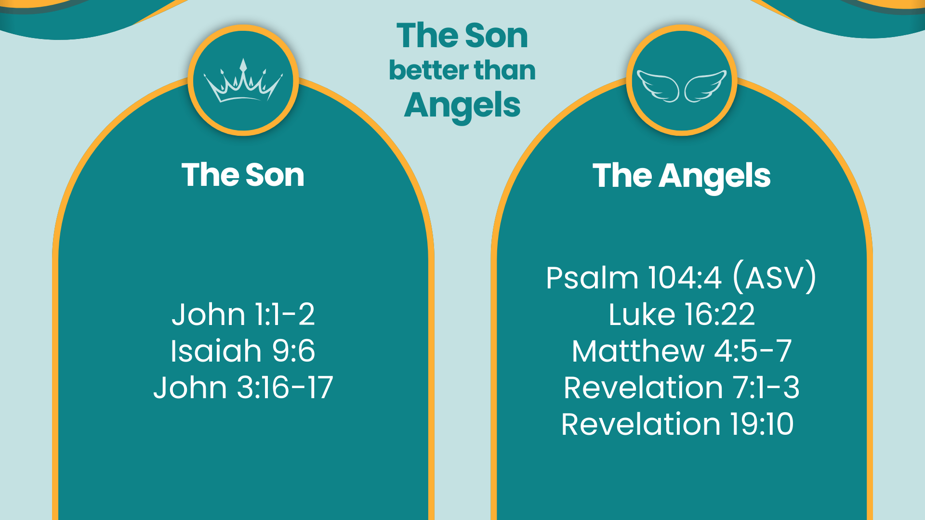
Notes:
The Son (Jesus Christ) is better than the angels
Hebrews 1:4-8 having become so much better than the angels, as He has by inheritance obtained a more excellent name than they. (5) For to which of the angels did He ever say: "YOU ARE MY SON, TODAY I HAVE BEGOTTEN YOU"? And again: "I WILL BE TO HIM A FATHER, AND HE SHALL BE TO ME A SON"? (6) But when He again brings the firstborn into the world, He says: "LET ALL THE ANGELS OF GOD WORSHIP HIM." (7) And of the angels He says: "WHO MAKES HIS ANGELS SPIRITS AND HIS MINISTERS A FLAME OF FIRE." (8) But to the Son He says: "YOUR THRONE, O GOD, IS FOREVER AND EVER; A SCEPTER OF RIGHTEOUSNESS IS THE SCEPTER OF YOUR KINGDOM."
Christ's Inheritance - A more excellent name
It is wrong to consider a unique Individual to be as the host of Heaven
Jesus Christ is God's Son, His only Begotten. I.e. Family - who was in the beginning with God!
John 1:1-2 In the beginning was the Word, and the Word was with God, and the Word was God. (2) He was in the beginning with God.
Jesus is Divine (Deity) The angels, while spiritual beings, are NOT!
Isaiah 9:6 For unto us a Child is born, Unto us a Son is given; And the government will be upon His shoulder. And His name will be called Wonderful, Counselor, Mighty God, Everlasting Father, Prince of Peace.
Jesus is God's Son! He has proclaimed it of Jesus, none other!
John 3:16-17 For God so loved the world that He gave His only begotten Son, that whoever believes in Him should not perish but have everlasting life. (17) For God did not send His Son into the world to condemn the world, but that the world through Him might be saved.
cf. The references (prophecies) in our text (Psalm 2:7; 2 Samuel 7:14)
In contrast note the description the Hebrew writer gives to the angels
Hebrews 1:7 And of the angels He says: "WHO MAKES HIS ANGELS SPIRITS AND HIS MINISTERS A FLAME OF FIRE."
This text (taken from Psalm 104) is a praise to God as the Creator. Angels are both created, and created for a specific purpose
Angels (described as the term is primarily used in scriptrue) - The word angel is applied in Scripture to an order of supernatural or heavenly beings whose business it is to act as God's messengers to men, and as agents who carry out His will. (International Standard Bible Encyclopedia)
Winds and Flames of Fire
Psalms 104:4 [ASV] Who maketh winds his messengers; Flames of fire his ministers;
This is an apt description of angels, as the Hebrew writer rightly ascribes them in our text.
The key for us here is the idea that these beings were created by God to be his messengers, and to serve him.
Four living creatures of Revelation 4. The angels performing the commands of God over creation in Revelation. The angels sent to Lot, and to Israel, and to Joseph and Mary, etc. to bring messages from God. BUT THE KEY IS THAT THEY ARE SERVANTS! NOT THE SON!
They took Lazarus to Paradise
Luke 16:22 And it came to pass, that the beggar died, and that he was carried away by the angels into Abraham's bosom: and the rich man also died, and was buried.
The were ready if summoned to save the Son from physical peril at His temptation
Matthew 4:5-7 Then the devil took Him up into the holy city, set Him on the pinnacle of the temple, (6) and said to Him, "If You are the Son of God, throw Yourself down. For it is written: 'HE SHALL GIVE HIS ANGELS CHARGE OVER YOU,' and, IN THEIR HANDS THEY SHALL BEAR YOU UP, LEST YOU DASH YOUR FOOT AGAINST A STONE.' " (7) Jesus said to him, "It is written again, 'YOU SHALL NOT TEMPT THE LORD YOUR GOD.' "
They performed God's chastisement in the book of Revelation
Revelation 7:1-3 After these things I saw four angels standing at the four corners of the earth, holding the four winds of the earth, that the wind should not blow on the earth, on the sea, or on any tree. (2) Then I saw another angel ascending from the east, having the seal of the living God. And he cried with a loud voice to the four angels to whom it was granted to harm the earth and the sea, (3) saying, "Do not harm the earth, the sea, or the trees till we have sealed the servants of our God on their foreheads."
Unlike the Son, they were not to be worshipped as God
Revelation 19:10 [John's angelic instructor] And I fell at his feet to worship him. But he said to me, "See that you do not do that! I am your fellow servant, and of your brethren who have the testimony of Jesus. Worship God! For the testimony of Jesus is the spirit of prophecy."

Slide 4
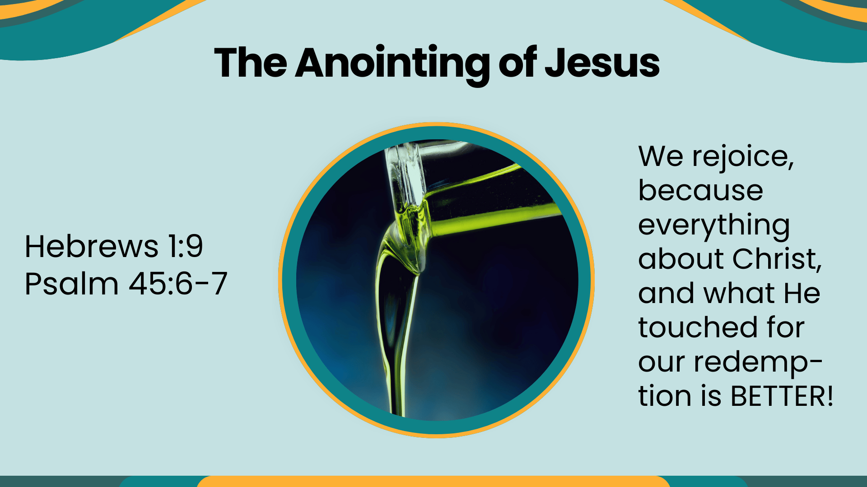
Notes:
Hebrews 1:9 YOU HAVE LOVED RIGHTEOUSNESS AND HATED LAWLESSNESS; THEREFORE GOD, YOUR GOD, HAS ANOINTED YOU WITH THE OIL OF GLADNESS MORE THAN YOUR COMPANIONS."
This passage a quotation from Psalm 45:6,7 a love song by the Psalmist to the coming Messiah
Psalms 45:6-7 Your throne, O God, is forever and ever; A scepter of righteousness is the scepter of Your kingdom. (7) You love righteousness and hate wickedness; Therefore God, Your God, has anointed You With the oil of gladness more than Your companions.
For us, God chose the Son, Jesus to make Lord of Lord and King of Kings
Because of His justness and mercy. He has been given an annointing, "with the oil of gladness MORE THAN [His] COMPANIONS"
We rejoice, because everything about Christ, and what He touched for our redemption is BETTER! Amen

