Slide 1
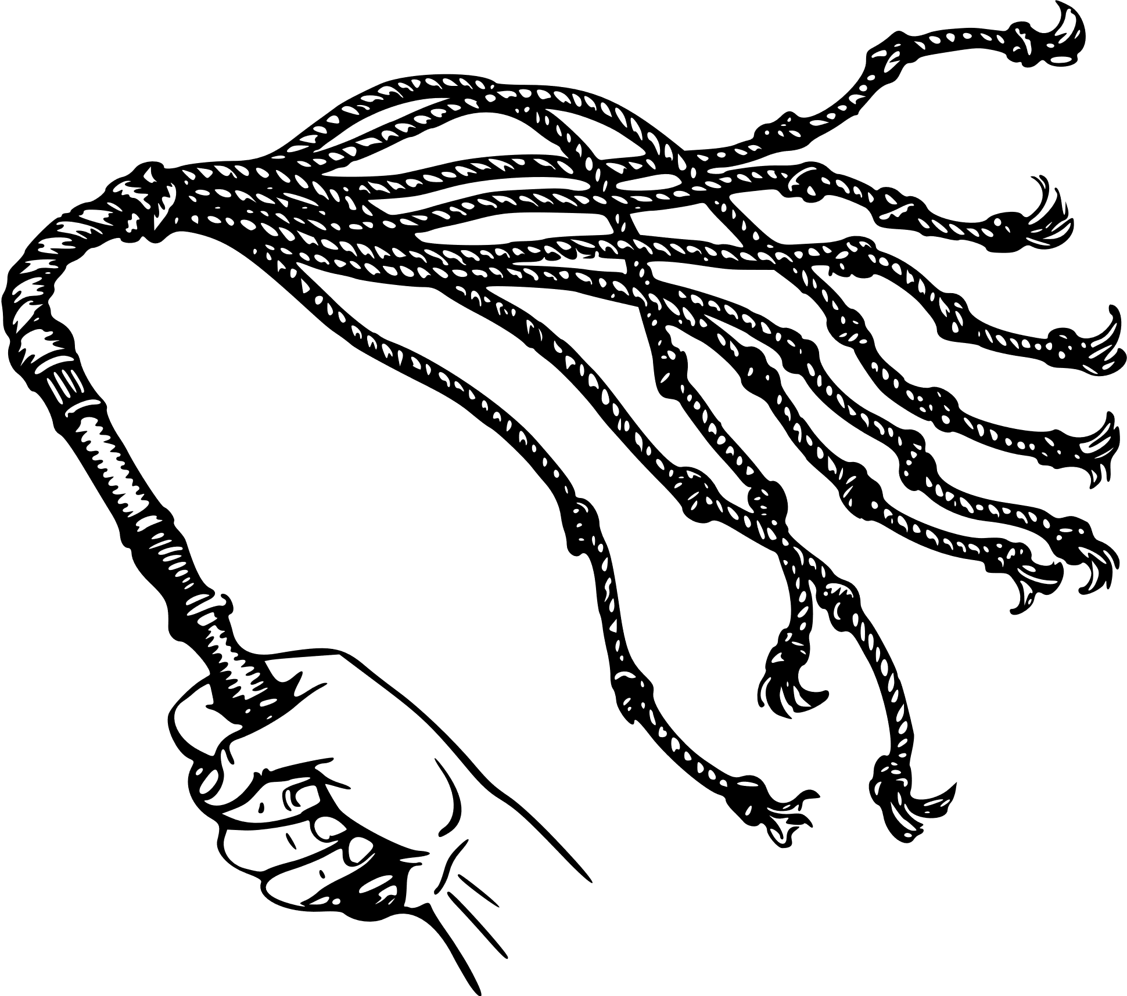
“By whose stripes you were healed”
1 Peter 2:18-25
Notes:
Introduction:
Peter’s admonitions (like Paul and the other New Testament writers) are bound up in the reality of what God has done for us.
(1 Peter 2:18-25), “Servants, be submissive to your masters with all fear, not only to the good and gentle, but also to the harsh. ¹⁹ For this is commendable, if because of conscience toward God one endures grief, suffering wrongfully. ²⁰ For what credit is it if, when you are beaten for your faults, you take it patiently? But when you do good and suffer, if you take it patiently, this is commendable before God. ²¹ For to this you were called, because Christ also suffered for us, leaving us an example, that you should follow His steps: ²² “Who committed no sin, Nor was deceit found in His mouth”; ²³ who, when He was reviled, did not revile in return; when He suffered, He did not threaten, but committed Himself to Him who judges righteously; ²⁴ who Himself bore our sins in His own body on the tree, that we, having died to sins, might live for righteousness—by whose stripes you were healed. ²⁵ For you were like sheep going astray, but have now returned to the Shepherd and Overseer of your souls.”
Why are servants to be submissive toward masters?
Why are we to endure patiently when we suffer for doing good?
It is because we were called to do this!
Called (Thayer, regarding the term as used in 1 Peter 2:21) “only those are spoken of as called by God who have listened to his voice addressed to them in the gospel, hence those who have enlisted in the service of Christ”
We are called in the gospel, and in responding we enter into a relationship with Jesus Christ
As Christians, we benefit from His shed blood, and victory over death.
Again and again, scripture calls us to a life of obedience, and service to God and man.
(1 Peter 3:8-9), “Finally, all of you be of one mind, having compassion for one another; love as brothers, be tenderhearted, be courteous; ⁹ not returning evil for evil or reviling for reviling, but on the contrary blessing, knowing that you were called to this, that you may inherit a blessing.”
I want us to consider especially verses 21-25, to see the full import of Jesus’ efforts on our behalf!

Slide 2
“Christ also suffered for us”
He was reviled (23)
Isaiah 53:7; Matthew 26:59-64; 27:11-14
He bore our sins in His own body on the tree (24)
Isaiah 53:8,12; Romans 5:6-9; 1 John 3:16-18
He suffered “stripes” (24)
Isaiah 53:5,7; 6:10
Notes:
“But when you do good and suffer, if you take it patiently, this is commendable before God. ²¹ For to this you were called, because Christ also suffered for us.” (20b-21)
It is a simple principle, Christ’s suffering is an example
As such, it is a commendable thing to bear up under our own trials, just as did the Lord
When Jesus suffered, He “committed no sin, nor was deceit found in His mouth.”
He was reviled (23)
(Isaiah 53:7), “He was oppressed and He was afflicted, yet He opened not His mouth; He was led as a lamb to the slaughter, and as a sheep before its shearers is silent, so He opened not His mouth.”
Definition, revile – (Thayer) “to reproach, rail at, revile, heap abuse upon”
What is typical? When someone rails at you, the typical response is to give as good as you get!
Fistfights, broken friendships and even failed marriages are the typical outcome of such action.
Most obvious example was in the final hours of His life.
At His Jewish trial
(Matthew 26:59-64), “Now the chief priests, the elders, and all the council sought false testimony against Jesus to put Him to death, ⁶⁰ but found none. Even though many false witnesses came forward, they found none. But at last two false witnesses came forward ⁶¹ and said, “This fellow said, ‘I am able to destroy the temple of God and to build it in three days.’ ” ⁶² And the high priest arose and said to Him, “Do You answer nothing? What is it these men testify against You?” ⁶³ But Jesus kept silent. And the high priest answered and said to Him, “I put You under oath by the living God: Tell us if You are the Christ, the Son of God!” ⁶⁴ Jesus said to him, “It is as you said. Nevertheless, I say to you, hereafter you will see the Son of Man sitting at the right hand of the Power, and coming on the clouds of heaven.”
At His Roman trial as well
(Matthew 27:11-14), “Now Jesus stood before the governor. And the governor asked Him, saying, “Are You the King of the Jews?” Jesus said to him, “It is as you say.” ¹² And while He was being accused by the chief priests and elders, He answered nothing. ¹³ Then Pilate said to Him, “Do You not hear how many things they testify against You?” ¹⁴ But He answered him not one word, so that the governor marveled greatly.”
His mistreatment included physical suffering: “when he suffered, he did not threaten, but committed Himself to Him who judges righteously” (23).
He had a crown of thorns placed upon his head. As He hung upon the cross, men heaped abuse.
Through it all, he did not threaten (no threats of retaliation or revenge), though it was within his power!
(He could have brought down more than 12 legions of angels (Matt. 26:53). Literally, more than 88,000)
Our application in example.
How you handle yourself while suffering trials for your faith is an indication of your true character!
(Romans 12:19-21), “Beloved, do not avenge yourselves, but rather give place to wrath; for it is written, “Vengeance is Mine, I will repay,” says the Lord. ²⁰ Therefore “If your enemy is hungry, feed him; if he is thirsty, give him a drink; for in so doing you will heap coals of fire on his head.” ²¹ Do not be overcome by evil, but overcome evil with good.”
[CLICK] He bore our sins in His own body on the tree (24)
(Isaiah 53:8), “He was taken from prison and from judgment, and who will declare His generation? For He was cut off from the land of the living; for the transgressions of My people He was stricken.”
(Isaiah 53:12), “Therefore I will divide Him a portion with the great, and He shall divide the spoil with the strong, because He poured out His soul unto death, and He was numbered with the transgressors, and He bore the sin of many, and made intercession for the transgressors.”
A sacrifice was required to appease God’s wrath against sin, and He delivered the supreme sacrifice for mankind.
There is no way to express the emotional pain Jesus experienced through this humiliation. As the sinless one, he took on the sins of the whole world.
The physical suffering is describable, and itself serves as a wonderful example of selflessness and patience (Remember, He could of avoided it, if He had not determined to do His Father’s will, no matter the cost.
I would encourage you to read the accounts, in Matt. 27; Mark 15; Luke 23; John 19
Crucifixion was invented by the Persians between 300-400 B.C.
One of the most painful deaths ever invented by mankind
The word excruciating comes from the word cruficixion (slow, painful suffering)
Process
The hands (Greek includes wrists) are nailed to the cross piece (patibulum)as Jesus lies on the ground
The cross piece would be raised to the vertical (stipe) which remains permanently in the ground, and the feet would be nailed to the stipe.
The nails were huge, 7 to 9 inches long, and would sever major nerves causing excruciating pain
The weight of His body makes is impossible to exhale without pushing up.
Pushing up was also required to have the air to speak. Each of the words Jesus said while on the cross would have been painful. (Luke 23:34), “Then Jesus said, “Father, forgive them, for they do not know what they do.”
Slow suffocation leads to a build up of Carbon dioxide, damage to the tissues and capillaries, leading to leakage, and a build up of fluid around the heart and lungs.
Finally, after hours of suffering (in Jesus’ case about 6 hours), the heart would arrest.
Such an expression of God’s love for mankind must be reciprocated by us
(Romans 5:6-9), “For when we were still without strength, in due time Christ died for the ungodly. ⁷ For scarcely for a righteous man will one die; yet perhaps for a good man someone would even dare to die. ⁸ But God demonstrates His own love toward us, in that while we were still sinners, Christ died for us. ⁹ Much more then, having now been justified by His blood, we shall be saved from wrath through Him.”
John expressed it well
(1 John 3:16-18), “By this we know love, because He laid down His life for us. And we also ought to lay down our lives for the brethren. ¹⁷ But whoever has this world's goods, and sees his brother in need, and shuts up his heart from him, how does the love of God abide in him? ¹⁸ My little children, let us not love in word or in tongue, but in deed and in truth.”
[CLICK] He suffered “stripes” (24)
Definition – stripes (mōlōps) “ a bruise, wale, or wound that trickles with blood” (Thayer)
It seems Peter is alluding here to the prophet Isaiah’s words
(Isaiah 53:5), “But He was wounded for our transgressions, He was bruised for our iniquities; the chastisement for our peace was upon Him, and by His stripes we are healed.”
Jesus was first mistreated by the Jewish Sanhedrin, then beaten by the guards (Mark 14:65)
Note: If this was a formal punishment, 39 lashes would have been delivered. The limit was 40, as recorded in the Law (cf. Deut. 25:3).
Paul was beaten in this fashion on five different occasions (2 Cor. 11:24).
He was also was abused by the Roman guards who fashioned the crown of thorns, struck him on the head, and spit on him (Mark 15:19)
Pilate ordered Him to be scourged before His crucifixion (Matthew 27:26)
Historians say that the whip was often tipped with bits of lead or stone, making it a brutal slashing weapon. It would rip the skin of the back and legs, shredding it.
(Isaiah 53:7), “He was led as a lamb to the slaughter…”
But, it is by the stripes laid upon our Lord that we “are healed” (24)
Definition – healed: iaomai (to heal, cure, to make whole. i.e. to free from errors ans sins, to bring about (one’s) salvation (Thayer)
Sin is a wound that separates man from God. Both Jesus and Paul refer to sin this way, in quoting from Isaiah 6:10
(Isaiah 6:10), “Make the heart of this people dull, and their ears heavy, and shut their eyes; lest they see with their eyes, and hear with their ears, and understand with their heart, and return and be healed.”
Jesus is the balm that heals these spiritual wounds.
Balm in Gilead refrain (song, Nana Mouskouri) (Daniel Harrell sang it in 8th grade)
There is a balm in Gilead To make the wounded whole There is a balm in Gilead To heal the sin-sick soul
(Jeremiah 8:22), [the prophet’s lament to the Sinning people of Judah], “For the hurt of the daughter of my people I am hurt. I am mourning; Astonishment has taken hold of me. ²² Is there no balm in Gilead, Is there no physician there? Why then is there no recovery for the health of the daughter of my people?”
Jesus is the balm. He is the Great Physician. By His stripes our spiritual wounds receive healing

Slide 3
You can receive healing and comfort through Jesus Christ !
Matthew 11:28-29
Notes:
Conclusion:
You can receive healing and comfort through Jesus Christ!
(Matthew 11:28-29), “Come to Me, all you who labor and are heavy laden, and I will give you rest. ²⁹ Take My yoke upon you and learn from Me, for I am gentle and lowly in heart, and you will find rest for your souls.”

