Slide 1
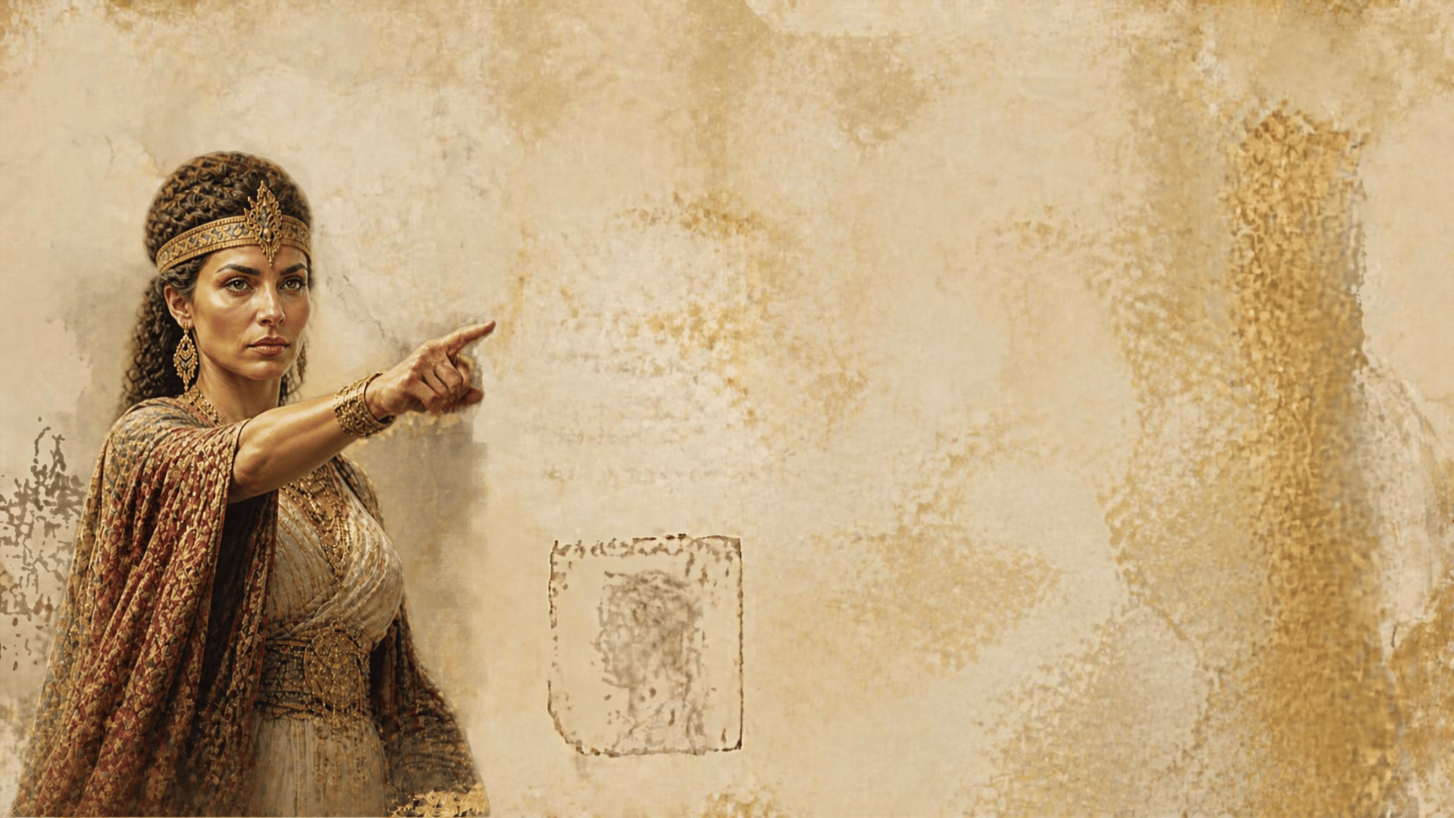
Condemned by
Others
Luke 11:29-32
Notes:
Based in part on an outline by Mark Copeland
Preached on May 13, 2007 PM
Print Slides: 5, 7, 9, 10, 11, 12
Preached again October 11, 2026

Slide 2

Condemned by Others
Ultimately on the Day of Judgment we will be judged by Jesus Christ
John 12:48; Acts 17:30-31
But, Jesus spoke of others judging on that day as well!
The Queen of the South (11:31)
The Men of Nineveh (11:32)

Slide 3

The Queen of the South
Queen of Sheba (1 Kings 10:1-13)
Located 1,200 miles south of Judah.
Amazed at Solomon’s wealth and wisdom.
Why would she condemn? (11:31)
She traveled many miles for the truth,
they had the truth at hand.
She went to hear Solomon; they were rejecting the teachings of one
far wiser even than he.

Slide 4
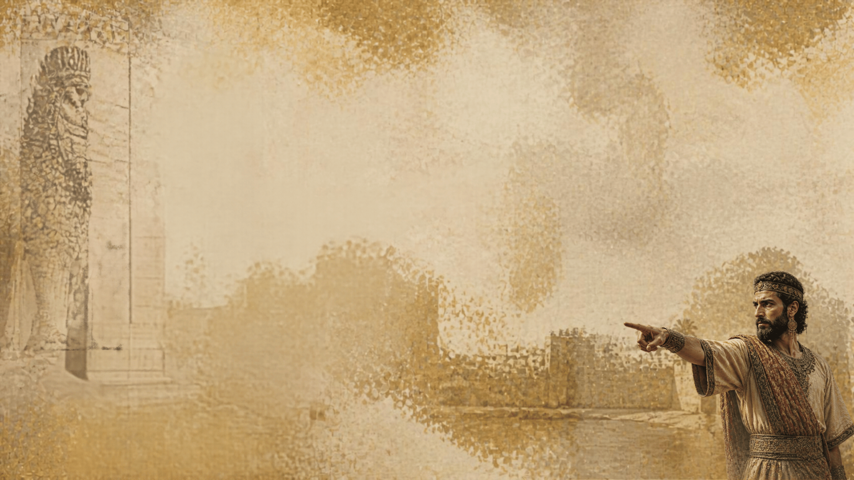
The Men of Nineveh
Jonah’s Preaching (Jonah 3:1-10)
Responded favorably to Jonah’s message.
Their repentance caused God
to spare them.
Why will they condemn? (11:32)
The Ninevites repented at the austere preaching of a resentful prophet.
They had the message of grace and redemption, given by
a compassionate Savior.

Slide 5
Will We Be Judged by Them?
If we don’t take advantage of the easy access we have to the Word of God!
If we allow such things as distance or time to preclude our learning truth, attending worship, going to gospel meetings, etc.
If we refuse to repent and to respond to the gospel message, though many opportunities are granted us today.
If we reject the message of the Lord Jesus Christ!

Slide 6
Might Others Judge Us Today?
Some Christians might shame us with their dedication to worship attendance, etc., though greatly limited by health or handicap!
Some non-Christians might shame us as they show more devotion to their hobbies, clubs, etc. than to God!
Some Christians – by responding in faith and repentance immediately upon hearing the Word of God!
Some non-Christians – by their dedication to their false religions exceeding our devotion to God and His truth!

Slide 7
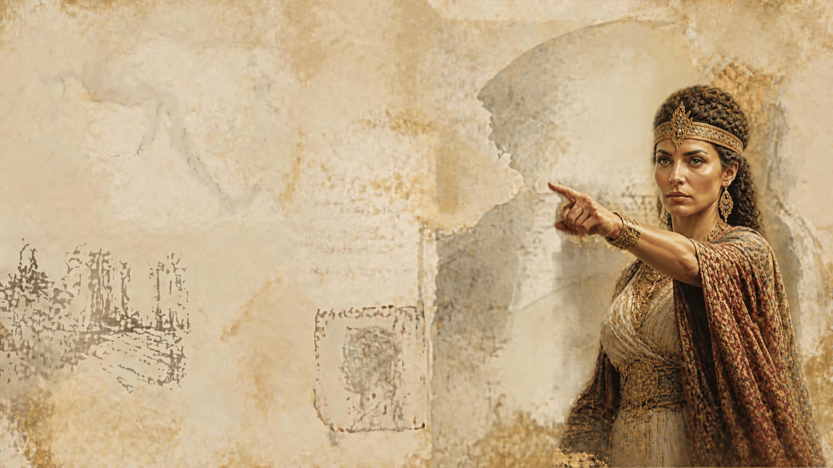
Conclusion
With whom will we stand in judgment? Those who seek out and respond to the truth of God? Or those who rejected the Savior who was sent to deliver them?
The answer depends upon how we make use of the opportunities we are given to heed the truth of God.

