Slide 1

Notes:
Effective Sacrifice
Romans 12:3-21
INTRODUCTION:
Romans 12:1 I beseech you therefore, brethren, by the mercies of God, that you present your bodies a living sacrifice, holy, acceptable to God, which is your reasonable service.
The concept of sacrifice is a selfless/not selfish idea
To present yourself to God as holy and acceptable it is necessary to be in His service.
This is a logical consequence of God's existence, and His grace
To be a "living sacrifice" implies necessarily activity on our part
It means to put to death the deeds of the flesh
It means to live in the Spirit, according to the truth He has revealed in the inspired word of God
Romans 8:13 For if you live according to the flesh you will die; but if by the Spirit you put to death the deeds of the body, you will live.
Galatians 5:16 I say then: Walk in the Spirit, and you shall not fulfill the lust of the flesh.
This transformation begins by a renewal of the mind!
Romans 12:2 And do not be conformed to this world, but be transformed by the renewing of your mind, that you may prove what is that good and acceptable and perfect will of God.
We will never fully make invest ourselves fully into sacrificing for God until we fully commit. We really have to want to, not be grudging about it in any way.
Our Text today (Romans 12:3-21) teaches us how to be a living sacrifice that is acceptable to God.
Sermon based on article by Joe Price, The Spirit's Sword, Jan. 11, 2004

Slide 2

Think Soberly (3)
  Matt. 25:24-25, 30; 1 Cor. 14:18-19
Function Faithfully (12:4-8)
  1 Cor. 12:4-11
Cor
Love Sincerely (12:9-10)
  Amos 5:15
Serve Fervently (12:11-16)
  Matt. 20:27-28; Jn 17:4; Psa. 69:9
Live Peaceably (12:17-21)
  2 Cor. 5:10; 2 Thess. 1:6-10
Notes:
DISCUSSION:
Think Soberly (12:3)
Romans 12:3 For I say, through the grace given to me, to everyone who is among you, not to think of himself more highly than he ought to think, but to think soberly, as God has dealt to each one a measure of faith.
We have to properly estimate ourselves, what we can do and what it beyond either our authority or our ability
Definition - "to put a moderate estimate upon one's self" or "thing of one's self soberly" (Thayer).
The idea of sobriety means to understand the abilities that we do have
Not like the unfruitful servant who was unwilling to do for the Lord, so he hid his talent in the ground (cf. Matthew 25:24-25)
Matthew 25:24-25 "Then he who had received the one talent came and said, 'Lord, I knew you to be a hard man, reaping where you have not sown, and gathering where you have not scattered seed. (25) And I was afraid, and went and hid your talent in the ground. Look, there you have what is yours.'
Matthew 25:30 And cast the unprofitable servant into the outer darkness. There will be weeping and gnashing of teeth.'
Not like those self-seeking Christians who desired the most ostentatious spiritual gifts (specifically tongue speaking), to be seen of men (cf. 1 Corinthians 14:18-19)
1 Corinthians 14:18-19 I thank my God I speak with tongues more than you all; (19) yet in the church I would rather speak five words with my understanding, that I may teach others also, than ten thousand words in a tongue.
[CLICK HERE FOR NEW POINT]
Function Faithfully (12:4-8)
Romans 12:4-8 For as we have many members in one body, but all the members do not have the same function, (5) so we, being many, are one body in Christ, and individually members of one another. (6) Having then gifts differing according to the grace that is given to us, let us use them: if prophecy, let us prophesy in proportion to our faith; (7) or ministry, let us use it in our ministering; he who teaches, in teaching; (8) he who exhorts, in exhortation; he who gives, with liberality; he who leads, with diligence; he who shows mercy, with cheerfulness.
It is important we see that we are single parts of a greater whole
The world does not revolve around us (it is immature to think so)
The church does not revolve around us either!
Romans 12:5 so we, being many, are one body in Christ, and individually members of one another.
So, we should strive to do our part with the abilities and opportunities that are given to us by the Lord
A "living sacrifice" faithfully accepts his or her role, without grumbling or chafing under any limitations they might have.
For examples: How male leadership affects women
How one without the qualifications of elder should not be envious of others
How a babe in Christ should understand their limitations in wisdom and experience, and instead of being angry, accept and seek to build
How a preacher should acknowledge the difference between pastor and evanglist
In 1st century (1 Corinthians 12) to accept the spiritual gifts that they themselves have been given
1 Corinthians 12:4-11 There are diversities of gifts, but the same Spirit. (5) There are differences of ministries, but the same Lord. (6) And there are diversities of activities, but it is the same God who works all in all. (7) But the manifestation of the Spirit is given to each one for the profit of all: (8) for to one is given the word of wisdom through the Spirit, to another the word of knowledge through the same Spirit, (9) to another faith by the same Spirit, to another gifts of healings by the same Spirit, (10) to another the working of miracles, to another prophecy, to another discerning of spirits, to another different kinds of tongues, to another the interpretation of tongues. (11) But one and the same Spirit works all these things, distributing to each one individually as He wills.
By accepting our roles, we honor our Lord and show honor and care to one another
[CLICK HERE FOR NEW POINT]
Love Sincerely (12:9-10)
Romans 12:9-10 Let love be without hypocrisy. Abhor what is evil. Cling to what is good. (10) Be kindly affectionate to one another with brotherly love, in honor giving preference to one another;
Without hypocrisy indicate a genuine love, whether it is for family and friends, your brethren, or even your enemies
While some do not believe it, such love makes the distinction
Abor what is evil
Cling to what is good
i.e - you absolutely CAN hate the sin and love the sinner
To love someone to tell them they are in sin, that is not hateful judging!
Amos 5:15 [God's words to the house of Israel] Hate evil, love good; Establish justice in the gate. It may be that the LORD God of hosts Will be gracious to the remnant of Joseph.
For brethren, sincere love is seen through kindly affection, and the giving of preference (both should be our first inclination in any interaction with other Christians.
[CLICK HERE FOR NEW POINT]
Serve Fervently (12:11-16)
Romans 12:11-16 not lagging in diligence, fervent in spirit, serving the Lord; (12) rejoicing in hope, patient in tribulation, continuing steadfastly in prayer; (13) distributing to the needs of the saints, given to hospitality. (14) Bless those who persecute you; bless and do not curse. (15) Rejoice with those who rejoice, and weep with those who weep. (16) Be of the same mind toward one another. Do not set your mind on high things, but associate with the humble. Do not be wise in your own opinion.
If Jesus Himself came as a servant, shouldn't we willingly serve as well?
Matthew 20:27-28 And whoever desires to be first among you, let him be your slave— (28) just as the Son of Man did not come to be served, but to serve, and to give His life a ransom for many."
John 17:4 I have glorified You on the earth. I have finished the work which You have given Me to do.
Following His example of service, we are reminded of how we are to serve the Lord (cf. 12:12-15), see boldface above.
As indicated, fervent service even covers those who persecute us! Again, note Jesus' example:
Psalms 69:9 [Messianic Prophecy] Because zeal for Your house has eaten me up, And the reproaches of those who reproach You have fallen on me.
He died for the ungodly and rebellious, that was fervent service!
[CLICK HERE FOR FINAL POINT IN SLIDE]
Live peaceably (12:17-21)
Romans 12:17-21 Repay no one evil for evil. Have regard for good things in the sight of all men. (18) If it is possible, as much as depends on you, live peaceably with all men. (19) Beloved, do not avenge yourselves, but rather give place to wrath; for it is written, "VENGEANCE IS MINE, I WILL REPAY," says the Lord. (20) Therefore "IF YOUR ENEMY IS HUNGRY, FEED HIM; IF HE IS THIRSTY, GIVE HIM A DRINK; FOR IN SO DOING YOU WILL HEAP COALS OF FIRE ON HIS HEAD." (21) Do not be overcome by evil, but overcome evil with good.
Retribution belongs to the Lord, not us. He is our Judge, the Judge of all!
2 Corinthians 5:10 For we must all appear before the judgment seat of Christ, that each one may receive the things done in the body, according to what he has done, whether good or bad.
To stoop to "getting back at" anyone, or to treat others as they have treated us is the fleshly response to evil. Instead, we are to overcome evil with good!
"give place to wrath" and interesting phrase! Indicates a need to stand by, make room for God. Wrath belongs rightly to the one who is our Judge, God Himself. Don't take it upon you. That is not your place.
2 Thessalonians 1:6-10 since it is a righteous thing with God to repay with tribulation those who trouble you, (7) and to give you who are troubled rest with us when the Lord Jesus is revealed from heaven with His mighty angels, (8) in flaming fire taking vengeance on those who do not know God, and on those who do not obey the gospel of our Lord Jesus Christ. (9) These shall be punished with everlasting destruction from the presence of the Lord and from the glory of His power, (10) when He comes, in that Day, to be glorified in His saints and to be admired among all those who believe, because our testimony among you was believed.

Slide 3
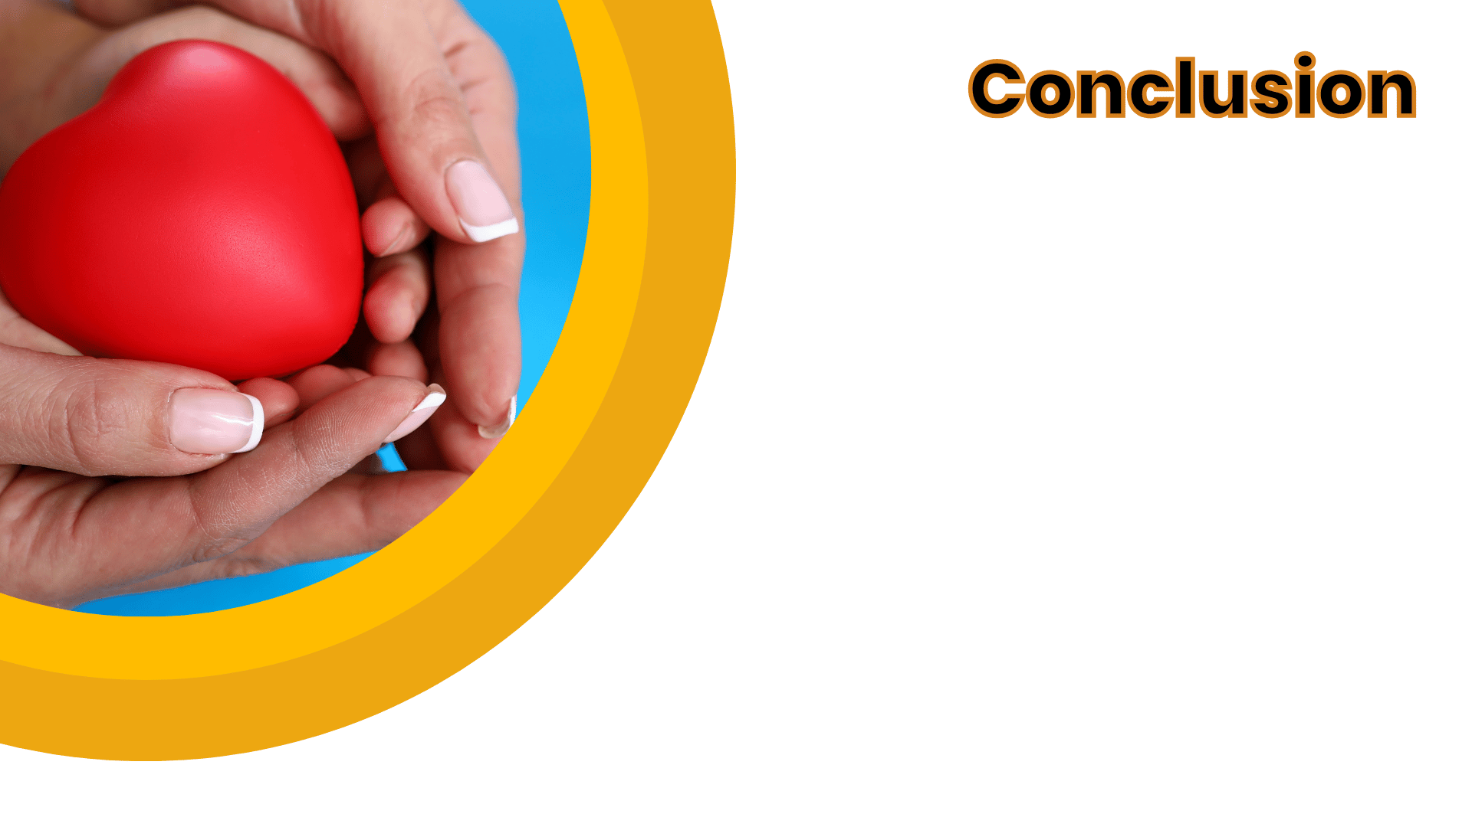
Living sacrifices present themselves to God for His service and honor.
Living sacrifices obey the word of God, not the selfish appeals of the world.
Living sacrifices set their minds on things above.
Living sacrifices please God.
Notes:
CONCLUSION
Living sacrifices present themselves to God for His service and honor.
Living sacrifices obey the word of God, not the selfish appeals of the world.
Living sacrifices set their minds on things above.
Living sacrifices please God.

