Slide 1

Notes:
Emotions and Emotionalism
Introduction:
Humans are created by God with emotions. Our character is often defined by how emotional or by how stoic we are
Emotions can be good, or they can be bad
This is primarily defined contextually. What can be an understandable, and even a positive emotion in one context can be completely unreasonable or inappropriate in another
Types: many. This is studied. One study presented by the University of California, Berkley, in 2017 listed 27 discreet human emotions.
One well known Psychologist, Robert Plutchick, in his work categorized them into 8 basic emotions, which are: Fear, Anger, Sadness, Joy, Disgust, Surprise, Trust and Anticipation.
Emotions serve to express our beliefs or convictions. We use them to reveal our attitudes. Again, These emotions can be right or appropriate, or they can be wrong!
It is often that emotions deceive us... just as Paul's anger and disgust toward Christians and the Christian faith deceived him, as he revealed in our text
Acts 26:9-11 "Indeed, I myself thought I must do many things contrary to the name of Jesus of Nazareth. (10) This I also did in Jerusalem, and many of the saints I shut up in prison, having received authority from the chief priests; and when they were put to death, I cast my vote against them. (11) And I punished them often in every synagogue and compelled them to blaspheme; and being exceedingly enraged against them, I persecuted them even to foreign cities.
There are two different views in religion regarding how our emotions interact with our faith! One legitimate, and one not.
Emotions existing legitimately and necessarily as aspects of our faith...
The danger of emotionalism... Emotions subjectively dictating our faith rather than being a direct result of our objective reaction to God's standards.
Based on an outline by Joe R. Price
The Spirit's Sword, September 2, 2007

Slide 2

Notes:
THE ROLE OF EMOTIONS IN THE CHRISTIAN’S LIFE.
Worthy emotions grow out of convictions that are based upon truth!
Ex: Godly Sorrow (convicted of sin by God's word)
Matthew 26:75 [Peter, convicted by Jesus' prediction of his denial] "And Peter remembered the word of Jesus who had said to him, "Before the rooster crows, you will deny Me three times." So he went out and wept bitterly."
Acts 2:37 [Jews on Pentecost, convicted by Peter's sermon] "Now when they heard this, they were cut to the heart, and said to Peter and the rest of the apostles, "Men and brethren, what shall we do?"
Ex: Joy and Gladness
Philippians 4:4-7 [Based upon a knowledge of a true relationship with Jesus] Rejoice in the Lord always. Again I will say, rejoice! (5) Let your gentleness be known to all men. The Lord is at hand. (6) Be anxious for nothing, but in everything by prayer and supplication, with thanksgiving, let your requests be made known to God; (7) and the peace of God, which surpasses all understanding, will guard your hearts and minds through Christ Jesus.
Ex: Provocation and Grief over the sins of others
Matthew 9:35-38 [Jesus' reaction to the legitimate sin and desperation of the people] Then Jesus went about all the cities and villages, teaching in their synagogues, preaching the gospel of the kingdom, and healing every sickness and every disease among the people. (36) But when He saw the multitudes, He was moved with compassion for them, because they were weary and scattered, like sheep having no shepherd. (37) Then He said to His disciples, "The harvest truly is plentiful, but the laborers are few. (38) Therefore pray the Lord of the harvest to send out laborers into His harvest."
Emotions are Good & Beneficial when Produced by a Truth-Based Conviction
Ex: Jacob's mourning for his son Joseph's death was not good or helpful, because he was deceived by his own sons, who had sold Joseph into slavery!
Genesis 37:31-35 So they took Joseph's tunic, killed a kid of the goats, and dipped the tunic in the blood. (32) Then they sent the tunic of many colors, and they brought it to their father and said, "We have found this. Do you know whether it is your son's tunic or not?" (33) And he recognized it and said, "It is my son's tunic. A wild beast has devoured him. Without doubt Joseph is torn to pieces." (34) Then Jacob tore his clothes, put sackcloth on his waist, and mourned for his son many days. (35) And all his sons and all his daughters arose to comfort him; but he refused to be comforted, and he said, "For I shall go down into the grave to my son in mourning." Thus his father wept for him.
Ex: In contrast, the Eunuchs rejoicing was good and beneficial, because he truly had been saved!
Acts 8:38-39 So he commanded the chariot to stand still. And both Philip and the eunuch went down into the water, and he baptized him. (39) Now when they came up out of the water, the Spirit of the Lord caught Philip away, so that the eunuch saw him no more; and he went on his way rejoicing.
[CLICK HERE FOR NEXT POINTS]
However, emotions do not determine what is true doctrine!
True Doctrine is determined by God's word!
2 Timothy 3:16-17 All Scripture is given by inspiration of God, and is profitable for doctrine, for reproof, for correction, for instruction in righteousness, (17) that the man of God may be complete, thoroughly equipped for every good work.
2 Timothy 2:7 [Paul to Timothy, indicating that his words were inspired by God!] Consider what I say, and may the Lord give you understanding in all things.
Our righteousness, the life of faith we live, is not determined by Emotions!
Jesus said so Himself
Matthew 7:21 "Not everyone who says to Me, 'Lord, Lord,' shall enter the kingdom of heaven, but he who does the will of My Father in heaven.
It is very clear that our own perceptions of right and wrong are faulty, we must depend upon God to tell us what is right and what is wong!
Proverbs 14:12 There is a way that seems right to a man, But its end is the way of death.
Jeremiah 10:23 O LORD, I know the way of man is not in himself; It is not in man who walks to direct his own steps.

Slide 3

Notes:
RULE OF EMOTIONS: EMOTIONALISM.
When Emotions Rule Us, the Authority of God’s Revealed Word Becomes Clouded and Minimized
Areas of doctrine (Men's words are declared as true when they differ or add to God's words)
Matthew 7:21-23 "Not everyone who says to Me, 'Lord, Lord,' shall enter the kingdom of heaven, but he who does the will of My Father in heaven. (22) Many will say to Me in that day, 'Lord, Lord, have we not prophesied in Your name, cast out demons in Your name, and done many wonders in Your name?' (23) And then I will declare to them, 'I never knew you; depart from Me, you who practice lawlessness!'
Areas of worship (Worship is done ignorantly, rather than in truth)
John 4:22-24 You worship what you do not know; we know what we worship, for salvation is of the Jews. (23) But the hour is coming, and now is, when the true worshipers will worship the Father in spirit and truth; for the Father is seeking such to worship Him. (24) God is Spirit, and those who worship Him must worship in spirit and truth."
Areas of evangelism (Preaching a message not from God corrupts!)
2 Corinthians 11:3-4 But I fear, lest somehow, as the serpent deceived Eve by his craftiness, so your minds may be corrupted from the simplicity that is in Christ. (4) For if he who comes preaches another Jesus whom we have not preached, or if you receive a different spirit which you have not received, or a different gospel which you have not accepted—you may well put up with it!

Slide 4
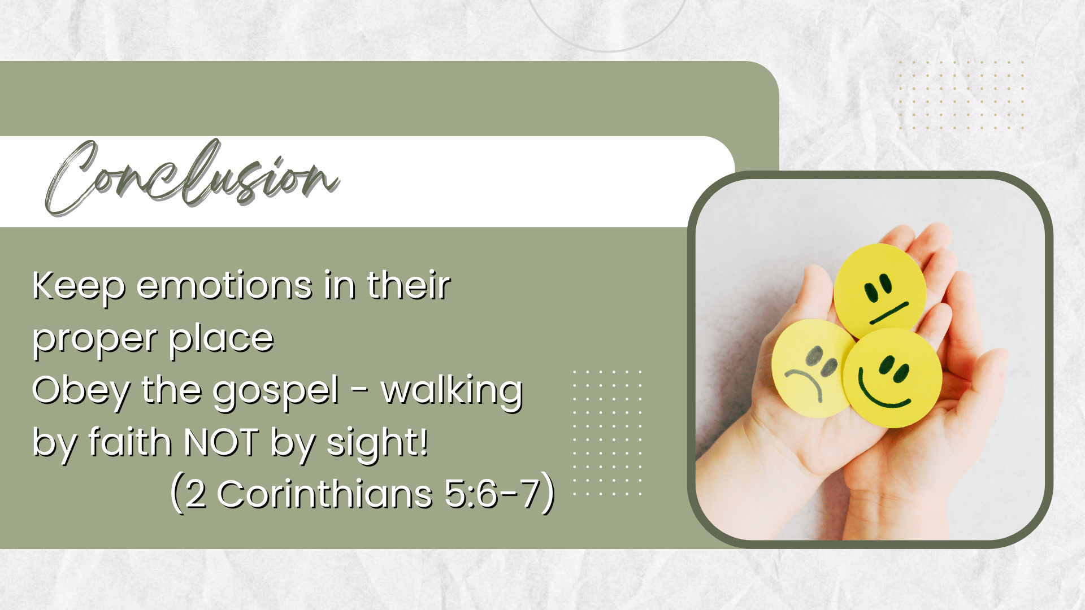
Notes:
Conclusion
Keep emotions in their proper place: NOT THE CAUSE, BUT the result of the power of truth in your life
Obey the gospel; Walk by faith, not by sight
2 Corinthians 5:6-7 So we are always confident, knowing that while we are at home in the body we are absent from the Lord. (7) For we walk by faith, not by sight.

