Slide 1

False Prophets
“who try to make My people forget My name”
Jeremiah 23:27
Notes:
False Prophets
Jeremiah 23
INTRODUCTION:
Jeremiah 23:27, "who try to make My people forget My name."
This passage, which we will see fully in context as our lesson continues, discusses the problem of false prophets in Judah

Slide 2
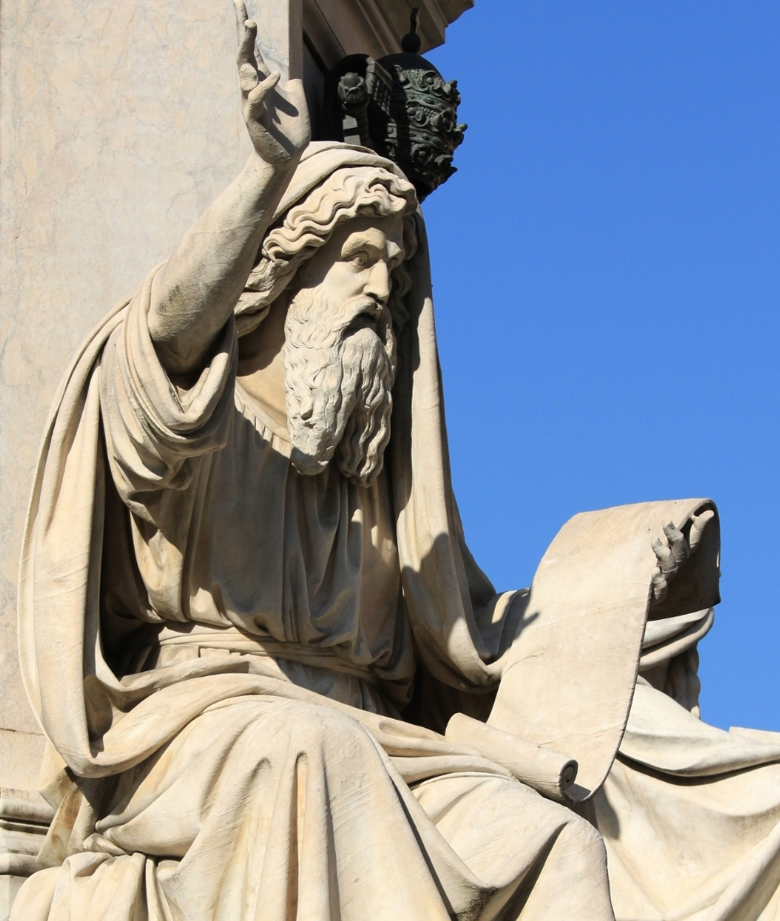
The Prophet in Scripture
Hb. (nâbı̂y') Gk. (prophētēs)
A foreteller. An inspired man
The Bible’s Declaration
First of all – Jesus
Deut. 18:18; Heb. 1:1-2
All of Scripture
2 Peter 1:20-21
Notes:
[CLICK for New Slide]
Who is a prophet?
First, let's look at a couple of definitions
Hebrew (Naw-bee, nabiy) - a prophet, or inspired man
Greek (prof-ay-tace, prophetes) - a foreteller; an inspired speaker
[CLICK]
The Bible speaks of such men
The Lord referred to Jesus in this way, speaking to Moses of it in Deuteronomy 18:18.
Deuteronomy 18:18 I will raise up for them a Prophet like you from among their brethren, and will put My words in His mouth, and He shall speak to them all that I command Him.
Hebrews 1:1-2 God, who at various times and in various ways spoke in time past to the fathers by the prophets, (2) has in these last days spoken to us by His Son
Scripture agrees with the definitions. A true prophet is one who is inspired of God
2 Peter 1:20-21 knowing this first, that no prophecy of Scripture is of any private interpretation, (21) for prophecy never came by the will of man, but holy men of God spoke as they were moved by the Holy Spirit.

Slide 3
The False Prophet
Hb. (shequer) An untruth; deceit, a sham.
Gk. (psuedoprophētēs) a spurious prophet, a pretended foreteller or religious imposter
What does FALSE describe?
2 Peter 2:1, cf. 12-18
Exodus 20:16; Mark 14:56
2 Corinthians 11:13-15; John 7:24
Notes:
[CLICK for New Slide]
Now, let's contrast the Prophet of God with the False Prophet
The contrast in definitions here is the word false. Consider the Hebrew and Greek definitions of the word
In the Greek the word for false is as a prefix to describe all kinds in the New Testament, brethren, teachers, witnesses, etc.
Hebrew (Sheh'ker, shequer) - an untruth; deceit, a sham.
Greek (psyoo-dop-rof-ay'-tace, pseudoprophētēs) spurious prophet, that is, pretended forteller or religious imposter.
Question: Comes about because of 2 Peter, and the description of the character of the men who were described by him as false teachers.
First, warning:
2 Peter 2:1 But there were also false prophets among the people, even as there will be false teachers among you, who will secretly bring in destructive heresies, even denying the Lord who bought them, and bring on themselves swift destruction.
Second, Description: like natural brute beasts, lewd, corrupt, carousers, covetous, adulterous actors. (cf. 2 Peter 2:12-18)
Contention: False describes the character of the individual, not what he does. Effect: If a man is characteristically "good" or "righteous", it is wrong to describe him as a false teacher, even if he teaches a doctrine that is not true!
The contention is wrong, illogical, and unscriptural
Does false define the character or the action? (Take as an example, a witness)
In the Old Testament, the action.
Exodus 20:16 "You shall not bear false witness against your neighbor.
In the New Testament, as well. (psyoo-dom-ar-too-reh'-o, pseudomartureō)
Mark 14:56 For many bore false witness against Him, but their testimonies did not agree.
Question: Is a false witness evil? Of course, he has violated the command of God.
If he otherwise was a sincere individual, a nice individual an agreeable individual, would this no longer make him evil in his disobedience?
No! The same is true with false prophets, false christs, false apostles, false brethren and false teachers
They may be overtly evil, but they may seem to be very nice, even righteous.
2 Corinthians 11:13-15 [ Paul describing this sort. For example, false apostles] For such are false apostles, deceitful workers, transforming themselves into apostles of Christ. (14) And no wonder! For Satan himself transforms himself into an angel of light. (15) Therefore it is no great thing if his ministers also transform themselves into ministers of righteousness, whose end will be according to their works.
We are not supposed to judge motives, only actions!
John 7:24 [Jesus told the people at the Feast of Tabernacles] Do not judge according to appearance, but judge with righteous judgment."

Slide 4
The Evil that False Prophets Do
Jeremiah 23
Destroy and Scatter (1-4)
Profane and Slippery (11-12)
Cause the people to err (13)
Walk in lies, strengthen the hands of evildoers (14)
Lie in God’s name (25)
Follow their own heart (26)
Make people forget God! (27)
“I will feed them with wormwood, and make them drink the water of gall” (15)
Notes:
[CLICK FOR NEW SLIDE]
The Evil that False Prophets Do! (READ from JEREMIAH 23)
Destroy and Scatter (1-4)
Profane and Slippery (11-12)
Cause the people to err (13)
Walk in lies, strengthen the hands of evildoers (14)
Lie in God’s name (25)
Follow their own heart (26)
Make people forget God! (27)
[CLICK for scripture on book]
Because of their evil, God would punish them!
Jeremiah 23:15 "Therefore thus says the LORD of hosts concerning the prophets: 'Behold, I will feed them with wormwood, And make them drink the water of gall; For from the prophets of Jerusalem Profaneness has gone out into all the land.' "

Slide 5
Dealing with the False Prophet
(or false teacher) Jeremiah 23
Don’t consider God’s word to be a burden (oracle) (33-34)
    Ezekiel 18:25
Ask the question, “what does the Lord say?” (35-37)
    Matthew 17:1-5
Notes:
[CLICK FOR NEW SLIDE]
How to deal with the false prophet or teacher
Don't consider God's word to be a burden! (33-34)
NKJV - Oracle; KJV - Burden; (mas-saw', maśśâ') a burden; figuratively an utterance, chiefly a doom
The rebellious people considered words from God to be burdenesome and unfair
Another example, the people of Ezekiel's day...
Ezekiel 18:25 "Yet you say, 'The way of the Lord is not fair.' Hear now, O house of Israel, is it not My way which is fair, and your ways which are not fair?
[CLICK] Next Point
Ask the question: What does the Lord say? (35-37) READ
In the last days, He has established His words through Jesus, His Son
Matthew 17:1-5 Now after six days Jesus took Peter, James, and John his brother, led them up on a high mountain by themselves; (2) and He was transfigured before them. His face shone like the sun, and His clothes became as white as the light. (3) And behold, Moses and Elijah appeared to them, talking with Him. (4) Then Peter answered and said to Jesus, "Lord, it is good for us to be here; if You wish, let us make here three tabernacles: one for You, one for Moses, and one for Elijah." (5) While he was still speaking, behold, a bright cloud overshadowed them; and suddenly a voice came out of the cloud, saying, "This is My beloved Son, in whom I am well pleased. Hear Him!"

Slide 6
Conclusion
“Therefore behold, I am against the prophets,” says the LORD, “who steal My words every one from his neighbor”
(Jeremiah 23:30)
No matter the pressure, don’t champion one whom God is against because he is false!
Notes:
[CLICK FOR NEW SLIDE]
CONCLUSION
Jeremiah 23:30 “Therefore behold, I am against the prophets,” says the LORD, “who steal My words every one from his neighbor.
don't follow the false teacher
don't be his apologist
don't ignore the damage
don't criticize the defender of truth
Don't be for those that God has rejected!
PERSIST IN DEFENDING TRUTH - NO MATTER THE PRESSURE OR UNPLEASANTNESS OF THIS DEFENSE AGAINST THOSE WHO CLAIM TO BE ANGELS OF LIGHT, BUT ARE NOT!

