Slide 2
Nehemiah 6:15-16
¹⁵ So the wall was finished on the twenty-fifth day of Elul, in fifty-two days.
¹⁶ And it happened, when all our enemies heard of it, and all the nations around us saw these things, that they were very disheartened in their own eyes; for they perceived that this work was done by our God.
Notes:
I believe this one of the most inspirational texts found in all of Scripture!

Slide 3
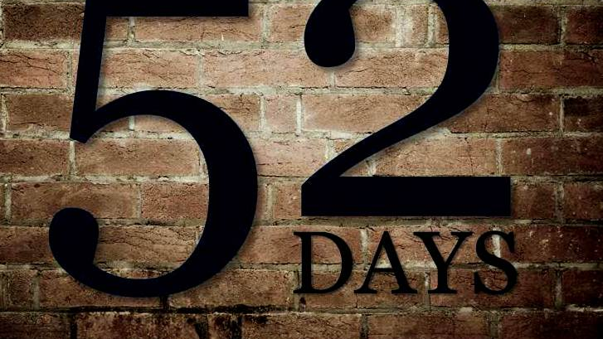
Notes:
It was absolutely incredible, monumental, what this remnant of Jewish exiles accomplished in just 52 Days! Especially when you consider the circumstances that existed and that they faced as they did this great work!

Slide 4
Fifty-Two Days
The Condition of the People of Jerusalem
In great distress and reproach (Neh. 1:3a)
The Condition of the Walls of Jerusalem
Broken down and the gates burned with fire (Nehemiah 1:3b; 2:13)
Their Enemies Mocked & Plotted Against Them
Nehemiah 2:10, 19; 4:1-3, 7-8

Slide 5
Fifty-Two Days
The Remnant had Strong, Godly Leadership
Ezra (Ezra 7:10; Neh. 8:1-8); Nehemiah (2:11-20)
The People had a Mind to Work
Nehemiah 4:6
The People Joined Together in a United Effort
Nehemiah 3
Continued to Work & were Prepared to Fight
Nehemiah 4:9-23
Notes:
Nehemiah Prayed and Trusted in God (1:4-11; 2:4; 4:4-5, 9; 6:9)

Slide 6
WHAT COULD YOU DO IN…
?

