Slide 2
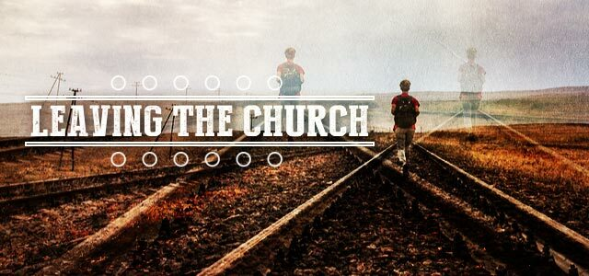
Notes:
I’ve heard the numbers quoted all my adult life: half of all children of Christians leave the faith. Without going to the trouble of a survey, we all intuitively know that this is the case. Many sermons have been preached on why they left.

Slide 3
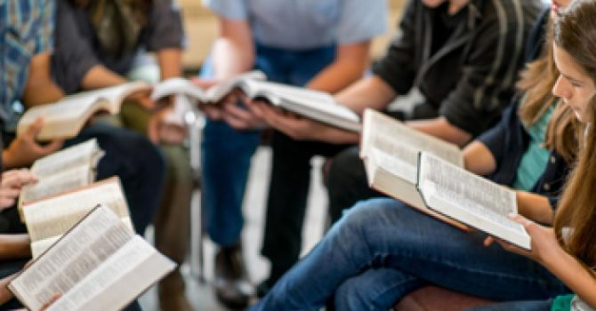
Why Young People Stay “In Church”
Notes:
What I want to do is share the research as to why half stayed. Five characteristics were common among children that never lost their faith:

Slide 4
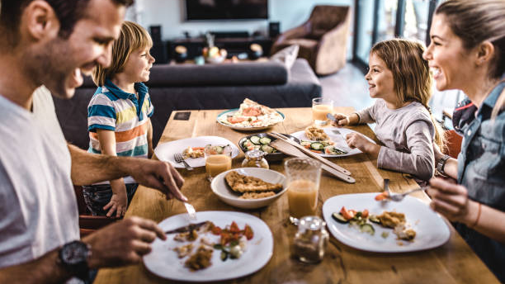
1) Ate dinner 5 of 7 nights a week as a family. (Prov. 15:17; Psa. 128:1-4)

Slide 5
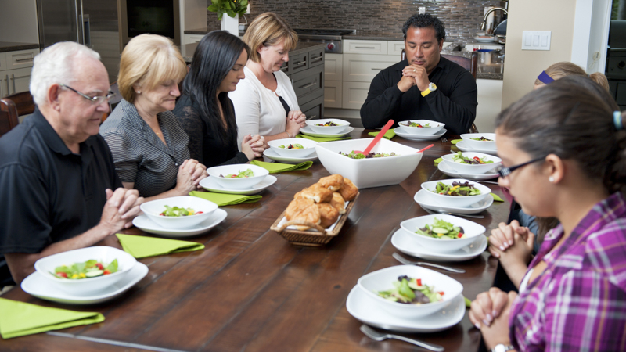
The Family Dinner Table Connie Adams
Historically the family table has not only met the physical needs of its members, but has done much to nourish their emotional needs as well. In godly homes, the table has been the place where God is thanked for daily provisions. It has been a place for shared moments for laughter, for concern, for instruction and training and has done much to establish memories which contribute to lasting bonds within a family. “Dinner is ready” has been a welcomed sound to many for a long time.
Notes:
Guardian of Truth XLI: 24 p. 3-4, December 18, 1997

Slide 6
The Family Dinner Table Connie Adams
The demands of modern life in our culture have been such that the value (or even presence) of a family table has been diminished. In many a household, families do not eat together. It is difficult to set a time when everyone is present at the same time. Work schedules, school functions, part-time jobs, the desire to eat in a separate room to see something on television, or the notion that “I’ll eat when I am hungry” has interfered with the family table.

Slide 7
The Family Dinner Table Connie Adams
Many in the present time regard anything which smacks of a routine or schedule as sinister. Forgotten is the fact that family meals are not just to satisfy hunger. They are social events, a time for families to share the same food at the same time, to talk of the events of the day, learn about what happened at work, at school. It is an ideal time for children to listen to their parents and learn something of their heritage. It is a time which ought to challenge every parent to make the occasion special.

Slide 8
The Family Dinner Table Connie Adams
At that table we learned respect for each other and especially our elders. We had our turns to say what we wanted to say, but we did not interrupt when the “grown folks” were talking. At the family supper table I learned so much about the men with whom my father worked that I felt like I knew them all. From my father and mother we learned much about our heritage. Our grandmother added much spice with her stories of times past. Somehow we felt attached to the people and places of which they spoke so fondly.

Slide 9
The Family Dinner Table Connie Adams
At that table I learned not to aggravate my brother, at least not in reach of my father’s hand! The only time I remember that he ever physically struck me was over just such an occasion. It startled everyone and scared the living daylights out of me! My father’s method of correction was usually to talk to us in such a way that we felt ashamed of ourselves. His sudden action was totally unexpected, uncharacteristic, and never forgotten.

Slide 10
It was at that table, when I was eleven years old, that my parents explained to us why we were leaving the Christian church, in which we had many relatives and long-time friends. Serious Bible talk made lasting impressions. Somehow, at that table, we were all one family. There we could mourn our losses, savor our victories, commiserate with one another, pass down folk-lore from one generation to another. There at that table the pressures and stresses of the day, of work, school and play, dissolved as we sat down together. The food was not always gourmet, but it was abundant (even in hard times) and lovingly prepared. We did not have the finest china and silverware, but we sure did set the table with love.

Slide 11
The Family Dinner Table Connie Adams
So, amid the rush and press of life as it is lived today, don’t forget the importance of the family dinner table. Take time to eat together, then sit back for a little while and savor the moment and talk to each other. Neglecting the family dinner table will have the same harmful effect on your physical family as neglecting the “table of the Lord” will have on your spiritual family. Do you think it was just an accident that the Lord chose a table as the place to remember His suffering and to renew our hope for the world to come?

Slide 12
2) Served with their families in a local church.
Parents and their children personally involved in the work of the local church.
Cleaning the building
Participate in a workday
Preparing communion
Taking food to a member
Visiting the elderly
1 Corinthians 16:15-18
Notes:
Romans 12:13

Slide 13
3) Had one spiritual experience in the home during the week.
Prayer should be a daily activity.
Reading the Bible and discussing it.
Preparing lessons for Bible classes.
Engaging our children in spiritual conversations.
1 Thess. 5:17; 2 Timothy 3:14-17; Psalm 145:4; Deuteronomy 6:4-9

Slide 14
“Train Up A Child” Family Life: A Biblical Perspective L.A. Stauffer, p. 56
This is what parenting is all about. Conscientious parents spend long hours studying the Scriptures to prepare themselves for the task of teaching their children. It is they who must combat the atheistic, humanistic value system that grows out of the evolutionary hypothesis and denies basic biblical morality and ethics. Over and over and over, as this text indicates, fathers and mothers must drill, instill and fill their offspring with the scriptural message of righteousness.

Slide 15
“Train Up A Child” Family Life: A Biblical Perspective L.A. Stauffer, p. 56
A steady diet of daily Bible study and prayer must be an integral part of family life. At the supper table, around the coffee table, before the fireplace, in the automobile the Scriptures must be read, analyzed, and applied. If children are to remain free from the garbage of secular values, parents must shut off the TV, bow in prayer with them, open the Bible, and take a little time each evening to teach them some spiritual truth. Do it, daddy and mama, when the children are babes and as adolescents they won’t be embarrassed by it and it won’t seem like “church stuff” that is out of place in the home.

Slide 16
Helping to prepare the classroom for a new teaching quarter.
Preparing communion
Putting up numbers for songs/attendance.
Handing out bulletins.
Reading Scripture.
Leading prayer.
Extending the invitation.
Leading singing.
4) Entrusted with responsibility in spiritual service at an early age.
Luke 2:49
Ecclesiastes 12:1
Notes:
Responsibility – placing trust in them – gives them confidence – builds esteem – involvement – connectivity

Slide 17
5) Had at least one faith-focused adult in their lives other than a parent.
Those that take a sincere interest in them:
Preacher
Elders
Deacons
Bible class teachers
Parents of other young people
Older Members
2 Kings 12:1-2; Hebrews 13:7, 17; 1 Peter 5:3

Slide 18
Why Young People Stay “In Church”
Ate dinner 5 of 7 nights a week as a family.
Served with their families in a local church.
Had one spiritual experience in the home during the week.
Entrusted with responsibility in spiritual service at an early age.
Had at least one faith-focused adult in their lives other than a parent.
Notes:
As you can see, the emphasis was not raising a “church kid,” but a disciple of Jesus (Luke 9:23-26). A child who remains faithful in serving the Lord is one who truly connected with Christ at an early age — and stayed connected.

Slide 19
STAYING IN
Attached instead of detached.
Involved instead of uninvolved.
Connected instead of disconnected.
A spiritual focus instead of a worldly focus.

Slide 20
Two-Fold Responsibility
“Train up a child in the way he should go, and when he is old he will not depart from it” (Proverbs 22:6; cf. Ephesians 6:4).
“Remember now your Creator in the days of your youth, before the difficult days come, and the years draw near when you say, ‘I have no pleasure in them’” (Ecclesiastes 12:1).
Notes:
“bring them up in the discipline and instruction of the Lord” (Ephesians 6:4, NASB).

Slide 21
Acts 2:37-38, 47
³⁷ Now when they heard this, they were cut to the heart, and said to Peter and the rest of the apostles, “Men and brethren, what shall we do?”
³⁸ Then Peter said to them, “Repent, and let every one of you be baptized in the name of Jesus Christ for the remission of sins; and you shall receive the gift of the Holy Spirit.”
⁴⁷ And the Lord added to the church daily those who were being saved.

