Slide 1
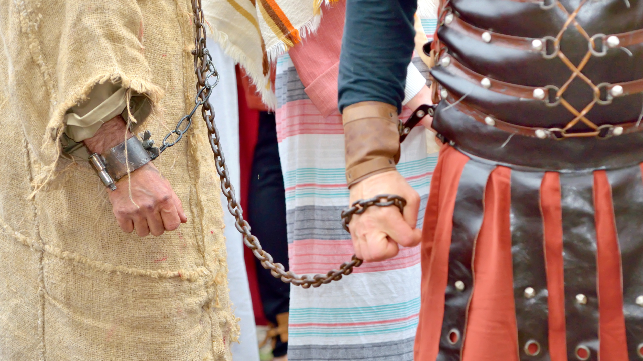
“For I Am Ready”
Acts 21:13
Notes:
For I am Ready
As we have talked about the book of Acts in our Bible study, we have come across the prophecies concerning Paul’s tribulation in Jerusalem
He revealed it to the elders of Ephesus while in Miletus
(Acts 20:22-24), “And see, now I go bound in the spirit to Jerusalem, not knowing the things that will happen to me there, ²³ except that the Holy Spirit testifies in every city, saying that chains and tribulations await me. ²⁴ But none of these things move me; nor do I count my life dear to myself, so that I may finish my race with joy, and the ministry which I received from the Lord Jesus, to testify to the gospel of the grace of God.”
This caused the elders sorrow
(Acts 20:37-38), “Then they all wept freely, and fell on Paul’s neck and kissed him, ³⁸ sorrowing most of all for the words which he spoke, that they would see his face no more. And they accompanied him to the ship.”
Disciples in Tyre had been told by the Holy Spirit of the danger in Jerusalem
(Acts 21:3-4), “When we had sighted Cyprus, we passed it on the left, sailed to Syria, and landed at Tyre; for there the ship was to unload her cargo. ⁴ And finding disciples, we stayed there seven days. They told Paul through the Spirit not to go up to Jerusalem.”
The prophet Agabus came from Judea to Caesarea, and said the same
(Acts 21:10-11), “And as we stayed many days, a certain prophet named Agabus came down from Judea. ¹¹ When he had come to us, he took Paul’s belt, bound his own hands and feet, and said, “Thus says the Holy Spirit, So shall the Jews at Jerusalem bind the man who owns this belt, and deliver him into the hands of the Gentiles.’ ”
His provocative way of delivering the message distressed Paul’s traveling companions, including Luke
(Acts 21:12), “Now when we heard these things, both we and those from that place pleaded with him not to go up to Jerusalem.”
This is what led Paul to the declaration of our text!
(Acts 21:13), “Then Paul answered, “What do you mean by weeping and breaking my heart? For I am ready not only to be bound, but also to die at Jerusalem for the name of the Lord Jesus.”
It is obvious that their love for him touched him “breaking my heart.”
However, his steadfastness in his purpose would not waver. He was bound to go to Jerusalem, no matter what would happen to him there.
Note: This was not a probability, it was a certainty, as all of them knew!
Notice the resignation of Paul’s companions at his words
(Acts 21:14), “So when he would not be persuaded, we ceased, saying, “The will of the Lord be done.”
Let’s consider Paul’s words, “For I am ready not only to be bound, but also to die at Jerusalem for the name of the Lord Jesus.”

Slide 2
“For I Am Ready”
Paul’s Two Imprisonments
Philippians 1:12-18; 2 Timothy 4:6-7
Notes:
“For I Am Ready”
We can see God’s providence in this
God not only wanted Jesus to testify of him to the Jews, but also in Rome!
After Paul was arrested in Jerusalem, and rescued by a Roman garrison. He was taken to the Roman barracks
(Acts 23:11), “But the following night the Lord stood by him and said, “Be of good cheer, Paul; for as you have testified for Me in Jerusalem, so you must also bear witness at Rome.”
So, all of this was ordained by God! Thus, Paul did not fight against it.
Paul’s two imprisonments
Paul’s first imprisonment is seen here in Acts 23, and led eventually to Rome, where he was under house arrest for two years.
(Acts 28:30-31), “Then Paul dwelt two whole years in his own rented house, and received all who came to him, ³¹ preaching the kingdom of God and teaching the things which concern the Lord Jesus Christ with all confidence, no one forbidding him.”
Paul’s first imprisonment was caused by the false accusations of the Jews, the procrastination of Felix, Paul’s appeal to Caesar in front of Felix, and a successful, but eventful trip to Rome that ends the book of Acts
Paul referred to this imprisonment in several of his epistles (Prison Epistles - Ephesians, Philippians, Colossians, and Philemon)
Consider his words to the Philippians, who helped support him while he was in prison.
(Philippians 1:12-18), “But I want you to know, brethren, that the things which happened to me have actually turned out for the furtherance of the gospel, ¹³ so that it has become evident to the whole palace guard, and to all the rest, that my chains are in Christ; ¹⁴ and most of the brethren in the Lord, having become confident by my chains, are much more bold to speak the word without fear. ¹⁵ Some indeed preach Christ even from envy and strife, and some also from goodwill: ¹⁶ The former preach Christ from selfish ambition, not sincerely, supposing to add affliction to my chains; ¹⁷ but the latter out of love, knowing that I am appointed for the defense of the gospel. ¹⁸ What then? Only that in every way, whether in pretense or in truth, Christ is preached; and in this I rejoice, yes, and will rejoice.”
Much less is known about Paul’s second imprisonment, but it is believed that between the two he wrote 1 Timothy and Titus
He may also have spent time in Spain, though the scriptures say nothing of it.
It seems like 2 Timothy was written while he was imprisoned a second time. And this time it ended with the Apostle’s death
It also leaves us with a wonderful valedictory of his life.
(2 Timothy 4:6-7),”For I am already being poured out as a drink offering, and the time of my departure is at hand. ⁷ I have fought the good fight, I have finished the race, I have kept the faith.”

Slide 3
“For I Am Ready”
Paul’s Two Imprisonments
Philippians 1:12-18; 2 Timothy 4:6-7
Paul’s Eventual Death
http://britannica.com
Notes:
Paul’s Eventual Death
Other than references in 2 Timothy to the fact that he was imprisoned, nothing in scripture reveals anything about his death. 2 Timothy 4:6-8 only notes that it was imminent.
I came across this quote from Britannica.com “The exact details of St. Paul’s death are unknown, but tradition holds that he was beheaded in Rome and thus died as a martyr for his faith. His death was perhaps part of the executions of Christians ordered by the Roman emperor Nero following the great fire in the city in 64.“
So, it seems the second imprisonment, where we see no indication of Paul’s confidence in being released, finished very differently for him.

Slide 4
“For I Am Ready”
Paul’s Two Imprisonments
Philippians 1:12-18; 2 Timothy 4:6-7
Paul’s Eventual Death
http://britannica.com
Paul’s Motivation and Stewardship
Phil. 3:8-11; Romans 1:14-15; 1 Cor. 4:1-5
Notes:
Paul’s Motivation and Stewardship
(Philippians 3:8-11), “Yet indeed I also count all things loss for the excellence of the knowledge of Christ Jesus my Lord, for whom I have suffered the loss of all things, and count them as rubbish, that I may gain Christ ⁹ and be found in Him, not having my own righteousness, which is from the law, but that which is through faith in Christ, the righteousness which is from God by faith; ¹⁰ that I may know Him and the power of His resurrection, and the fellowship of His sufferings, being conformed to His death, ¹¹ if, by any means, I may attain to the resurrection from the dead.”
Motivation: To gain Christ, and the blessings therein (the power of His resurrection, that he might attain himself to the resurrection from the dead).
(Romans 1:14-15), “I am a debtor both to Greeks and to barbarians, both to wise and to unwise. ¹⁵ So, as much as is in me, I am ready to preach the gospel to you who are in Rome also.”
Motivation: A sense of debt to Christ, transferred to his fellow man.
(1 Corinthians 4:1-5), “Let a man so consider us, as servants of Christ and stewards of the mysteries of God. ² Moreover it is required in stewards that one be found faithful. ³ But with me it is a very small thing that I should be judged by you or by a human court. In fact, I do not even judge myself. ⁴ For I know of nothing against myself, yet I am not justified by this; but He who judges me is the Lord. ⁵ Therefore judge nothing before the time, until the Lord comes, who will both bring to light the hidden things of darkness and reveal the counsels of the hearts. Then each one’s praise will come from God.”
Motivation: Responsibility of Stewardship

Slide 5
“For I Am Ready”
Paul’s Two Imprisonments
Philippians 1:12-18; 2 Timothy 4:6-7
Paul’s Eventual Death
http://britannica.com
Paul’s Motivation and Stewardship
Phil. 3:8-11; Romans 1:14-15; 1 Cor. 4:1-5
Paul’s Reward
2 Timothy 4:6-8 esp. 8
Notes:
Paul’s Reward
The same available to you and I
(2 Timothy 4:6-7),”For I am already being poured out as a drink offering, and the time of my departure is at hand. ⁷ I have fought the good fight, I have finished the race, I have kept the faith. ⁸ Finally, there is laid up for me the crown of righteousness, which the Lord, the righteous Judge, will give to me on that Day, and not to me only but also to all who have loved His appearing.”

Slide 6
Conclusion
Paul did all possible to please His Lord.
What about you?
Notes:
Conclusion:
Put simply – Paul was willing (and did) do anything and everything he could to perform his stewardship and please his Lord
What about you and me?

