Slide 1
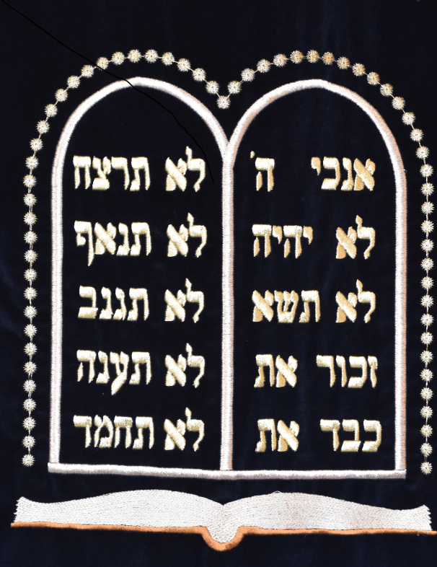
God Requires Obedience
Deuteronomy 5-9
Notes:
God Requires Obedience!
(Deuteronomy 5-9)
Introduction:
In Deuteronomy 5, Moses restated the covenant that Israel entered with God at Horeb (or Mount Sinai).
The foundation of this agreement are the ten commandments, noted here in 5:6-21
You shall have no other gods before Me
You shall not make for yourself a carved image
You shall not take the name of the Lord your God in vain
Observe the Sabbath day, to keep it Holy
Honor your father and your mother
You shall not murder
You shall not commit adultery
You shall not steal
You shall not bear false witness against your neighbor
You shall not covet your neighbor's wife, your neigbor's house, his field, his male or female servants, his ox, don,y or anything that is your neighbors
It is important here to note the place that obedience has in the redemption of men
Such obedience is not absolute. All of us sin from time to time
Romans 3:23 for all have sinned and fall short of the glory of God
As such, our redemption is not secured by perfect keeping of the law
Galatians 3:21-22a Is the law then against the promises of God? Certainly not! For if there had been a law given which could have given life, truly righteousness would have been by the law. But the Scripture has confined all under sin...
This was why God, in His mercy, determined to give us the gift of redemption through faith in Jesus
Galatians 3:21-25 Is the law then against the promises of God? Certainly not! For if there had been a law given which could have given life, truly righteousness would have been by the law. ²² But the Scripture has confined all under sin, that the promise by faith in Jesus Christ might be given to those who believe. ²³ But before faith came, we were kept under guard by the law, kept for the faith which would afterward be revealed. ²⁴ Therefore the law was our tutor to bring us to Christ, that we might be justified by faith. ²⁵ But after faith has come, we are no longer under a tutor.
Question: Does the fact that we can't earn our salvation via obedience to God's laws (because of our failure) mean that a failure to obey is acceptable? Or that a claim that works of righteousness, obedience to God's commands constitutes either legalism or a claim of salvation by works? OBVIOUSLY NOT!!!!
This is the entire purpose of James' explanation in James 2
James 2:21-26 Was not Abraham our father justified by works when he offered Isaac his son on the altar? (22) Do you see that faith was working together with his works, and by works faith was made perfect? (23) And the Scripture was fulfilled which says, "ABRAHAM BELIEVED GOD, AND IT WAS ACCOUNTED TO HIM FOR RIGHTEOUSNESS." And he was called the friend of God. (24) You see then that a man is justified by works, and not by faith only. (25) Likewise, was not Rahab the harlot also justified by works when she received the messengers and sent them out another way? (26) For as the body without the spirit is dead, so faith without works is dead also.
A simple look at these few chapters in Deuteronomy (and other scriptures in the New Covenant) show that obedience is required by God!

Slide 2
God Requires Obedience
Required by God (5:31-33) Phil. 2:12
Basis of Blessings (6:1-3) Matt. 7:24-27
Revolve around Love (6:5-9) Jn. 14:15; Matt. 22:34-40
Disobedience brings Wrath (7:7-11) 2 Thess. 1:8-9
Disobedience indicates Forgetfulness (8:11-17) Rom. 1:18-23
Disobedience active Wickedness (9:1-4) Rom. 11:19-22
Notes:
Discussion:
Obedience in general is required by God (5:31-33) READ
Philippians 2:12 Therefore, my beloved, as you have always obeyed, not as in my presence only, but now much more in my absence, work out your own salvation with fear and trembling;
Obedience to God is the basis of blessings from Him (6:1-3) READ
Matthew 7:24-27 "Therefore whoever hears these sayings of Mine, and does them, I will liken him to a wise man who built his house on the rock: (25) and the rain descended, the floods came, and the winds blew and beat on that house; and it did not fall, for it was founded on the rock. (26) "But everyone who hears these sayings of Mine, and does not do them, will be like a foolish man who built his house on the sand: (27) and the rain descended, the floods came, and the winds blew and beat on that house; and it fell. And great was its fall."
Note: As indicated in Hebrews in James, obedience to God's commands is inextricably linked to the claim of faith. The faith that God accepts and blesses is the faith that brings forth obedience!
The most fundamental commands revolve around the concept of love! (6:5-9) READ
John 14:15 "If you love Me, keep My commandments."
Matthew 22:34-40 But when the Pharisees heard that He had silenced the Sadducees, they gathered together. (35) Then one of them, a lawyer, asked Him a question, testing Him, and saying, (36) "Teacher, which is the great commandment in the law?" (37) Jesus said to him, 'YOU SHALL LOVE THE LORD YOUR GOD WITH ALL YOUR HEART, WITH ALL YOUR SOUL, AND WITH ALL YOUR MIND.' (38) This is the first and great commandment. (39) And the second is like it: 'YOU SHALL LOVE YOUR NEIGHBOR AS YOURSELF.' (40) On these two commandments hang all the Law and the Prophets."
Disobedience to God brings His wrath! (He does care!) (7:7-11) READ
2 Thessalonians 1:8-9 [Jesus will come again] in flaming fire taking vengeance on those who do not know God, and on those who do not obey the gospel of our Lord Jesus Christ. (9) These shall be punished with everlasting destruction from the presence of the Lord and from the glory of His power,
Failure to Obey indicates faithlessness and forgetfulness (8:11-17) READ
Romans 1:18-23 For the wrath of God is revealed from heaven against all ungodliness and unrighteousness of men, who suppress the truth in unrighteousness, (19) because what may be known of God is manifest in them, for God has shown it to them. (20) For since the creation of the world His invisible attributes are clearly seen, being understood by the things that are made, even His eternal power and Godhead, so that they are without excuse, (21) because, although they knew God, they did not glorify Him as God, nor were thankful, but became futile in their thoughts, and their foolish hearts were darkened. (22) Professing to be wise, they became fools, (23) and changed the glory of the incorruptible God into an image made like corruptible man—and birds and four-footed animals and creeping things.
Disobedience is Active Wickedness, and worthy of Punishment! (9:1-4) READ
This is true, whether Jew or Gentile, just as obedience guarantees the opposite. Again, faithfulness (faith) proven by obedience
Romans 11:19-22 You will say then, "Branches were broken off that I might be grafted in." (20) Well said. Because of unbelief they were broken off, and you stand by faith. Do not be haughty, but fear. (21) For if God did not spare the natural branches, He may not spare you either. (22) Therefore consider the goodness and severity of God: on those who fell, severity; but toward you, goodness, if you continue in His goodness. Otherwise you also will be cut off.

Slide 3
cONCLUSION
Life or Death! Our Choice, Like Israel
Deuteronomy 30:11-20
Notes:
Conclusion:
Life or Death! Our Choice, just like with Israel
(Deuteronomy 30:11-20) READ

