Slide 1
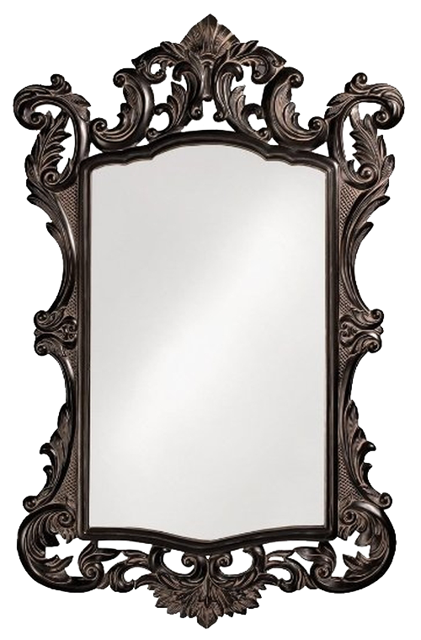
God’s Mirror James 1:22-25

Slide 2
God’s Mirror
James 1:22-25
Stan Cox – Evangelist
West Side church of Christ
Notes:
Some interesting notes about mirrors
Probably first time a man saw his reflection was in a pool of water
In ancient times, copper, steel, silver and gold were used to make mirrors (high polish)
Interestingly, the first glass mirrors date to the first century. However, it was still more common to use metal at that time.
Most of us used a mirror this morning.
In fact, most people use a mirror several times a day.
The reasons are obvious.
We want to know how we look because we care about how we look.
A mirror is a tool we use to improve our appearance.
James used the illustration of a mirror to teach an important spiritual truth
(James 1:22-25), “But be doers of the word, and not hearers only, deceiving yourselves. ²³ For if anyone is a hearer of the word and not a doer, he is like a man observing his natural face in a mirror; ²⁴ for he observes himself, goes away, and immediately forgets what kind of man he was. ²⁵ But he who looks into the perfect law of liberty and continues in it, and is not a forgetful hearer but a doer of the work, this one will be blessed in what he does.”
The person who hears God's word but will not obey it is like a man who looks at a mirror, sees his appearance, yet fails to improve himself.
He forgets what he saw - it makes no impression on him.
Since we all need spiritual improvement, none of us should be like this self-deluded man.
Consider the following comparisons of God's word to a mirror:

Slide 3
We must know how we look to God
James 1:23
2 Corinthians 13:5
Romans 3:23
Acts 2:38
Stan Cox – Evangelist
West Side church of Christ
Notes:
We must know how we look to God
Whether we pay attention to our spiritual appearance, God knows exactly how we look
Too many are self-deluded (Rose colored glasses).
(Vanity filters on your cell phone. Run yourself through such a filter a few times…, look good, but NOT natural!)
God’s word shows us how we look to Him
(James 1:23), “For if anyone is a hearer of the word and not a doer, he is like a man observing his natural face in a mirror; ²⁴ for he observes himself, goes away, and immediately forgets what kind of man he was.”
If we can manage to see ourselves as God sees us (what kind of man), we are able to make God-approved improvements
(2 Corinthians 13:5), “Examine yourselves as to whether you are in the faith. Test yourselves. Do you not know yourselves, that Jesus Christ is in you?—unless indeed you are disqualified. ⁶ But I trust that you will know that we are not disqualified.”
Shows the importance of this self-examination
Also shows Paul’s confidence that the mirror of God’s word would prove to the Corinthians that he was righteous
God's word shows us our sins and teaches us what to do about them
(Romans 3:23), “for all have sinned and fall short of the glory of God”
(Acts 2:38), “Then Peter said to them, “Repent, and let every one of you be baptized in the name of Jesus Christ for the remission of sins; and you shall receive the gift of the Holy Spirit.”

Slide 4
We should want to improve our appearance
James 1:24
James 1:25
1 John 1:6-9
Stan Cox – Evangelist
West Side church of Christ
Notes:
We should want to improve our appearance
In James 1:24, James talks about how ridiculous it is to use a mirror, and not act upon the information it reveals.
(James 1:24), “for he observes himself, goes away, and immediately forgets what kind of man he was.”
Wake up in the morning, hair really looks crazy, then walk away without combing it.
Woman checking her makeup sees smudged mascara, then walks away without fixing it.
Checking your teeth, and seeing spinach stuck between them, and not removing it.
RIDICULOUS!
Nothing is gained by using God's word to learn of our spiritual condition, but not acting upon what we learn
Finding we are in sin, but then failing to repent and obey God.
Only by making the necessary changes in heart and conduct that God's word teaches will you be blessed
(James 1:25), “But he who looks into the perfect law of liberty and continues in it, and is not a forgetful hearer but a doer of the work, this one will be blessed in what he does.”
(1 John 1:6-9), “If we say that we have fellowship with Him, and walk in darkness, we lie and do not practice the truth. ⁷ But if we walk in the light as He is in the light, we have fellowship with one another, and the blood of Jesus Christ His Son cleanses us from all sin. ⁸ If we say that we have no sin, we deceive ourselves, and the truth is not in us. ⁹ If we confess our sins, He is faithful and just to forgive us our sins and to cleanse us from all unrighteousness.”

Slide 5
We must use a reliable mirror to make reliable changes
James 1:25
Matthew 15:1-9
2 Timothy 3:16-17
Stan Cox – Evangelist
West Side church of Christ
Notes:
We must use a reliable mirror in order to be make reliable changes
(James 1:25), “But he who looks into the perfect law of liberty and continues in it, and is not a forgetful hearer but a doer of the work, this one will be blessed in what he does.”
Some mirrors distort images instead of giving a clear reflection.
Fun house mirrors are especially known for this, VERY distorted
A manufacturer sells what it calls the SKINNY MIRROR, and sells it to some retail stores
The company, founded in 2013, produces mirrors designed to make one’s reflection appear 5 to 10 pounds thinner. The Skinny Mirror claims the mirrors can boost stores’ retail sales by up to 18 percent.
Man-made doctrines distort the will of God and are not unreliable "mirrors" to use to be assured of God's approval
Some are very subtle in their distortion, but regardless they do not reflect reality
(Matthew 15:1-9), “Then the scribes and Pharisees who were from Jerusalem came to Jesus, saying, ² “Why do Your disciples transgress the tradition of the elders? For they do not wash their hands when they eat bread.” ³ He answered and said to them, “Why do you also transgress the commandment of God because of your tradition? ⁴ For God commanded, saying, “Honor your father and your mother’; and, ‘He who curses father or mother, let him be put to death.’ ⁵ But you say, “Whoever says to his father or mother, ‘Whatever profit you might have received from me is a gift to God”— ⁶ then he need not honor his father or mother.’ Thus you have made the commandment of God of no effect by your tradition. ⁷ Hypocrites! Well did Isaiah prophesy about you, saying: ⁸ ‘These people draw near to Me with their mouth, And honor Me with their lips, But their heart is far from Me. ⁹ And in vain they worship Me, Teaching as doctrines the commandments of men.’”
Only God's word is reliable and sufficient to improve your spiritual condition before God
(2 Timothy 3:16-17), “All Scripture is given by inspiration of God, and is profitable for doctrine, for reproof, for correction, for instruction in righteousness, ¹⁷ that the man of God may be complete, thoroughly equipped for every good work.”
Conclusion:
Look into the perfect law of liberty
Act on what you see!
Do you need to change? Make the changes necessary to please Him!
Be a doer of the work! Not just a hearer of the word.

Slide 6
For more Bible Study material
go to
http://soundteaching.org

