Slide 1
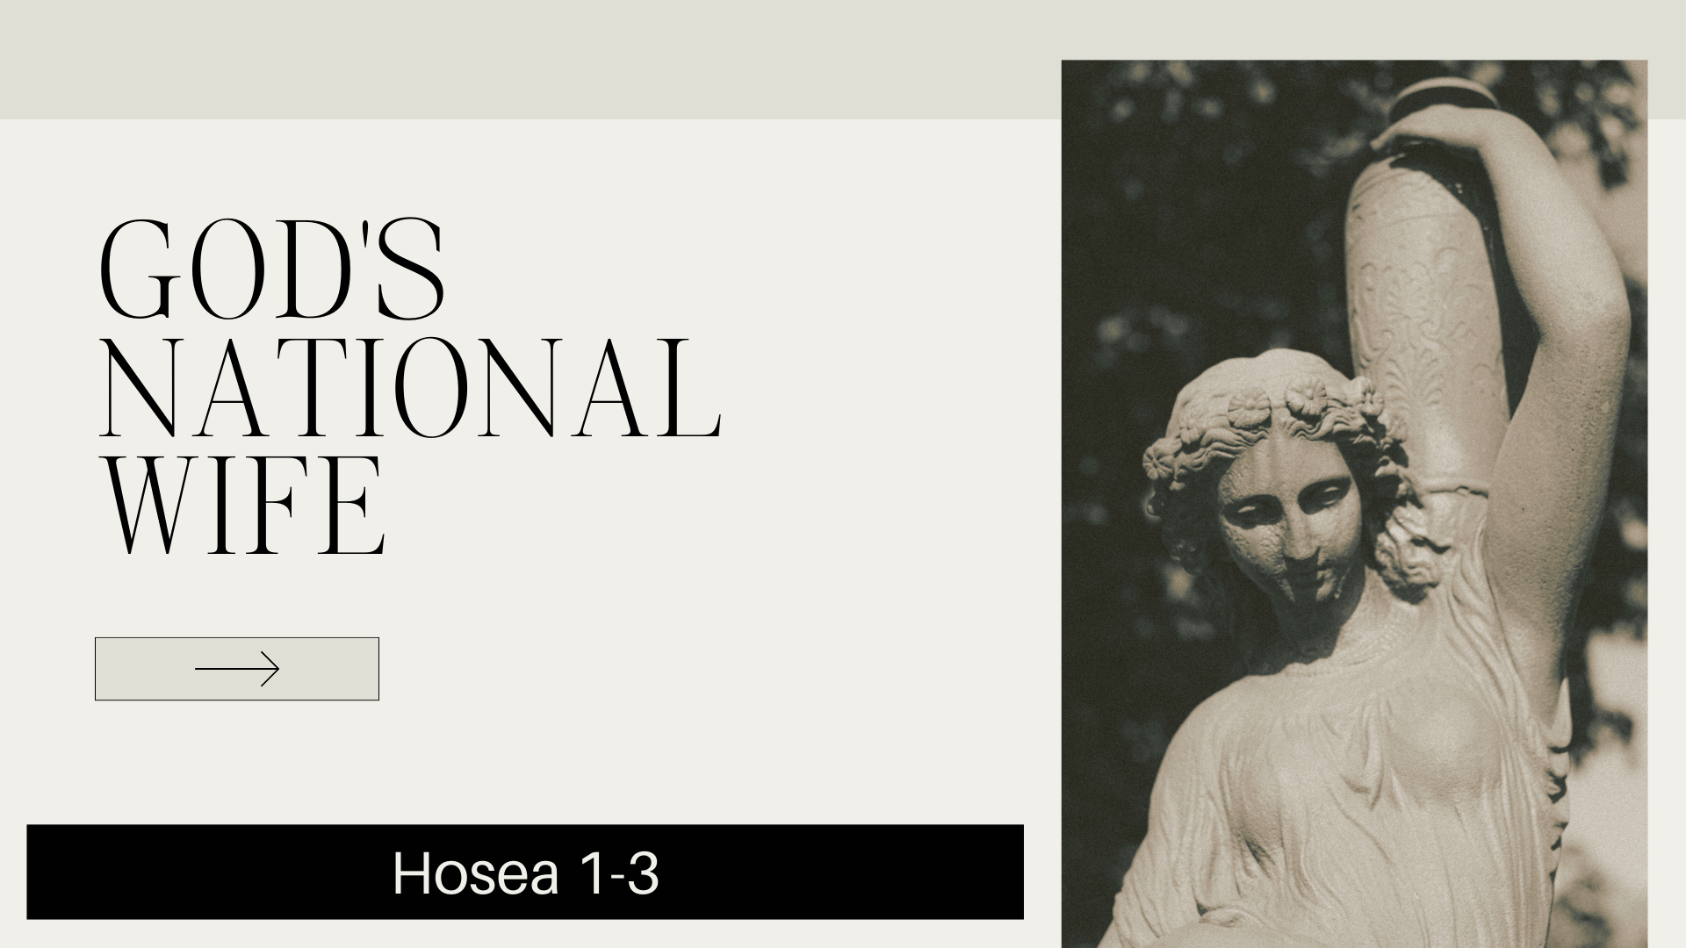

Slide 2
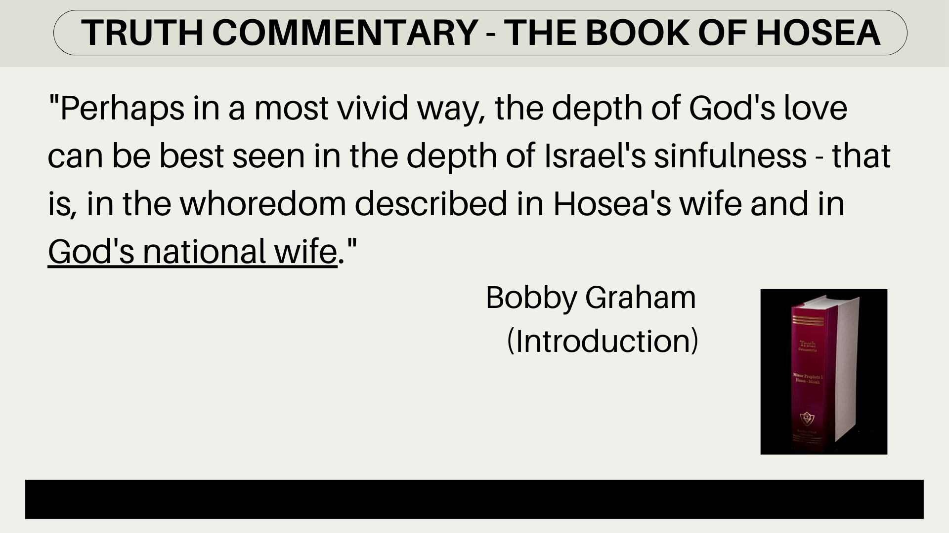
Jezreel – God Scatters
Lo-Ruhamah – No Mercy
Lo-Ammi – Not My People

Slide 3
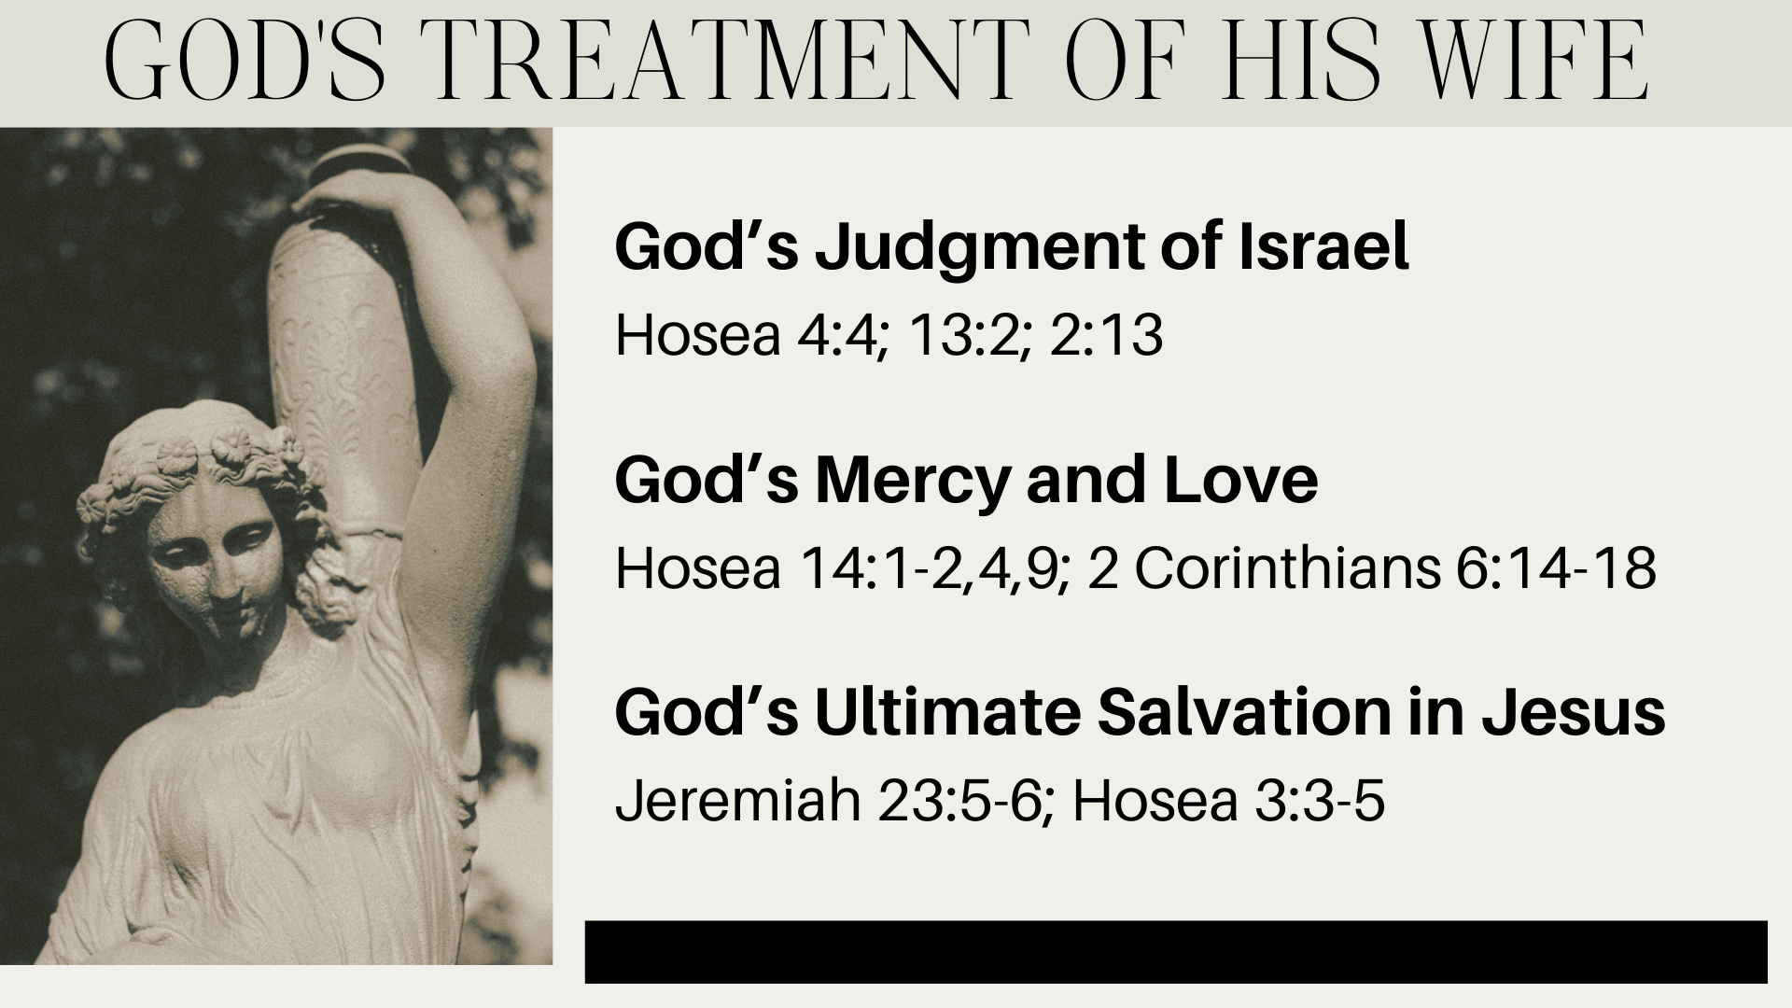

Slide 4
