Slide 1
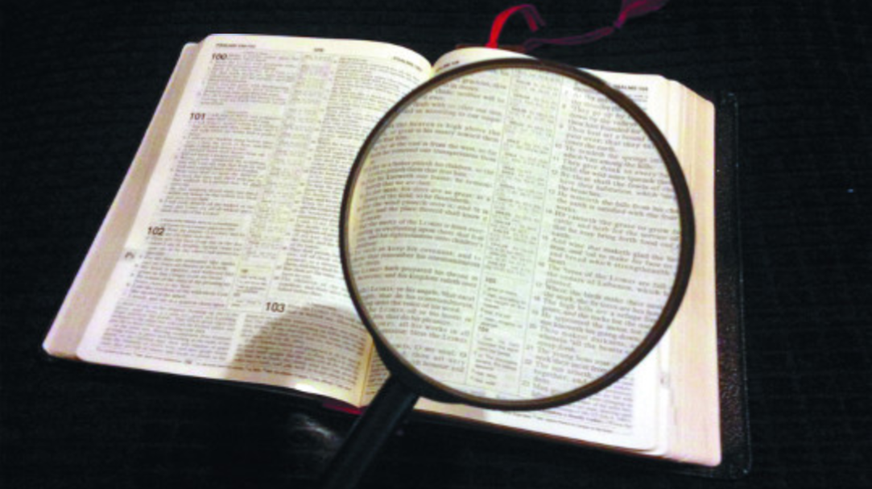
God’s
Word is
Excellent!
Psalm 119
Notes:
God’s Word is Excellent!
Based on a sermon idea by Jeremiah Cox
(Correlates with the call to begin a systemic Bible reading habit in the New Year)
Introduction:
The 119th Psalm is a wonderful treatise on the excellence of God’s word
As Christians, our view of the Bible (and its importance) is almost unique
Few denominations give anything other than lip service to scripture. Often departing from it, developing man made creeds, taking issue with some of the principles contained within it.
We accept the sentiment that scripture thoroughly equips us in life.
(2 Timothy 3:16-17), “All Scripture is given by inspiration of God, and is profitable for doctrine, for reproof, for correction, for instruction in righteousness, ¹⁷ that the man of God may be complete, thoroughly equipped for every good work.”
Following God’s word bring’s God lbessings upon us, and helps us to avoid the shame of sin.
(Psalm 119:1-6) “Blessed are the undefiled in the way, who walk in the law of the Lord! ² Blessed are those who keep His testimonies, who seek Him with the whole heart! ³ They also do no iniquity; they walk in His ways. ⁴ You have commanded us to keep Your precepts diligently. ⁵ Oh, that my ways were directed to keep Your statutes! ⁶ Then I would not be ashamed, when I look into all Your commandments. ⁷ I will praise You with uprightness of heart, when I learn Your righteous judgments. ⁸ I will keep Your statutes; Oh, do not forsake me utterly!”
An ability to be ashamed of actions is important, and the sign of a tender conscience
It, together with a knowledge of God’s will, leads us to act in a way to avoid the shame of disobedience to our God.
Let us consider some of the blessings we receive from God’s excellent word!

Slide 2
Blessings from God’s Excellent Word
It directs and enlightens our path (vs. 105)
It enables us to avoid sin against God (vs. 11)
It brings comfort and peace (vs. 49-56, 165)
It brings true wisdom (vs. 97-100)
It supplies answers to opponents (vs. 42)
It brings salvation (vs. 41, 81, 123-124, 155)
Notes:
It directs and enlightens our path
(Psalm 119:105), “Your word is a lamp to my feet and a light to my path.”
The concept of a correct path to walk (as it pertains to our life, and our eternal reward) is common in scripture.
(Matthew 7:13-14), “Enter by the narrow gate; for wide is the gate and broad is the way that leads to destruction, and there are many who go in by it. ¹⁴ Because narrow is the gate and difficult is the way which leads to life, and there are few who find it.”
Illumination for that path (the path itself) is found in an appeal to scripture.
(Psalm 119:35), “Make me walk in the path of Your commandments, for I delight in it.”
[CLICK] It enables us to avoid sin against God
(Psalm 119:11), “Your word I have hidden in my heart, that I might not sin against You.”
Sin is a missing of the mark. That mark is God’s word!
(Matthew 7:21-23), “Not everyone who says to Me, ‘Lord, Lord,’ shall enter the kingdom of heaven, but he who does the will of My Father in heaven. ²² Many will say to Me in that day, ‘Lord, Lord, have we not prophesied in Your name, cast out demons in Your name, and done many wonders in Your name?’ ²³ And then I will declare to them, ‘I never knew you; depart from Me, you who practice lawlessness!’”
[CLICK] It brings comfort and peace
(Psalm 119:49-56), “Remember the word to Your servant, upon which You have caused me to hope. ⁵⁰ This is my comfort in my affliction, for Your word has given me life. ⁵¹ The proud have me in great derision, yet I do not turn aside from Your law. ⁵² I remembered Your judgments of old, O Lord, and have comforted myself. ⁵³ Indignation has taken hold of me because of the wicked, who forsake Your law. ⁵⁴ Your statutes have been my songs in the house of my pilgrimage. ⁵⁵ I remember Your name in the night, O Lord, and I keep Your law. ⁵⁶ This has become mine, because I kept Your precepts.”
(Psalm 119:165), “Great peace have those who love Your law, and nothing causes them to stumble.”
Imagine the unrest in knowing there is a right way, but not knowing whether you are walking in it!
Remember Josiah’s reaction to re-discovering the book of the Law?
(2 Kings 22:11-13), “Now it happened, when the king heard the words of the Book of the Law, that he tore his clothes. ¹² Then the king commanded Hilkiah the priest, Ahikam the son of Shaphan, Achbor the son of Michaiah, Shaphan the scribe, and Asaiah a servant of the king, saying, ¹³ “Go, inquire of the Lord for me, for the people and for all Judah, concerning the words of this book that has been found; for great is the wrath of the Lord that is aroused against us, because our fathers have not obeyed the words of this book, to do according to all that is written concerning us.”
The calm certainty of knowing what is right is a wonderful feeling!
[CLICK] It brings true wisdom
(Psalm 119:97-100), “Oh, how I love Your law! It is my meditation all the day. ⁹⁸ You, through Your commandments, make me wiser than my enemies; for they are ever with me. ⁹⁹ I have more understanding than all my teachers, for Your testimonies are my meditation. ¹⁰⁰ I understand more than the ancients, because I keep Your precepts.”
Wiser than enemies, teachers, ancients (predecessors). Should not bring arrogance, but confidence!
(1 Corinthians 3:18-23), “Let no one deceive himself. If anyone among you seems to be wise in this age, let him become a fool that he may become wise. ¹⁹ For the wisdom of this world is foolishness with God. For it is written, “He catches the wise in their own craftiness”; ²⁰ and again, “The Lord knows the thoughts of the wise, that they are futile.” ²¹ Therefore let no one boast in men. For all things are yours: ²² whether Paul or Apollos or Cephas, or the world or life or death, or things present or things to come—all are yours. ²³ And you are Christ's, and Christ is God’s.”
[CLICK] It supplies answers to opponents
(Psalm 119:42), “So shall I have an answer for him who reproaches me, for I trust in Your word.”
The answers from God’s word are right, and defensible. The truth does not need to fear examination.
Peter understood this, and gave instructions even in the midst of suffering persecution
(1 Peter 3:15), “But sanctify the Lord God in your hearts, and always be ready to give a defense to everyone who asks you a reason for the hope that is in you, with meekness and fear.”
[CLICK] It brings salvation (vs. 41, 81, 123, 155)
(Psalm 119:41), “Let Your mercies come also to me, O Lord—Your salvation according to Your word.”
(Psalm 119:81), “My soul faints for Your salvation, but I hope in Your word.”
(Psalm 119:123-124), “My eyes fail from seeking Your salvation and Your righteous word. ¹²⁴ Deal with Your servant according to Your mercy, and teach me Your statutes.”
(Psalm 119:155), “Salvation is far from the wicked, for they do not seek Your statutes.”
God always ties salvation to obedience to His will
A man is found righteous before God as he conforms his life to God’s word!
(Philippians 2:12-16), “Therefore, my beloved, as you have always obeyed, not as in my presence only, but now much more in my absence, work out your own salvation with fear and trembling; ¹³ for it is God who works in you both to will and to do for His good pleasure. ¹⁴ Do all things without complaining and disputing, ¹⁵ that you may become blameless and harmless, children of God without fault in the midst of a crooked and perverse generation, among whom you shine as lights in the world, ¹⁶ holding fast the word of life, so that I may rejoice in the day of Christ that I have not run in vain or labored in vain.”

Slide 3
Do You properly respect
God’s word?
Psalm 119:15-16
Notes:
Do you truly respect the excellence of God’s word, and what it provides you as you live your life?
(Psalm 119:15-16), “I will meditate on Your precepts, and contemplate Your ways. ¹⁶ I will delight myself in Your statutes; I will not forget Your word.”
Let His will guide us in every aspect of our lives!
We call upon all to respond in faith to God’s word, and obey His commands to your salvation

