Slide 1
G O S S I P
the sin of
James 3:5-6
Notes:
Introduction:
I am sure that all are in agreement that the tongue is a powerful thing
Words bring comfort and express kindness and concern
Words impart wisdom and knowledge, and are used to spread God’s truths
The tongue can be used in destructive ways as well.
(James 3:5-6), “Even so the tongue is a little member and boasts great things. See how great a forest a little fire kindles! ⁶ And the tongue is a fire, a world of iniquity. The tongue is so set among our members that it defiles the whole body, and sets on fire the course of nature; and it is set on fire by hell.”
Words have started world wars
Words have destroyed churches and divided brethren
Words have gutted homes and ended marriages.
Words have turned friends into enemies
We must learn to restrain our tongues! This takes the control of our hearts to accomplish.
(Matthew 15:11), “Not what goes into the mouth defiles a man; but what comes out of the mouth, this defiles a man.”
(Matthew 15:16-20), “So Jesus said, “Are you also still without understanding? ¹⁷ Do you not yet understand that whatever enters the mouth goes into the stomach and is eliminated? ¹⁸ But those things which proceed out of the mouth come from the heart, and they defile a man. ¹⁹ For out of the heart proceed evil thoughts, murders, adulteries, fornications, thefts, false witness, blasphemies. ²⁰ These are the things which defile a man, but to eat with unwashed hands does not defile a man.”
One of the things that defiles a man is the sin of Gossip
It shows contempt for your neighbor
It is evidence of an unrestrained tongue, without the control of a good heart.
(James 3:8-10), “But no man can tame the tongue. It is an unruly evil, full of deadly poison. ⁹ With it we bless our God and Father, and with it we curse men, who have been made in the similitude of God. ¹⁰ Out of the same mouth proceed blessing and cursing. My brethren, these things ought not to be so.”
So, we need to document how God feels about this sin, and how to avoid it!
Points taken from an article, The Sin of Gossip, written by Joe R. Price. (The Spirit’s Sword, June 2, 2002)

Slide 2
The Person who Gossips is a Talebearer
Proverbs 17:9; 18:8
Notes:
The person who gossips is a talebearer.
(Proverbs 17:9), “He who covers a transgression seeks love, but he who repeats a matter separates friends.”
It is disturbing how much thrill and enjoyment the gossip gets out of spreading tales
(Proverbs 18:8), “The words of a talebearer are like tasty trifles, and they go down into the inmost body.”
We can’t emphasize enough how destructive their efforts can be
The gossip spreads poison to others, and especially to their own souls

Slide 3
The Person who Gossips Sows Strife
Proverbs 16:16,19
Notes:
The person who gossips sows strife.
One who "sows discord among brethren" is an abomination to the Lord
(Proverbs 6:16), “These six things the Lord hates, yes, seven are an abomination to Him.”
(6:19), “A false witness who speaks lies, and one who sows discord among brethren.”
That, and that alone, is reason enough not to gossip.

Slide 4
The Person who Gossips Is A Slanderer
Proverbs 16:28 Psalm 101:5
Notes:
The person who gossips is a slanderer.
(Proverbs 16:28), “A perverse man sows strife, and a whisperer separates the best of friends.”
A desire to bring strife is a perverse desire (corrupt). Whispering to destroy reputations is slander.
(Psalm 101:5), “Whoever secretly slanders his neighbor, him I will destroy; the one who has a haughty look and a proud heart, him I will not endure.”

Slide 5
The Person who Gossips Is A BusyBody
1 Peter 4:15 2 Thessalonians 3:11-12
Notes:
The person who gossips is a busybody
(1 Peter 4:15), “But let none of you suffer as a murderer, a thief, an evildoer, or as a busybody in other people’s matters.”
Definition: one who takes the supervision of affairs pertaining to others and in no wise to himself, [a meddler in other men's matters] (Thayer)
Gossip is truly meddling! (It affects others. It damages reputations. It is censorious and judgmental. It is harmful!
(2 Thessalonians 3:11-12), “For we hear that there are some who walk among you in a disorderly manner, not working at all, but are busybodies. Now those who are such we command and exhort through our Lord Jesus Christ that they work in quietness and eat their own bread.”
Now, with the next two slides: How to avoid Gossip?

Slide 6
Idleness Invites Gossiping
1 Timothy 5:13
Notes:
Idleness invites gossiping (So you need to be industrious!)
(1 Timothy 5:13), “And besides they learn to be idle, wandering about from house to house, and not only idle but also gossips and busybodies, saying things which they ought not.”
Those who are busy have little time to insert themselves into other lives
“Idle hands are the devil’s workshop!”
To avoid the sin of gossip, use your time productively, bearing righteous rather than poisonous fruit!

Slide 7
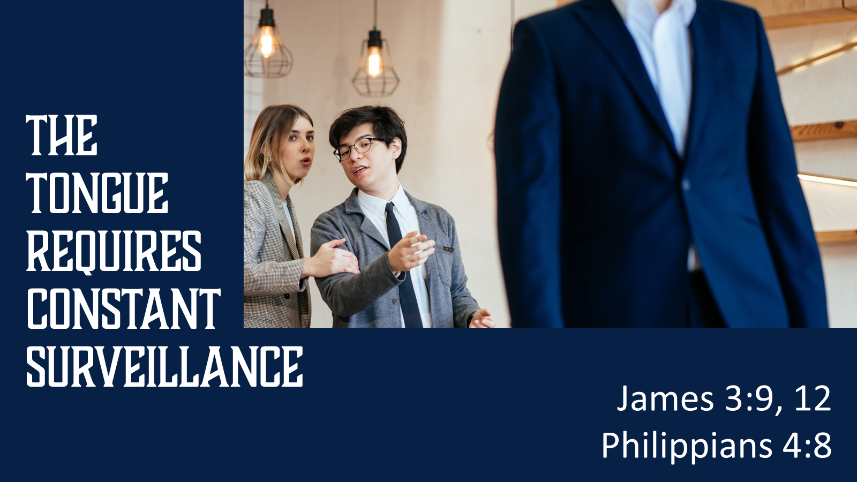
The Tongue Requires Constant Surveillance
James 3:9, 12 Philippians 4:8
Notes:
The tongue requires constant surveillance
(James 3:8), “But no man can tame the tongue. It is an unruly evil, full of deadly poison.”
Illustration: A careful lion tamer does not turn his back on the lion
In 2003 Roy Horn of the lion tamer duo Siegfried and Roy was attacked by a White lion
He was bit first on the arm, then reacting by slapping the cat, the lion knocked him off his feet, and bit his neck, severing his spine and causing a stroke. That, and massive blood loss cause permanent motor and speech damage.
He survived, but barely. This was a man fully at home with the animals, who made a simple mistake in dealing with them
In the same way, even the most experienced of us can sin because of an unguarded moment. The tongue is that dangerous!
(James 3:9-12), “With it we bless our God and Father, and with it we curse men, who have been made in the similitude of God. ¹⁰ Out of the same mouth proceed blessing and cursing. My brethren, these things ought not to be so. ¹¹ Does a spring send forth fresh water and bitter from the same opening? ¹² Can a fig tree, my brethren, bear olives, or a grapevine bear figs? Thus no spring yields both salt water and fresh.”
Constant vigilance is required for it to be effective for blessing rather than cursing.
We must keep our hearts pure, guarding against the sin of gossip
(Philippians 4:8), “Finally, brethren, whatever things are true, whatever things are noble, whatever things are just, whatever things are pure, whatever things are lovely, whatever things are of good report, if there is any virtue and if there is anything praiseworthy—meditate on these things.”

Slide 8
Conclusion Gossip is not harmless or minor. God hates it, and so should we!
cf. Proverbs 16:19
Notes:
Conclusion
Among the 7 things that are an abomination to God (cf. Proverbs 6:19) is the “one who sows discord among brethren.”
It is not harmless. It is not minor. God hates it and so should we!

