Slide 1
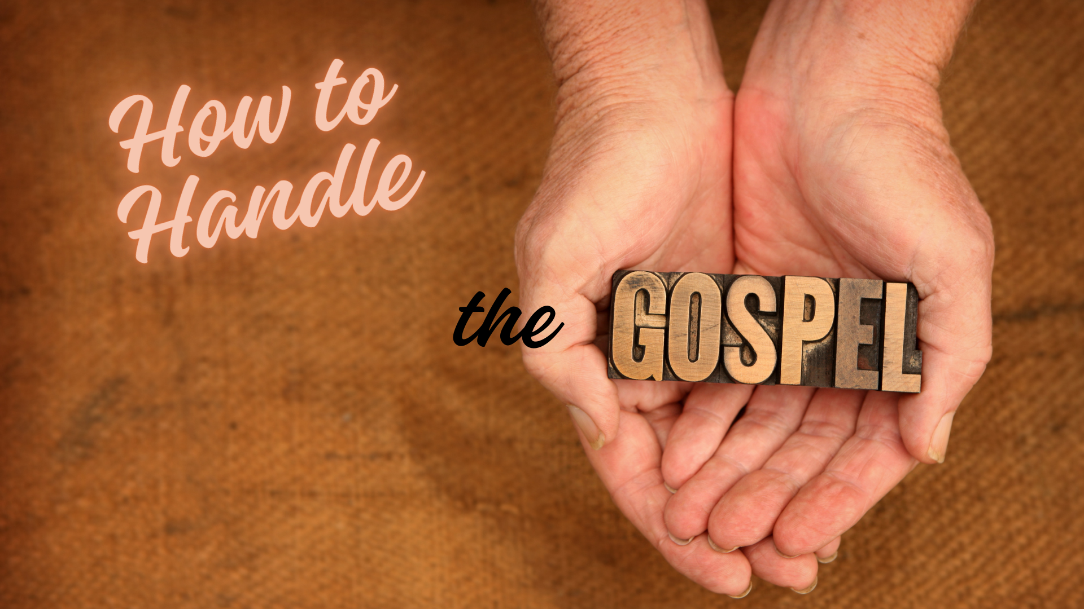
Notes:
Introduction:
The Bible very clearly establishes the value and power of the gospel of Christ
Its value is such that it should be treated with the utmost care
Just like we would handle anything that is precious, and that can be ruined.
Car – Caution, precious cargo (children).
(2 Timothy 2:15 NKJV) "Be diligent to present yourself approved to God, a worker who does not need to be ashamed, rightly dividing the word of truth.“
(2 Peter 3:14-16 NKJV) "Therefore, beloved, looking forward to these things, be diligent to be found by Him in peace, without spot and blameless; and consider that the longsuffering of our Lord is salvation--as also our beloved brother Paul, according to the wisdom given to him, has written to you, as also in all his epistles, speaking in them of these things, in which are some things hard to understand, which untaught and unstable people twist to their own destruction, as they do also the rest of the Scriptures."
The world is plagued with an inability or unwillingness to handle the gospel aright.
It leads to immorality and worldliness
It leads to doctrinal error
It leads to digression and apostasy
We need to be aware of the same danger of not handling the gospel correctly. Hence a discussion of these 7 points
Based on an article by Dub McClish (January 5, 1978)

Slide 2
Do Not Be Ashamed
Consider how much Paul valued the gospel!
Romans 1:15-16
Worldliness and Pride can cause us to be ashamed!
Notes:
How to Handle the Gospel – Do not be Ashamed of it!
Consider Paul’s ministry in the gospel of Jesus Christ
He suffered greatly (cf. 2 Corinthians 11)
Why would he willing to suffer so much for a faith he once persecuted.
Because of the value of the truth!
(Romans 1:15-16 NKJV) "So, as much as is in me, I am ready to preach the gospel to you who are in Rome also. For I am not ashamed of the gospel of Christ, for it is the power of God to salvation for everyone who believes, for the Jew first and also for the Greek."
Too often worldliness and pride cause us to be ashamed of the truth, our brethren, the church.
This constitutes a mishandling of the gospel!

Slide 3
Do Not Pervert
Pervert – to corrupt (literally, a turn about, turn around).
Galatians 1:6-7
When the gospel is changed, it is no longer good news.
Notes:
How to Handle the Gospel – Do Not Pervert it.
(Galatians 1:6-7 NKJV) "I marvel that you are turning away so soon from Him who called you in the grace of Christ, to a different gospel, which is not another; but there are some who trouble you and want to pervert the gospel of Christ.“
Pervert – (metastrephō) – to turn about, turn around. Equivalent to to pervert, corrupt.
Just like a pure glass of water, with any kind of foreign substance put in. No longer trustworthy, drinkable, palatable.
When the gospel is changed, it is no longer good news (see text again)
It brings severe consequences
(Galatians 1:8-9 NKJV) "But even if we, or an angel from heaven, preach any other gospel to you than what we have preached to you, let him be accursed. As we have said before, so now I say again, if anyone preaches any other gospel to you than what you have received, let him be accursed."

Slide 4
Obey
Initial obedience to the gospel of Jesus Christ.
2 Thessalonians 1:6-10
Obey or Else. Flaming Fire or Eternal Rest.
Notes:
How to Handle the Gospel - Obey It.
Here we are talking about an initial obedience to the gospel of Christ
It is a binary choice. No equivocation. Yes to No. Both have consequences.
(2 Thessalonians 1:6-10 NKJV) "since it is a righteous thing with God to repay with tribulation those who trouble you, and to give you who are troubled rest with us when the Lord Jesus is revealed from heaven with His mighty angels, in flaming fire taking vengeance on those who do not know God, and on those who do not obey the gospel of our Lord Jesus Christ. These shall be punished with everlasting destruction from the presence of the Lord and from the glory of His power, when He comes, in that Day, to be glorified in His saints and to be admired among all those who believe, because our testimony among you was believed.“
Salvation is available only to those who are obedient to the gospel of Jesus Christ
Without Salvation, all we have to look forward to is eternal punishment

Slide 5
Defend
It is incorrect to say that the truth needs no defense.
Philippians 1:7; Jude 3
A failure to defend the truth is unconscionable.
Notes:
How to Handle the Gospel - Defend it.
Some say that the truth needs no defense
This is simply not so, the Bible is replete with commands to defend the truth against error.
We are to wage warfare. Truth will be victorious, but sophistry unanswered can sway the unstable!
(Philippians 1:7 NKJV) "just as it is right for me to think this of you all, because I have you in my heart, inasmuch as both in my chains and in, you all are partakers with me of grace. the defense and confirmation of the gospel.”
(Jude 3 NKJV) "Beloved, while I was very diligent to write to you concerning our common salvation, I found it necessary to write to you exhorting you to contend earnestly for the faith which was once for all delivered to the saints.“
A failure to defend the truth is totally unacceptable for the child of God. It would definitely be a mishandling of the gospel

Slide 6
Hold Fast
Now we are talking about remaining faithful!
1 Corinthians 15:1-2, 58
Hebrews 2:1-3
Drifting can lead to loss.
Notes:
How to Handle the Gospel - Hold Fast To It.
Not only must the gospel be obeyed, we must remain faithful to it for our entire life!
(1 Corinthians 15:1-2), "Moreover, brethren, I declare to you the gospel which I preached to you, which also you received and in which you stand, by which also you are saved, if you hold fast that word which I preached to you--unless you believed in vain.”
(1 Corinthians 15:58), “Therefore, my beloved brethren, be steadfast, immovable, always abounding in the work of the Lord, knowing that your labor is not in vain in the Lord."
Drifting can lead to loss
(Hebrews 2:1-3) "Therefore we must give the more earnest heed to the things we have heard, lest we drift away. For if the word spoken through angels proved steadfast, and every transgression and disobedience received a just reward, how shall we escape if we neglect so great a salvation, which at the first began to be spoken by the Lord, and was confirmed to us by those who heard Him,“
Don’t suffer the shipwreck of your faith, like Hymenaeus and Alexander (cf. 1 Timothy 1:19)

Slide 7
Live Worthy
The gospel is perfect, a high standard to live by!
Philippians 1:27
Ephesians 4:1
What do others think about our conduct?
Notes:
How to Handle the Gospel - Live Worthy of it.
This is a real challenge for every disciple. When you consider the perfection of God’s word, to live a worthy life in response takes diligence and effort.
These are the works of God
(Ephesians 2:10 NKJV) "For we are His workmanship, created in Christ Jesus for good works, which God prepared beforehand that we should walk in them.“
This is a continuous challenge levied by Paul in his epistles
(Philippians 1:27 NKJV) "Only let your conduct be worthy of the gospel of Christ, so that whether I come and see you or am absent, I may hear of your affairs, that you stand fast in one spirit, with one mind striving together for the faith of the gospel."
(Ephesians 4:1 NKJV) "I, therefore, the prisoner of the Lord, beseech you to walk worthy of the calling with which you were called,"
What do others think of the church and the gospel because of our speech and conduct? Are they impressed? Are they critical?

Slide 8
Preach
Salt does no good if it remains in the shaker!
1 Corinthians 9:16
The gospel must be shared, not shelved.
Notes:
How to Handle the Gospel - Preach it.
Salt does no good if it remains in the shaker
The gospel is the fragrance of life to those being saved. Are we diffusing it?
(1 Corinthians 9:16 NKJV) "For if I preach the gospel, I have nothing to boast of, for necessity is laid upon me; yes, woe is me if I do not preach the gospel!"
The gospel must be shared, not shelved.
Conclusion and Invitation:
Our eternal destiny depends upon what we do with the Good News of Christ
Today there may be some here who need to obey it. (Again, a binary choice. Yes or No).
Will you come forward today, and begin to rightly handle the gospel of Christ?

