Slide 1

Notes:
Husbands and Wives
(Ephesians 5:22-33)
INTRODUCTION:
The husband/wife relationship is the most intimate and loving relationship on earth. (Or, at least it should be)
This was the way it was intended by God from the beginning
Genesis 2:20-24 So Adam gave names to all cattle, to the birds of the air, and to every beast of the field. But for Adam there was not found a helper comparable to him. (21) And the LORD God caused a deep sleep to fall on Adam, and he slept; and He took one of his ribs, and closed up the flesh in its place. (22) Then the rib which the LORD God had taken from man He made into a woman, and He brought her to the man. (23) And Adam said: "This is now bone of my bones And flesh of my flesh; She shall be called Woman, Because she was taken out of Man." (24) Therefore a man shall leave his father and mother and be joined to his wife, and they shall become one flesh.
Consider some truths from these verses:
Word "helper" - to help or succor (which means to assist during times of hardship or distress).
Word "comparable" - seems to indicate an ability to supply what is needed or lacking.
Neither word indicates anything lesser than the man
The woman is a companion, different than the man, but similar enough for the two to complement one another. I.E. God made her directly for the man!
The headship of the man is not a estimation of his relative value or importance. It is due to the order and purpose of their Creation.
1 Corinthians 11:7-9 For a man indeed ought not to cover his head, since he is the image and glory of God; but woman is the glory of man. (8) For man is not from woman, but woman from man. (9) Nor was man created for the woman, but woman for the man.
The reason she was named woman "Because she was taken out of man"
The feminized version of the word for man in the Hebrew. Same kind (humans), but the counterpart to them man.
"One flesh." (The marriage)
Sexual activity is both an obligation and exclusively the domain of husband and wife. (Any other sexuality is perversion, including heretosexual sex outside of the marriage relationship).
The husband/wife relationship is the most significant human relationship on earth. (More even than parent/child).
Matthew 19:6 So then, they are no longer two but one flesh. Therefore what God has joined together, let not man separate."
As Christians, we should realize that God gives no more liberty to divorce your spouse as he does to desert your parents or children. In fact, the relationship, entered into voluntarily by both parties, should be the closest and most sacrosanct of all.
The parameters God set from the beginning serve as the basis of Paul's teaching in Ephesians 5. Let's consider what Paul has to say.

Slide 2

Notes:
The Wife
"Wives, submit to your own husbands, as to the Lord" (22)
As indicated in verse 23, this call to submit is an acknowledgment of the headship of the man in the husband/wife relationship.
1 Corinthians 11:8-9 For man is not from woman, but woman from man. (9) Nor was man created for the woman, but woman for the man.
The nature of this headship is prescribed. In other words, it can't be ignored just because both the husband and the wife agree. The man's responsibility to head the family is a non-negotiable obligation. The wife's responsibility to submit ("in everything", vs. 24) is likewise non-negotiable.
1 Peter 3:5-6 For in this manner, in former times, the holy women who trusted in God also adorned themselves, being submissive to their own husbands, (6) as Sarah obeyed Abraham, calling him lord, whose daughters you are if you do good and are not afraid with any terror.
Note: Though this passage does not explicitly state the necessity of loving the husband, it is an obvious aspect of willing submission!
This too can be illustrated in the disciple's relationship to Jesus. He said:
John 14:15 "If you love Me, keep My commandments.
Such an intimate, willing submission indicates love. A relationship that is built upon such a principle will not work if the submissive party is antagonistic to such humility.
Ladies, in our culture especially, you choose who you will marry.
In your choice, this consideration is important. Do you love and trust this man enough to submit (to subordinate yourself to... to put yourself under and obey) to him? When you marry, this is a commitment you make before God!
This is not to say it's your fault if your husband acts in ungodly ways. It is simply a warning to be careful and to be sure before marrying a man.

Slide 3
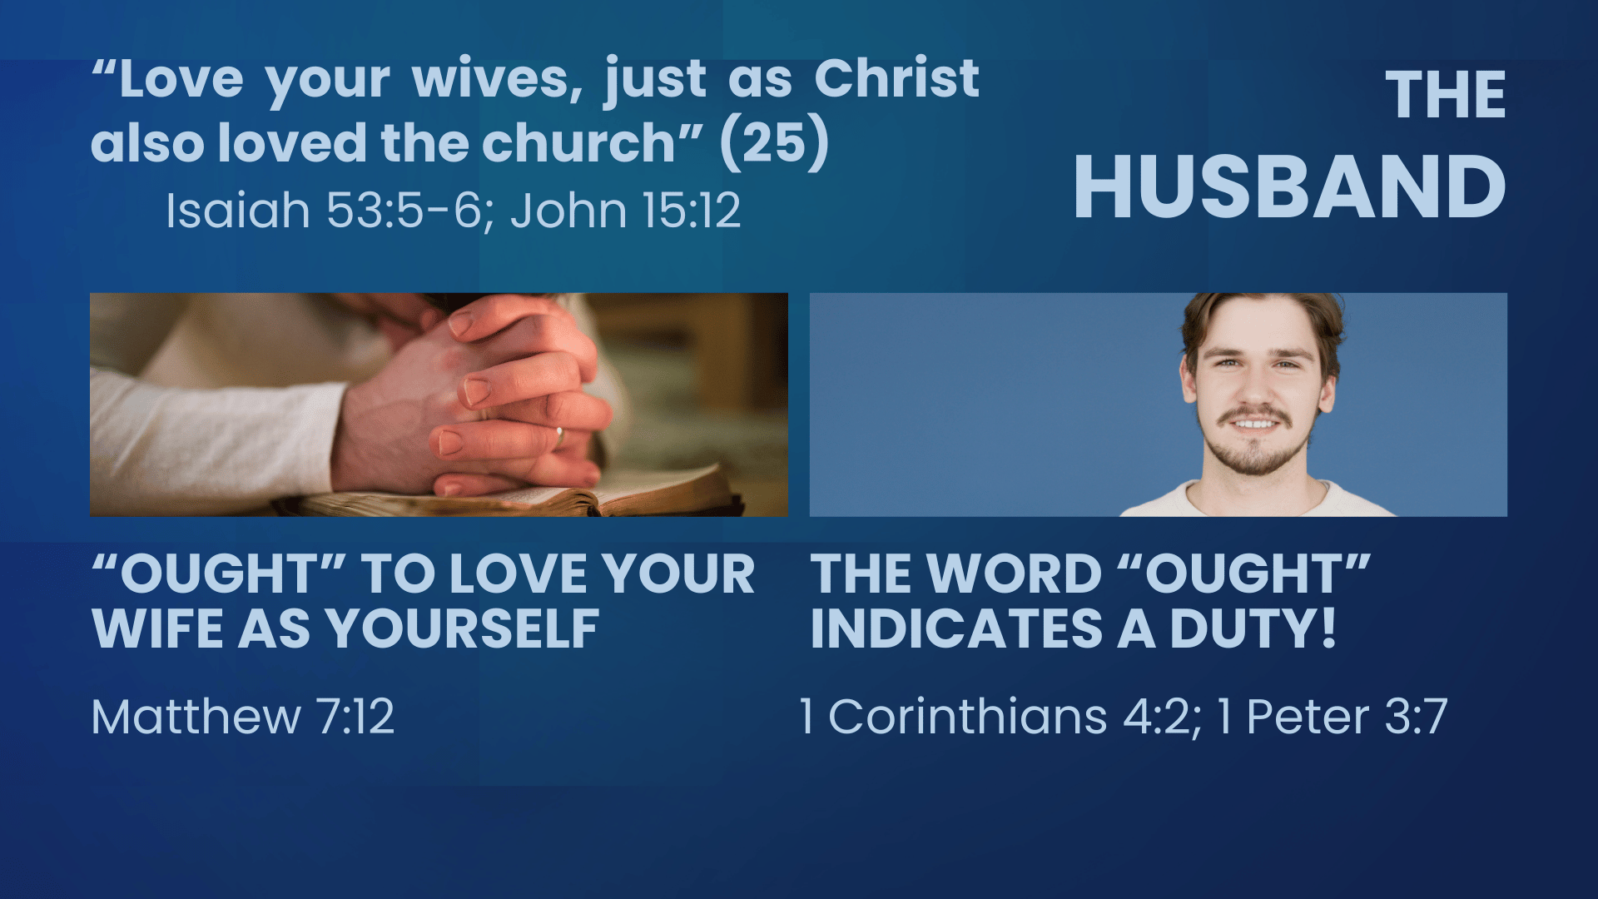
Notes:
The Husband
"Husbands, love your wives, just as Christ also loved the church and gave Himself for her." (25)
First, consider the analogy being used here. Jesus' love for His people is the greatest demonstration of love known to the world.
Isaiah 53:5-6 But He was wounded for our transgressions, He was bruised for our iniquities; The chastisement for our peace was upon Him, And by His stripes we are healed. (6) All we like sheep have gone astray; We have turned, every one, to his own way; And the LORD has laid on Him the iniquity of us all.
Trying to live up to the example of love the Lord has given us should cause every husband to pause, and engage in serious self-examination!
Such selflessness, sacrifice and affection. Jesus' entire reason for existing on earth was to seek the welfare of mankind!
John 15:12 This is My commandment, that you love one another as I have loved you.
If this is true in all of our relationships, it is certainly true in this most special one, designed and ordained by God!
"Ought" to love your wife as you love your own body
This is a simple expression of the golden rule, shown in this most important relationship.
Matthew 7:12 Therefore, whatever you want men to do to you, do also to them, for this is the Law and the Prophets.
Not completely accurate to say: "There goes my better half"
Instead: There goes a part of my very being! (And treat her as such!)
The word "ought" establishes a duty that cannot be shirked without God's displeasure.
God has put this most important stewardship upon man
1 Corinthians 4:2 Moreover it is required in stewards that one be found faithful.
No husband is successful, not matter what he accomplishes in life, if his wife (and by extension his children) do not have his full protection and welfare in mind.
It is especially important that this be seen spiritually.
1 Peter 3:7 Husbands, likewise, dwell with them with understanding, giving honor to the wife, as to the weaker vessel, and as being heirs together of the grace of life, that your prayers may not be hindered.
From Clinton Hamilton's commentary on 1 Peter: "A husband who disobeys this instruction cannot approach God because of this disobedience unless he repents. The wife would consider his prayer to be insincere if he calls on God and at the same time he disregards God's instructions in the conduct towards his wife. In the event of his disobedience to these words, their prayers would be impeded. They are to conduct themselves so that their prayers are not impeded."

Slide 4
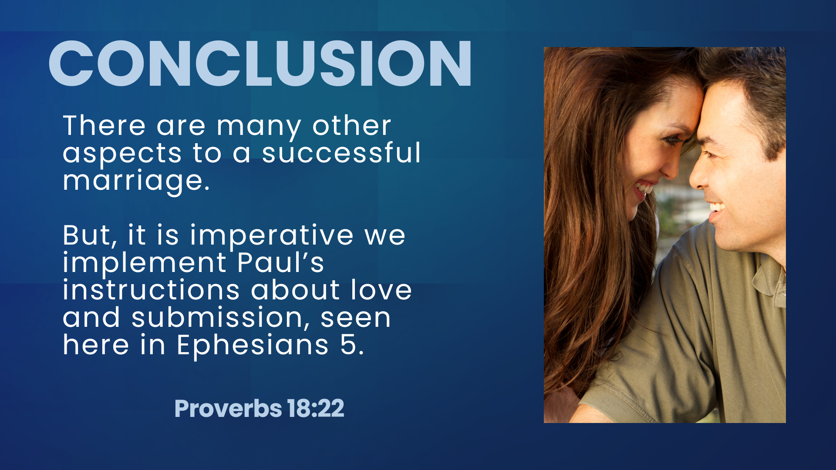
Notes:
CONCLUSION:
There are many other aspects to a successful marriage
Service to God
Godly characteristics
Communication
Godly parenting
etc.
But here in Ephesians 5, Paul concerned himself with two things.
Submission
Love
We must meditate upon and apply his wise instructions.
Proverbs 18:22 He who finds a wife finds a good thing, And obtains favor from the LORD.

