Slide 1
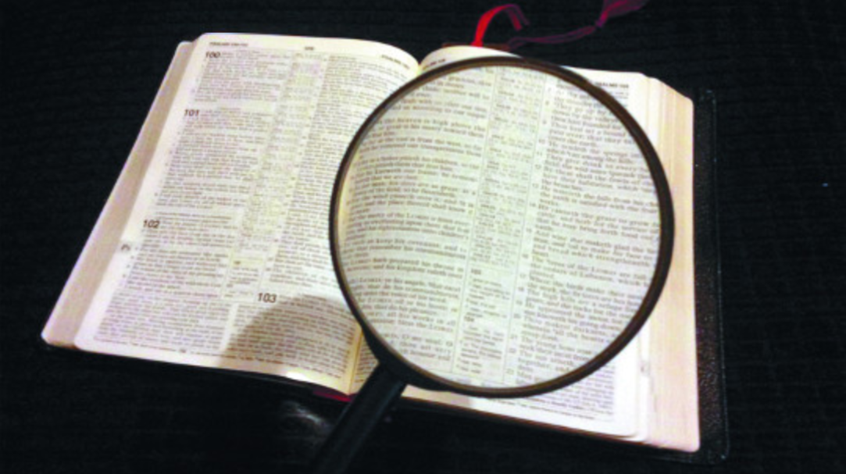
Investigation
“The first one to plead his cause seems right, until his neighbor comes and examines him” (Proverbs 18:17).
Notes:
Chinese Curse: May you live in interesting times….
We certainly do!
Investigations into an “email scandal” and into “Russian collusion” in the last election are only the last in investigations that have been almost constant as long as I can remember. (Watergate anyone? I was 12 when that scandal hit).
One interesting aspect of the present investigations is that they are now INVESTIGATING THE INVESTIGATORS!
Investigating the investigators is not necessarily a bad thing, especially when conducted properly and with integrity.
No one is above examination, especially those who are charged with the goods and welfare of others.
(Proverbs 18:17), “The first one to plead his cause seems right, until his neighbor comes and examines him.”
The primary thought I want you to consider as we discuss this topic is the importance of integrity, of honesty
While our text notes the idea of investigating others, that will not be our primary consideration this morning.
Before I begin to examine others, I need to investigate myself with honesty and integrity!
A final introductory consideration: God’s truths are the standard to which we commit ourselves for His approval.
The laws of the land determine whether an individual is guilty or innocent of a crime
God’s word as we investigate our own actions and behavior, is the standard in determining whether we have done right or wrong!
(Proverbs 23:23), “Buy the truth, and do not sell it, also wisdom and instruction and understanding.”

Slide 2
Principles of Investigation
God investigates us
Proverbs 16:2; 5:21-22; 1 Thessalonians 2:4
Notes:
God investigates us. Our ways are seen by Him, and He tests our hearts
(Proverbs 16:2), “All the ways of a man are pure in his own eyes, but the Lord weighs the spirits.”
The idea that we have the right to live our lives as we see fit is flawed
God is the judge. And, rest assured that he will find any fault to which our own conceit blinds us.
So, it is a wonderful thing for the righteous that God is just. We can trust Him. But, we must make it our aim to please Him rather than ourselves.
(Proverbs 5:21-22), [The wise man giving reason for his son to avoid the arms of a seductress], “For the ways of man are before the eyes of the Lord, and He ponders all his paths. ²² His own iniquities entrap the wicked man, and he is caught in the cords of his sin.”
(1 Thessalonians 2:4), [Paul’s intent in preaching], “But as we have been approved by God to be entrusted with the gospel, even so we speak, not as pleasing men, but God who tests our hearts.”

Slide 3
Principles of Investigation
God investigates us
We must investigate “all things”
1 Thessalonians 5:21-22; Proverbs 14:12
Notes:
We must investigate all things to discern good from evil and make right choices
(1 Thessalonians 5:21-22), “Test all things; hold fast what is good. ²² Abstain from every form of evil.”
This, as we have noted, to be done with the word of God as the standard upon with the “all things” are measured.
(Proverbs 14:12 & 16:15, identical), “There is a way that seems right to a man, but its end is the way of death.”
Without God’s guidance, we can’t know what is right and what is wrong.

Slide 4
Principles of Investigation
God investigates us
We must investigate “all things”
We must investigate ourselves
2 Corinthians 13:5; Galatians 6:4-5
Notes:
We must investigate ourselves using God’s word to see if we are in the faith
(2 Corinthians 13:5), “Examine yourselves as to whether you are in the faith. Test yourselves. Do you not know yourselves, that Jesus Christ is in you?—unless indeed you are disqualified.”
This is where integrity and honesty show their importance
Can we be honest with ourselves? Do we have sufficient self-awareness to note our own imperfections and biases? Do we have the integrity to take the blame rather than blaming another for our own failures?
Context of Galatians 6. Bear one another’s burdens (Help each other). But, personal responsibility and accountability!
(Galatians 6:4-5), “But let each one examine his own work, and then he will have rejoicing in himself alone, and not in another. ⁵ For each one shall bear his own load.”
If I sin – mitigating circumstances aside, I bear the responsibility
(Exodus 18:20), “The soul who sins shall die. The son shall not bear the guilt of the father, nor the father bear the guilt of the son. The righteousness of the righteous shall be upon himself, and the wickedness of the wicked shall be upon himself.”

Slide 5
Principles of Investigation
God investigates us
We must investigate “all things”
We must investigate ourselves
We must humbly accept investigation
Matthew 18:15-17; 1 Timothy 5:19-22
Notes:
When warranted, we should accept investigation to establish the truth and to obey the truth
(Matthew 18:15-17), “Moreover if your brother sins against you, go and tell him his fault between you and him alone. If he hears you, you have gained your brother. ¹⁶ But if he will not hear, take with you one or two more, that ‘by the mouth of two or three witnesses every word may be established.’ ¹⁷ And if he refuses to hear them, tell it to the church. But if he refuses even to hear the church, let him be to you like a heathen and a tax collector.”
(1 Timothy 5:19-22), “Do not receive an accusation against an elder except from two or three witnesses. ²⁰ Those who are sinning rebuke in the presence of all, that the rest also may fear. ²¹ I charge you before God and the Lord Jesus Christ and the elect angels that you observe these things without prejudice, doing nothing with partiality. ²² Do not lay hands on anyone hastily, nor share in other people's sins; keep yourself pure.”
On the flip side (not receiving investigation, but doing the investigating). It is true that sometimes we must rebuke a brother or sister in Christ
The need for integrity is so great in this.
False accusations will not be tolerated by God
The showing of favoritism or prejudice will likewise be unacceptable to Him
Finally, hypocrisy has no place among Christians
(Matthew 7:1-5), “Judge not, that you be not judged. ² For with what judgment you judge, you will be judged; and with the measure you use, it will be measured back to you. ³ And why do you look at the speck in your brother's eye, but do not consider the plank in your own eye? ⁴ Or how can you say to your brother, ‘Let me remove the speck from your eye’; and look, a plank is in your own eye? ⁵ Hypocrite! First remove the plank from your own eye, and then you will see clearly to remove the speck from your brother's eye.” (This serves to introduce our final point).

Slide 6
Principles of Investigation
God investigates us
We must investigate “all things”
We must investigate ourselves
We must humbly accept investigation
We will be examined by the standard we apply to others
Luke 6:37-38; John 7:24
Notes:
We will be examined by the standard we apply to others.
(Luke 6:37-38), “Judge not, and you shall not be judged. Condemn not, and you shall not be condemned. Forgive, and you will be forgiven. ³⁸ Give, and it will be given to you: good measure, pressed down, shaken together, and running over will be put into your bosom. For with the same measure that you use, it will be measured back to you.”
This does not mean that we overlook sin. Rather that we deal with sin righteously
Can we expect God’s mercy when we judge harshly?
Can we expect God’s forgiveness when we are unwilling to forgive?
(John 7:24), “Do not judge according to appearance, but judge with righteous judgment.”

