Slide 1
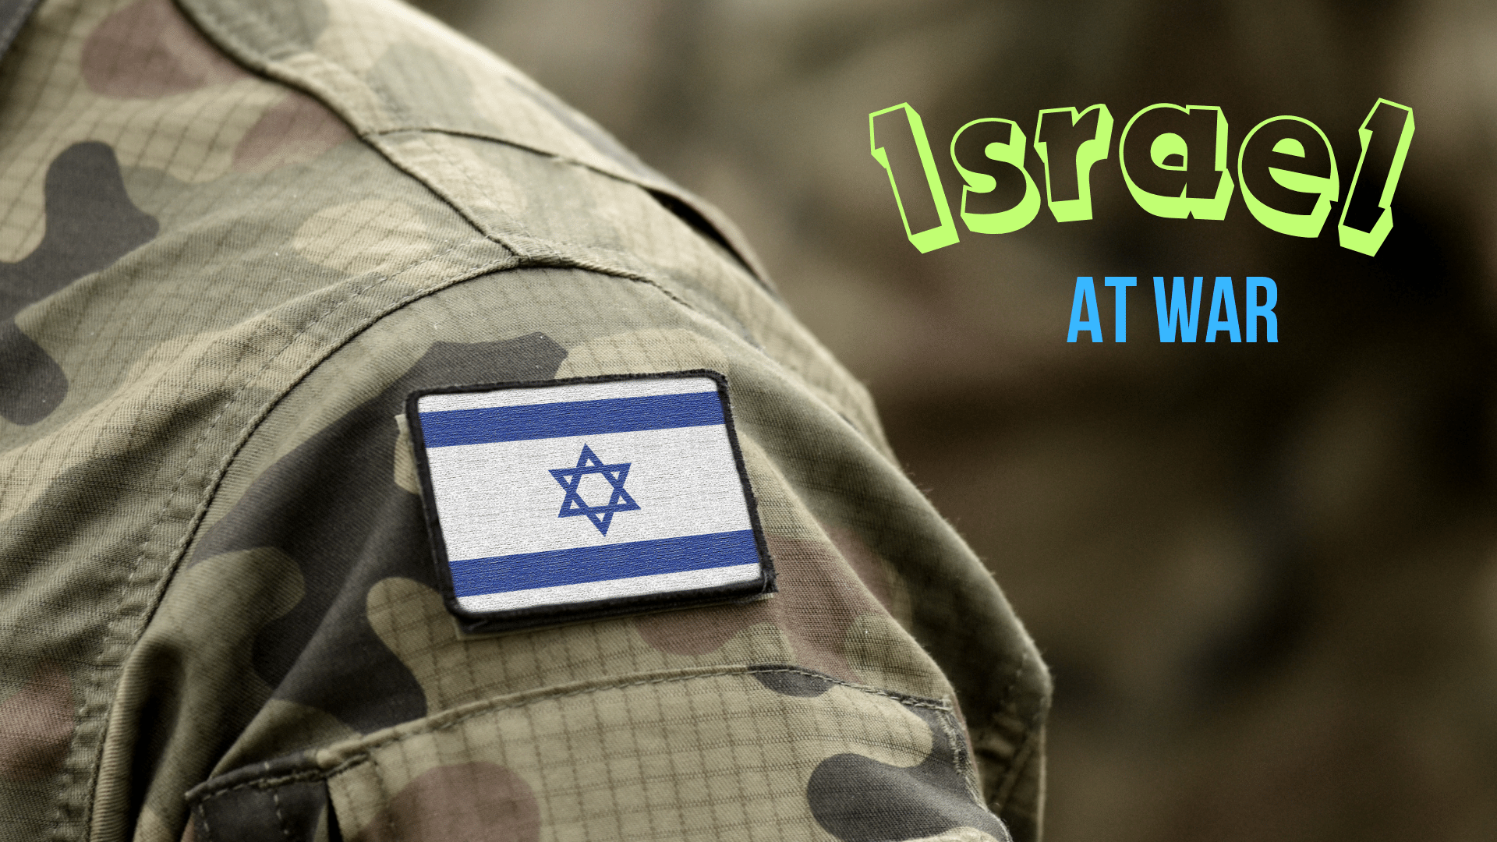
Notes:
A short history and explanation of our topic
First, we need to talk a little bit about antisemitism (hatred of Jews)
The history is long, it has its’ origin well before Jesus’ time on earth
Simply put, the Jews developed animosity toward Gentiles, and Gentiles for Jews (Gentiles, anyone not a Jew)
Why? In part because of God’s special choosing of the Jewish nation
(Deuteronomy 7:6), [God to Israel], “For you are a holy people to the LORD your God; the LORD your God has chosen you to be a people for Himself, a special treasure above all the peoples on the face of the earth.”
There is no indication in scripture that God ever chose any other nation to be a people for Himself.
The purpose of the choosing was to prepare the world for the coming of Jesus Christ.
As you know, God’s preservation, the prophecies, the genealogies, the protection of God in the Old Testament, as well as His chastisements, all prepared the world for faith in Christ Jesus which came in the last days (of which we today are a part).
However, when Jesus came, the nation of Israel (in large part) rejected Him.
(Matthew 23:37-39), [Lord, at the Jew’s rejection of Him and His ministry}, “O Jerusalem, Jerusalem, the one who kills the prophets and stones those who are sent to her! How often I wanted to gather your children together, as a hen gathers her chicks under her wings, but you were not willing! ³⁸ See! Your house is left to you desolate; ³⁹ for I say to you, you shall see Me no more till you say, Blessed is He who comes in the name of the LORD!’ ”
This truth is born out in the early Christian’s preaching to their Jewish audience (some of which brought repentance, some violence).
(Acts 2:36-37), “‘Therefore let all the house of Israel know assuredly that God has made this Jesus, whom you crucified, both Lord and Christ.’ ³⁷ Now when they heard this, they were cut to the heart, and said to Peter and the rest of the apostles, ‘Men and brethren, what shall we do?’”
(Acts 7:51-53), “You stiff-necked and uncircumcised in heart and ears! You always resist the Holy Spirit; as your fathers did, so do you. ⁵² Which of the prophets did your fathers not persecute? And they killed those who foretold the coming of the Just One, of whom you now have become the betrayers and murderers, ⁵³ who have received the law by the direction of angels and have not kept it.”
The first Christians were Jews, many of which had consented to His death. Regardless, the idea of hatred, antisemitism or hatred of Gentiles, was not and would not be tolerated
There were early conflicts between Jewish Christians and Gentile Christians
The answer of the apostles was always love and unity!
(1 John 2:9-12), “ He who says he is in the light, and hates his brother, is in darkness until now. ¹⁰ He who loves his brother abides in the light, and there is no cause for stumbling in him. ¹¹ But he who hates his brother is in darkness and walks in darkness, and does not know where he is going, because the darkness has blinded his eyes.” Finally, the Jewish nation was ended in God’s judgment (Not Jewish people as a whole).
They were to be God’s chosen ones so long as they obeyed and served Him.
This was a warning that God made clear to Israel from the very beginning.
(Deuteronomy 4:23-27), [Moses, late in life, addressing Israel as they were first about to inherit the land], “Take heed to yourselves, lest you forget the covenant of the LORD your God which He made with you, and make for yourselves a carved image in the form of anything which the LORD your God has forbidden you. ²⁴ For the LORD your God is a consuming fire, a jealous God. ²⁵ “When you beget children and grandchildren and have grown old in the land, and act corruptly and make a carved image in the form of anything, and do evil in the sight of the LORD your God to provoke Him to anger, ²⁶ I call heaven and earth to witness against you this day, that you will soon utterly perish from the land which you cross over the Jordan to possess; you will not prolong your days in it, but will be utterly destroyed. ²⁷ And the LORD will scatter you among the peoples, and you will be left few in number among the nations where the LORD will drive you.”
Jesus predicted the fall of Jerusalem in Matthew 24
(Matthew 24:1-2), “Then Jesus went out and departed from the temple, and His disciples came up to show Him the buildings of the temple. ² And Jesus said to them, “Do you not see all these things? Assuredly, I say to you, not one stone shall be left here upon another, that shall not be thrown down.”
This actually happened as Jesus predicted when the Roman General Titus laid siege to, and then destroyed Jerusalem in 70 A.D.
This routing of the Jews coincided with the establishment of God’s new kingdom, and the fulfillment of God’s treatment of all men.

Slide 2
The New Kingdom of Israel
Christ is the King, Reigning in His Kingdom
Acts 2:29-33; Colossians 1:13
All Nations Are Welcome to This New, Spiritual Kingdom
Acts 11:15-18; Micah 4:1-2
The New Spiritual Jew is the Christian!
Romans 2:28-29; Galatians 3:28-29
Notes:
In The last Days, God Establishes a New Kingdom
The Figure of Israel is used, but there is a difference between the physical kingdom of Israel, and Christ’s reign on David’s throne Heaven
(Acts 2:29-33), “Men and brethren, let me speak freely to you of the patriarch David, that he is both dead and buried, and his tomb is with us to this day. ³⁰ Therefore, being a prophet, and knowing that God had sworn with an oath to him that of the fruit of his body, according to the flesh, He would raise up the Christ to sit on his throne, ³¹ he, foreseeing this, spoke concerning the resurrection of the Christ, that His soul was not left in Hades, nor did His flesh see corruption. ³² This Jesus God has raised up, of which we are all witnesses. ³³ Therefore being exalted to the right hand of God, and having received from the Father the promise of the Holy Spirit, He poured out this which you now see and hear.”
Consider the description of this new kingdom.
(Colossians 1:13-18), “He has delivered us from the power of darkness and conveyed us into the kingdom of the Son of His love, ¹⁴ in whom we have redemption through His blood, the forgiveness of sins. ¹⁵ He is the image of the invisible God, the firstborn over all creation. ¹⁶ For by Him all things were created that are in heaven and that are on earth, visible and invisible, whether thrones or dominions or principalities or powers. All things were created through Him and for Him. ¹⁷ And He is before all things, and in Him all things consist. ¹⁸ And He is the head of the body, the church, who is the beginning, the firstborn from the dead, that in all things He may have the preeminence.”
In this New Kingdom of Israel, all nations are welcome!
(Acts 11:15-18), [Peter’s words to the initial Jewish Christians, relating the conversion of Cornelius and his household (Romans)], “And as I began to speak, the Holy Spirit fell upon them, as upon us at the beginning. ¹⁶ Then I remembered the word of the Lord, how He said, John indeed baptized with water, but you shall be baptized with the Holy Spirit.’ ¹⁷ If therefore God gave them the same gift as He gave us when we believed on the Lord Jesus Christ, who was I that I could withstand God?” ¹⁸ When they heard these things they became silent; and they glorified God, saying, “Then God has also granted to the Gentiles repentance to life.”
Prophecy makes this clear
(Micah 4:1-2), “Now it shall come to pass in the latter days that the mountain of the LORD’s house shall be established on the top of the mountains, and shall be exalted above the hills; and peoples shall flow to it. ² Many nations shall come and say, ‘Come, and let us go up to the mountain of the LORD, to the house of the God of Jacob; He will teach us His ways, and we shall walk in His paths.’ For out of Zion the law shall go forth, and the word of the LORD from Jerusalem.”
The New Jew is not physical in God’s eyes, he is spiritual!
(Romans 2:28-29), “For he is not a Jew who is one outwardly, nor is circumcision that which is outward in the flesh; ²⁹ but he is a Jew who is one inwardly; and circumcision is that of the heart, in the Spirit, not in the letter; whose praise is not from men but from God.”
In effect, faithful Christians are the new chosen people of God!
(Galatians 3:28-29), “There is neither Jew nor Greek, there is neither slave nor free, there is neither male nor female; for you are all one in Christ Jesus. ²⁹ And if you are Christ’s, then you are Abraham’s seed, and heirs according to the promise.”

Slide 3
But What About Romans 11
Israel’s Rejection is not Permanent (1)
Just Like the Gentiles, the Jew’s Salvation Comes Through Grace and Faith (5-6)
Natural Branches / Grafted Branches (13-23)
Salvation Today Comes to All Through God’s Mercy Shown in His Son (25-33)
Notes:
But what about Romans 11
Israel’s rejection is not permanent
(Romans 11:1), “I say then, has God cast away His people? Certainly not! For I also am an Israelite, of the seed of Abraham, of the tribe of Benjamin.”
Some take this statement to indicate the NATION of Israel will return… NOT SO!
Just like the gentiles, the Jew’s salvation comes through grace and faith
(Romans 11:5-6), “Even so then, at this present time there is a remnant according to the election of grace. ⁶ And if by grace, then it is no longer of works; otherwise grace is no longer grace. But if it is of works, it is no longer grace; otherwise work is no longer work.”
Natural Branches / Grafted Branches
(Romans 11:13-23), “For I speak to you Gentiles; inasmuch as I am an apostle to the Gentiles, I magnify my ministry, ¹⁴ if by any means I may provoke to jealousy those who are my flesh and save some of them. ¹⁵ For if their being cast away is the reconciling of the world, what will their acceptance be but life from the dead? ¹⁶ For if the firstfruit is holy, the lump is also holy; and if the root is holy, so are the branches. ¹⁷ And if some of the branches were broken off, and you, being a wild olive tree, were grafted in among them, and with them became a partaker of the root and fatness of the olive tree, ¹⁸ do not boast against the branches. But if you do boast, remember that you do not support the root, but the root supports you. ¹⁹ You will say then, “Branches were broken off that I might be grafted in.” ²⁰ Well said. Because of unbelief they were broken off, and you stand by faith. Do not be haughty, but fear. ²¹ For if God did not spare the natural branches, He may not spare you either. ²² Therefore consider the goodness and severity of God: on those who fell, severity; but toward you, goodness, if you continue in His goodness. Otherwise you also will be cut off. ²³ And they also, if they do not continue in unbelief, will be grafted in, for God is able to graft them in again.”
Salvation today comes to all through God’s Mercy shown in His Son
(Romans 11:25-33), “For I do not desire, brethren, that you should be ignorant of this mystery, lest you should be wise in your own opinion, that blindness in part has happened to Israel until the fullness of the Gentiles has come in. ²⁶ And so all Israel will be saved, as it is written: ‘The Deliverer will come out of Zion, and He will turn away ungodliness from Jacob; ²⁷ For this is My covenant with them, when I take away their sins.’ ²⁸ Concerning the gospel they are enemies for your sake, but concerning the election they are beloved for the sake of the fathers. ²⁹ For the gifts and the calling of God are irrevocable. ³⁰ For as you were once disobedient to God, yet have now obtained mercy through their disobedience, ³¹ even so these also have now been disobedient, that through the mercy shown you they also may obtain mercy. ³² For God has committed them all to disobedience, that He might have mercy on all. ³³ Oh, the depth of the riches both of the wisdom and knowledge of God! How unsearchable are His judgments and His ways past finding out!”

Slide 4
So, How Does This Impact Israel At War?
The Jewish state is secular, not part of God’s plan.
Any foreign policy that exists with the idea that the Jewish nation constitutes God’s chosen is in error.
Terrorism is always bad!
Discernment is needed to be able to determine who is in the right.
What this secular word provides has no bearing on our relationship with Jesus
Our citizenship is in heaven!
Notes:
So, how does this impact the war in Israel today
The Jewish state is secular, not part of God’s plan
The formation of Israel in 1947 and independence in 1948 was a function of British generosity and a United Nations resolution following the Holocaust
The Arab nations surrounding the land, and in Palestine never have and do not now accept the state of Israel’s right to exist.
In fact, when the agreement to give Jews part of the land as a homeland was made, the Mufti of Jerusalem Haj Amin Al Husseini stated: “I declare a holy war, my Moslem brothers”. “Murder them all!”
Any foreign policy that exists with the idea that the Jews are God’s chosen people today is in error.
Premillennialism is one such doctrine, that Jesus is going to reign on a physical throne for a 1,000 years sometime in the future
First, Jesus’ kingdom already exists, and is spiritual
Second, God does not need our help to accomplish His will.
Terrorism is always bad… murder, crime, evil
The killing of small children
The killing of civilians
Any unprovoked attack on the vulnerable. Terrorism is unacceptable.
However, there can be evil on both sides. And most often is…
To be honest, there is much we can’t know, as we only get information from a secular and biased media and government.
I have my ideas, you may have yours. We need to be careful and discerning before making judgments between right and wrong.
What this secular word provides has no bearing on our relationship with Jesus
My American citizenship is secondary to the fact that I am a citizen in Christ’s kingdom
American views and values have to be subjugated to our values as children of God
The nation in which we live, has no bearing on our standing with Jesus, as long as we are serving Him acceptably.
Our citizenship is in heaven
Don’t let politics, culture, or societal conflicts define who you are
You are first and foremost a child of God
(1 Peter 2:9-12), “But you are a chosen generation, a royal priesthood, a holy nation, His own special people, that you may proclaim the praises of Him who called you out of darkness into His marvelous light; ¹⁰ who once were not a people but are now the people of God, who had not obtained mercy but now have obtained mercy. ¹¹ Beloved, I beg you as sojourners and pilgrims, abstain from fleshly lusts which war against the soul, ¹² having your conduct honorable among the Gentiles, that when they speak against you as evildoers, they may, by your good works which they observe, glorify God in the day of visitation.”

Slide 5
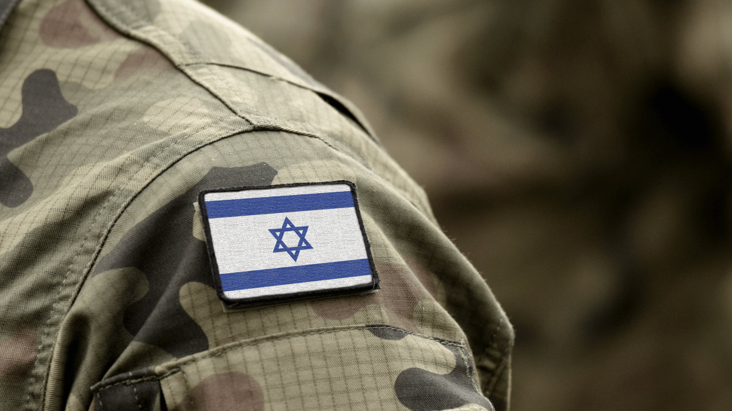
Conclusion
Preach
Pray
Love
1 John 5:4-5
Notes:
Conclusion
Ultimately, while this world is troubling and in trouble, it has no bearing on our relation with God
As always, our responsibility is to Preach, Pray and Love our fellow man
(1 John 5:4-5), “For whatever is born of God overcomes the world. And this is the victory that has overcome the world—our faith. ⁵ Who is he who overcomes the world, but he who believes that Jesus is the Son of God?”

