Slide 1
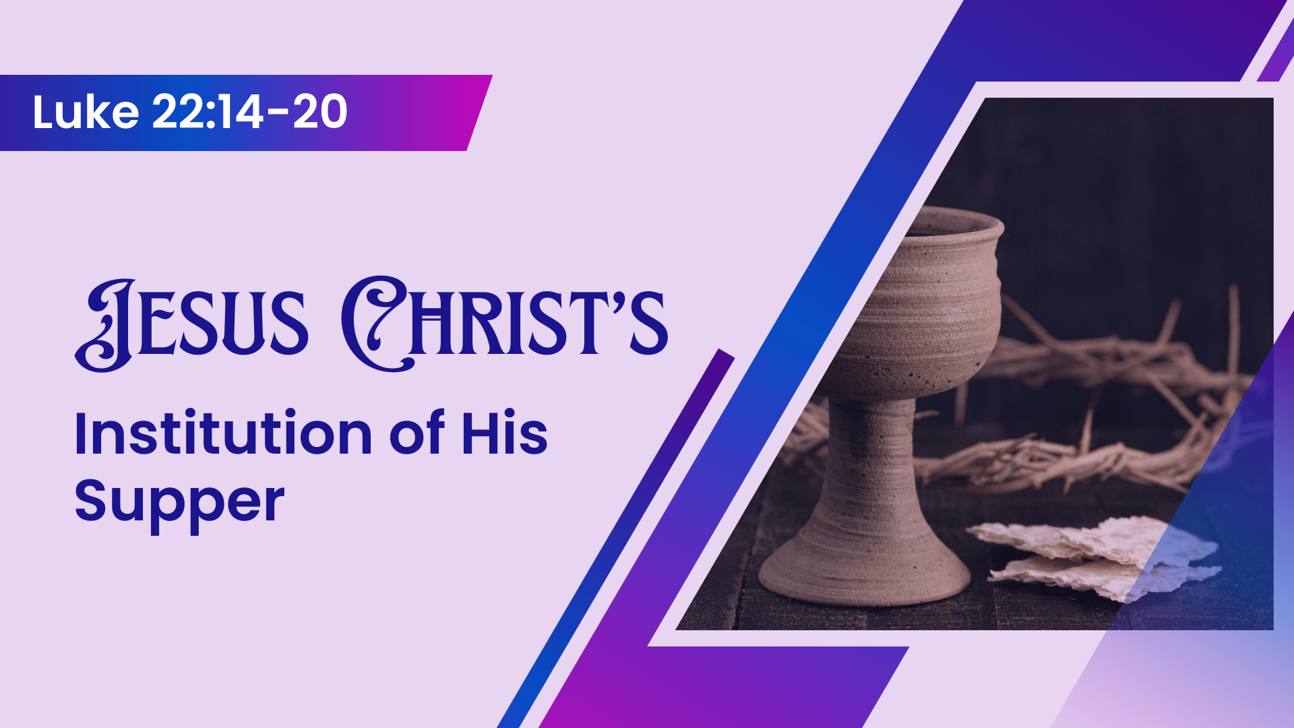
Notes:
Christ's Institution of His Supper
Luke 22:14-20
Introduction:
God has always set memorials for His people, to observe special events and examples of mercy shown to His people
Things like the bow in the cloud following His first judgment on the world
The ark of the covenant containing: the Ten Commandments, a pot of manna, and Aaron's rod that budded
The Passover feast - to memorialize God's deliverence of the Jews from Egypt
The 12 stones erected as Israel passed through the Jordan to the promised land
Jesus, in His covenant, erected one such memorial for us, instituted shortly before his betrayal, arrest and death on the cross
It is the institution of His supper that we will discuss in our text today
The command and examples of Christians observing it as a part of their faith
Paul's instructions at Corinth
1 Corinthians 11:26-28 For as often as you eat this bread and drink this cup, you proclaim the Lord's death till He comes. (27) Therefore whoever eats this bread or drinks this cup of the Lord in an unworthy manner will be guilty of the body and blood of the Lord. (28) But let a man examine himself, and so let him eat of the bread and drink of the cup.
The brethren in Troas
Acts 20:7 Now on the first day of the week, when the disciples came together to break bread, Paul, ready to depart the next day, spoke to them and continued his message until midnight.
The Christians in Jerusalem from the very beginning!
Acts 2:42 And they continued steadfastly in the apostles' doctrine and fellowship, in the breaking of bread, and in prayers.
How blessed we are that Jesus gave us this memorial
It is a sober, and important part of our weekly worship
It is a major reason that we, like the disciples in Troas, come together each Lord's day!
We should rejoice in our Lord's institution of this spiritual feast.
Luke 22:14-20 When the hour had come, He sat down, and the twelve apostles with Him. (15) Then He said to them, "With fervent desire I have desired to eat this Passover with you before I suffer; (16) for I say to you, I will no longer eat of it until it is fulfilled in the kingdom of God." (17) Then He took the cup, and gave thanks, and said, "Take this and divide it among yourselves; (18) for I say to you, I will not drink of the fruit of the vine until the kingdom of God comes." (19) And He took bread, gave thanks and broke it, and gave it to them, saying, "This is My body which is given for you; do this in remembrance of Me." (20) Likewise He also took the cup after supper, saying, "This cup is the new covenant in My blood, which is shed for you.

Slide 2
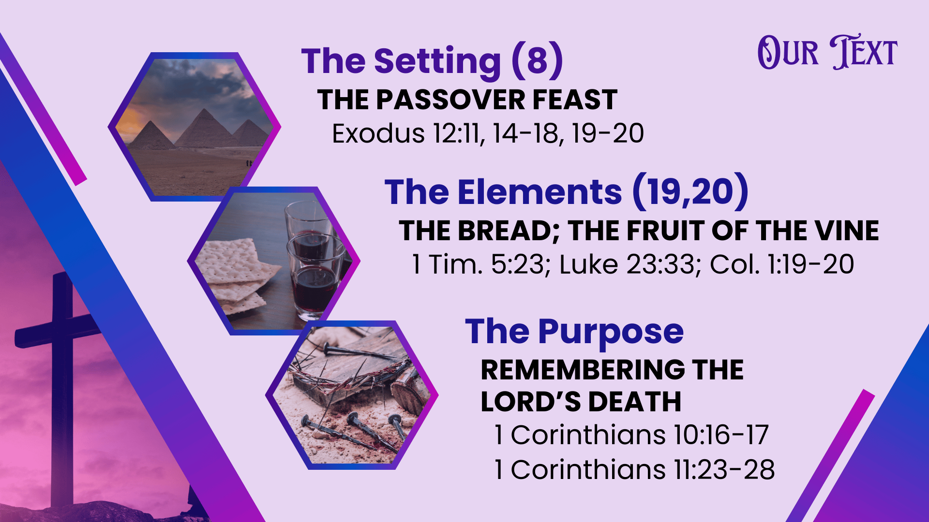
Notes:
Discussion:
Setting: The Passover Feast
God's command: Take a lamb without blemish and sacrifice it to avoid the angel of death visiting the firstborn of Egypt
Exodus 12:11 And thus you shall eat it: with a belt on your waist, your sandals on your feet, and your staff in your hand. So you shall eat it in haste. It is the LORD's Passover.
Exodus 12:14-18 'So this day shall be to you a memorial; and you shall keep it as a feast to the LORD throughout your generations. You shall keep it as a feast by an everlasting ordinance. (15) Seven days you shall eat unleavened bread. On the first day you shall remove leaven from your houses. For whoever eats leavened bread from the first day until the seventh day, that person shall be cut off from Israel. (16) On the first day there shall be a holy convocation, and on the seventh day there shall be a holy convocation for you. No manner of work shall be done on them; but that which everyone must eat—that only may be prepared by you. (17) So you shall observe the Feast of Unleavened Bread, for on this same day I will have brought your armies out of the land of Egypt. Therefore you shall observe this day throughout your generations as an everlasting ordinance. (18) In the first month, on the fourteenth day of the month at evening, you shall eat unleavened bread, until the twenty-first day of the month at evening.
It was during the observance of this feast that Jesus established his own memorial, using elements contained in the feast.
Note: There was to be no leaven in the house during this feast!
Exodus 12:19-20 For seven days no leaven shall be found in your houses, since whoever eats what is leavened, that same person shall be cut off from the congregation of Israel, whether he is a stranger or a native of the land. (20) You shall eat nothing leavened; in all your dwellings you shall eat unleavened bread.' "
[CLICK HERE FOR NEXT POINT]
Elements of the Supper
What they are and how we know
Luke 22:19 And He took bread, gave thanks and broke it, and gave it to them, saying, "This is My body which is given for you; do this in remembrance of Me."
Simple. It was unleavened bread, the bread that was present at the Passover feast. Remember, no leaven in the home at the time of the Passover.
What they drank. The cup.
Luke 22:20 Likewise He also took the cup after supper, saying, "This cup is the new covenant in My blood, which is shed for you.
Figure of speech (You can't literally drink a cup) Metonymy. The container is used for the contents. What they drank? The fruit of the vine. (Grape Juice).
Luke 22:18 for I say to you, I will not drink of the fruit of the vine until the kingdom of God comes."
The container is an expedient, the significance is the content
As the container is not what is meant by the cup, how many containers are used, their style, or anything else is not important. What matters is the content!
Is it wine? (Catholics - Sacramental wine)
Nowhere is the greek oinos used to describe the contents. Rather gennema ampelos (the word ampelos is consistently used in scripture to refer to grape juice, not any other kind of juice).
Strongest argument surrounds the Passover requirements - no leaven to be in the house or ingested. Leaven (yeast) is what is used to ferment wine.
Unlike common claims, the use of unfermented grape juice in society was not uncommon. In fact, this may be why it was necessary for Paul to enjoin the use of a little fermented wine for medicinal use for Timothy (cf. 1 Timothy 5:23). He was abstinent. He stayed away from all fermented drink! Which would seem to indicate that his keeping of the supper would have been non-fermented grape juice.
1 Timothy 5:23 No longer drink only water, but use a little wine for your stomach's sake and your frequent infirmities.
Regardless, long standing (and even predominate) tradition does not establish authority. The Bible specifies something other than wine. We are safe in following it's instructions
What they signify about Christ
The bread signifies the body given by Christ for our redemption.
Luke 23:33 And when they had come to the place called Calvary, there they crucified Him, and the criminals, one on the right hand and the other on the left.
The fruit of the vine symbolizes His shed blood in his death
Colossians 1:19-20 For it pleased the Father that in Him all the fullness should dwell, (20) and by Him to reconcile all things to Himself, by Him, whether things on earth or things in heaven, having made peace through the blood of His cross.
[CLICK HERE FOR NEXT POINT]
The overall purpose: To observe the sacrificial death of Christ
To commune with the Lord regarding his death on the cross
Commune - koinonia - fellowship, association, community, communion, joint participation (Thayer) (This is a sign or our fellowship through Jesus Christ)
To remember that death frequently, soberly and with thanksgiving in our hearts
To proclaim his death until he comes again
1 Corinthians 10:16-17 The cup of blessing which we bless, is it not the communion of the blood of Christ? The bread which we break, is it not the communion of the body of Christ? (17) For we, though many, are one bread and one body; for we all partake of that one bread.
1 Corinthians 11:23-28 For I received from the Lord that which I also delivered to you: that the Lord Jesus on the same night in which He was betrayed took bread; (24) and when He had given thanks, He broke it and said, "Take, eat; this is My body which is broken for you; do this in remembrance of Me." (25) In the same manner He also took the cup after supper, saying, "This cup is the new covenant in My blood. This do, as often as you drink it, in remembrance of Me." (26) For as often as you eat this bread and drink this cup, you proclaim the Lord's death till He comes. (27) Therefore whoever eats this bread or drinks this cup of the Lord in an unworthy manner will be guilty of the body and blood of the Lord. (28) But let a man examine himself, and so let him eat of the bread and drink of the cup.

Slide 3
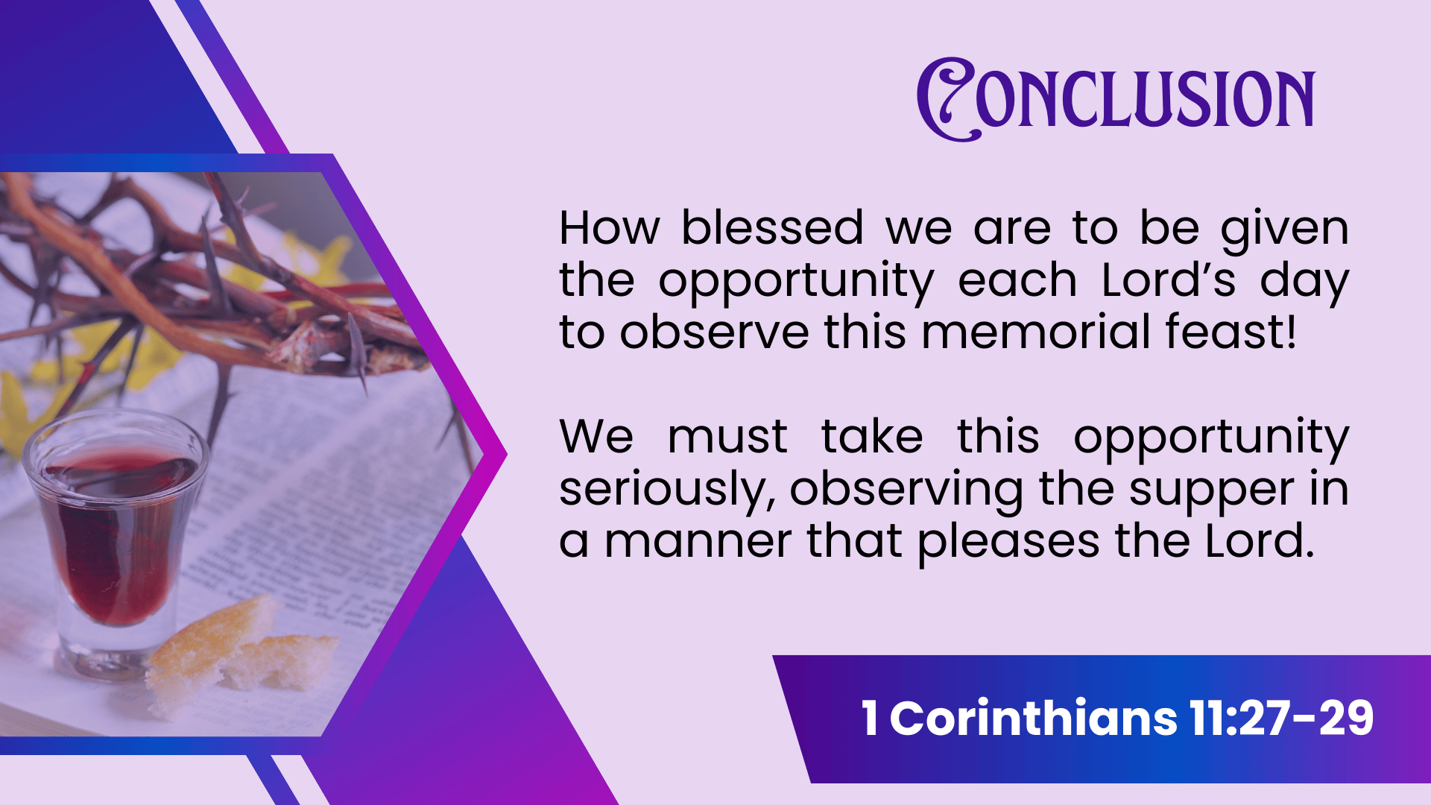
Notes:
Conclusion:
How blessed we are that Jesus has given us this opportunity each Lord's day to observe this memorial feast!
Examine ourselves as we eat! (Seriously and obediently)
1 Corinthians 11:27-29 Therefore whoever eats this bread or drinks this cup of the Lord in an unworthy manner will be guilty of the body and blood of the Lord. (28) But let a man examine himself, and so let him eat of the bread and drink of the cup. (29) For he who eats and drinks in an unworthy manner eats and drinks judgment to himself, not discerning the Lord's body.

