Slide 1
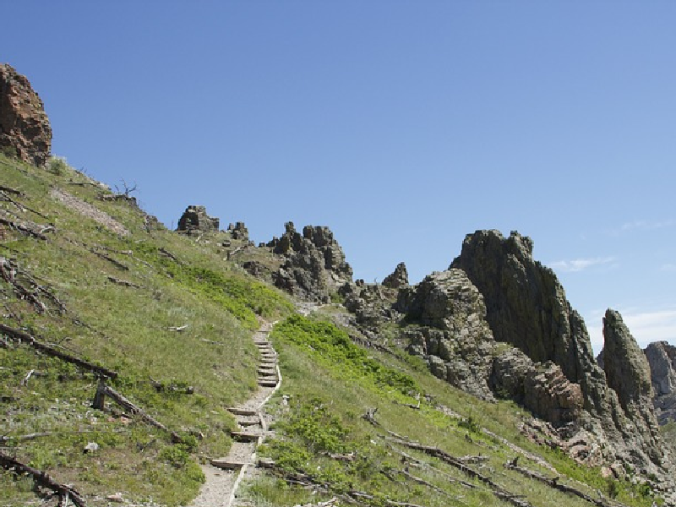
~ Jesus ~ Our Trailblazer
John 13:12-17
Notes:
Trailblazer - a person who makes a new track through wild country. a pioneer; an innovator.
So, one who goes first, or before. Serves as an example!
(John 13:12-17), “So when He had washed their feet, taken His garments, and sat down again, He said to them, " Do you know what I have done to you? ¹³ You call Me Teacher and Lord, and you say well, for so I am. ¹⁴ If I then, your Lord and Teacher, have washed your feet, you also ought to wash one another's feet. ¹⁵ For I have given you an example, that you should do as I have done to you. ¹⁶ Most assuredly, I say to you, a servant is not greater than his master; nor is he who is sent greater than he who sent him. ¹⁷ If you know these things, blessed are you if you do them.”
Every spiritual principle God enjoins on us, Jesus did first.
We must follow in His steps, Matt. 9:9; 16:24; Jno. 12:26; 1 Pet. 2:21; 1 Jno. 2:5-6.
(John 12:26), “If anyone serves Me, let him follow Me; and where I am, there My servant will be also. If anyone serves Me, him My Father will honor.”

Slide 2
~ Jesus ~ Our Trailblazer
Jesus blazed the trail of obedience
John 15:10; 12:49; 4:34
Notes:
JESUS BLAZED THE TRAIL OF OBEDIENCE
(John 15:10), “If you keep My commandments, you will abide in My love, just as I have kept My Father's commandments and abide in His love.”
He Yielded to Authority
(John 12:49), “For I have not spoken on My own authority; but the Father who sent Me gave Me a command, what I should say and what I should speak.”
B. He Served the Will of God
(John 4:34), “Jesus said to them, ‘My food is to do the will of Him who sent Me, and to finish His work.’”

Slide 3
~ Jesus ~ Our Trailblazer
Jesus blazed the trail of obedience
John 15:10; 12:49; 4:34
Jesus blazed the trail of sacrifice
John 10:17-18; Matthew 16:24; 13:44-46
Notes:
JESUS BLAZED THE TRAIL OF SACRIFICE
(John 10:17-18), “Therefore My Father loves Me, because I lay down My life that I may take it again. ¹⁸ No one takes it from Me, but I lay it down of Myself. I have power to lay it down, and I have power to take it again. This command I have received from My Father.“
Self-Denial is the Essence of Sacrifice ~ Carrying Your Cross Requires Sacrifice
(Matthew 16:24-25), “Then Jesus said to His disciples, " If anyone desires to come after Me, let him deny himself, and take up his cross, and follow Me. 25 For whoever desires to save his life will lose it, but whoever loses his life for My sake will find it.”
The Value of the Kingdom Compels Sacrifice,
(Matthew 13:44-46), “Again, the kingdom of heaven is like treasure hidden in a field, which a man found and hid; and for joy over it he goes and sells all that he has and buys that field. ⁴⁵ " Again, the kingdom of heaven is like a merchant seeking beautiful pearls, ⁴⁶ who, when he had found one pearl of great price, went and sold all that he had and bought it.”

Slide 4
~ Jesus ~ Our Trailblazer
Jesus blazed the trail of obedience
John 15:10; 12:49; 4:34
Jesus blazed the trail of sacrifice
John 10:17-18; Matthew 16:24; 13:44-46
Jesus blazed the trail of love
1 John 4:19-21; John 13:34-35; 14:15
Notes:
JESUS BLAZED THE TRAIL OF LOVE
(1 John 4:19-21), “We love Him because He first loved us. ²⁰ If someone says, "I love God," and hates his brother, he is a liar; for he who does not love his brother whom he has seen, how can he love God whom he has not seen? ²¹ And this commandment we have from Him: that he who loves God must love his brother also.”
Our Love Shows We Belong to Him
(John 13:34-35), “A new commandment I give to you, that you love one another; as I have loved you, that you also love one another. ³⁵ By this all will know that you are My disciples, if you have love for one another.“
(John 14:15), “If you love Me, keep My commandments.”

Slide 5
~ Jesus ~ Our Trailblazer
Jesus blazed the trail of obedience
John 15:10; 12:49; 4:34
Jesus blazed the trail of sacrifice
John 10:17-18; Matthew 16:24; 13:44-46
Jesus blazed the trail of love
1 John 4:19-21; John 13:34-35; 14:15
Jesus blazed the trail of forgiveness
Lk. 23:34; 1 John 1:9; Lk. 17:1-4; Matt. 18:32-35
Notes:
JESUS BLAZED THE TRAIL OF FORGIVENESS
(Luke 23:34) JESUS AT HIS CRUCIFIXION, “Then Jesus said, " Father, forgive them, for they do not know what they do."
Immediately, Totally
(1 John 1:9), “If we confess our sins, He is faithful and just to forgive us our sins and to cleanse us from all unrighteousness.”
Always
(Luke 17:1-4), “Then He said to the disciples, " It is impossible that no offenses should come, but woe to him through whom they do come! ² It would be better for him if a millstone were hung around his neck, and he were thrown into the sea, than that he should offend one of these little ones. ³ Take heed to yourselves. If your brother sins against you, rebuke him; and if he repents, forgive him. ⁴ And if he sins against you seven times in a day, and seven times in a day returns to you, saying, 'I repent,' you shall forgive him."
From the Heart
(Matthew 18:32-35), “Then his master, after he had called him, said to him, 'You wicked servant! I forgave you all that debt because you begged me. ³³ Should you not also have had compassion on your fellow servant, just as I had pity on you? ' ³⁴ And his master was angry, and delivered him to the torturers until he should pay all that was due to him. ³⁵ " So My heavenly Father also will do to you if each of you, from his heart, does not forgive his brother his trespasses."

Slide 6
~ Jesus ~ Our Trailblazer
Jesus blazed the trail of obedience
John 15:10; 12:49; 4:34
Jesus blazed the trail of sacrifice
John 10:17-18; Matthew 16:24; 13:44-46
Jesus blazed the trail of love
1 John 4:19-21; John 13:34-35; 14:15
Jesus blazed the trail of forgiveness
Lk. 23:34; 1 John 1:9; Lk. 17:1-4; Matt. 18:32-35
Jesus blazed the trail of resisting temptation
Heb. 4:15; 1 Peter 5:8; James 4:7; 1 Cor. 10:13
Notes:
JESUS BLAZED THE TRAIL OF RESISTING TEMPTATION
(Hebrews 4:15), “For we do not have a High Priest who cannot sympathize with our weaknesses, but was in all points tempted as we are, yet without sin.”
Temptation to Sin always exist
(1 Peter 5:8), “Be sober, be vigilant; because your adversary the devil walks about like a roaring lion, seeking whom he may devour.”
Do not Yield to Temptation
(James 4:7), “Therefore submit to God. Resist the devil and he will flee from you.”
Put Your Faith in the Faithfulness of God,
(1 Corinthians 10:13), “No temptation has overtaken you except such as is common to man; but God is faithful, who will not allow you to be tempted beyond what you are able, but with the temptation will also make the way of escape, that you may be able to bear it.”

Slide 7
Conclusion
Jesus calls us to follow His examples, to walk the trail the Master first trod!
(John 13:12-17)
Notes:
(John 13:12-17), “So when He had washed their feet, taken His garments, and sat down again, He said to them, " Do you know what I have done to you? ¹³ You call Me Teacher and Lord, and you say well, for so I am. ¹⁴ If I then, your Lord and Teacher, have washed your feet, you also ought to wash one another's feet. ¹⁵ For I have given you an example, that you should do as I have done to you. ¹⁶ Most assuredly, I say to you, a servant is not greater than his master; nor is he who is sent greater than he who sent him. ¹⁷ If you know these things, blessed are you if you do them.

