Slide 1
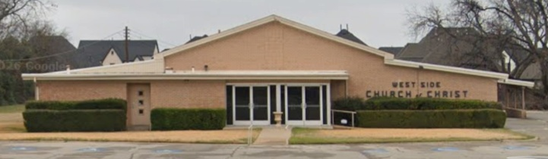

A “Great” Congregation

Slide 2
Churches Are Not Great Because Of Their . . .
  Size
  Wealth
  Preacher
  Reputation
  Heritage
  Traditions

Slide 3
Jerusalem Church
Prominent spiritual features
Examples of worthiness
“Great” things, Acts 4:32-37

Slide 4
“Great” Unity of Faith
Acts 4:32

Slide 5
Unity of Faith
Hearts and lives united in Christ, Acts 4:32; 1 Corinthians 1:10
  Devoted to God’s word, Acts 2:42
  Truth produces faith
  Truth instills the value of unity
  and the strength of oneness

Slide 6
Unity of Faith
Common practices, 4:32 (2:42-46)
Guard unity in Christ, Eph. 4:1-3
  Factiousness happens when hearts are not united in truth
  and faith, 1 Corinthians 3:1-4 (4:6)
  Be likeminded, Romans 15:5-6

Slide 7
“Great” Power
Acts 4:33

Slide 8
Power of God
Emboldened apostles’ preaching, Acts 1:8; 2:43; 4:31 (Mark 16:20)
We rely on their testimony,
Gal. 1:11-12; Eph. 3:3-5, 20-21
  Faith in God’s power, 1 Cor. 2:4-5
  A truth-guided church relies on the power of God’s word, Rev. 2:29

Slide 9
“Great” Grace
Acts 4:33

Slide 10
Blessed with Grace
Greatly blessed, Ephesians 1:3-7
Stand in grace, Romans 5:1-2
  Justified by faith (1)
  Peace with God (1)
  Access by faith into grace (2)
  Rejoice in hope of glory (2)
  Great assurance of hope, Rom. 5:3-5

Slide 11
“Great” Sacrifice
Acts 4:34-35

Slide 12
Mutual Sacrifice
To meet needs, Acts 2:44-45
Full expression of love helps
one another in times of need,
1 John 3:16-19
  Common treasury, Acts 4:35
  Also to relieve brethren in other places, 1 Corinthians 16:1-3

Slide 13
“Great” Encouragement
Acts 4:36-37

Slide 14
Son of Encouragement
Every church needs a Barnabas Acts 11:21-24
Every Christian can be a
Barnabas, Hebrews 10:24
  We can become more effective encouragers of one another,
  Galatians 6:2 (1 Thess. 5:14-15)

Slide 15
“Great” Fear
Acts 5:5, 11

Slide 16
Reverence for God
Genuine character and authentic faith contrasted, Acts 4:36-5:2
Two reactions, Acts 5:12-14
  None like Ananias and Sapphira wanted any part of the church
  People of faith and integrity were being saved (Acts 2:47)

Slide 17
Challenges to Face
False teachers, Acts 15
Negligence, apathy, and unbelief,
Heb. 3:12-14; 4:11; 5:12; 6:11-12; 12:1
Any church that thinks it cannot
fall has already started to drift, Hebrews 10:36 (2:1)

