Slide 1
“And Jehovah gave the people favor in the sight of the Egyptians. Moreover the man Moses was very great in the land of Egypt, in the sight of Pharaoh’s servants, and in the sight of the people.” (Ex. 11:3)

Slide 2
Moses
Greatness
Personified

Slide 3
Moses’ Shortcomings
Hesitancy to become deliverer of Israel
Ex. 3:11-12, 13-14; 4:1-9, 10-17
Negligence in circumcising his son
Ex. 4:18-26
Careless speech at the waters of Meribah
Num. 20:1-13; Psa. 106:32-33

Slide 4
Moses: A Great Man
Meekest man of his generation (Num. 12:3)
God spoke to him “face to face” (Ex. 33:11)
“The man of God” (Dt. 33:1; Josh. 14:6)
“The servant of Jehovah” (Josh. 1:13; 8:31)
“The servant of God” (1 Chr. 6:49)
“His chosen” (Psa. 106:23)
No prophet like him (Dt. 34:10-12)

Slide 5
“And there hath not arisen a prophet since in Israel like unto Moses, whom Jehovah knew face to face, in all the signs and the wonders, which Jehovah sent him to do in the land of Egypt, to Pharaoh, and to all his servants, and to all his land, and in all the mighty hand, and in all the great terror, which Moses wrought in the sight of all Israel.” (Dt. 34:10-12)

Slide 6
Moses: A Great Man
Stood before Pharaoh
Unleashed 10 plagues
Parted the Red Sea
Received God’s law
Reviewed God’s law

Slide 7
The Ten Plagues
Water to blood (Ex. 7:14-25)
Frogs (Ex. 8:1-5)
Lice (Ex. 8:16-19) *
Flies (Ex. 8:20-32) **
Disease on livestock (Ex. 9:1-7)
Boils (Ex. 9:8-12)
Hail (Ex. 9:13-35)
Locusts (Ex. 10:1-20)
Darkness (Ex. 10:21-29)
Death of firstborn (Ex. 11:1-10; 12:29-36)
* Magicians fail (Ex. 8:18-19)
** Israelites spared (Ex. 8:22-23)

Slide 8
Moses Had Problems, Too

Slide 9
Moses Had Problems, Too
Discriminated Against
Corrupting Environment
A Fugitive
Lost Everything
Personally Handicapped

Slide 10
Moses’ Excuses
“Who am I?” (Ex. 3:11-12)
“What shall I say?” (Ex. 3:13-14)
“What if they will not listen” (Ex. 4:1-9)
“I am not eloquent” (Ex. 4:10-17)

Slide 11
Moses Had Problems, Too
Family Troubles
Life Was Threatened
Criticized By His People
Real Disappointment

Slide 12
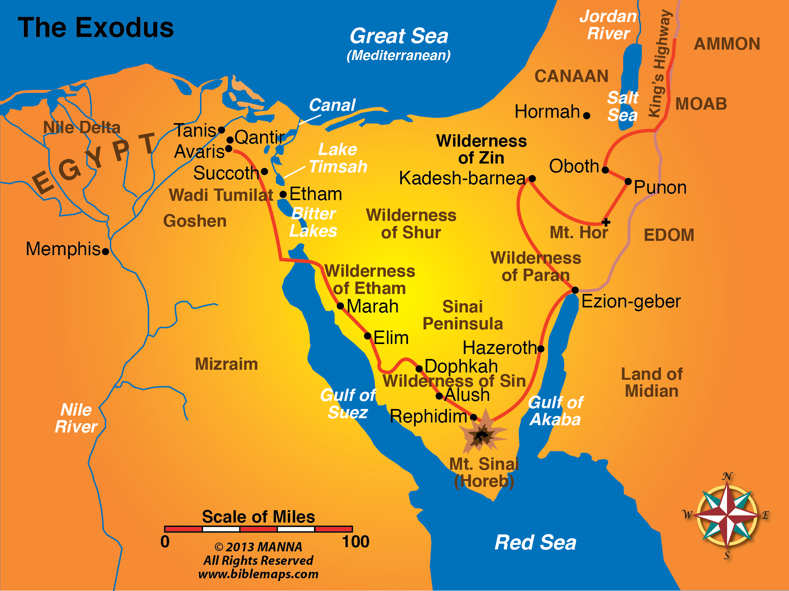
Pursuing Egyptians
Bitter Water
10 Spies
No Food
Korah’s Rebellion
No Flesh
No Water
Notes:
The Exodus

Slide 13
Lessons For Us Today
Serving God Does Not Exempt Us From Problems
Our Problems Are Not A Reason To Stop Serving God
We Can Overcome Our Problems

