Slide 1
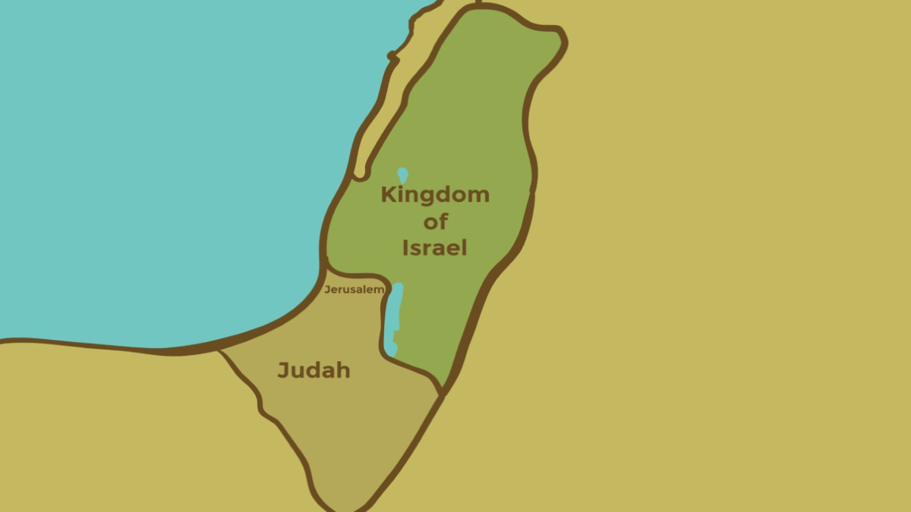
King Abijah
Lessons learned from…
2 Chronicles 13
Notes:
Abijah was the second king of Judah (son of Rehoboam), following the division of the Kingdom of Israel
Jereboam and the 10 northern tribes had seceded, and Jereboam had encouraged the building of high places in Israel, and the worship of idols.
(1 Kings 12:25-31), “Then Jeroboam built Shechem in the mountains of Ephraim, and dwelt there. Also he went out from there and built Penuel. ²⁶ And Jeroboam said in his heart, “Now the kingdom may return to the house of David: ²⁷ If these people go up to offer sacrifices in the house of the Lord at Jerusalem, then the heart of this people will turn back to their lord, Rehoboam king of Judah, and they will kill me and go back to Rehoboam king of Judah.” ²⁸ Therefore the king asked advice, made two calves of gold, and said to the people, “It is too much for you to go up to Jerusalem. Here are your gods, O Israel, which brought you up from the land of Egypt!” ²⁹ And he set up one in Bethel, and the other he put in Dan. ³⁰ Now this thing became a sin, for the people went to worship before the one as far as Dan. ³¹ He made shrines on the high places, and made priests from every class of people, who were not of the sons of Levi.”
Rehoboam, too, was both unwise and evil in his rule
(2 Chronicles 12:14-16), “And he did evil, because he did not prepare his heart to seek the Lord. ¹⁵ The acts of Rehoboam, first and last, are they not written in the book of Shemaiah the prophet, and of Iddo the seer concerning genealogies? And there were wars between Rehoboam and Jeroboam all their days. ¹⁶ So Rehoboam rested with his fathers, and was buried in the City of David. Then Abijah his son reigned in his place.”
Abijah was also a wicked ruler, though the kingdom of Judah was not taken into idolatry at this time.
(1 Kings 15:1-7), “In the eighteenth year of King Jeroboam the son of Nebat, Abijam became king over Judah. ² He reigned three years in Jerusalem. His mother's name was Maachah the granddaughter of Abishalom. ³ And he walked in all the sins of his father, which he had done before him; his heart was not loyal to the Lord his God, as was the heart of his father David. ⁴ Nevertheless for David's sake the Lord his God gave him a lamp in Jerusalem, by setting up his son after him and by establishing Jerusalem; ⁵ because David did what was right in the eyes of the Lord, and had not turned aside from anything that He commanded him all the days of his life, except in the matter of Uriah the Hittite. ⁶ And there was war between Rehoboam and Jeroboam all the days of his life. ⁷ Now the rest of the acts of Abijam, and all that he did, are they not written in the book of the chronicles of the kings of Judah? And there was war between Abijam and Jeroboam.”
With these introductory thoughts in mind, 2 Chronicles 13 relates a battle between Jereboam and Abijah, which reveals several points of application for us today
(2 Chronicles 13:1-20), “In the eighteenth year of King Jeroboam, Abijah became king over Judah. ² He reigned three years in Jerusalem. His mother's name was Michaiah the daughter of Uriel of Gibeah. And there was war between Abijah and Jeroboam. ³ Abijah set the battle in order with an army of valiant warriors, four hundred thousand choice men. Jeroboam also drew up in battle formation against him with eight hundred thousand choice men, mighty men of valor. ⁴ Then Abijah stood on Mount Zemaraim, which is in the mountains of Ephraim, and said, “Hear me, Jeroboam and all Israel: ⁵ Should you not know that the Lord God of Israel gave the dominion over Israel to David forever, to him and his sons, by a covenant of salt? ⁶ Yet Jeroboam the son of Nebat, the servant of Solomon the son of David, rose up and rebelled against his lord. ⁷ Then worthless rogues gathered to him, and strengthened themselves against Rehoboam the son of Solomon, when Rehoboam was young and inexperienced and could not withstand them. ⁸ And now you think to withstand the kingdom of the Lord, which is in the hand of the sons of David; and you are a great multitude, and with you are the gold calves which Jeroboam made for you as gods. ⁹ Have you not cast out the priests of the Lord, the sons of Aaron, and the Levites, and made for yourselves priests, like the peoples of other lands, so that whoever comes to consecrate himself with a young bull and seven rams may be a priest of things that are not gods? ¹⁰ But as for us, the Lord is our God, and we have not forsaken Him; and the priests who minister to the Lord are the sons of Aaron, and the Levites attend to their duties. ¹¹ And they burn to the Lord every morning and every evening burnt sacrifices and sweet incense; they also set the showbread in order on the pure gold table, and the lampstand of gold with its lamps to burn every evening; for we keep the command of the Lord our God, but you have forsaken Him. ¹² Now look, God Himself is with us as our head, and His priests with sounding trumpets to sound the alarm against you. O children of Israel, do not fight against the Lord God of your fathers, for you shall not prosper!” ¹³ But Jeroboam caused an ambush to go around behind them; so they were in front of Judah, and the ambush was behind them. ¹⁴ And when Judah looked around, to their surprise the battle line was at both front and rear; and they cried out to the Lord, and the priests sounded the trumpets. ¹⁵ Then the men of Judah gave a shout; and as the men of Judah shouted, it happened that God struck Jeroboam and all Israel before Abijah and Judah. ¹⁶ And the children of Israel fled before Judah, and God delivered them into their hand. ¹⁷ Then Abijah and his people struck them with a great slaughter; so five hundred thousand choice men of Israel fell slain. ¹⁸ Thus the children of Israel were subdued at that time; and the children of Judah prevailed, because they relied on the Lord God of their fathers. ¹⁹ And Abijah pursued Jeroboam and took cities from him: Bethel with its villages, Jeshanah with its villages, and Ephrain with its villages. ²⁰ So Jeroboam did not recover strength again in the days of Abijah; and the Lord struck him, and he died.”’’

Slide 2
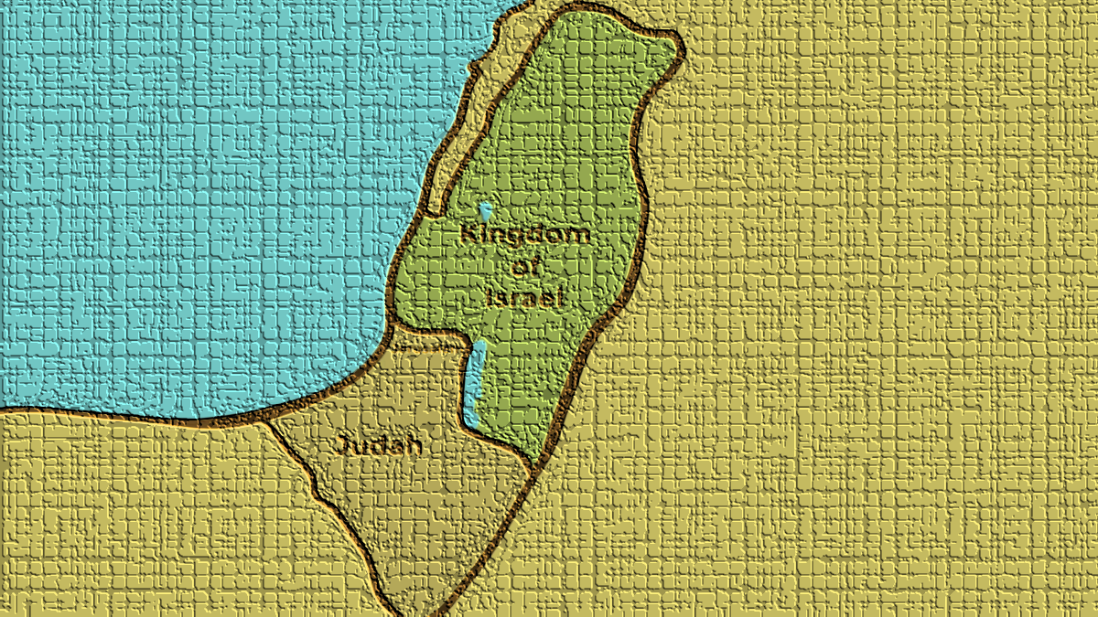
Lessons learned from King Abijah
The army of Abijah was greatly outnumbered (2-3); Matthew 7:13-14; Romans 8:31-39
Notes:
Consider first in this civil war, that the army of Abijah was greatly outnumbered (2-3)
(2 Chronicles 13:2-3), “And there was war between Abijah and Jeroboam. ³ Abijah set the battle in order with an army of valiant warriors, four hundred thousand choice men. Jeroboam also drew up in battle formation against him with eight hundred thousand choice men, mighty men of valor.”
800,000 men of valor were on the side of Jeroboam
Abijah’s army was half that size (though God was with them in this battle.
Application: We will always be in the minority. But, we make a majority with God
(Matthew 7:13-14), “Enter by the narrow gate; for wide is the gate and broad is the way that leads to destruction, and there are many who go in by it. ¹⁴ Because narrow is the gate and difficult is the way which leads to life, and there are few who find it.”
(Romans 8:31-39), “What then shall we say to these things? If God is for us, who can be against us? ³² He who did not spare His own Son, but delivered Him up for us all, how shall He not with Him also freely give us all things? ³³ Who shall bring a charge against God's elect? It is God who justifies. ³⁴ Who is he who condemns? It is Christ who died, and furthermore is also risen, who is even at the right hand of God, who also makes intercession for us. ³⁵ Who shall separate us from the love of Christ? Shall tribulation, or distress, or persecution, or famine, or nakedness, or peril, or sword? ³⁶ As it is written: “For Your sake we are killed all day long; We are accounted as sheep for the slaughter.” ³⁷ Yet in all these things we are more than conquerors through Him who loved us. ³⁸ For I am persuaded that neither death nor life, nor angels nor principalities nor powers, nor things present nor things to come, ³⁹ nor height nor depth, nor any other created thing, shall be able to separate us from the love of God which is in Christ Jesus our Lord.”

Slide 3
Lessons learned from King Abijah
The army of Abijah was greatly outnumbered (2-3); Matthew 7:13-14; Romans 8:31-39
The battle was not won by tactics (13-14); 3 John 9-11; Romans 12:18-21
Notes:
Consider second, that the battle was not won by the use of superior tactics (13-14)
Abijah made a great speech, but Jeroboam took advantage, and with a classic battle tactic, put the soldiers of Judah at a real disadvantage
(2 Chronicles 13:13-14), “But Jeroboam caused an ambush to go around behind them; so they were in front of Judah, and the ambush was behind them. ¹⁴ And when Judah looked around, to their surprise the battle line was at both front and rear; and they cried out to the Lord, and the priests sounded the trumpets.”
Outnumbered 2 to 1 by men of valor, with a divided front, there is no way a victory could come via natural means!
Men today will often use tactics instead of righteousness to get their way or gain advantage.
(3 John 9-11), [Diotrophese is a classic example of this], “I wrote to the church, but Diotrephes, who loves to have the preeminence among them, does not receive us. ¹⁰ Therefore, if I come, I will call to mind his deeds which he does, prating against us with malicious words. And not content with that, he himself does not receive the brethren, and forbids those who wish to, putting them out of the church. ¹¹ Beloved, do not imitate what is evil, but what is good. He who does good is of God, but he who does evil has not seen God.”
(Romans 12:18-21), “If it is possible, as much as depends on you, live peaceably with all men. ¹⁹ Beloved, do not avenge yourselves, but rather give place to wrath; for it is written, “Vengeance is Mine, I will repay,” says the Lord. ²⁰ Therefore “If your enemy is hungry, feed him; If he is thirsty, give him a drink; For in so doing you will heap coals of fire on his head.” ²¹ Do not be overcome by evil, but overcome evil with good.”

Slide 4
Lessons learned from King Abijah
The army of Abijah was greatly outnumbered (2-3); Matthew 7:13-14; Romans 8:31-39
The battle was not won by tactics (13-14); 3 John 9-11; Romans 12:18-21
The sin of Israel was great, displeasing God (8-12); Luke 9:57-62; Ecclesiastes 12:13
Notes:
Consider third, the sin of Israel was great, causing God’s displeasure (8-12)
(2 Chronicles 13:8-12), “And now you think to withstand the kingdom of the Lord, which is in the hand of the sons of David; and you are a great multitude, and with you are the gold calves which Jeroboam made for you as gods. ⁹ Have you not cast out the priests of the Lord, the sons of Aaron, and the Levites, and made for yourselves priests, like the peoples of other lands, so that whoever comes to consecrate himself with a young bull and seven rams may be a priest of things that are not gods? ¹⁰ But as for us, the Lord is our God, and we have not forsaken Him; and the priests who minister to the Lord are the sons of Aaron, and the Levites attend to their duties. ¹¹ And they burn to the Lord every morning and every evening burnt sacrifices and sweet incense; they also set the showbread in order on the pure gold table, and the lampstand of gold with its lamps to burn every evening; for we keep the command of the Lord our God, but you have forsaken Him. ¹² Now look, God Himself is with us as our head, and His priests with sounding trumpets to sound the alarm against you. O children of Israel, do not fight against the Lord God of your fathers, for you shall not prosper!”
Idolatry is unfaithfulness to God. There is no greater travesty than replacing God as the first priority in your life!
(Luke 9:57-62), “Now it happened as they journeyed on the road, that someone said to Him, “Lord, I will follow You wherever You go.” ⁵⁸ And Jesus said to him, “Foxes have holes and birds of the air have nests, but the Son of Man has nowhere to lay His head.” ⁵⁹ Then He said to another, “Follow Me.” But he said, “Lord, let me first go and bury my father.” ⁶⁰ Jesus said to him, “Let the dead bury their own dead, but you go and preach the kingdom of God.” ⁶¹ And another also said, “Lord, I will follow You, but let me first go and bid them farewell who are at my house.” ⁶² But Jesus said to him, “No one, having put his hand to the plow, and looking back, is fit for the kingdom of God.”
(Ecclesiastes 12:13), “Let us hear the conclusion of the whole matter: Fear God and keep His commandments, For this is man's all.”

Slide 5
Lessons learned from King Abijah
The army of Abijah was greatly outnumbered (2-3); Matthew 7:13-14; Romans 8:31-39
The battle was not won by tactics (13-14); 3 John 9-11; Romans 12:18-21
The sin of Israel was great, displeasing God (8-12); Luke 9:57-62; Ecclesiastes 12:13
The victory is won when we rely upon the Lord (18); 1 Corinthians 15:54-57; Revelation 2:10-11
Notes:
Consider last, that victory is won when we rely upon the Lord (18)
(2 Chronicles 13:18), “Thus the children of Israel were subdued at that time; and the children of Judah prevailed, because they relied on the Lord God of their fathers.”
As Judah was victorious because the relied upon the Lord, so too we will ultimately prevail through our faith in Jesus Christ
(1 Corinthians 15:54-57), [Paul writing about the resurrection of the dead, our hope in Jesus], “So when this corruptible has put on incorruption, and this mortal has put on immortality, then shall be brought to pass the saying that is written: “Death is swallowed up in victory.” ⁵⁵ “O Death, where is your sting? O Hades, where is your victory?” ⁵⁶ The sting of death is sin, and the strength of sin is the law. ⁵⁷ But thanks be to God, who gives us the victory through our Lord Jesus Christ.”
Eternity in heaven, for all who trust God, live righteously, and endure to the end!
(Revelation 2:10-11) [Christ’s letter to the church in Smyrna], “Do not fear any of those things which you are about to suffer. Indeed, the devil is about to throw some of you into prison, that you may be tested, and you will have tribulation ten days. Be faithful until death, and I will give you the crown of life. ¹¹ “He who has an ear, let him hear what the Spirit says to the churches. He who overcomes shall not be hurt by the second death.”

Slide 6
Conclusion
“Be strong and of good courage, do not fear nor be afraid of them; for the Lord your God, He is the One who goes with you. He will not leave you nor forsake you.”
(Deuteronomy 31:6)
Notes:
(Deuteronomy 31:6), [Moses’ words to Israel, as they prepared to cross over the Jordan, to take the land under Joshua’s leadership. We can take the same comfort in these words as children of God through faith in Jesus Christ],
“Be strong and of good courage, do not fear nor be afraid of them; for the Lord your God, He is the One who goes with you. He will not leave you nor forsake you.”

