Slide 1
King, Rod, Priest
Matthew
22:41-46
Psalm 110

Slide 2
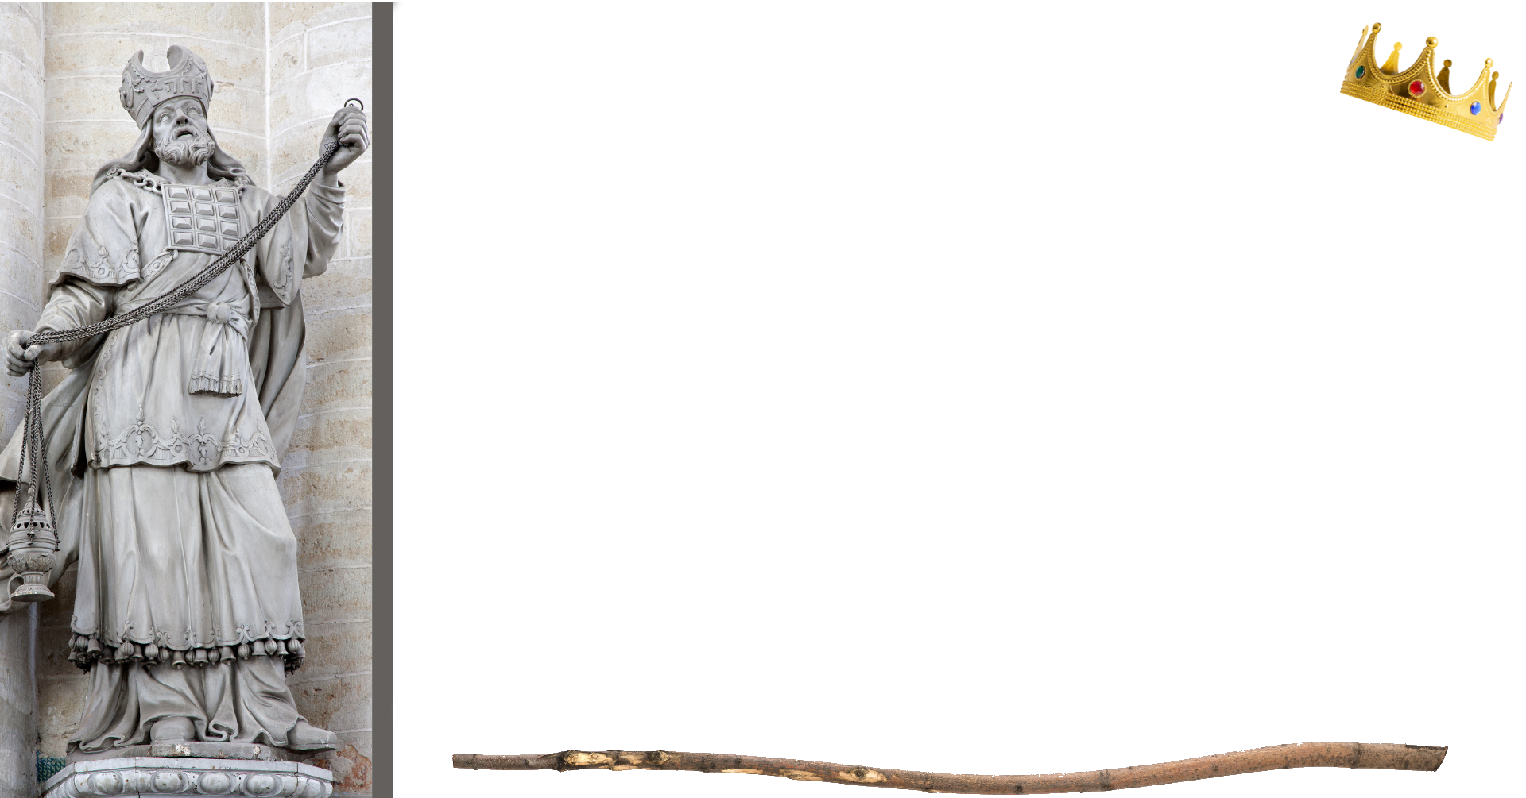
King, Rod, Priest
Christ is King until all enemies are defeated (1)
Acts 2:36-38; Heb. 1:1-3, 8-13
1 Cor. 15:24-28; Matt. 28:18; Rom. 1:16
Christ’s rule is with a rod of strength (2)
Isa. 11:1-4; Psa. 45:6; Rev. 2:25-29; 19:11-16
Christ uniquely serves as High Priest (4)
Gen. 14:8; Heb. 5:5-11; 7:24-26

Slide 3
Concluding Thoughts
Christ as King and Priest has been God’s plan for redeeming man from the very beginning (Even before this Psalm)
Ephesians 1:3-10
The Father and Son, working together for our Redemption!

