Slide 1
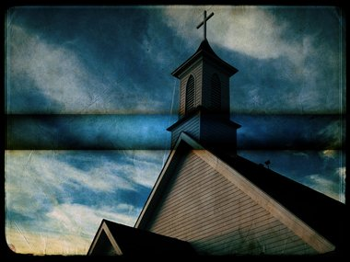
WHAT WILL MAKE THE CHURCH GROW?

Slide 2
WHAT MADE THE CHURCH GROW IN THE 1ST CENTURY?
PREACHING PREACHERS
TEACHING TEACHERS
FAITHFUL MEMBERS
WORKING MEMBERS
GIVING MEMBERS

Slide 3
WHAT ARE YOU DOING
TO HELP THIS
CHURCH GROW?

