Slide 1
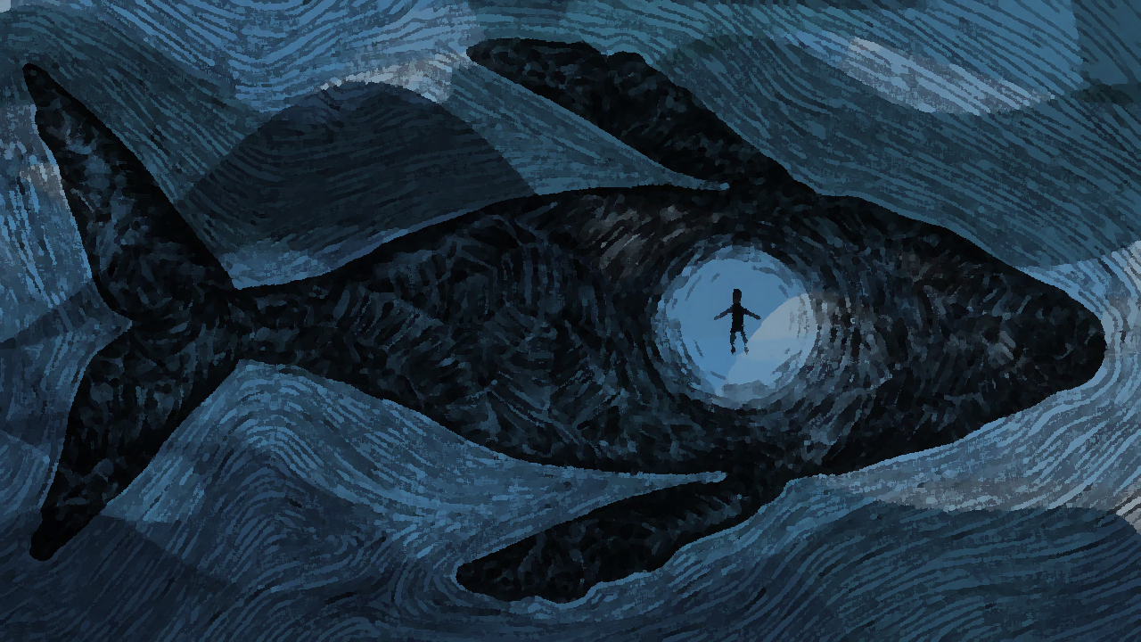
Lessons Learned from a Fish’s Belly
Jonah 1:10-17
Notes:
The prophet Jonah prophesied during the reign of Jereboam, the son of Joash
(2 Kings 14:25), “He [Jereboam] restored the territory of Israel from the entrance of Hamath to the Sea of the Arabah, according to the word of the Lord God of Israel, which He had spoken through His servant Jonah the son of Amittai, the prophet who was from Gath Hepher.”
He was chosen by God to go to the enemy, the Assyrians, whose capital city was Nineveh, to preach a message of judgment.
The book of Jonah is unique in that the emphasis is not upon the message, but the prophet himself.
Chapter 1 tells of his initial refusal to do the job God sent him to do
(Jonah 1:1-3), “Now the word of the Lord came to Jonah the son of Amittai, saying, ² “Arise, go to Nineveh, that great city, and cry out against it; for their wickedness has come up before Me.” ³ But Jonah arose to flee to Tarshish from the presence of the Lord. He went down to Joppa, and found a ship going to Tarshish; so he paid the fare, and went down into it, to go with them to Tarshish from the presence of the Lord.”
You can’t escape God so easily
(Jonah 1:10-17) [A storm threatened the boat, and Jonah admitted to the sailors that the fault was his] READ
Other lessons can be taken from Jonah’s preaching to Nineveh, and the aftermath
Our lesson is concerned with what Jonah learned from his effort to go “from the presence of the Lord”
Borrowed from a sermon outline by Joe Price, October 2017, The Spirit’s Sword

Slide 2
We can’t hide from God
Jonah 1:1-3
Hebrews 4:13; Psalm 139:1-4, 7-12
Notes:
WE CAN’T HIDE FROM GOD
(Jonah 1:1-3), “Now the word of the Lord came to Jonah the son of Amittai, saying, ² “Arise, go to Nineveh, that great city, and cry out against it; for their wickedness has come up before Me.” ³ But Jonah arose to flee to Tarshish from the presence of the Lord. He went down to Joppa, and found a ship going to Tarshish; so he paid the fare, and went down into it, to go with them to Tarshish from the presence of the Lord.”
This is a lesson we must all recognize. God’s omniscience, omnipotence and eternal presence precludes our ability to physically or mentally hide from Him
We cannot Hide our Hearts from Him,
(Hebrews 4:13), “And there is no creature hidden from His sight, but all things are naked and open to the eyes of Him to whom we must give account.”
(Psalm 139:1-4), “O Lord, You have searched me and known me. ² You know my sitting down and my rising up; You understand my thought afar off. ³ You comprehend my path and my lying down, and are acquainted with all my ways. ⁴ For there is not a word on my tongue, but behold, O Lord, You know it altogether.
(Psalm 139:7-12), “Where can I go from Your Spirit? Or where can I flee from Your presence? ⁸ If I ascend into heaven, You are there; if I make my bed in hell, behold, You are there. ⁹ If I take the wings of the morning, and dwell in the uttermost parts of the sea, ¹⁰ even there Your hand shall lead me, and Your right hand shall hold me. ¹¹ If I say, “Surely the darkness shall fall on me,”
even the night shall be light about me; ¹² Indeed, the darkness shall not hide from You, but the night shines as the day; the darkness and the light are both alike to You.”
The moment we learn this lesson, as did Jonah, can be the first step in preparing for our own salvation.

Slide 3
God hears and answers our prayers if we turn our hearts to Him
Jonah 2:1-4
Acts 8:22-24; 1 John 1:9; Jonah 2:6-7
Notes:
GOD HEARS AND ANSWERS PRAYERS OF HIS PEOPLE WHEN THEY TURN THEIR HEARTS TO HIM
(Jonah 2:1-4), “Then Jonah prayed to the Lord his God from the fish's belly. ² And he said: ‘I cried out to the Lord because of my affliction, and He answered me. ‘Out of the belly of Sheol I cried, and You heard my voice. ³ For You cast me into the deep, into the heart of the seas, and the floods surrounded me; all Your billows and Your waves passed over me. ⁴ Then I said, ‘I have been cast out of Your sight; Yet I will look again toward Your holy temple.’”
Power of Prayer
(Acts 8:22-24), [Pray can bring forgiveness of our sins, Simon as example], “Repent therefore of this your wickedness, and pray God if perhaps the thought of your heart may be forgiven you. ²³ For I see that you are poisoned by bitterness and bound by iniquity.” ²⁴ Then Simon answered and said, “Pray to the Lord for me, that none of the things which you have spoken may come upon me.”
(1 John 1:9), “If we confess our sins, He is faithful and just to forgive us our sins and to cleanse us from all unrighteousness.”
(James 5:15-18), “And the prayer of faith will save the sick, and the Lord will raise him up. And if he has committed sins, he will be forgiven. ¹⁶ Confess your trespasses to one another, and pray for one another, that you may be healed. The effective, fervent prayer of a righteous man avails much. ¹⁷ Elijah was a man with a nature like ours, and he prayed earnestly that it would not rain; and it did not rain on the land for three years and six months. ¹⁸ And he prayed again, and the heaven gave rain, and the earth produced its fruit.”
Although Our Sins Separate Us from God, He Delivers Us When We Repent and Look to Him,
(Jonah 2:6-7), “I went down to the moorings of the mountains; the earth with its bars closed behind me forever; yet You have brought up my life from the pit, O Lord, my God. ⁷ “When my soul fainted within me, I remembered the Lord; and my prayer went up to You, into Your holy temple.”

Slide 4
God disciplines us with trials and sufferings so we will remember Him
Jonah 2:3-7
Hebrews 12:3-6, 9-10; 12:11; 1 Peter 4:12-13, 16
Notes:
GOD DISCIPLINES US WITH TRIALS AND SUFFERINGS SO WE WILL REMEMBER HIM,
(Jonah 2:3-7), [Read again Jonah’s description of his ordeal, and try to imagine how it must have been!], “For You cast me into the deep, into the heart of the seas, and the floods surrounded me; all Your billows and Your waves passed over me. ⁴ Then I said, ‘I have been cast out of Your sight; yet I will look again toward Your holy temple.’ ⁵ The waters surrounded me, even to my soul; the deep closed around me; weeds were wrapped around my head. ⁶ I went down to the moorings of the mountains; the earth with its bars closed behind me forever; yet You have brought up my life from the pit, O Lord, my God. ⁷ “When my soul fainted within me, I remembered the Lord; and my prayer went up to You, into Your holy temple.”
Trials serve to discipline us
(Hebrews 12:3-6), “For consider Him who endured such hostility from sinners against Himself, lest you become weary and discouraged in your souls. ⁴ You have not yet resisted to bloodshed, striving against sin. ⁵ And you have forgotten the exhortation which speaks to you as to sons: “My son, do not despise the chastening of the Lord, nor be discouraged when you are rebuked by Him; ⁶ For whom the Lord loves He chastens, and scourges every son whom He receives.”
(Hebrews 12:9-10), “Furthermore, we have had human fathers who corrected us, and we paid them respect. Shall we not much more readily be in subjection to the Father of spirits and live? ¹⁰ For they indeed for a few days chastened us as seemed best to them, but He for our profit, that we may be partakers of His holiness.”
But, it requires Faith to See the Blessings of Trials (the perspective a Christian enjoys)
(Hebrews 12:11), “Now no chastening seems to be joyful for the present, but painful; nevertheless, afterward it yields the peaceable fruit of righteousness to those who have been trained by it.”
(1 Peter 4:12-13, 16), “Beloved, do not think it strange concerning the fiery trial which is to try you, as though some strange thing happened to you; ¹³ but rejoice to the extent that you partake of Christ's sufferings, that when His glory is revealed, you may also be glad with exceeding joy... (16), “Yet if anyone suffers as a Christian, let him not be ashamed, but let him glorify God in this matter.”

Slide 5
Salvation is of the Lord
Jonah 2:9-10
Jonah 2:8,9; Eccl. 5:1-5; 12:13-14; Heb. 5:8-9
Notes:
SALVATION IS OF THE LORD
(Jonah 2:9-10), “But I will sacrifice to You with the voice of thanksgiving; I will pay what I have vowed. Salvation is of the Lord.” ¹⁰ So the Lord spoke to the fish, and it vomited Jonah onto dry land.”
In contrast, the idols of men are worthless to save, (remember, the sailors had petitioned their idols to save them (1:5)
(Jonah 2:8), “Those who regard worthless idols forsake their own Mercy.”
Salvation does not excuse us from keeping our vows to God,
(Jonah 2:9), “I will pay what I have vowed.” (He would fulfill his obligations as a prophet of God).
(Ecclesiastes 5:1-5), “Walk prudently when you go to the house of God; and draw near to hear rather than to give the sacrifice of fools, for they do not know that they do evil. ² Do not be rash with your mouth, and let not your heart utter anything hastily before God. For God is in heaven, and you on earth; therefore let your words be few. ³ For a dream comes through much activity,
And a fool's voice is known by his many words. ⁴ When you make a vow to God, do not delay to pay it; for He has no pleasure in fools. Pay what you have vowed—⁵ Better not to vow than to vow and not pay.”
(Ecclesiastes 12:13-14), “Let us hear the conclusion of the whole matter: Fear God and keep His commandments, for this is man's all. ¹⁴ For God will bring every work into judgment, including every secret thing, whether good or evil.”
(Hebrews 5:8-9), “Though He was a Son, yet He learned obedience by the things which He suffered. ⁹ And having been perfected, He became the author of eternal salvation to all who obey Him.”

Slide 6
Obedience without Thanksgiving is Empty
Jonah 2:9
1 Timothy 1:12; (Jonah 3:1-4); Luke 22:31-32
Notes:
OBEDIENCE WITHOUT THANKSGIVING IS EMPTY
(Jonah 2:9), “But I will sacrifice to You with the voice of thanksgiving; I will pay what I have vowed. Salvation is of the Lord.”
Obey God because We Adore Him and Thank Him for Mercy
(1 Timothy 1:12), “And I thank Christ Jesus our Lord who has enabled me, because He counted me faithful, putting me into the ministry.”
You Must Repent to be Ready to do God’s Work
(Jonah 3:1-4), “Now the word of the Lord came to Jonah the second time, saying, ² “Arise, go to Nineveh, that great city, and preach to it the message that I tell you.” ³ So Jonah arose and went to Nineveh, according to the word of the Lord. Now Nineveh was an exceedingly great city, a three-day journey in extent. ⁴ And Jonah began to enter the city on the first day's walk. Then he cried out and said, “Yet forty days, and Nineveh shall be overthrown!”
(Luke 22:31-32), [Jesus, predicting Peter’s denial of him after His arrest], “And the Lord said, “Simon, Simon! Indeed, Satan has asked for you, that he may sift you as wheat. ³² But I have prayed for you, that your faith should not fail; and when you have returned to Me, strengthen your brethren.”

Slide 7
Conclusion
Turn TO God, not AWAY from Him!
Notes:
You can’t hide from the face of the Lord
Face your obligations, and serve Him! Loving Him with all your heart, your soul, your mind and your strength!

