Slide 1

Meditations on God’s Word
Psalm 119:73-80
Notes:
Meditations on God’s Word
The entire 119th Psalm is an ode to the Word and Will of Jehovah
The sentiments (and others like them) expressed in our text can be found throughout the chapter
Most in the world do not understand the significance and importance of our Bible
They are ignorant, many willfully so
Consider our passage as a reminder of how important the Bible (in its entirety) is to mankind.
(Psalm 119:73-80)
⁷³ “Your hands have made me and fashioned me; Give me understanding, that I may learn Your commandments.”
⁷⁴ “Those who fear You will be glad when they see me, Because I have hoped in Your word.”
⁷⁵ “I know, O Lord, that Your judgments are right, And that in faithfulness You have afflicted me.”
⁷⁶ “Let, I pray, Your merciful kindness be for my comfort, According to Your word to Your servant.”
⁷⁷ “Let Your tender mercies come to me, that I may live; For Your law is my delight.”
⁷⁸ “Let the proud be ashamed, For they treated me wrongfully with falsehood; But I will meditate on Your precepts.”
⁷⁹ “Let those who fear You turn to me, Those who know Your testimonies.”
⁸⁰ “Let my heart be blameless regarding Your statutes, That I may not be ashamed.”
Introduction: Our purpose in being created (73) to learn the commandments of God
Logic – We have a creator. It follows that said Creator may have a purpose for us, His creation
The purpose is found in His revealed will.
(2 Timothy 3:16-17), [He revealed His will in the Bible/Scripture], “All Scripture is given by inspiration of God, and is profitable for doctrine, for reproof, for correction, for instruction in righteousness, ¹⁷ that the man of God may be complete, thoroughly equipped for every good work.”
(Ecclesiastes 12:13-14), “Let us hear the conclusion of the whole matter: Fear God and keep His commandments, for this is man's all. ¹⁴ For God will bring every work into judgment, including every secret thing, whether good or evil.”
Consider the following “Meditations” of the Psalmist upon the significance of God’s word and will for man…

Slide 2
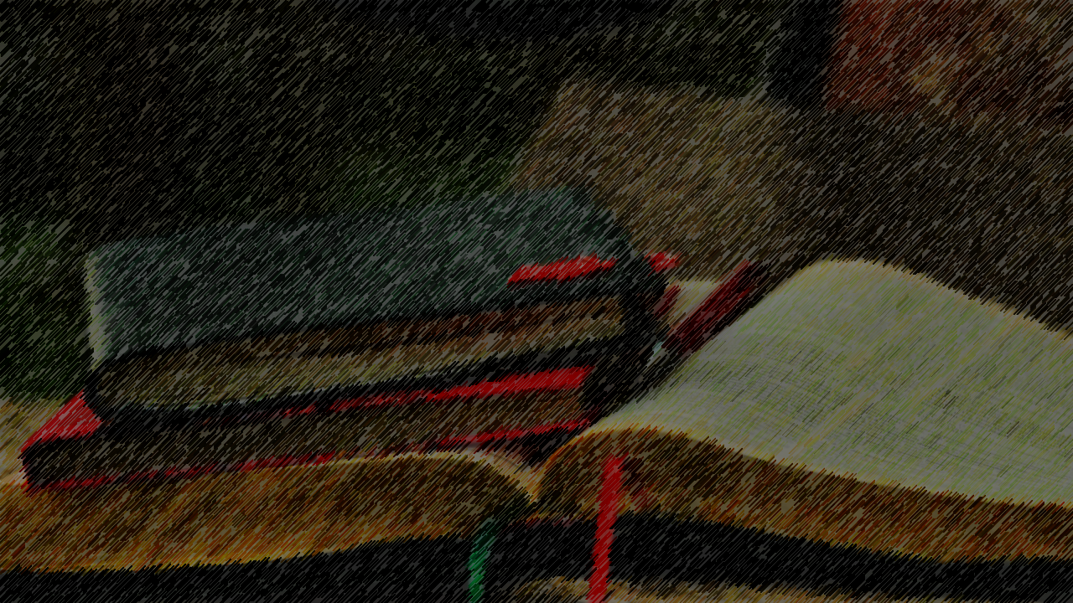
The joy and love of fellowship is based in God’s Word
74
James 1:25
2 John 1-3; 3 John 1-3
1 Corinthians 13:6
Notes:
The joy of fellowship is based in God’s word (74)
⁷⁴ “Those who fear You will be glad when they see me, Because I have hoped in Your word.”
All who fear God have in common their hope and trust in the words of God
(James 1:25), “But he who looks into the perfect law of liberty and continues in it, and is not a forgetful hearer but a doer of the work, this one will be blessed in what he does.”
This commonality leads to tender feelings toward those who are likeminded toward truth
This is demonstrated by the words of John in his epistles
(2 John 1-3), “The Elder, To the elect lady and her children, whom I love in truth, and not only I, but also all those who have known the truth, ² because of the truth which abides in us and will be with us forever: ³ Grace, mercy, and peace will be with you from God the Father and from the Lord Jesus Christ, the Son of the Father, in truth and love.”
(3 John 1-3), “The Elder, To the beloved Gaius, whom I love in truth: ² Beloved, I pray that you may prosper in all things and be in health, just as your soul prospers. ³ For I rejoiced greatly when brethren came and testified of the truth that is in you, just as you walk in the truth. ⁴ I have no greater joy than to hear that my children walk in truth.”
Love and truth are not opposed… they are complementary!
(1 Corinthians 13:6), [Love] “does not rejoice in iniquity, but rejoices in the truth.”

Slide 3
The actions of a just God are always defensible
75
Job 38:1-3; 42:1-6
Proverbs 3:11-12
Notes:
The actions of a just God are always defensible (75)
⁷⁵ “I know, O Lord, that Your judgments are right, And that in faithfulness You have afflicted me.”
As we have revealed in scripture the judgments of God, we can trust them to be right
More to this point, we have no place to doubt God’s actions toward us
“Why God?” is a common question, but as with Job, beyond our right to ask
(Job 38:1-3), [Job had defended his own integrity, and cried out against God’s treatment of him, because he was “righteous in his own eyes.” (32:1), God answers Him], “Then the Lord answered Job out of the whirlwind, and said: ² “Who is this who darkens counsel by words without knowledge? ³ Now prepare yourself like a man; I will question you, and you shall answer Me.”
At God’s admonition, notice Job’s response
(Job 42:1-6), “Then Job answered the Lord and said: ² “I know that You can do everything, and that no purpose of Yours can be withheld from You. ³ You asked, ‘Who is this who hides counsel without knowledge?’ Therefore I have uttered what I did not understand, things too wonderful for me, which I did not know. ⁴ Listen, please, and let me speak; You said, ‘I will question you, and you shall answer Me.’ ⁵ “I have heard of You by the hearing of the ear, but now my eye sees You. ⁶ Therefore I abhor myself, and repent in dust and ashes.”
May we all show the same humility toward God in the midst of our own afflictions!
(Proverbs 3:11-12), “My son, do not despise the chastening of the Lord, nor detest His correction; ¹² For whom the Lord loves He corrects, just as a father the son in whom he delights.”

Slide 4
God keeps His promises of mercy and provision
76
Deuteronomy 7:7-9
2 Timothy 2:11-13
Notes:
God keeps His promises of mercy and provision (76)
⁷⁶ “Let, I pray, Your merciful kindness be for my comfort, According to Your word to Your servant.”
He is the faithful God!
(Deuteronomy 7:7-9), “The Lord did not set His love on you nor choose you because you were more in number than any other people, for you were the least of all peoples; ⁸ but because the Lord loves you, and because He would keep the oath which He swore to your fathers, the Lord has brought you out with a mighty hand, and redeemed you from the house of bondage, from the hand of Pharaoh king of Egypt. ⁹ “Therefore know that the Lord your God, He is God, the faithful God who keeps covenant and mercy for a thousand generations with those who love Him and keep His commandments.”
His faithfulness remains both with His promises and His threatenings
(2 Timothy 2:11-13), “This is a faithful saying: For if we died with Him, we shall also live with Him.
¹² If we endure, we shall also reign with Him. If we deny Him, He also will deny us. ¹³ If we are faithless, He remains faithful; He cannot deny Himself.”

Slide 5
The provisions of God come to the obedient
77
Ephesians 1:3
James 4:4-6
Notes:
The provisions of God come to the obedient (77)
⁷⁷ “Let Your tender mercies come to me, that I may live; For Your law is my delight.”
This is a simple concept – God’s spiritual blessings come to those who are His
(Ephesians 1:3), “Blessed be the God and Father of our Lord Jesus Christ, who has blessed us with every spiritual blessing in the heavenly places in Christ.”
(James 4:4-6), “Adulterers and adulteresses! Do you not know that friendship with the world is enmity with God? Whoever therefore wants to be a friend of the world makes himself an enemy of God. ⁵ Or do you think that the Scripture says in vain, “The Spirit who dwells in us yearns jealously”? ⁶ But He gives more grace. Therefore He says: “God resists the proud, but gives grace to the humble.”

Slide 6
The pride of man leads to disobedience
78
Proverbs 11:2; 16:18
Jeremiah 9:23-24
Notes:
The pride of man leads to disobedience
⁷⁸ “Let the proud be ashamed, For they treated me wrongfully with falsehood; But I will meditate on Your precepts.”
Pride, selfishness, arrogance, willfulness. All of these are synonymous, and completely unacceptable for children of God. They bring sin with them!
(Proverbs 11:2), “When pride comes, then comes shame; but with the humble is wisdom.”
(Proverbs 16:18), “Pride goes before destruction, and a haughty spirit before a fall.”
Basically, it leads to doing what you want, rather than what God wants you to do!
(Jeremiah 9:23-24), “Thus says the Lord: “Let not the wise man glory in his wisdom, let not the mighty man glory in his might, nor let the rich man glory in his riches; ²⁴ but let him who glories glory in this, that he understands and knows Me, that I am the Lord, exercising lovingkindness, judgment, and righteousness in the earth. For in these I delight,” says the Lord.”

Slide 7
Those who fear God show it by obeying His word!
79
Exodus 18:19-21
Deuteronomy 6:1-2
Notes:
Those who fear God show it by obeying His word (79)
⁷⁹ “Let those who fear You turn to me, Those who know Your testimonies.”
Notice the Psalmist equates those who fear God with those who know what He says!
(Exodus 18:19-21) [Moses’ father-in-law, in giving advice to Moses, did the same!], “Listen now to my voice; I will give you counsel, and God will be with you: Stand before God for the people, so that you may bring the difficulties to God. ²⁰ And you shall teach them the statutes and the laws, and show them the way in which they must walk and the work they must do. ²¹ Moreover you shall select from all the people able men, such as fear God, men of truth, hating covetousness; and place such over them to be rulers of thousands, rulers of hundreds, rulers of fifties, and rulers of tens.”
It’s not enough to know His will, we must also obey it!
(Deuteronomy 6:1-2), [Moses’ instruction to Israel as he taught them the 10 commandments], “Now this is the commandment, and these are the statutes and judgments which the Lord your God has commanded to teach you, that you may observe them in the land which you are crossing over to possess, ² that you may fear the Lord your God, to keep all His statutes and His commandments which I command you, you and your son and your grandson, all the days of your life, and that your days may be prolonged.”
Those who fear God show that fear by obeying His word (79)

Slide 8
To Avoid Shame, Obey God! (80)
John 14:21
Notes:
Conclusion: To Avoid Shame, Obey God!
⁸⁰ “Let my heart be blameless regarding Your statutes, That I may not be ashamed.”
Shame comes in willful disobedience
Those who humbly obey, they are the one who will receive glory!
(John 14:21), “He who has My commandments and keeps them, it is he who loves Me. And he who loves Me will be loved by My Father, and I will love him and manifest Myself to him.”

