Slide 1
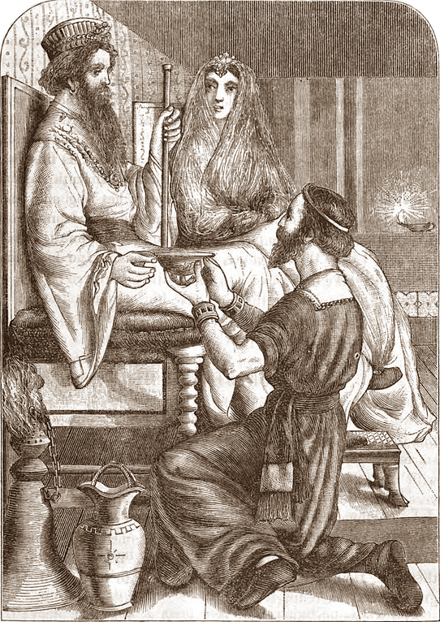
Nehemiah
A Man for His Time
“For I was the king’s cupbearer.”
(Nehemiah 1:11)

Slide 2
Nehemiah
A Man for His Time
“For I was the king’s cupbearer.”
(Nehemiah 1:11)
Stan Cox – Evangelist
West Side church of Christ
Notes:
Nehemiah – A man for his time.
The events of Nehemiah chapter 1 took place during the reign of Artexerxes, king of Persia (around 445 BC).
An earlier attempt to rebuild the wall of Jerusalem had been stopped (cf. Ezra 4:12-24) and it still remained in ruins.
Artexerxes had received an accusation against the Jews, and because he believed it, had by “force of arms made them cease” [with the work of rebuilding the walls and city, vs. 23]. “Thus the work of the house of God which is at Jerusalem ceased…” (vs. 24).
This was the cause of the nature of the report Nehemiah received in verse 3 of our text:
(Nehemiah 1), “The words of Nehemiah the son of Hachaliah.
“It came to pass in the month of Chislev, in the twentieth year, as I was in Shushan the citadel, ² that Hanani one of my brethren came with men from Judah; and I asked them concerning the Jews who had escaped, who had survived the captivity, and concerning Jerusalem. ³ And they said to me, “The survivors who are left from the captivity in the province are there in great distress and reproach. The wall of Jerusalem is also broken down, and its gates are burned with fire.”
^{“4} So it was, when I heard these words, that I sat down and wept, and mourned for many days; I was fasting and praying before the God of heaven.
^{“5} And I said: “I pray, Lord God of heaven, O great and awesome God, You who keep Your covenant and mercy with those who love You and observe Your commandments, ⁶ please let Your ear be attentive and Your eyes open, that You may hear the prayer of Your servant which I pray before You now, day and night, for the children of Israel Your servants, and confess the sins of the children of Israel which we have sinned against You. Both my father's house and I have sinned. ⁷ We have acted very corruptly against You, and have not kept the commandments, the statutes, nor the ordinances which You commanded Your servant Moses. ⁸ Remember, I pray, the word that You commanded Your servant Moses, saying, ‘If you are unfaithful, I will scatter you among the nations; ⁹ but if you return to Me, and keep My commandments and do them, though some of you were cast out to the farthest part of the heavens, yet I will gather them from there, and bring them to the place which I have chosen as a dwelling for My name.’ ¹⁰ Now these are Your servants and Your people, whom You have redeemed by Your great power, and by Your strong hand. ¹¹ O Lord, I pray, please let Your ear be attentive to the prayer of Your servant, and to the prayer of Your servants who desire to fear Your name; and let Your servant prosper this day, I pray, and grant him mercy in the sight of this man.”
“For I was the king's cupbearer.”
There are three points I want to take from this text, which put Nehemiah in a very good light.
He was obviously a special individual
He had risen to a very important position of trust in the Persian court
Consider these simple quotes from the Wikipedia article on “cupbearer”
“A cup-bearer was an officer of high rank in royal courts whose duty it was to serve the drinks at the royal table. On account of the constant fear of plots and intrigues, a person must be regarded as thoroughly trustworthy to hold the position. He must guard against poison in the king's cup and was sometimes required to swallow some of the drink before serving it. His confidential relations with the king often gave him a position of great influence. The position of cup-bearer is greatly valued and given only to a select few throughout history.
“In the Post-exilic period, Nehemiah rose to the high ranking palace position of cup-bearer to King Artaxerxes, the sixth King of the Medio/Persian Empire. The position placed his life on the line every day yet gave Nehemiah authority and high pay, and was held in high esteem by him, as the record shows. His financial ability (Nehemiah 5:8,10,14,17) would indicate that the office was a lucrative one.”
Through his leadership the wall surrounding Jerusalem was defended, the building was completed, and the wall was dedicated.
He was personally generous with his wealth, and by example and entreaty influenced the wealthy among the remnant to treat others fairly with generosity.
He and Ezra led the people to a penitent heart and renewal of their covenant with the Lord
He reformed the practices of the people, bringing them in line with the ordinances of God (including Sabbath observances)
The Concluding words of the book:
(Nehemiah 13:30-31), “Thus I cleansed them of everything pagan. I also assigned duties to the priests and the Levites, each to his service, ³¹ and to bringing the wood offering and the firstfruits at appointed times. Remember me, O my God, for good!”
Nehemiah was certainly the man that God needed for the time in which he lived.
Consider these three attributes, learned from the first few verses of the book.

Slide 3
Nehemiah
A heart of compassion and concern
(verse 2-4)
Matt. 10:42; 25:34-40
Acts 11:30; 2 Cor. 1:3-4
Stan Cox – Evangelist
West Side church of Christ
Notes:
A heart of compassion and concern
(Nehemiah 1:1-4), “The words of Nehemiah the son of Hachaliah. “It came to pass in the month of Chislev, in the twentieth year, as I was in Shushan the citadel, ² that Hanani one of my brethren came with men from Judah; and I asked them concerning the Jews who had escaped, who had survived the captivity, and concerning Jerusalem. ³ And they said to me, “The survivors who are left from the captivity in the province are there in great distress and reproach. The wall of Jerusalem is also broken down, and its gates are burned with fire.” ^{“4} So it was, when I heard these words, that I sat down and wept, and mourned for many days; I was fasting and praying before the God of heaven.”
We should be impacted by the plight of our fellow man
(The present protests, regardless of the rioting and lawlessness that accompany them, have arisen because of such compassion)
Those who are touched (even if the circumstances do not impact them personally) are expressing a special heart of compassion…
(Matthew 10:42), “And whoever gives one of these little ones only a cup of cold water in the name of a disciple, assuredly, I say to you, he shall by no means lose his reward.”
(Matthew 25:34-40), “Then the King will say to those on His right hand, ‘Come, you blessed of My Father, inherit the kingdom prepared for you from the foundation of the world: ³⁵ for I was hungry and you gave Me food; I was thirsty and you gave Me drink; I was a stranger and you took Me in; ³⁶ I was naked and you clothed Me; I was sick and you visited Me; I was in prison and you came to Me.’ ³⁷ “Then the righteous will answer Him, saying, ‘Lord, when did we see You hungry and feed You, or thirsty and give You drink? ³⁸ When did we see You a stranger and take You in, or naked and clothe You? ³⁹ Or when did we see You sick, or in prison, and come to You?’ ⁴⁰ And the King will answer and say to them, ‘Assuredly, I say to you, inasmuch as you did it to one of the least of these My brethren, you did it to Me.’”
We should especially have compassion and concern for our brethren
(Acts 11:27-30), “And in these days prophets came from Jerusalem to Antioch. ²⁸ Then one of them, named Agabus, stood up and showed by the Spirit that there was going to be a great famine throughout all the world, which also happened in the days of Claudius Caesar. ²⁹ Then the disciples, each according to his ability, determined to send relief to the brethren dwelling in Judea. ³⁰ This they also did, and sent it to the elders by the hands of Barnabas and Saul.”
(2 Corinthians 1:3-4), “Blessed be the God and Father of our Lord Jesus Christ, the Father of mercies and God of all comfort, ⁴ who comforts us in all our tribulation, that we may be able to comfort those who are in any trouble, with the comfort with which we ourselves are comforted by God.”

Slide 4
Nehemiah
A confidence in prayer’s power
(verse 4, 5-11)
Nehemiah 2:1-5
John 14:12-14; Jas. 5:16
Stan Cox – Evangelist
West Side church of Christ
Notes:
A confidence in the power of prayer
(Nehemiah 1:4, 5-7), ^{“4} So it was, when I heard these words, that I sat down and wept, and mourned for many days; I was fasting and praying before the God of heaven.
^{“5} And I said: “I pray, Lord God of heaven, O great and awesome God, You who keep Your covenant and mercy with those who love You and observe Your commandments, ⁶ please let Your ear be attentive and Your eyes open, that You may hear the prayer of Your servant which I pray before You now, day and night, for the children of Israel Your servants, and confess the sins of the children of Israel which we have sinned against You. Both my father's house and I have sinned. ⁷ We have acted very corruptly against You, and have not kept the commandments, the statutes, nor the ordinances which You commanded Your servant Moses.”
Nehemiah’s great work began with a petition made to God
(Nehemiah 2:1-5), “And it came to pass in the month of Nisan, in the twentieth year of King Artaxerxes, when wine was before him, that I took the wine and gave it to the king. Now I had never been sad in his presence before. ² Therefore the king said to me, “Why is your face sad, since you are not sick? This is nothing but sorrow of heart.” So I became dreadfully afraid, ³ and said to the king, “May the king live forever! Why should my face not be sad, when the city, the place of my fathers’ tombs, lies waste, and its gates are burned with fire?” ⁴ Then the king said to me, “What do you request?” So I prayed to the God of heaven. ⁵ And I said to the king, “If it pleases the king, and if your servant has found favor in your sight, I ask that you send me to Judah, to the city of my fathers’ tombs, that I may rebuild it.”
Jesus’ promise to His disciples
(John 14:12-14), “Most assuredly, I say to you, he who believes in Me, the works that I do he will do also; and greater works than these he will do, because I go to My Father. ¹³ And whatever you ask in My name, that I will do, that the Father may be glorified in the Son. ¹⁴ If you ask anything in My name, I will do it.”
We too can have confidence in the prayers we offer to the Father
(James 5:16), “Confess your trespasses to one another, and pray for one another, that you may be healed. The effective, fervent prayer of a righteous man avails much.”

Slide 5
Nehemiah
An awareness of his own abilities
(verse 11)
Mt. 11:11; Heb. 11:13-16
Ephesians 4:11-12, 16
Stan Cox – Evangelist
West Side church of Christ
Notes:
An awareness of his own abilities
(Nehemiah 1:11), “O Lord, I pray, please let Your ear be attentive to the prayer of Your servant, and to the prayer of Your servants who desire to fear Your name; and let Your servant prosper this day, I pray, and grant him mercy in the sight of this man.” “For I was the king's cupbearer.”
This was not arrogance or pride. It was simply an awareness of what he could do, leading to a willingness to do it!
No doubt, Nehemiah was a special individual. As were Moses, Elijah, Peter, John, Paul, Barnabas, etc., etc., etc.
However, the main thing that makes people special is their faith!
(Matthew 11:11), “Assuredly, I say to you, among those born of women there has not risen one greater than John the Baptist; but he who is least in the kingdom of heaven is greater than he.”
(Hebrews 11:13-16), “These all died in faith, not having received the promises, but having seen them afar off were assured of them, embraced them and confessed that they were strangers and pilgrims on the earth. ¹⁴ For those who say such things declare plainly that they seek a homeland. ¹⁵ And truly if they had called to mind that country from which they had come out, they would have had opportunity to return. ¹⁶ But now they desire a better, that is, a heavenly country. Therefore God is not ashamed to be called their God, for He has prepared a city for them.”
We too should identify our abilities, and have a willingness to use them to God’s glory!
(Ephesians 4:11-12, 16), “And He Himself gave some to be apostles, some prophets, some evangelists, and some pastors and teachers, ¹² for the equipping of the saints for the work of ministry, for the edifying of the body of Christ,… ¹⁶ from whom the whole body, joined and knit together by what every joint supplies, according to the effective working by which every part does its share, causes growth of the body for the edifying of itself in love. “

Slide 6
Conclusion
Can it be said that we are the types of men and women needed in our time?
It takes compassion, prayer, faith and a willingness to do what we can!
Stan Cox – Evangelist
West Side church of Christ
Notes:
Conclusion:
Can it be said that we are the types of men and women needed in our time?
It takes compassion, prayer, faith and a willingness to do what we can!

Slide 7
For more Bible study
Visit our website:
http://soundteaching.org
For more Bible study materials, and information about our congregation.
Please come visit!
Notes:
Conclusion:
Can it be said that we are the types of men and women needed in our time?
It takes compassion, prayer, faith and a willingness to do what we can!

