Slide 1
PARTICIPATION MATTERS
Blessings
Responsibilities
Notes:
This Lesson is designed to encourage active participation in the work of this congregation! (i.e. – Commitment)
Silly joke: When it comes to breakfast, the difference between the chicken and the pig? Chicken involved/Pig committed!
Our point: To rise above a mere involvement, and to encourage commitment on the part of all our members…
(Isaiah 6:9) [Consider Isaiah an example. God called him to be a prophet in a vision], “Also I heard the voice of the Lord, saying: ‘Whom shall I send, and who will go for Us?’ Then I said, ‘Here am I! Send me.’”

Slide 2
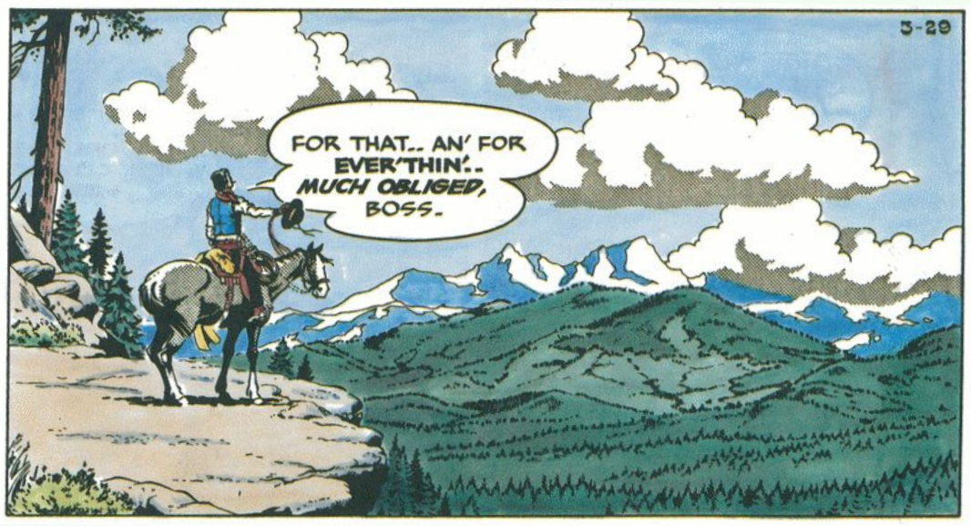
Solitary Religion – Not God’s Way!
God’s Plan includes collective action
Worship
Work
Notes:
The solitary practice of religion is popular, but not God’s plan
Sentiment: I think of myself as a spiritual person, but not particularly religious
Illustration: Hipshot Percussion (Easter morning – Rick O’Shay)
The most extensive study done on attendance to worship estimates that only 17% of Americans attend worship on any particular week of the year¹
Further, many Americans consider themselves religiously actively, even though they are not members of any local church, and attend worship less than 12 times per year.
There are varying degrees of participation (Chicken/Pig – involvement/commitment) Every congregation struggles with this to one extent or another
Irregular attendance
Once weekly attendance
Regular attendance to all worship services and classes
Involvement in the teaching program of a congregation
Active involvement in benevolence, hospitality and visitation
Volunteer work – building maintenance, weekly chores and duties, mundane things that are necessary for a congregation to thrive spiritually, and to be enabled to do the work God expects
While we often emphasize the responsibilities of such participation in the collective work of the local church (and will establish that quickly this morning. I want to make the main emphasis of our time considering the benefits that come from such dedication to the Lord’s cause.
https://churchleaders.com/pastors/pastor-articles/139575-7-startling-facts-an-up-close-look-at-church-attendance-in-america.html

Slide 3
Responsibilities
Worship (Psalm 96:8-9; Hebrews 10:24-25)
Notes:
When I say Participation, in this lesson I mean participating jointly with other Christians
Interestingly, that is the Bible definition of fellowship!
Thayer (koinonia) - 1) fellowship, association, community, communion, joint participation, intercourse; 1a) the share which one has in anything, participation
Scripture clearly establishes that such joint participation involves responsibilities to a congregation. Two examples to establish the point…
Discipline
(1 Corinthians 5:4-5), “In the name of our Lord Jesus Christ, when you are gathered together, along with my spirit, with the power of our Lord Jesus Christ, ⁵ deliver such a one to Satan for the destruction of the flesh, that his spirit may be saved in the day of the Lord Jesus.”
Submission
(Hebrews 13:17), “Obey those who rule over you, and be submissive, for they watch out for your souls, as those who must give account. Let them do so with joy and not with grief, for that would be unprofitable for you.”
(Click), The most obvious example of our responsibility is congregational Worship
(Psalm 96:8), “Give to the Lord the glory due His name; bring an offering, and come into His courts. ⁹ Oh, worship the Lord in the beauty of holiness! Tremble before Him, all the earth.”
(Hebrews 10:24-25), “And let us consider one another in order to stir up love and good works, ²⁵ not forsaking the assembling of ourselves together, as is the manner of some, but exhorting one another, and so much the more as you see the Day approaching.”

Slide 4
Responsibilities
Worship (Psalm 96:8-9; Hebrews 10:24-25)
Work (1 Corinthians 4:1-2, 16-17)
Edification (Ephesians 4:15-16)
Evangelism (1 Peter 2:9-10)
Benevolence (1 Corinthians 16:1-2)
Notes:
Work
(1 Corinthians 4:1-2), “Let a man so consider us, as servants of Christ and stewards of the mysteries of God. ² Moreover it is required in stewards that one be found faithful.”
(4:16-17), “Therefore I urge you, imitate me. ¹⁷ For this reason I have sent Timothy to you, who is my beloved and faithful son in the Lord, who will remind you of my ways in Christ, as I teach everywhere in every church.”
The concept of a family, discussed last week, helps in this. Think of the church as a family, rather than an institution, or a club, or a service. The idea of family requires personal involvement. Hospitality, friendship, involvement in each other’s lives.
Three examples of our responsibility to work with our brethren in the Lord’s cause (Consider the imperatives present in these verses!
Edification
(Ephesians 4:15-16), “But, speaking the truth in love, may grow up in all things into Him who is the head—Christ— ¹⁶ from whom the whole body, joined and knit together by what every joint supplies, according to the effective working by which every part does its share, causes growth of the body for the edifying of itself in love.”
Evangelism
(1 Peter 2:9-10), “But you are a chosen generation, a royal priesthood, a holy nation, His own special people, that you may proclaim the praises of Him who called you out of darkness into His marvelous light; ¹⁰ who once were not a people but are now the people of God, who had not obtained mercy but now have obtained mercy.”
Benevolence
(1 Corinthians 16:1-2), “Now concerning the collection for the saints, as I have given orders to the churches of Galatia, so you must do also: ² On the first day of the week let each one of you lay something aside, storing up as he may prosper, that there be no collections when I come.”

Slide 5
Blessings
Uplifted by Worship (Psalm 84)
Notes:
Greater emphasis on blessings
Uplifted by Worship
(Psalm 84), “How lovely is Your tabernacle, O Lord of hosts! ² My soul longs, yes, even faints for the courts of the Lord; my heart and my flesh cry out for the living God. ³ Even the sparrow has found a home, and the swallow a nest for herself, where she may lay her young—even Your altars, O Lord of hosts, my King and my God. ⁴ Blessed are those who dwell in Your house; they will still be praising You.
⁵ Blessed is the man whose strength is in You, whose heart is set on pilgrimage. ⁶ As they pass through the Valley of Baca, they make it a spring; the rain also covers it with pools. ⁷ They go from strength to strength; each one appears before God in Zion. ⁸ O Lord God of hosts, hear my prayer; give ear, O God of Jacob!
⁹ O God, behold our shield, and look upon the face of Your anointed. ¹⁰ For a day in Your courts is better than a thousand. I would rather be a doorkeeper in the house of my God than dwell in the tents of wickedness. ¹¹ For the Lord God is a sun and shield; the Lord will give grace and glory; no good thing will He withhold from those who walk uprightly. ¹² O Lord of hosts, blessed is the man who trusts in You!”

Slide 6
Blessings
Uplifted by Worship (Psalm 84)
Built up by Edification (Colossians 2:6-7)
Notes:
Greater emphasis on blessings
Built up by Edification
(Colossians 2:6-7), “As you therefore have received Christ Jesus the Lord, so walk in Him, ⁷ rooted and built up in Him and established in the faith, as you have been taught, abounding in it with thanksgiving.”

Slide 7
Blessings
Uplifted by Worship (Psalm 84)
Built up by Edification (Colossians 2:6-7)
Rewarded in the labor of Evangelism (1 Corinthians 3:14)
Notes:
Greater emphasis on blessings
Rewarded in the labor of Evangelism
Our text discusses the individual’s work in Evangelism, as a building of God
Paul was a “wise master builder”, laying a foundation
The Corinthians were to add to that foundation by preaching the Christ
From that, some will be saved, and endure, others will be saved, but later be burned.
(1 Corinthians 3:14), “If anyone's work which he has built on it endures, he will receive a reward.”
Such rewards are is some ways immediate, great pleasure, encouragement and satisfaction
Ultimately, God is pleased with our efforts, for “the harvest truly is great, but laborers are few!” (cf. Luke 10:2)

Slide 8
Blessings
Uplifted by Worship (Psalm 84)
Built up by Edification (Colossians 2:6-7)
Rewarded in the labor of Evangelism (1 Corinthians 3:14)
Fruit gained by works of Benevolence (Philippians 4:17)
Notes:
Greater emphasis on blessings
Fruit gained by works of Benevolence
Example: The physical aid sent to Paul by the Philippians
Note: Not technically benevolence, as Paul was being supported in the work of evangelism
However, our point still applies, because they benefited from the gift they gave to another
(Philippians 4:17), “Not that I seek the gift, but I seek the fruit that abounds to your account.”

Slide 9
Why Participate?
Duty
“We have done what was our duty to do.”
Blessings
“And all these blessings shall come upon you… because you obey the voice of the Lord your God.”
Notes:
Why participate?
Duty
(Luke 17:10), [Jesus’ response to the apostle’s request to ‘Increase our faith’], “So likewise you, when you have done all those things which you are commanded, say, ‘We are unprofitable servants. We have done what was our duty to do.’”
Blessings
(Deuteronomy 28:1-2), “Now it shall come to pass, if you diligently obey the voice of the Lord your God, to observe carefully all His commandments which I command you today, that the Lord your God will set you high above all nations of the earth. ² And all these blessings shall come upon you and overtake you, because you obey the voice of the Lord your God.”

