Slide 1


Slide 2
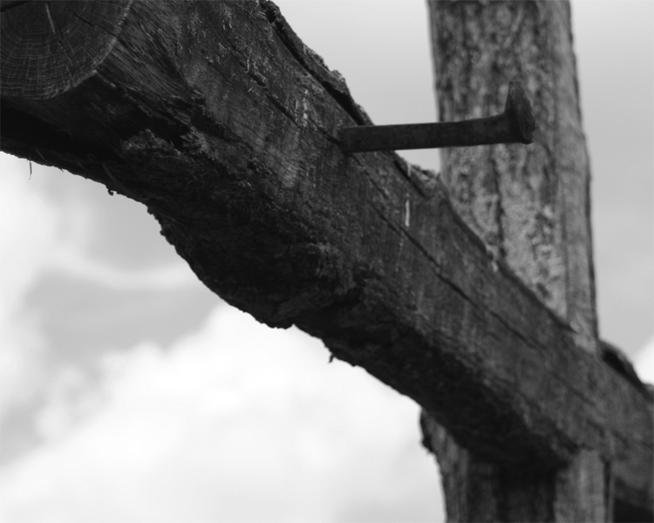
Psalms of Godly Sorrow:
Psalms 6, 25, 32, 38, 51, 130, 143
Hebrews 8:12; 10:17 (Jeremiah 31)
“So you also, when you have done all that you were commanded, say, 'We are unworthy servants; we have only done what was our duty.'" Luke 17:10
On one side of the cross, is our sorrow at the realization of my sins’ cost—the death of Christ.

Slide 3
Psalms of Gratitude for Salvation:
Psalms 18, 21, 30, 32, 34, 40, 66, 92, 108, 116, 118, 138
On the other side of the cross, is our gratitude at the realization of what God has done for me—sacrificed His Son.
John 3:16; 15:9-14; Romans 5:8; 1 John 4:7-10
What do you/should you think about during the partaking of the Lord’s Supper?
Why should you become (and live as) a Christian?

