Slide 1
“I’m Living for the King” Living in God’s Mercy During Difficult Days
God’s Righteousness
Humanity’s Wickedness
“The Just Shall Live By Faith”

Slide 2

“The Just Shall Live By Faith”
“For in it the righteousness of God is revealed from faith to faith; as it is written, ‘But the righteous man shall live by faith.’” (Rom. 1:17)
“Now that no one is justified by the Law before God is evident; for, ‘The righteous man shall live by faith.’” (Gal. 3:11)
“But my righteous one shall live by faith; and if he shrinks back, My soul has no pleasure in Him” (Heb. 10:38)

Slide 3
The date of the writing of Habakkuk is thought to have been from 612-606 BC
Internal evidence: “I must wait quietly for the day of trouble, for the coming up of the people that invade us” (Hab. 3:16)
The oppression of Judah and the carrying out of the first group into Babylon (605 BC) had not taken place yet
This book was written after the beginning of Babylon’s westward move for world conquest, but prior to the invasion of Jerusalem

Slide 4
“The Just Shall Live By Faith”
Faith Struggling With His Own
Sinful Nation and the Lord’s Reply (1:1-11)
God’s reply :“I am raising up the Chaldeans” to judge this people (1:5,6)
God’s description of their character: Bitter, hasty, terrible, dreadful, violent, mockers, idolatrous (1:6-11)
The prophet’s struggle: How can God remain indifferent to the wickedness of His people? (1:2)
The prophet’s lamentation: Wickedness & violence rules in the land (1:3,4)

Slide 5
“The Just Shall Live By Faith”
God’s reply (2:2-20)
Write it down and make it plain so it will be proclaimed (2)
The time will come (3)
A proud soul is not upright but the just shall live by faith (4)
Five woes proclaimed against wicked (5-20)
The prophet’s perplexity How can a holy God employ an impure and godless agent? (1:12,13)
The prophet’s rationalization: The Chaldeans were more wicked than Israel (1:14-2:1)

Slide 6
“The Just Shall Live By Faith”
Five woes proclaimed against wicked (5-20)
Woe – Endless appetite for conquest (Hab. 2:5-8)
Woe – Greed and Pride (Hab. 2:9-11)
Woe – Enrichment through bloodshed (Hab. 2:12-14)
Woe – Corruption of neighbors (Hab. 2:15-17)
Woe to those given over to idolatry (Hab. 2:18-20)

Slide 7
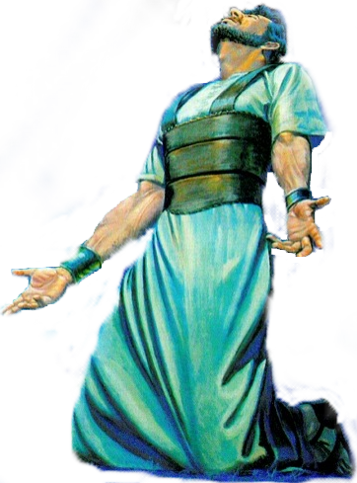
“The Just Shall Live By Faith”
The Prophets "Prayer":
Fear & Humility With Hope before God - 3:1-16
Praise for the Person of God (3:1-3)–(Asking that in His wrath He remember mercy - Praised God as Holy; Glorious; Praiseworthy)
Praise for the Power of God (3:4-7) – (God’s exposing light; His judgment upon the nations; power over the earth)
Praise for the Purpose of God (3:8-16) – (Bringing both judgment to the wicked and salvation to His people )
Humility & Hope Before God (3:16) – (He trembled at what he has heard, that he will have rest in the day of trouble )

Slide 8

“The Just Shall Live By Faith”
Habakkuk 3:17-19 ¹⁸ Yet I will rejoice in the Lord, I will joy in the God of my salvation. ¹⁹ The Lord God is my strength; He will make my feet like deer's feet, And He will make me walk on my high hills.

Slide 9
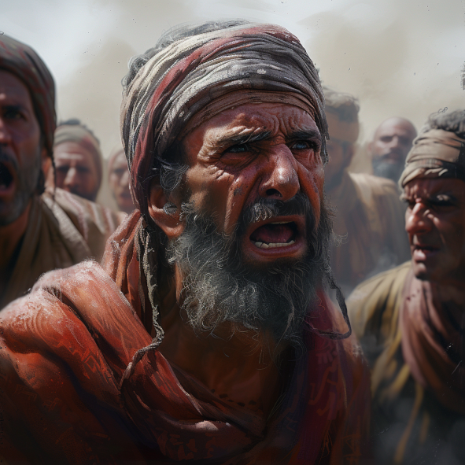
“The Just Shall Live By Faith”
Faith Struggling With A Problem & The Lord’s Reply (1:1-11)
Faith Struggling With The Solution & The Lord’s Reply 1:12-2:20
The Prophets Prayer: Fear & Humility With Hope before God - 3:1-16
The Prophets “Song“: Faith Glorying In Assurance - 3:17-19
Habakkuk 1:1 ¹ The burden which the prophet Habakkuk saw.

