Slide 1
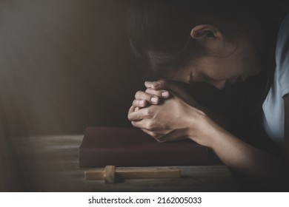
The Transforming Power of Confession
“If we confess our sins, He is faithful and righteous to forgive us our sins, and to cleanse us from all unrighteousness” (1 John 1:9)

Slide 2

Understanding the Background of John’s Writings
Proto-Gnosticism – An Early Heresy.
Before fully developed Gnosticism in the 2nd-3rd centuries, early forms were already spreading during John’s time, and these beliefs were a confusing mix of:
Religious, philosophical, and cultural trends that were beginning in the first century.
Jewish mysticism combining with pre-Gnostic thought.
A belief that spiritual knowledge and enlightenment occurred through these beliefs and gave them superiority.

Slide 3
Understanding the Background of John’s Writings
These false teachers claimed:
That they had deep spiritual insight, while others did not.
That the material world, including the human body, was evil.
Therefore, they could use their bodies however they wished – sin didn’t affect their spiritual enlightenment.
They denied the incarnation, bodily death, and resurrection of Jesus as the divine Son of God.
They rejected the idea of a future bodily resurrection for humanity.

Slide 4
The Costs of Denial: The Dangers of False Claims About Sin
False claim: “I can have fellowship while walking in darkness.”
“If we say that we have fellowship with Him and yet walk in the darkness, we lie and do not practice the truth” (1:6).
False claim:
“I have no sin.”
“If we say we have no sin, we deceive ourselves…” (1 John 1:8).
False Claim:
“I have never sinned”
“If we say we have not sinned, we make him a liar…” (1 John 1:10).

Slide 5
What God Does in Us Through Confession of Sin
Confession of sin acknowledges God’s holiness: “This is the message we have heard from Him and announce to you, that God is light, and in Him there is not darkness at all” (1:5).
Confession restores fellowship with God (1 John 1:6).
Confession pleads for Christ’s cleansing: “If we walk in the light as He is in the light, we have fellowship with one another and the blood of Jesus Christ His Son cleanses us from all sin” (1:7, 9; 2:1-2).
Confession sharpens our awareness of sin (1 John 2:1a).

Slide 6
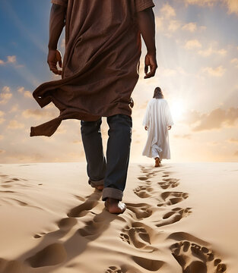
What God Does in Us Through the Confession of Sin
Confession fuels obedient love for God: “By this we know that we have come to know Him, if we keep His commandments” (1 John 2:3-5).
Confession leads us to continue to walk as Jesus walked: “Whoever says he abides in Him ought to walk in the same way in which He walked” (1 John 2:6).

Slide 7
The Transforming Power of Confession
“If we confess our sins, He is faithful and righteous to forgive us our sins, and to cleanse us from all unrighteousness” (1 John 1:9)

