Slide 1
Living in the
Obedience of Faith

Slide 2
What Does It Mean To Have Faith?
What it is to “Waver”?
  διακρίνω (diakrinō) – To stagger (KJV); waver (NASB); hesitate (Strong); doubt (Thayer).
  But the question is, “Had this always been the case in the life of Abraham?”
  Can we be like Abraham in faith?

Slide 3
Paul’s Use of “Faith”
It is a faith that transcends mere mental assent.
In fact, faith indicates loyalty, surrender, fidelity and allegiance to Jesus as King (Rom. 1:5; 6:16; 16:26; 6:3, 4; Gal. 2:20).
Paul’s contrast between “faith” and “works” is not a contrast between mental assent and obedience, but between two different systems of justification (Rom. 3:27).

Slide 4
Grasping Grace in Romans 4
Abraham was saved by grace through a working faith (Heb. 11:8, 17; James 2:23)
An obedient faith is not equal to sinless performance (Rom. 4:3-7)
Abraham and David were justified by God’s forgiveness, not by Christ’s personal righteousness being transferred to their souls (Rom. 4:3; Ps. 32:1-2)
Romans 4 does not deny that Abraham’s faith was active (Rom. 4:12)
The resurrecting power of God in the life of Abraham is the same power that raises us from spiritual death

Slide 5
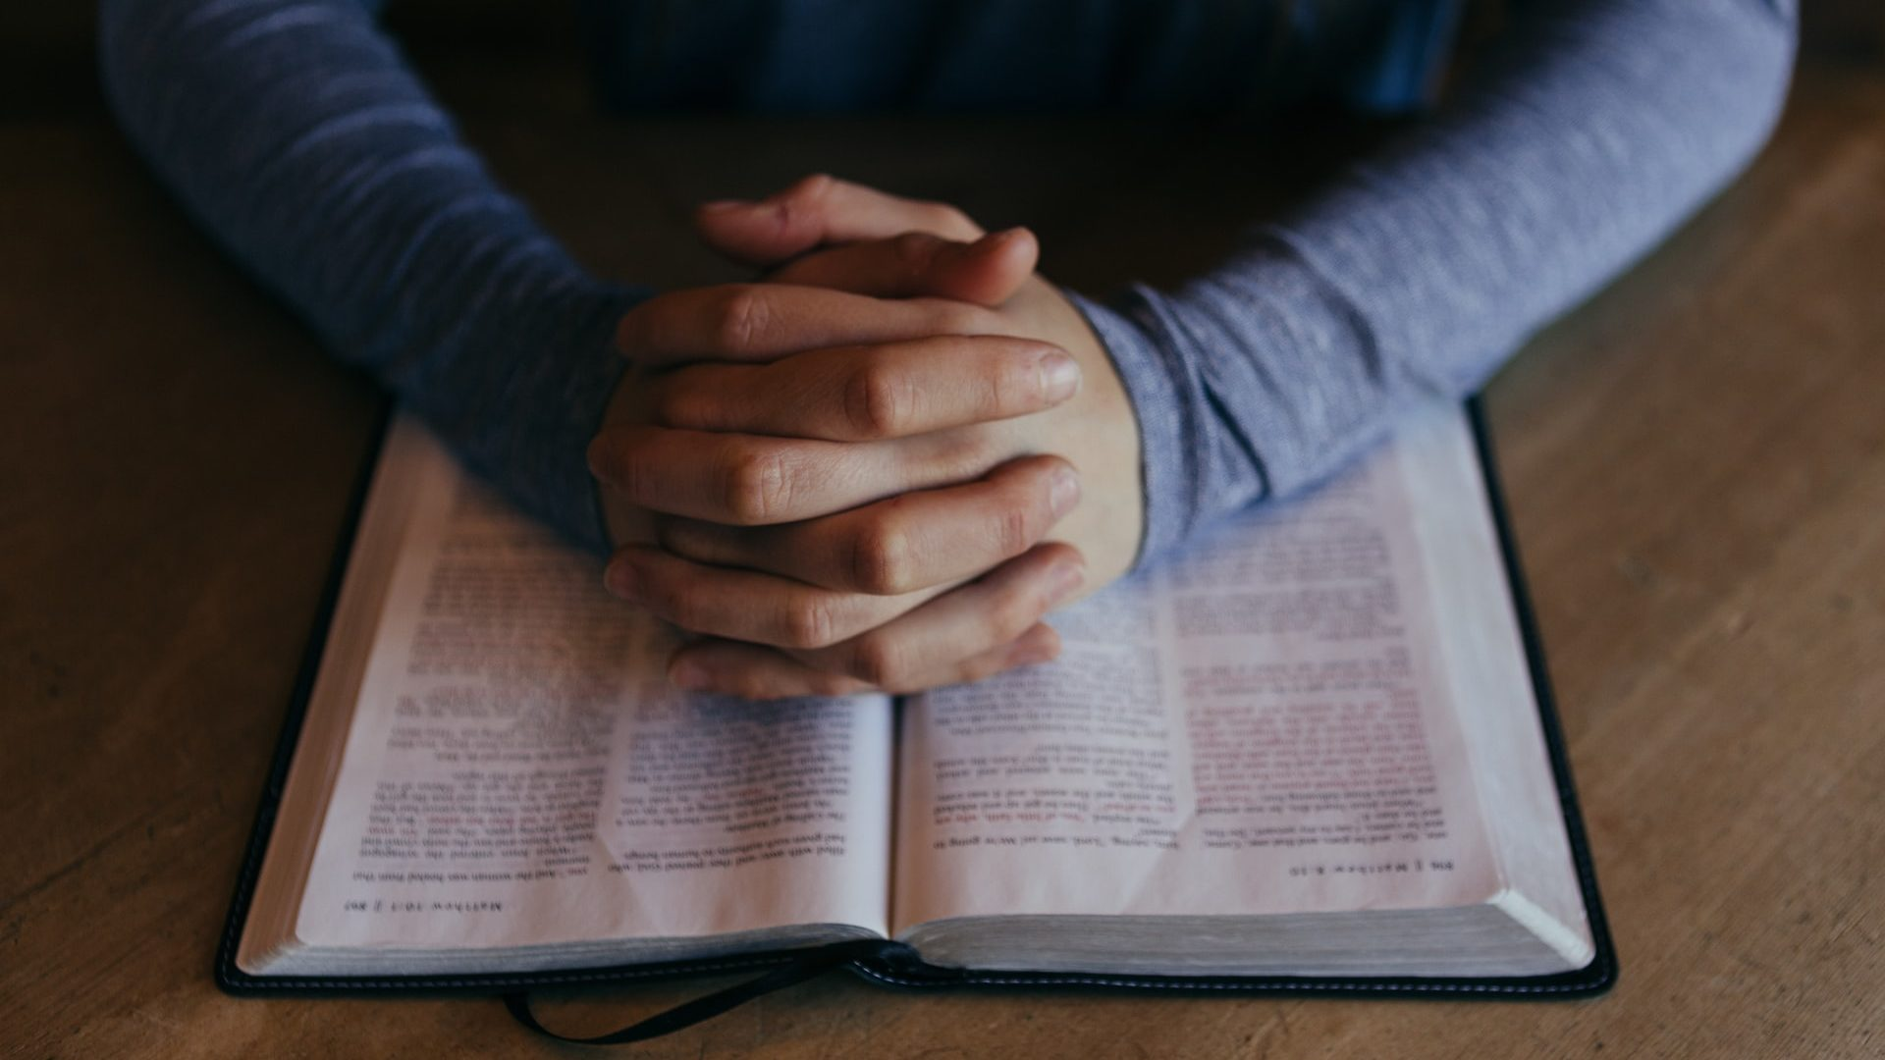
Abraham Grew Into Great Faith
Romans 4:19-26
  Faith is a journey, not a snapshot!

Slide 7
Abraham Did Struggle At Times
Abraham Struggled With His Faith:
  He sinned seriously (Gn. 12:13-19; 20:2-12).
  He was impatient (Gn. 15:1-6).
  He was willing to compromise (Gn. 16:2; 17:18).
Abraham Reached a Turning Point:
  Romans 4:20-21 parallels Genesis 21.
  The visitation of the Lord to Sarah (cf. 18:10).
  Abraham ceased to waver (cf. James 1:6).

Slide 8
Abraham Did Struggle At Times
Why did Abraham Struggle So?
  He was afraid (Gen. 12:12; 20:11).
  He was anxious (Gen. 15:2-3).
  He wanted to please men (Gen. 16:2).
  He was led by emotion (Gen. 17:18; cf. 21:11).
  He was plagued by the consequences of his past mistakes (Gen. 16:5; cf. 21:9-13).
  He was surrounded by doubters (Gen. 18:12-14).

Slide 9
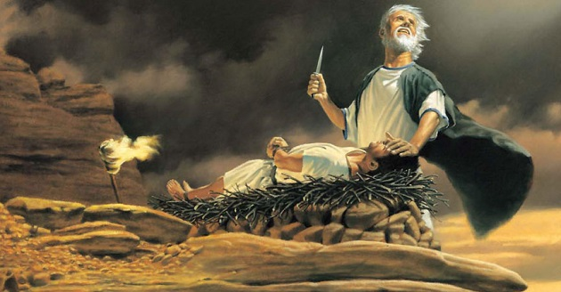
Abraham’s Faith Grew Stronger
Abraham Overcame and Was “Strong”
  To be strong, we must be tested.
  God tested Abraham (Gn. 22:1-18).
    Mt. Moriah
    The fire, the wood and a knife.
    “Where is the lamb for a burnt offering?”
    “God will provide Himself a lamb” (vv. 5 & 8).
    Abraham’s faith is settled (Heb. 11:17-19).
Finally, God says “Now, I know…”(v. 12).

Slide 10
Paul Describes Abraham’s Faith
“Against hope believed in hope…” (Rom. 4:18)
  Against all probability he expected
  Genesis 17:17.
“He considered not…” (Rom. 4:19).
  Faith looks to God’s strength, not difficulties.
  Genesis 18:14.
“Giving glory to God…” (Rom. 4:20)
  Ascribe what is due Him and obey in all things
  Genesis 21:33

Slide 11

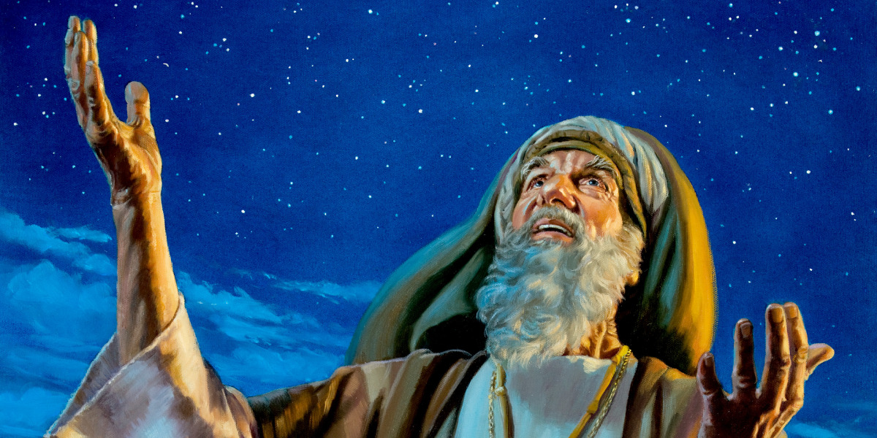
There MUST be two classes of “works” or else a contradiction!
Romans 4:1-6
Justified
Counted for
righteousness
Fulfilled
Genesis 15:6
Strong
Not of works
James 2:21-24
Justified
Counted for
righteousness
Fulfilled
Genesis 15:6
Perfect
By works
Notes:
The Word “Works” Used
In Different Ways!!

Slide 12

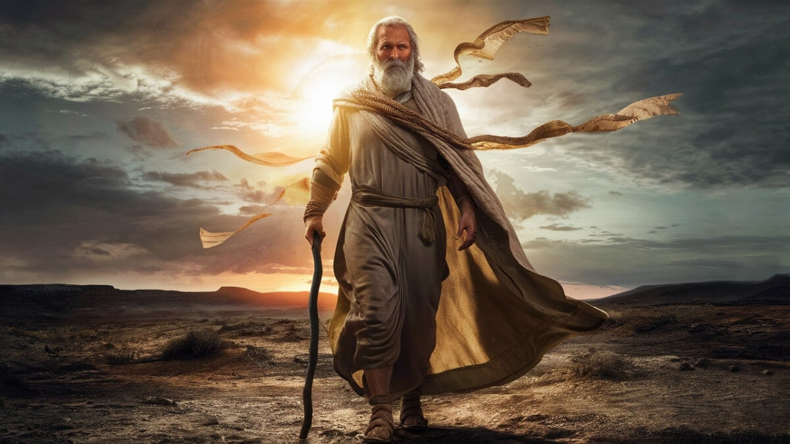
The Principle of Faith Applies to Both Alien Sinners and Children of God
“In the same way, was not Rahab the harlot also justified by works…”
“Was not Abraham our Father justified by works…

Slide 13
“It was not written for his sake alone”:
  Genesis 15:6 is applied as a generalization (See James 2:21-24 which cites both Genesis 15 and 22, while Hebrews 11:8 references Genesis 12).
  Abraham’s biography is preserved to give us encouragement.

Slide 14
Genesis 15
(Rom. 4:3)
Genesis 17-21
(Rom. 4:16-21)
Genesis 22
(James 2:21-23)
Believed
the Lord
Reckoned it to him as righteousness
99 Years Old
“Therefore, it was also credited to him as righteousness
Working Faith
Isaac Offered
Genesis 15:6
Fulfilled
Same Faith

Slide 15
“To whom it will be counted”
(Romans 4:24)
  Our goal is to get to where we do not stagger.
  “One step at a time…till faith grows stronger in Thee…till hope grows stronger in me.”

