Slide 1
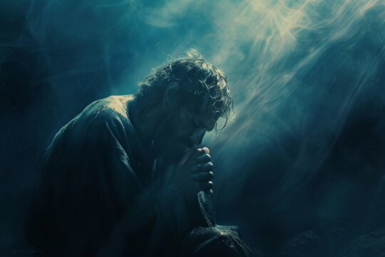
Jonah’s Prayer
“Out of My Distress”
Jonah 2:1-10

Slide 2
How Did Jonah
Get There?
Jonah’s prophecy is associated with Jeroboam II (eighth century BC) in the Northern Kingdom of Israel (2 Kings 14:25)
He was an Israelite and worshipper of Yahweh who was the Creator of land and sea (1:9)
But Jonah was a disobedient Israelite (1:2-3)
His downward trajectory reflects his spiritual condition before God (1:3-17)
The judgment, providence, and deliverance of the Lord (1:17; 2:10)

Slide 3

Jonah’s Prayer to the Lord
(Jonah 2:1-10)
Jonah’s prayer is similar to psalms of thanksgiving as it contains all the elements of such biblical poetry (Jonah 2:1-3; cf. Ps. 18:6; Jonah 2:8-9; cf. Ps. 31:7-8)
The depth of Jonah’s prayer:
  Deliverance from death
  God is his only hope
  Focus on the Temple and God’s Presence
  The ironic blindness of self-deception

Slide 4
Jonah’s Prayer and Us
Scripture informs and shapes our prayer (2:2 – Ps. 120:1; 2:3-Ps. 42:7; 2:4-Ps. 31:22; 2:5-Ps. 69:1; 2:7-Ps. 142:3; 2:8-Ps. 31:6; 2:9-Ps. 3:8)
God is longsuffering with us
We must be cautious of self-delusion
Salvation belongs to the Lord (2:9; 4:1-2)

Slide 5
Jonah’s Prayer
“Out of My Distress”
Jonah 2:1-10

