Slide 1
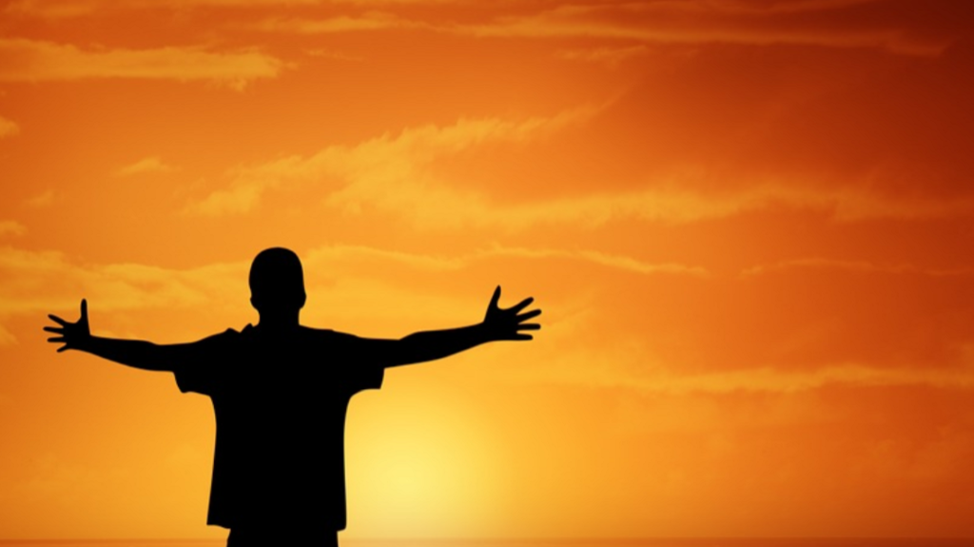
Rejoice!
“Rejoice in the Lord always. Again I will say, rejoice!”
Philippians 4:4
Notes:
Rejoice in the Lord always. Again I will say, rejoice!”
~ Philippians 4:4
The apostle Paul knew something wonderful. In every letter, and every circumstance in his life, he radiated the joy of the Lord.
It was evident in his service, in his writing and preaching, and in his daily interaction with his brethren.
Did Paul have a secret which helped him to constantly rejoice? Hardly.
The state of rejoicing is possible for every Christian and should be the default state each day of our lives!
The means of attaining the state where we constantly rejoice is available to all of God’s children.
Basis of our study is Peter’s wise text in 1 Peter 1:6-9
(1 Peter 1:6-9), “In this you greatly rejoice, though now for a little while, if need be, you have been grieved by various trials, ⁷ that the genuineness of your faith, being much more precious than gold that perishes, though it is tested by fire, may be found to praise, honor, and glory at the revelation of Jesus Christ, ⁸ whom having not seen you love. Though now you do not see Him, yet believing, you rejoice with joy inexpressible and full of glory, ⁹ receiving the end of your faith—the salvation of your souls” (1 Peter 1:6-9).
Peter’s words help us in the matter of perspective.
The default state of “greatly” rejoicing persisted for the Christians here even during a difficult time.
The trials they suffered did several things that were a cause for rejoicing. (That we want to examine)
The trials established the genuine nature of their faith.
They gave opportunity for praise, honor and glory.
They helped to validate their love for Jesus.
They helped to establish the true end of every Christian’s walk of faith, the “salvation of your souls.”

Slide 2

Why do we Rejoice?
Because we know our Redeemer!
Acts 2:22-33
The evidence is clear, Jesus is the Christ
Notes:
All of us rejoice because we know our Redeemer.
The evidence is clear, Jesus is the Christ. Peter, in his first gospel sermon established this truth. (Turn to Acts 2)
He first made his appeal by the miraculous works Jesus did while on earth. “Men of Israel, hear these words: Jesus of Nazareth, a Man attested by God to you by miracles, wonders, and signs which God did through Him in your midst, as you yourselves also know” (Acts 2:22). He could not have done what He did unless God was His father.
Peter then made an appeal to the prophets, specifically the words of David. “For You will not leave my soul in Hades, nor will You allow Your Holy One to see corruption. ²⁸ You have made known to me the ways of life; You will make me full of joy in Your presence” (Acts 2:27). Noting that David remained in the grave, Peter rightly argued that David spoke of another. “Therefore, being a prophet, and knowing that God had sworn with an oath to him that of the fruit of his body, according to the flesh, He would raise up the Christ to sit on his throne, ³¹ he, foreseeing this, spoke concerning the resurrection of the Christ, that His soul was not left in Hades, nor did His flesh see corruption” (Acts 2:30-31).
Finally, Peter contended that the resurrection of Jesus had occurred, and that there were eyewitnesses to establish it. “This Jesus God has raised up, of which we are all witnesses. ³³ Therefore being exalted to the right hand of God, and having received from the Father the promise of the Holy Spirit, He poured out this which you now see and hear” (Acts 2:32-33).
All of this led to the resounding, unassailable conclusion that compelled the Jews to faith and obedience, “Therefore let all the house of Israel know assuredly that God has made this Jesus, whom you crucified, both Lord and Christ” (Acts 2:36).
Jesus is the Christ, the Savior of the world. We know this, and we rejoice in that knowledge!
Consider the response of those Jews on Pentecost. Accepting Jesus as the Christ, they obeyed the commands of God, and were saved. We are told “Then those who gladly received his word were baptized” (Acts 2:41). As days followed, Luke records, “So continuing daily with one accord in the temple, and breaking bread from house to house, they ate their food with gladness and simplicity of heart, ⁴⁷ praising God and having favor with all the people” (Acts 2:46-47).

Slide 3
Why do we Rejoice?
Because we get to praise our God!
Psalm 100; Psalm 5:1-3, 11-12
“How great Thou art”
Notes:
All of us rejoice because we have an opportunity to praise our God.
As the Christians in Acts 2 spent their days praising God, so do we.
It is a wonderful thing to bow to the heavenly Father in prayer, with the purpose of praising Him for who He is, and for what He has done for us.
The Psalmist makes a strong case for the legitimacy of praising God:
Make a joyful shout to the Lord, all you lands! Serve the Lord with gladness; Come before His presence with singing. Know that the Lord, He is God; It is He who has made us, and not we ourselves; We are His people and the sheep of His pasture. Enter into His gates with thanksgiving, And into His courts with praise. Be thankful to Him, and bless His name. For the Lord is good; His mercy is everlasting, And His truth endures to all generations.” (Psalm 100)
We know what God has done for us, and we are thankful.
It is a natural and joyful thing for us to offer to Him the praise of our lips.
We rejoice as we contemplate His handiwork throughout the world. We rejoice to praise Him in our prayers. We rejoice to praise Him in the songs that we sing.
“Then sings my soul, my Savior God, to Thee. How great Thou art, how great Thou art.” (Carl Boberg)
The fifth Psalm declares the Psalmist’s determination to praise the Lord in prayer:
(5:1-3), “Give ear to my words, O Lord, consider my meditation. Give heed to the voice of my cry, my King and my God, for to You I will pray. My voice You shall hear in the morning, O Lord; In the morning I will direct it to You, and I will look up …
(11-12) But let all those rejoice who put their trust in You; Let them ever shout for joy, because You defend them; Let those also who love Your name be joyful in You. For You, O Lord, will bless the righteous; With favor You will surround him as with a shield” (Psalm 5:1-3, 11-12).

Slide 4
Why do we Rejoice?
Because we love God!
1 John 4:9; 1 Peter 1:7-8; Psalm 23
“We love Him because He first loved us”
Notes:
All of us rejoice because we love God.
In 1 John 4:19, the apostle gives a good reason for this, “We love Him because He first loved us.”
As Peter indicated, our love for the Lord Jesus exists because of the faith that we enjoy, “that the genuineness of your faith, being much more precious than gold that perishes, though it is tested by fire, may be found to praise, honor, and glory at the revelation of Jesus Christ, ⁸ whom having not seen you love” (1 Peter 1:7-8).
We are in the same boat as Peter’s readers. We have not seen Jesus.
But, we believe that He came to earth to die for us. He, “made Himself of no reputation, taking the form of a bondservant, and coming in the likeness of men. ⁸ And being found in appearance as a man, He humbled Himself and became obedient to the point of death, even the death of the cross” (Philippians 2:7-8). What a wonderful sacrifice! What an expression of devotion to mankind! Truly He loved us first!
The expressions of Christ’s love are seen in every aspect of our lives. Our standing with God, of course, but we are also bestowed with small measures of His grace each and every day. We thank God for our daily bread, because we are sustained by Him. We rejoice at our very existence as His creation because we are “fearfully and wonderfully made” (Psalm 139:14). We rejoice at the favor He bestows through His compassionate providence.
The entire twenty-third Psalm is an explanation of God’s providential care for King David:
“The Lord is my shepherd; I shall not want. He makes me to lie down in green pastures; He leads me beside the still waters. He restores my soul; He leads me in the paths of righteousness for His name's sake. Yea, though I walk through the valley of the shadow of death, I will fear no evil; For You are with me; Your rod and Your staff, they comfort me. You prepare a table before me in the presence of my enemies; You anoint my head with oil; My cup runs over. Surely goodness and mercy shall follow me all the days of my life; And I will dwell in the house of the Lord forever.”
He cares for us as well. We are promised, “For your heavenly Father knows that you need all these things [provisions of life]. But seek first the kingdom of God and His righteousness, and all these things shall be added to you” (Matthew 6:32-33).
Because we know of His love and devotion, we rejoice, and love Him in return!

Slide 5
Why do we Rejoice?
Because we are going to Heaven!
Philippians 3:20-21; 1 John 2:24-25
Our reward is sure because
the promise is from God
Notes:
All of us rejoice because we are going to heaven.
The life of the redeemed is a life of rejoicing because of the eternal reward promised to those who belong to Him.
“For our citizenship is in heaven, from which we also eagerly wait for the Savior, the Lord Jesus Christ, ²¹ who will transform our lowly body that it may be conformed to His glorious body, according to the working by which He is able even to subdue all things to Himself” (Philippians 3:20-21).
What a wonderful knowledge we have!
Paul describes our future existence as a metamorphosis. “For this corruptible must put on incorruption, and this mortal must put on immortality. ⁵⁴ So when this corruptible has put on incorruption, and this mortal has put on immortality, then shall be brought to pass the saying that is written: “Death is swallowed up in victory” (1 Corinthians 15:53-54).
As such, we know “that [our] labor is not in vain in the Lord” (1 Corinthians 15:58).
And, our knowledge is sure. It is sure because it is based in God’s promises.
He is faithful, and capable of delivering on His assurances of reward. Paul had no doubts, “I have fought the good fight, I have finished the race, I have kept the faith. ⁸ Finally, there is laid up for me the crown of righteousness, which the Lord, the righteous Judge, will give to me on that Day, and not to me only but also to all who have loved His appearing” (2 Timothy 4:7-8).
John likewise was sure of this hope, “Therefore let that abide in you which you heard from the beginning. If what you heard from the beginning abides in you, you also will abide in the Son and in the Father. ²⁵ And this is the promise that He has promised us—eternal life” (1 John 2:24-25).
They were sure, not because of their apostleship, but because of their relationship as children of God.
Their assurance is ours as well. And so, we rejoice in the knowledge that we will spend eternity in the presence of God!

Slide 6
Rejoice!
Philippians 4:4
Romans 8:37-39
Notes:
The etymology of the word translated “rejoice” in 1 Peter 1:6 is interesting.
It is the Greek word (agalliao). The word is combined from two root words (agan) which means “much”; and (hallomai) which means “to jump; figuratively to gush: - leap, spring up.”
It is a word which indicates extreme exultation, exceeding joy.
Above all people, Christians have a cause to rejoice. Heaven is ours! We have overcome the sting of sin and death! Our life is eternal in nature, in the presence of God!
Perhaps that is why Paul put his exhortation as he did in (Philippians 4:4, see below).
How in the world could any Christian not be happy, despite the difficulties of his life?
What can the world ever do to rob us of the pure bliss that is ours in Christ? “Yet in all these things we are more than conquerors through Him who loved us. ³⁸ For I am persuaded that neither death nor life, nor angels nor principalities nor powers, nor things present nor things to come, ³⁹ nor height nor depth, nor any other created thing, shall be able to separate us from the love of God which is in Christ Jesus our Lord” (Romans 8:37-39).
Rejoice in the Lord always. Again I will say, rejoice!” ~ Philippians 4:4

