Slide 1
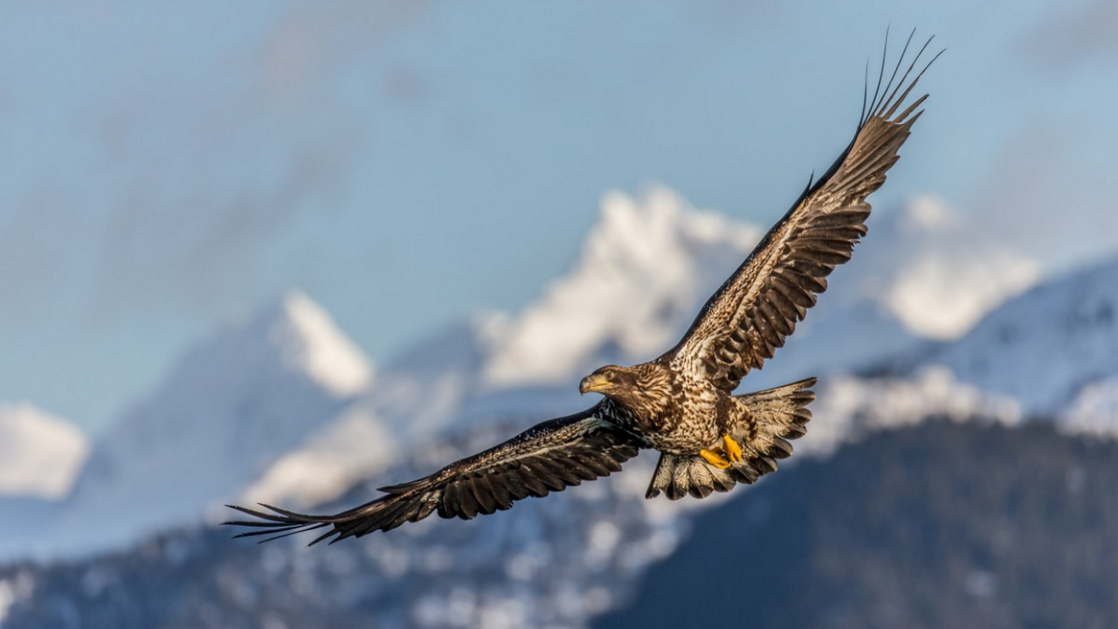
Renewal
Isaiah 40:27-31
Notes:
Discuss the text:
(Isaiah 40:1-5), “Comfort, yes, comfort My people!” Says your God. ² “Speak comfort to Jerusalem, and cry out to her, that her warfare is ended, that her iniquity is pardoned; for she has received from the Lord's hand double for all her sins.” ³ The voice of one crying in the wilderness: “Prepare the way of the Lord; make straight in the desert a highway for our God. ⁴ Every valley shall be exalted and every mountain and hill brought low; the crooked places shall be made straight and the rough places smooth; ⁵ the glory of the Lord shall be revealed, and all flesh shall see it together; or the mouth of the Lord has spoken.”
This text is delivered to God’s people in Babylon, prophesying an end of an exile that would last in total 70 years.
While the time is dark, and the people had suffered, God would bring them relief and renewal!
The text has a double meaning, referring as well to the advent of the Messiah, who would deliver the entire world from the bondage of sin. (cf. vs. 3, an obvious Messianic reference, fulfilled in Luke 3:3-6).
God was satisfied with the time of suffering for their iniquity.
He here promises what was difficult to become easy
What was rough to become smooth
His favor was returning to the remnant who would come out of Babylon, and return to inhabit the promised land.
In the same way, through the coming of the Messiah, the time of bondage to sin came to a close, and a time of renewal for all men came to be.
(Note: Isaiah 40:6-26 describes a grand and powerful God, who was able to deliver on His promise of renewal)
(Isaiah 40:10-11), “Behold, the Lord God shall come with a strong hand, and His arm shall rule for Him; behold, His reward is with Him, and His work before Him. ¹¹ He will feed His flock like a shepherd; He will gather the lambs with His arm, and carry them in His bosom, and gently lead those who are with young.”
With this all in mind, note verses 27-31
(Isaiah 40:27-31), “Why do you say, O Jacob, and speak, O Israel: ‘My way is hidden from the Lord, and my just claim is passed over by my God’? ²⁸ Have you not known? Have you not heard? The everlasting God, the Lord, the Creator of the ends of the earth, neither faints nor is weary. His understanding is unsearchable. ²⁹ He gives power to the weak, and to those who have no might He increases strength. ³⁰ Even the youths shall faint and be weary, and the young men shall utterly fall, ³¹ but those who wait on the Lord shall renew their strength; they shall mount up with wings like eagles, they shall run and not be weary, they shall walk and not faint.”
It is never right to think that God does not see our troubles. That He is tired, or unable to help. He loves us, and is ready to renew us, if we wait on Him!
I feel I need here to acknowledge the troubles we have experienced as a congregation
The conflict just passed has caused discouragement and stress to us all. It was not a pleasant thing, though it was necessary.
Often there are consequences to doing what is right. Our congregation no longer has an eldership, we have lost several members who we love dearly, and this has certainly been discouraging to all of us.
However, as the conflict has ended, and the congregation has stood for what is right, this can and should be a time of renewal
Debbie and I look at this a bit differently, as we have been struggling with these matters for almost the entire previous year.
What was cause for surprise and what was an unforeseen eruption for most, was a simmering and discouraging constant for Debbie and me.
My own feelings are not of discouragement and shock, though I am certainly saddened by the events of the last two months. Rather, I see the trials and difficulties of 2018, to have culminated in righteous, determined action on the part of God’s people. My faith and love for this congregation has been validated and strengthened by your steadfastness. In us, there is relief, and joy in knowing the strength and zeal shown to do what is right.
My prayer in this new year is that each and everyone member here at West Side will be renewed by the Almighty God in heaven. I have full confidence that as the weeks and months progress, we will be able to work together to grow both spiritually and numerically, and to be a congregation that is fully pleasing to the Lord. To do this, we must commit ourselves to the work. I would encourage you to consider a few thoughts in this regard…

Slide 2
Renewal
Trust in the Lord!
vs. 31; Philippians 4:13
Psalm 46:1-3; 51:10-12
Notes:
Remember, these can be applied to each member individually, and as with Israel, with our congregation as a whole!
(Isaiah 40:31), “But those who wait on the Lord shall renew their strength; they shall mount up with wings like eagles, they shall run and not be weary, they shall walk and not faint.”
There is no reason to be discouraged, as Christ is with us!
(Philippians 4:13), “I can do all things through Christ who strengthens me.”
There is no reason to fear, because God is our refuge!
(Psalm 46:1-3), “God is our refuge and strength, a very present help in trouble. ² Therefore we will not fear, even though the earth be removed, and though the mountains be carried into the midst of the sea; ³ though its waters roar and be troubled, though the mountains shake with its swelling.”
There is no reason to doubt, our God is the author of our salvation!
Consider this Psalm [written by David, as he acknowledged his sin with Bathsheba]
(Psalm 51:10-12), “Create in me a clean heart, O God, and renew a steadfast spirit within me. ¹¹ Do not cast me away from Your presence, and do not take Your Holy Spirit from me. ¹² Restore to me the joy of Your salvation, and uphold me by Your generous Spirit.”

Slide 3
Renewal
Renew Your Mind!
vs. 9; Ephesians 4:20-24
2 Corinthians 7:1; Revelation 2:4-5
Notes:
(Isaiah 40:9), [A commitment and trust in God was needed], “O Zion, you who bring good tidings, get up into the high mountain; O Jerusalem, you who bring good tidings, lift up your voice with strength, lift it up, be not afraid; say to the cities of Judah, “Behold your God!”
This is a matter of will on our part. We must determine to put off sin, and do righteousness!
(Ephesians 4:20-24), “But you have not so learned Christ, ²¹ if indeed you have heard Him and have been taught by Him, as the truth is in Jesus: ²² that you put off, concerning your former conduct, the old man which grows corrupt according to the deceitful lusts, ²³ and be renewed in the spirit of your mind, ²⁴ and that you put on the new man which was created according to God, in true righteousness and holiness.”
Renewal is defined clearly. (Not emotions) A determination to put on the new man, perfecting holiness!
(2 Corinthians 7:1), “Therefore, having these promises, beloved, let us cleanse ourselves from all filthiness of the flesh and spirit, perfecting holiness in the fear of God.”
Commitment to the same zeal and ardor that led us to Christ in the beginning!
(Revelation 2:4-5), [Church at Ephesus], “Nevertheless I have this against you, that you have left your first love. ⁵ Remember therefore from where you have fallen; repent and do the first works, or else I will come to you quickly and remove your lampstand from its place—unless you repent.”

Slide 4
Renewal
Rededicate Yourself to the Work!
vs. 29-31; Romans 12:1-2
2 Timothy 2:15; Galatians 2:20
Notes:
(Isaiah 40:29-31), [renewal is seen in effort on our part], “He gives power to the weak, and to those who have no might He increases strength. ³⁰ Even the youths shall faint and be weary, and the young men shall utterly fall, ³¹ but those who wait on the Lord shall renew their strength; they shall mount up with wings like eagles, they shall run and not be weary, they shall walk and not faint.”
Present our bodies in service to the Master
(Romans 12:1-2), “I beseech you therefore, brethren, by the mercies of God, that you present your bodies a living sacrifice, holy, acceptable to God, which is your reasonable service. ² And do not be conformed to this world, but be transformed by the renewing of your mind, that you may prove what is that good and acceptable and perfect will of God.”
Diligence in the work of the Lord
(2 Timothy 2:15), “Be diligent to present yourself approved to God, a worker who does not need to be ashamed, rightly dividing the word of truth.”
Doing the will of the Lord
(Galatians 2:20), [It is Christ’s will. I am committed to live by faith], “I have been crucified with Christ; it is no longer I who live, but Christ lives in me; and the life which I now live in the flesh I live by faith in the Son of God, who loved me and gave Himself for me.”

Slide 5
Conclusion
A new year, a new beginning!
Let this be a time of renewal for us all!
Notes:
We are beginning a new year, and a new beginning for our congregation! Let this be a time of renewal for us all!
[Click to Fade Away]
May we all renew our strength; mount up with wings like eagles, run and not be weary, walk and not faint, as we trust in and depend upon our God!
(Isaiah 41:9-10), [Wonderful words of comfort for Israel, and for us as Spiritual Israel today], “You whom I have taken from the ends of the earth, and called from its farthest regions, and said to you, ‘You are My servant, I have chosen you and have not cast you away: ¹⁰ Fear not, for I am with you; be not dismayed, for I am your God. I will strengthen you, yes, I will help you, I will uphold you with My righteous right hand.’”

