Slide 1
Repay No One Evil for Evil
Romans 12:17
Notes:
Repay No One Evil for Evil
Introduction:
It hurts when people wrong us.
That is especially true when one whom we least suspect injures and wrongs us.
Jesus experienced this sort of unfair treatment time and again.
One of His apostles betrayed Him, another denied knowing Him, and all of them scattered from Him when He was arrested.
The religious leaders of the Jews, who should have rejoiced in His coming, condemned Him to death.
Truly, Jesus was “a Man of sorrows, and acquainted with grief” (cf. Isaiah 53:3).
(1 Peter 2:21-24), “For to this you were called, because Christ also suffered for us, leaving us an example, that you should follow His steps: ²² “Who committed no sin, Nor was deceit found in His mouth”; ²³ who, when He was reviled, did not revile in return; when He suffered, He did not threaten, but committed Himself to Him who judges righteously; ²⁴ who Himself bore our sins in His own body on the tree, that we, having died to sins, might live for righteousness—by whose stripes you were healed.”
Note His wonderful restraint! What love He shoed. What Goodness!
Jesus is our example for how to respond when others wrong and mistreat us:
Sure, Jesus was hurt when people mistreated Him, just as we are.
(Psalm 55:12-13), [David prophetically said], “For it was not an enemy that reproached me; Then I could have borne it: Neither was it he that hated me that did magnify himself against me: Then I would have hid myself from him: But it was thou, a man mine equal, My companion, and my familiar friend”
And yet, His response was righteous, and serves to show us how to be righteous ourselves when we are mistreated
This is not an impossible task.
This business of turn­ing the other cheek is the essence of loving our enemies
(Matthew 5:38-39), “You have heard that it was said, An eye for an eye and a tooth for a tooth.’ ³⁹ But I tell you not to resist an evil person. But whoever slaps you on your right cheek, turn the other to him also.”
(Matthew 5:44-45a), “But I say to you, love your enemies, bless those who curse you, do good to those who hate you, and pray for those who spitefully use you and persecute you, ⁴⁵ that you may be sons of your Father in heaven…”
Christians must not wrong the wrongdoer.
We must not repay evil for evil, even when we are tempted to feel justified in doing so
(Romans 12:17), “Repay no one evil for evil. Have regard for good things in the sight of all men.”
Such conduct is from the devil, not God.
How can victims of evil possibly return good for evil? Jesus teaches us how in Matthew 5 and in Luke 6
Render to No Man Evil for Evil Joe R. Price
Reprint, The Spirit's Sword, Nov. 30, 2003

Slide 2
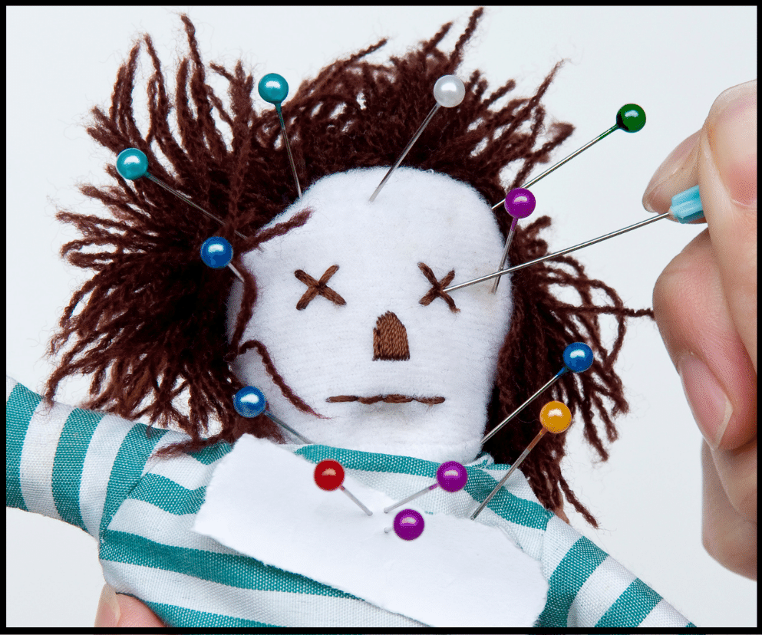
True Love Thinks No Evil!
Act Unselfishly
(Matthew 5:38-42)
Practice Love for Others
(Matthew 5:43-48)
Pray Even for Our Enemies
(Luke 6:27-28; 23:33-34)
Do Good to Everyone
(Luke 6:27-28; Acts 10:38)
Be Merciful to Others
(Luke 6:35-36; Matthew 5:7)
Notes:
True Love Thinks No Evil
Discussion:
Act Unselfishly
(Matthew 5:38-42), “You have heard that it was said, An eye for an eye and a tooth for a tooth.’ ³⁹ But I tell you not to resist an evil person. But whoever slaps you on your right cheek, turn the other to him also. ⁴⁰ If anyone wants to sue you and take away your tunic, let him have your cloak also. ⁴¹ And whoever compels you to go one mile, go with him two. ⁴² Give to him who asks you, and from him who wants to borrow from you do not turn away.”
Unselfishness is the essential quality of turning the other cheek.
We must devalue ourselves in our own estimation in order to ever be able to value the evildoer …
Espe­cially when he carries out his evil against us!
[CLICK] Practice Love for Others
(Matthew 5:43-48), “ You have heard that it was said, You shall love your neighbor and hate your enemy.’ ⁴⁴ But I say to you, love your enemies, bless those who curse you, do good to those who hate you, and pray for those who spitefully use you and persecute you, ⁴⁵ that you may be sons of your Father in heaven; for He makes His sun rise on the evil and on the good, and sends rain on the just and on the unjust. ⁴⁶ For if you love those who love you, what reward have you? Do not even the tax collectors do the same? ⁴⁷ And if you greet your brethren only, what do you do more than others? Do not even the tax collectors do so? ⁴⁸ Therefore you shall be perfect, just as your Father in heaven is perfect.”
Loving our enemies may be one of the most difficult things we are called upon to do.
Remember, love does not keep a scorecard of wrongs committed against it.
[CLICK] Pray Even for Our Enemies
(Luke 6:27-28), “But I say to you who hear: Love your enemies, do good to those who hate you, ²⁸ bless those who curse you, and pray for those who spitefully use you.”
Those who treat us abusively need our prayers.
We are following Christ’s example when we pray for our enemies:
(Luke 23:33-34), “And when they had come to the place called Calvary, there they crucified Him, and the criminals, one on the right hand and the other on the left. ³⁴ Then Jesus said, “Father, forgive them, for they do not know what they do.” And they divided His garments and cast lots.”
The sinner needs our petitions, not our animosity and contempt.
[CLICK] Do good to Everyone
(Luke 6:27-28), “But I say to you who hear: Love your enemies, do good to those who hate you, ²⁸ bless those who curse you, and pray for those who spitefully use you.
It is also good to take the initiative and respond with kind actions.
Jesus went about doing good to all
(Acts 10:37-38), “that word you know, which was proclaimed throughout all Judea, and began from Galilee after the baptism which John preached: ³⁸ how God anointed Jesus of Nazareth with the Holy Spirit and with power, who went about doing good and healing all who were oppressed by the devil, for God was with Him.”
The Father’s sunshine and rain blesses the evil and the good (Matt. 5:45). Likewise, we are to be doers of good to those who hate us. What a challenge it is to be like Christ!
[CLICK] Be merciful to Others
(Lk. 6:35-36), “But love your enemies, do good, and lend, hoping for nothing in return; and your reward will be great, and you will be sons of the Most High. For He is kind to the unthankful and evil. ³⁶ Therefore be merciful, just as your Father also is merciful.”
We all need the mercy of God because we are all sinners.
But, that fact tends to be obscured by our pain when someone sins against us. We lash out, instead of extending mercy.
We must never forget that we, too, will only reach heaven by the mercy of God.
We should give other sinners that which we cannot do without.
(Matthew 5:7), “Blessed are the merciful, for they shall obtain mercy.”

Slide 3
Conclusion
“Repay no one evil for evil. Have regard for good things in the sight of all men. ¹⁸ If it is possible, as much as depends on you, live peaceably with all men. ¹⁹ Beloved, do not avenge yourselves, but rather give place to wrath… ‘If your enemy is hungry, feed him; If he is thirsty, give him a drink; for in so doing you will heap coals of fire on his head.’ ²¹ Do not be overcome by evil, but overcome evil with good.”
(Romans 12:17-21)
Notes:
Conclusion:
The next time you are wronged, instead of repaying evil for evil, try taking Jesus’ approach.
And, do not despair when you do
Jesus’ way is best, whether the sinner appreciates it or whether he continues to take advantage of you.
By following Jesus’ way you will be “sons of the Most High. For He is kind to the unthankful and evil” (Luke 6:35).
(Romans 12:17-21), “Repay no one evil for evil. Have regard for good things in the sight of all men. If it is possible, as much as depends on you, live peaceably with all men. Beloved, do not avenge yourselves, but rather give place to wrath; for it is written, “Vengeance is Mine, I will repay,” says the Lord. Therefore “If your enemy is hungry, feed him; If he is thirsty, give him a drink; For in so doing you will heap coals of fire on his head.” Do not be overcome by evil, but overcome evil with good.”

